Slide 1
WikiTube

Slide 2
Two Questions - 5 seconds
How much time and energy do we waste by having to search for the same information across multiple platforms?
How can we expect to progress and innovate as a society if we don't streamline the way we store and access information?

Slide 3
Concept - Presented Jenelle
Description of our Project
Motivation for its development
User story

Slide 4
User Story
AS A user of Project WikiTube
I WANT to search for a topic in both text and video formats
SO THAT I can see content from two separate sources
SO THAT I can see an image representing my search terms
SO THAT I can read an overview of text information about my search
SO THAT I can see popular videos on my search terms
I WANT to search for recent videos on my search terms
AS A user I should be to see my recent searches
SO THAT I can re-run them
AS A user I should be able to enter a brand new search

Slide 5
Technologies Used - Presented by Mike Samaras
GitHub
HTML
CSS
JavaScript
APIs (Wikipedia, YouTube)
Google font

Slide 6

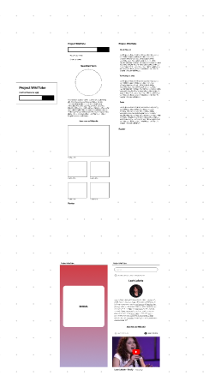
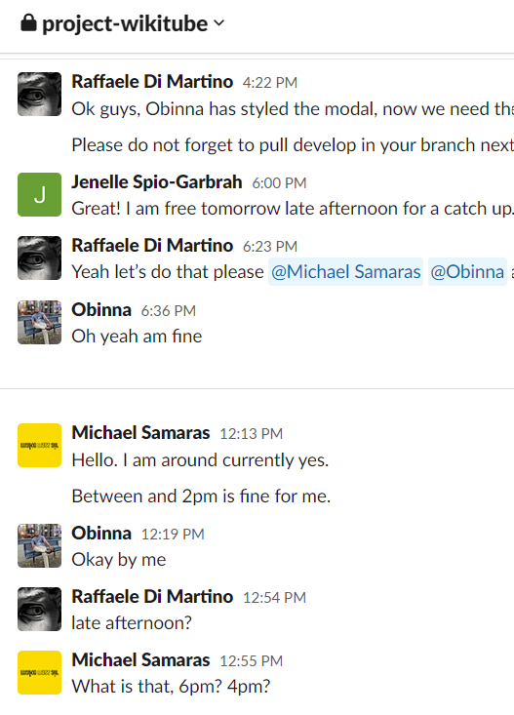
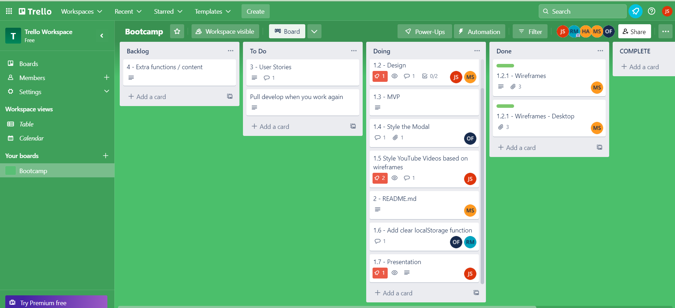
Technology For the Project
Trello Board for project management
We used slack to communicate.
Figma to design wireframe

Slide 7
Developers/Task
Raffaele Di Martino
Michael Frank Samaras
Onanike Francis
Jenelle Spio-Garbrah

Slide 8
Challenges
Working with YouTube <iframes> Jenelle had difficulty with ratios for large screens.
YouTube API has a daily limit on calls.
Conflicts when merging
Not enough team members at the start.
The requirements were not clear.
Time

Slide 9
Demo - Presented by Raffael Di Martino

Slide 10
Future Development - Presented by Obinna Onanike
Personalization: adding personalized recommendations based on the user's search history and preferences. This will help to make the experience more engaging and relevant to each individual user.
Integration with other APIs: Integrating other relevant APIs, such as those for news articles or images, to provide even more comprehensive information and multimedia content.
User feedback and ratings: Implement a system for users to provide feedback and ratings on the videos and articles they find. This will help to improve the quality of the content and make it more reliable.

Slide 11
Future Development
Social media sharing: Add the option for users to share articles and videos on social media platforms, such as Facebook, Twitter, and Instagram.
Advertising revenue: Adding advertising to the app to generate revenue. This could be done by displaying relevant advertisements alongside the articles and videos.

Slide 12
Future Development
User-generated content: Allow users to contribute their own articles and videos to the app, creating a community-driven platform for knowledge and information.
Improved search functionality: Adding advanced search functionality, such as filters and sorting options, to help users find exactly what they're looking for more quickly and easily.
These are just a few suggestions for improving and expanding our app. By continuously iterating and adding new features and functionality, we will keep your users engaged and coming back for more.

Slide 13
Links

