Slide 1


Employee Churn

Slide 2
Agenda
Overview dataset
What variables are relevant ?
Can we predict churn ?
What lessons can we learn ?
How can we improve the model ?

Slide 3
Dataset
Field
Employee ID
Employee last name
Employee first name
Gender
Manager of the employee
Employee type: Internal or External
Department of the employee
Department change flag
Job description
Employee status
Company: Subsidiary where the employee works
Field
Site: Place where the employee works
Type of contract
Employee class
FTE
Employee level
Handicap
Citizenship: Country of the employee
Age of the employee
Contract tenure: No. of years of the current contract
Employee tenure: No. of years of the employee in the company

Slide 4
Dataset
Field
Sum Bonus Unexpected 3Mago
Sum Bonus Welcome 3Mago
Sum Bonus Challenge 3Mago
Sum Bonus Misc 3Mago
Sum Bonus Exc 3Mago
Sum Bonus Language 3Mago
Sum Bonus Sharing 3Mago
Sum Bonus Objective 3Mago
Sum Bonus Yield 3Mago
Sum Bonus Technical 3Mago
Sum Bonus Total 3Mago
Field
Sum Bonus Unexpected
Sum Bonus Welcome
Sum Bonus Challenge
Sum Bonus Misc
Sum Bonus Exc
Sum Bonus Language
Sum Bonus Sharing
Sum Bonus Objective
Sum Bonus Yield
Sum Bonus Technical
Sum Bonus Total

Slide 5
Dataset
Field
Evolution Bonus Challenge (index)
Evolution Bonus Exc (index)
Evolution Bonus Language (index)
Evolution Bonus Misc (index)
Evolution Bonus Objective (index)
Evolution Bonus Sharing (index)
Evolution Bonus Technical (index)
Evolution Bonus Total (index)
Evolution Bonus Unexpected (index)
Evolution Bonus Welcome (index)
Evolution Bonus Yield (index)
Field
Target Churn: Employee still in the company

Slide 6
Question 1: Which variables are relevant ?
Criteria:
Not quasi constant
Sufficient variance
Correlation with target
Validation:
Mutual information
Check performance of prediction models with reduced vs. all variables

Slide 7
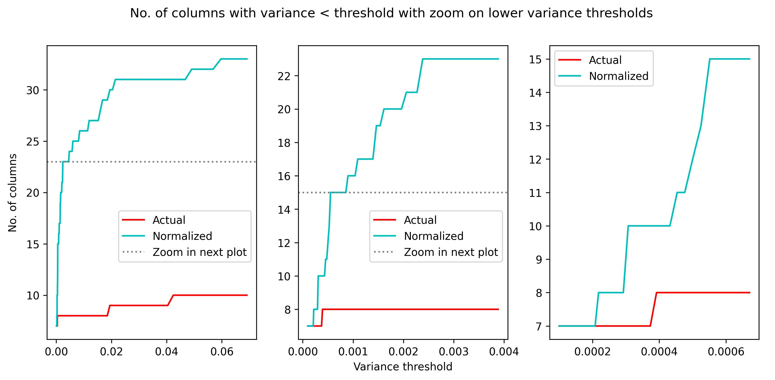
Example: Variance of bonus columns

Slide 8
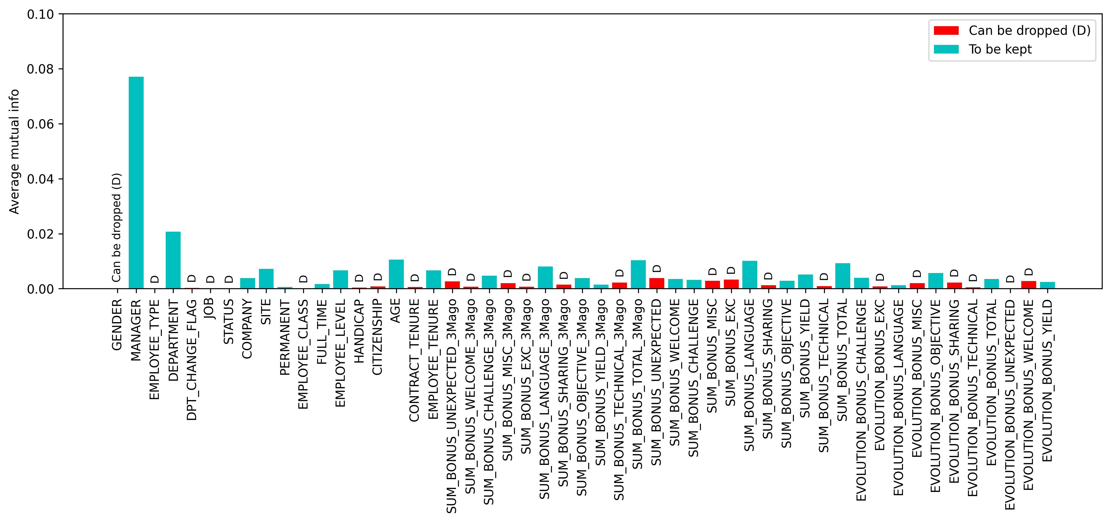
Check: Mutual information

Slide 9
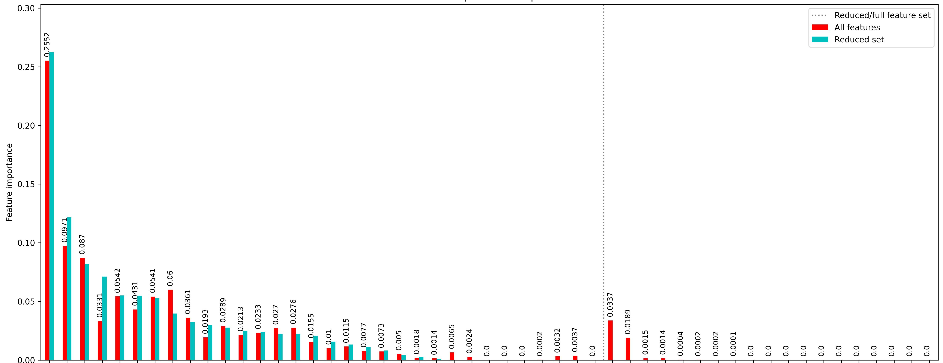
Check: model with reduced vs. full dataset
Top-15 features :
Manager
Age
Department
Sum bonus language
Employee tenure
Employee level
Sum bonus total
Evolution bonus total
Sum bonus total 3m ago
Sum bonus language 3m ago
Sum bonus objective
Site
Sum bonus yield 3m ago
Sum bonus yield
Company
plot = gradient boosting
common to all 4 models
common to 3 models

Slide 10
Dataset
Field
Employee ID
Employee last name
Employee first name
Gender
Manager of the employee
Employee type: Internal or External
Department of the employee
Department change flag
Job description
Employee status
Company: Subsidiary where the employee works
Field
Site: Place where the employee works
Type of contract
Employee class
FTE
Employee level
Handicap
Citizenship: Country of the employee
Age of the employee
Contract tenure: No. of years of the current contract
Employee tenure: No. of years of the employee in the company

Slide 11
Dataset
Field
Sum Bonus Unexpected 3Mago
Sum Bonus Welcome 3Mago
Sum Bonus Challenge 3Mago
Sum Bonus Misc 3Mago
Sum Bonus Exc 3Mago
Sum Bonus Language 3Mago
Sum Bonus Sharing 3Mago
Sum Bonus Objective 3Mago
Sum Bonus Yield 3Mago
Sum Bonus Technical 3Mago
Sum Bonus Total 3Mago
Field
Sum Bonus Unexpected
Sum Bonus Welcome
Sum Bonus Challenge
Sum Bonus Misc
Sum Bonus Exc
Sum Bonus Language
Sum Bonus Sharing
Sum Bonus Objective
Sum Bonus Yield
Sum Bonus Technical
Sum Bonus Total

Slide 12
Dataset
Field
Evolution Bonus Challenge (index)
Evolution Bonus Exc (index)
Evolution Bonus Language (index)
Evolution Bonus Misc (index)
Evolution Bonus Objective (index)
Evolution Bonus Sharing (index)
Evolution Bonus Technical (index)
Evolution Bonus Total (index)
Evolution Bonus Unexpected (index)
Evolution Bonus Welcome (index)
Evolution Bonus Yield (index)
Field
Target Churn: Employee still in the company

Slide 13
Question 2: Can we predict churn ?
Variables that don’t contribute not taken into consideration
Unbalanced dataset

Slide 14
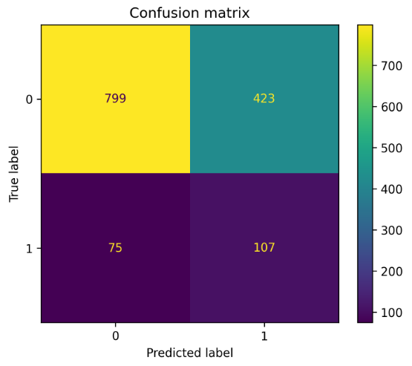
Question 2: Can we predict churn ?
Best models are (only) 65% accurate
Still:
Relative churn potential of employees allows proactive action to retain (40 employees have churn probability > 90%)
Outliers in churn rate allow for targeted management improvement paths.

Slide 15
Question 3: What lessons can we learn ?
Recall
Manager
Age
Department
Sum bonus language
Employee tenure
Employee level
Sum bonus total
Evolution bonus total
Sum bonus total 3m ago
Sum bonus language 3m ago
Sum bonus objective
Site
Sum bonus yield 3m ago
Sum bonus yield
Company

Slide 16
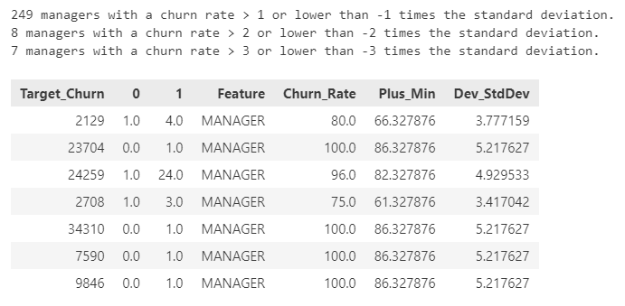
Churn rate by manager

Slide 17
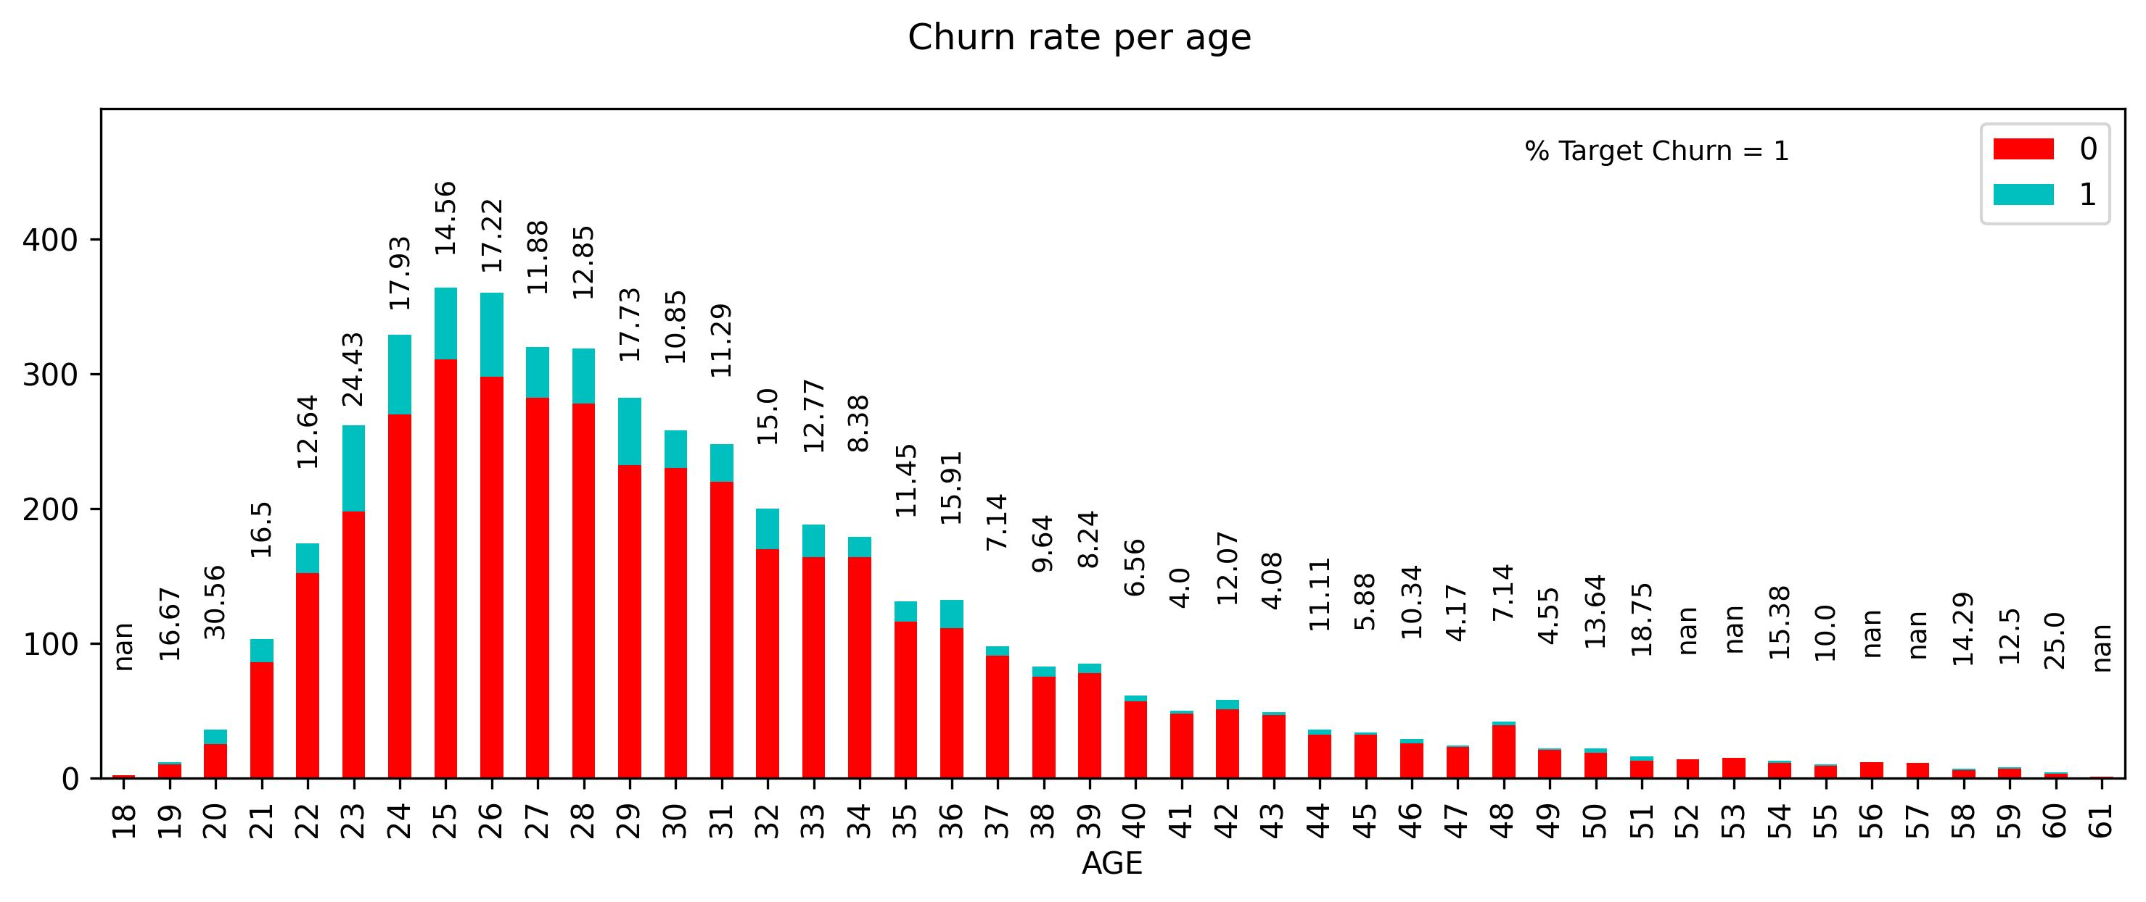
Churn rate analysis

Slide 18
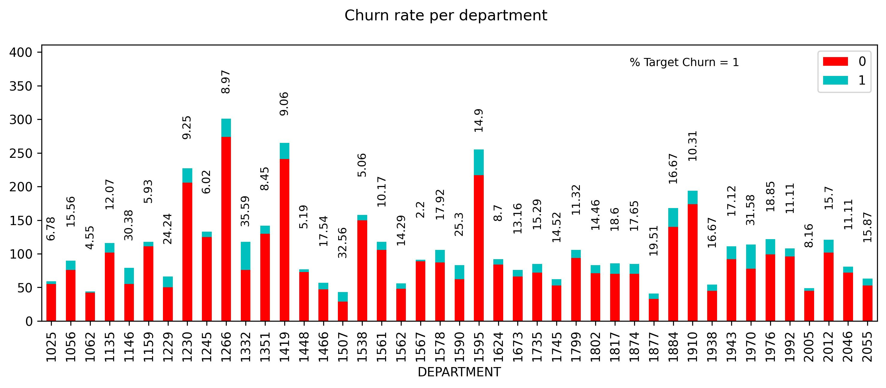
Churn rate analysis

Slide 19
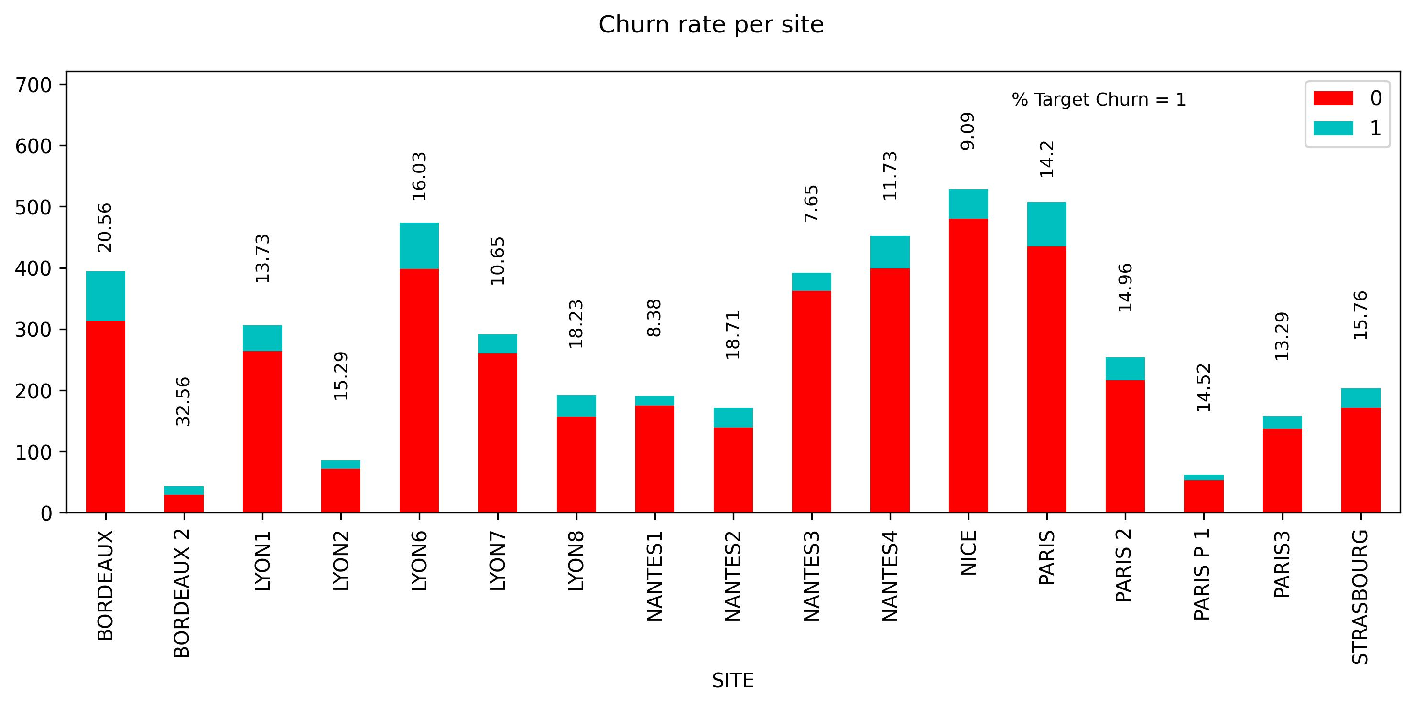
Churn rate analysis

Slide 20
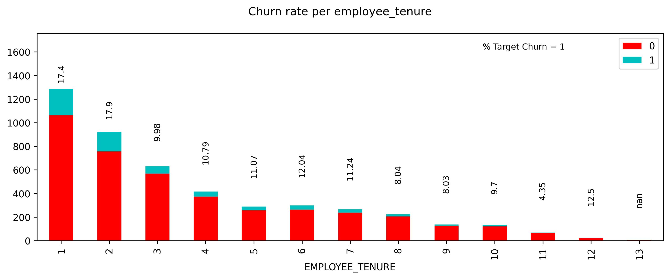
Churn rate analysis

Slide 21
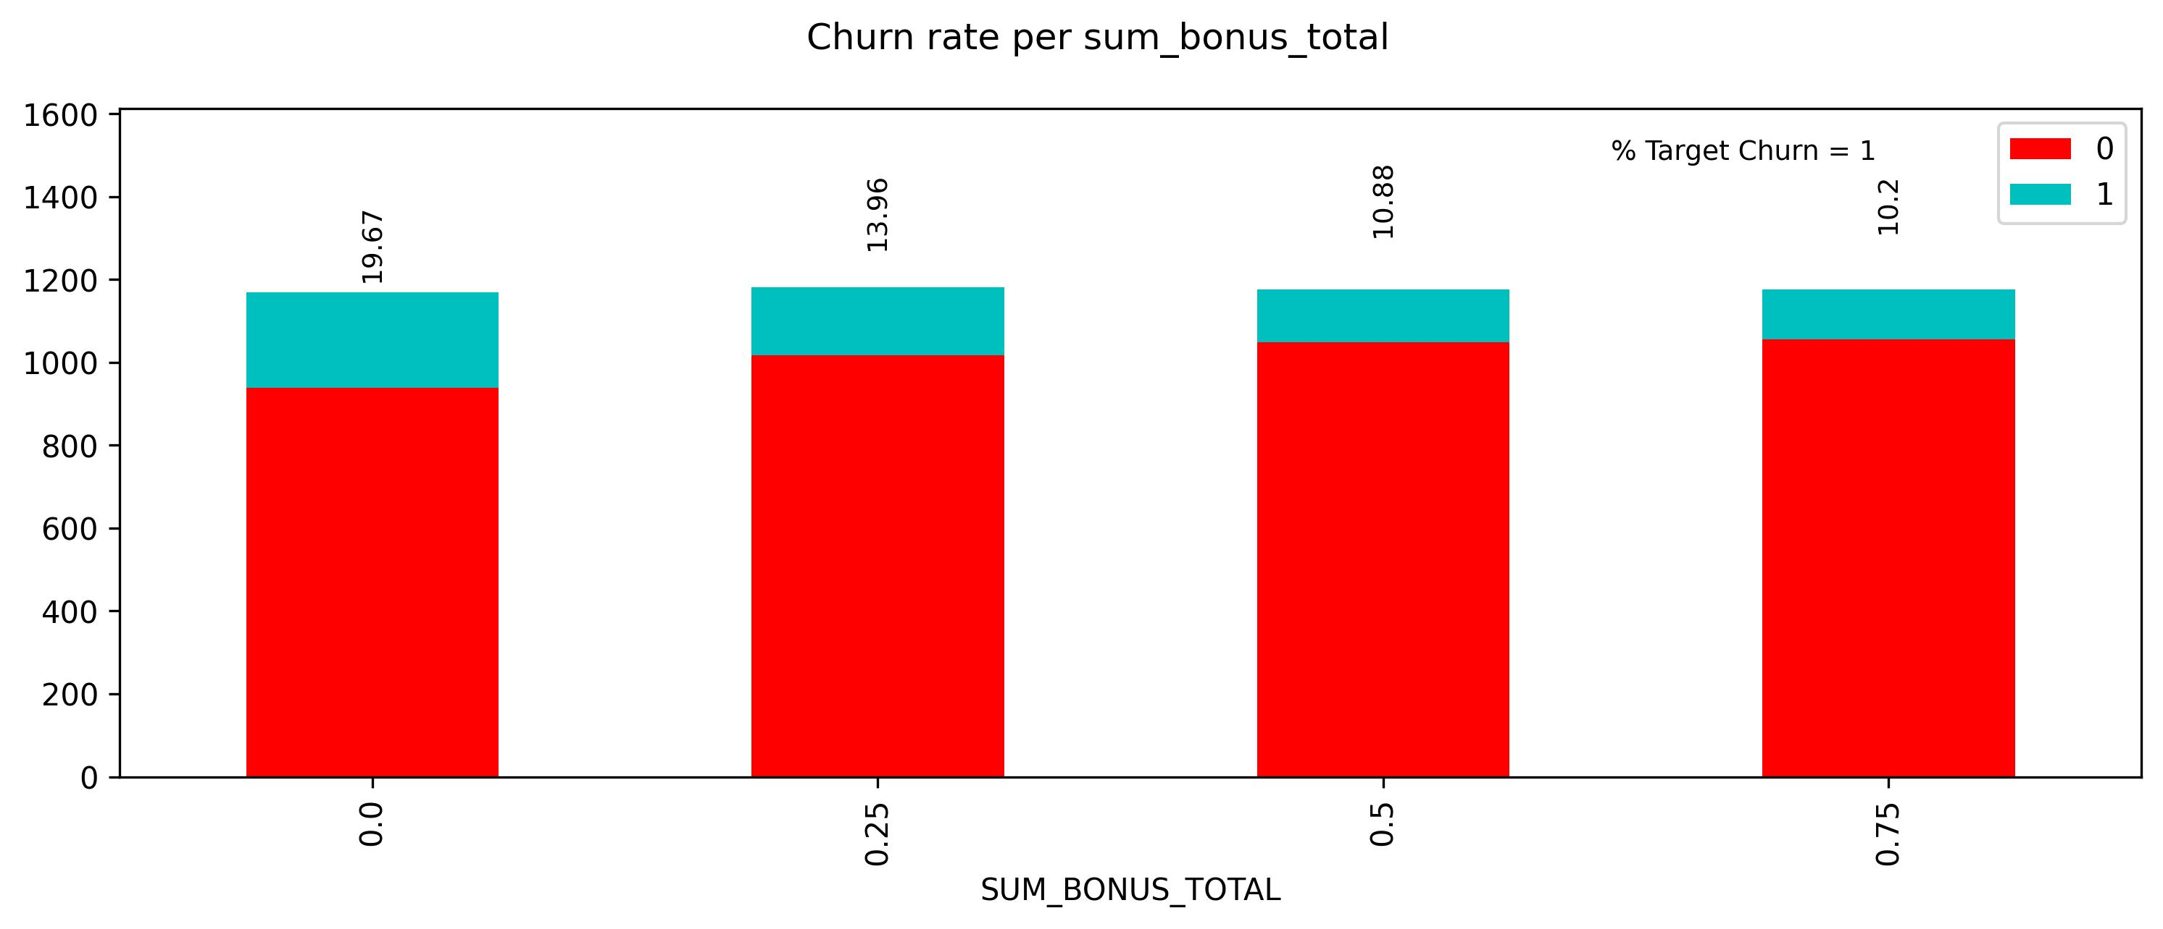
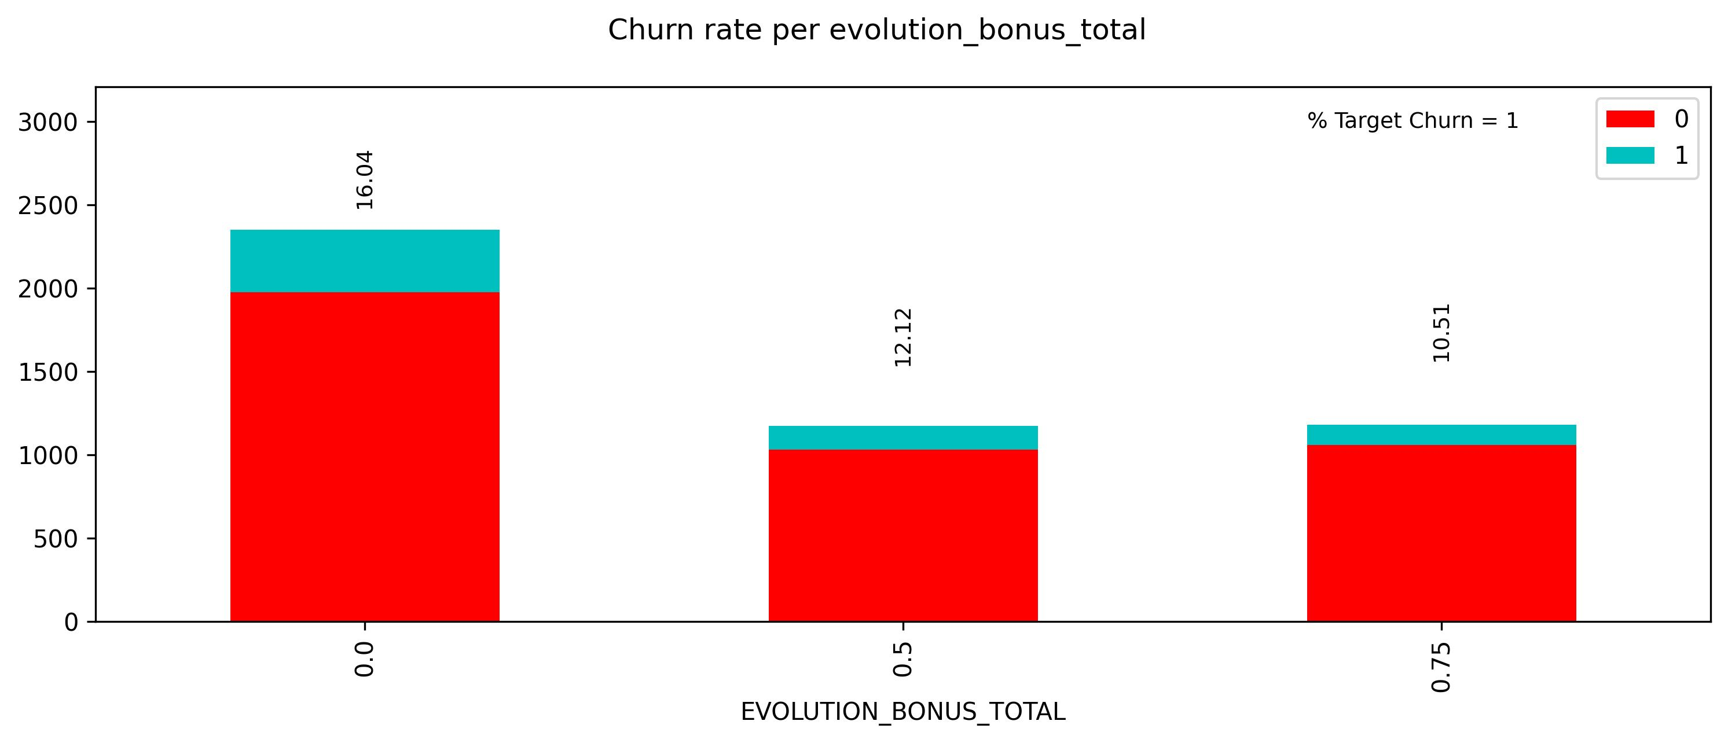
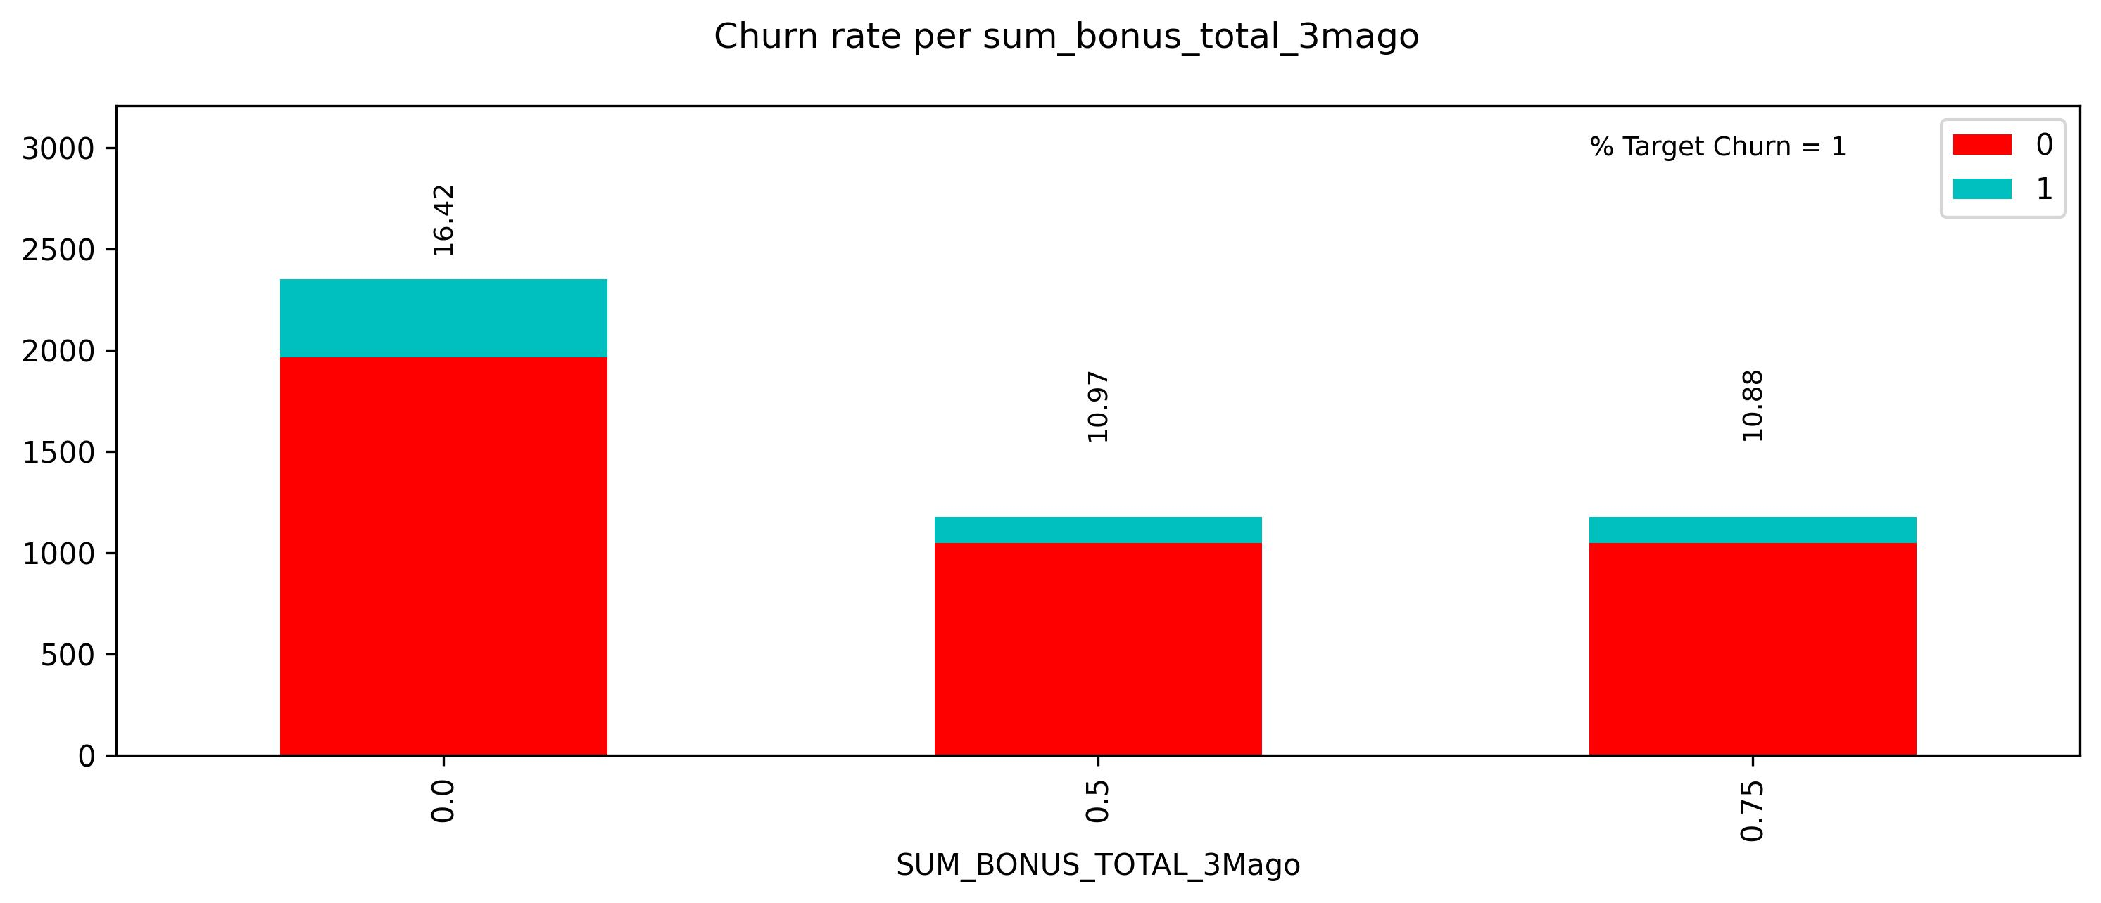
Churn rate analysis (total bonuses)

Slide 22
Follow-up question
How important are bonuses really ?

Slide 23
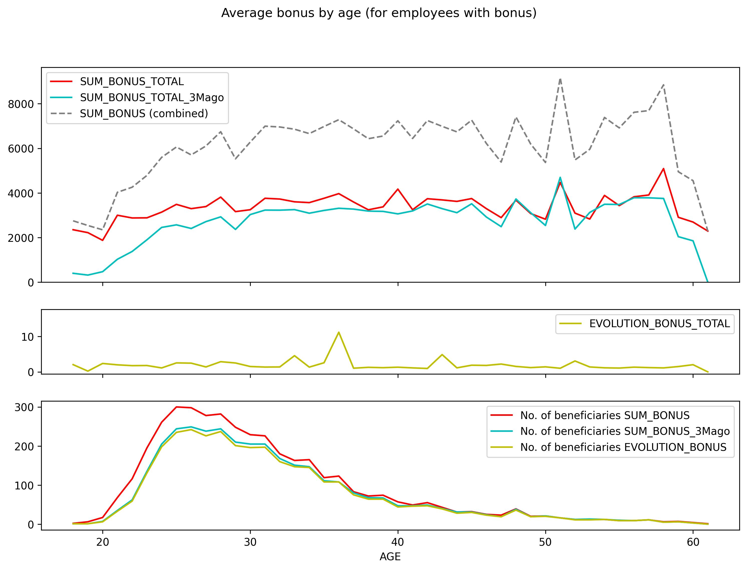
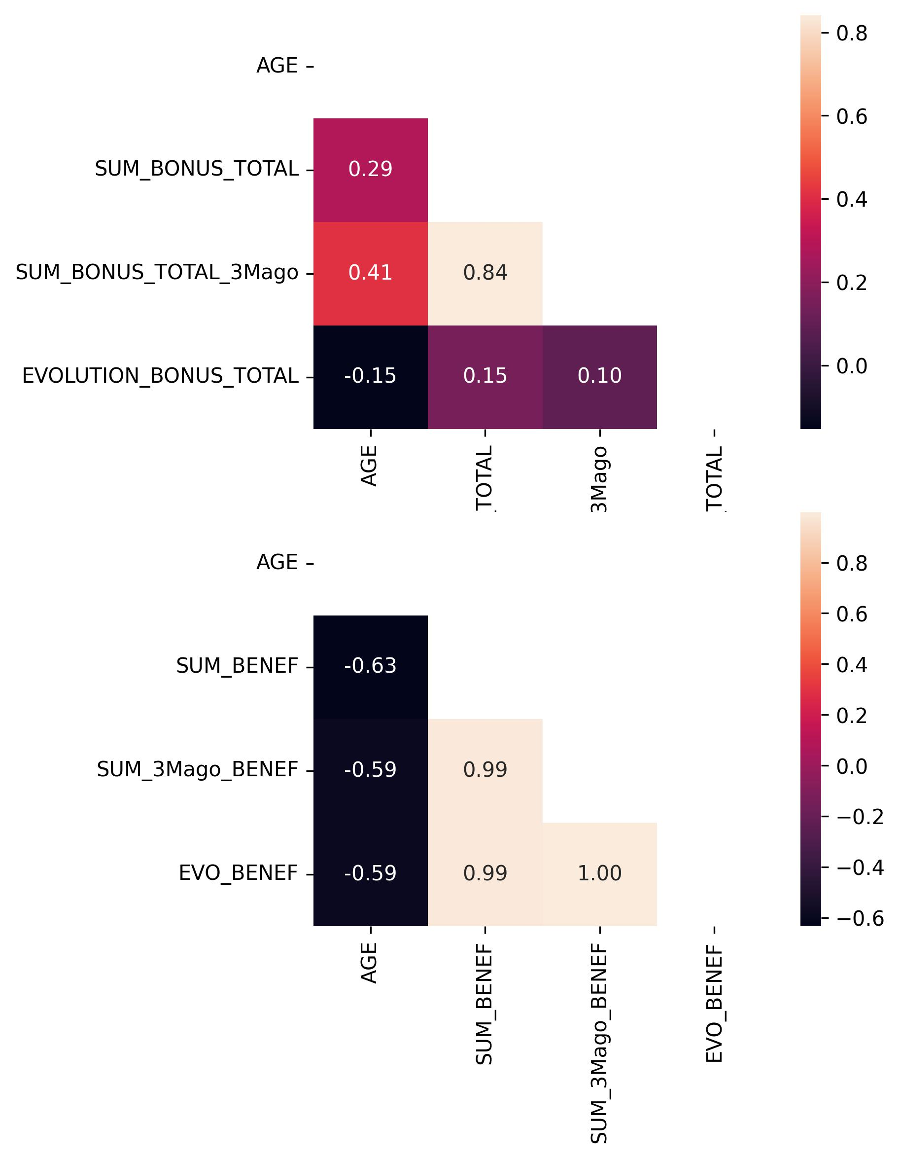
Follow-up question

Slide 24
Follow-up question
How important are bonuses really ?
There does seem to be a correlation between bonuses and age.
Younger employees tend to have lower bonuses, yet also have a higher churn rate.

Slide 25
Side-note
A similar effect seems at play for Employee Tenure

Slide 26
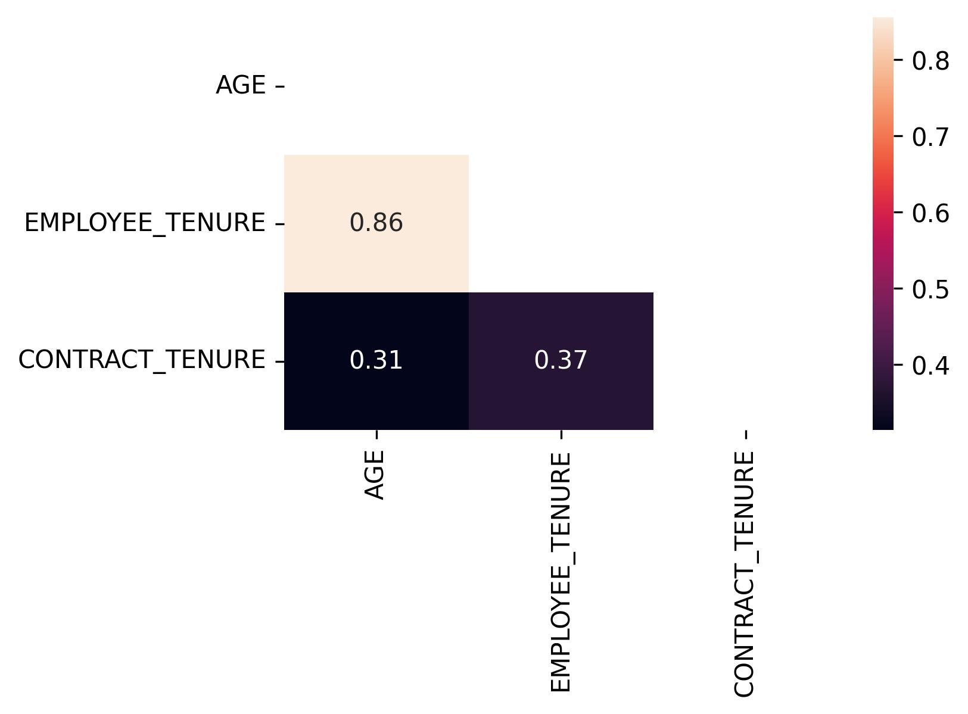
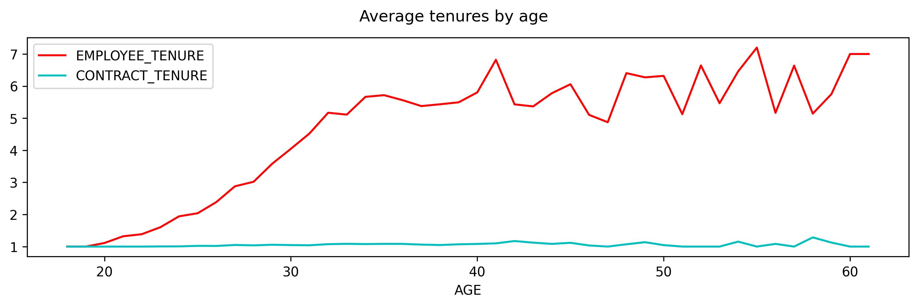
Side-note

Slide 27



If not bonuses, then what is important ?
The ABC of self-determination theory:
Human beings have 3 basic psychological needs.
Autonomy (Can I make my own decisions, organize my work as I see fit ?)
Belonging (Am I feeling part of a team ? Can I collaborate well ?)
Competence (Is my job routine or stimulating ?)
A
B
C

Slide 28
If not bonuses, then what is important ?
A
Relevance of ‘manager’:
Management style is related to allowing more/less autonomy.
‘manager’ is also an evaluation of the team.
Relevance of ‘company’:
Company culture can have important impact on autonomy and/or how strict jobs are defined.
B
A
C

Slide 29
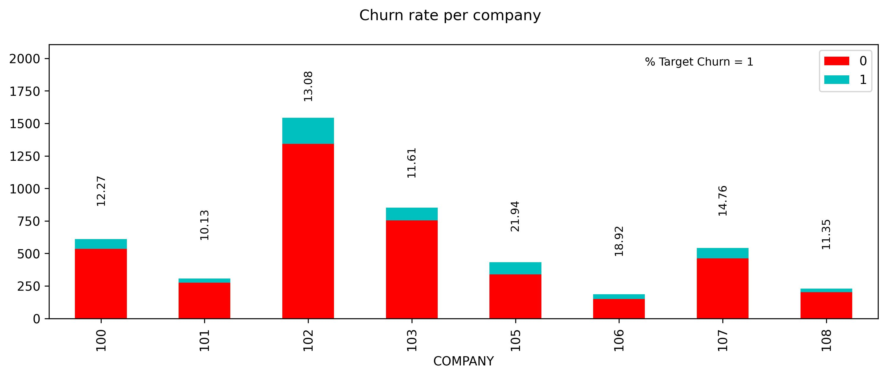
Churn rate analysis
Notes:
Company seems better indicator for company culture than site because e.g. Japanese company can have affiliates abroad.

Slide 30
Question 4: How to improve the model ?
Not all leavers are equally relevant
Some we cannot act upon.
Others we don’t seek to retain.
 | External | Internal
Voluntary | e.g. family reasons, relocation, … | e.g. stress, no fit with company culture, lack of career opportunities, …
Involuntary | e.g. economic circumstances | underperformance, no fit with company culture, misconduct, …

Slide 31
Question 4: How to improve the model ?
Add qualitative information (employee engagement)
How are people feeling ?
How do people experience the organization and their place in it ?
Survey → quantitative score
Find KPI’s related to the ABC’s
Are off-work team activities being organized ? (And how many people show up ?)
Check related KPI’s
Absenteism

Slide 32
Question 4: How to improve the model ?
Include monetary aspects
Does budget play a role ?
Does wage level play a role ? (One could expect higher churn with lower wages ?)
Prioritize (groups of) employees or jobs
Who are the ‘high potentials’ ?
Which jobs have the highest recrutement time/cost ?
Broader range of techniques & models

Slide 33
Raf Ledeganck
Syntra Data Scientist 2022 – 2024
raf.ledeganck@flexso.com

