Slide 1

PROGRAMOWANIE URZĄDZEŃ
MOBILNYCH
WYKŁAD 13
Paging

Slide 2

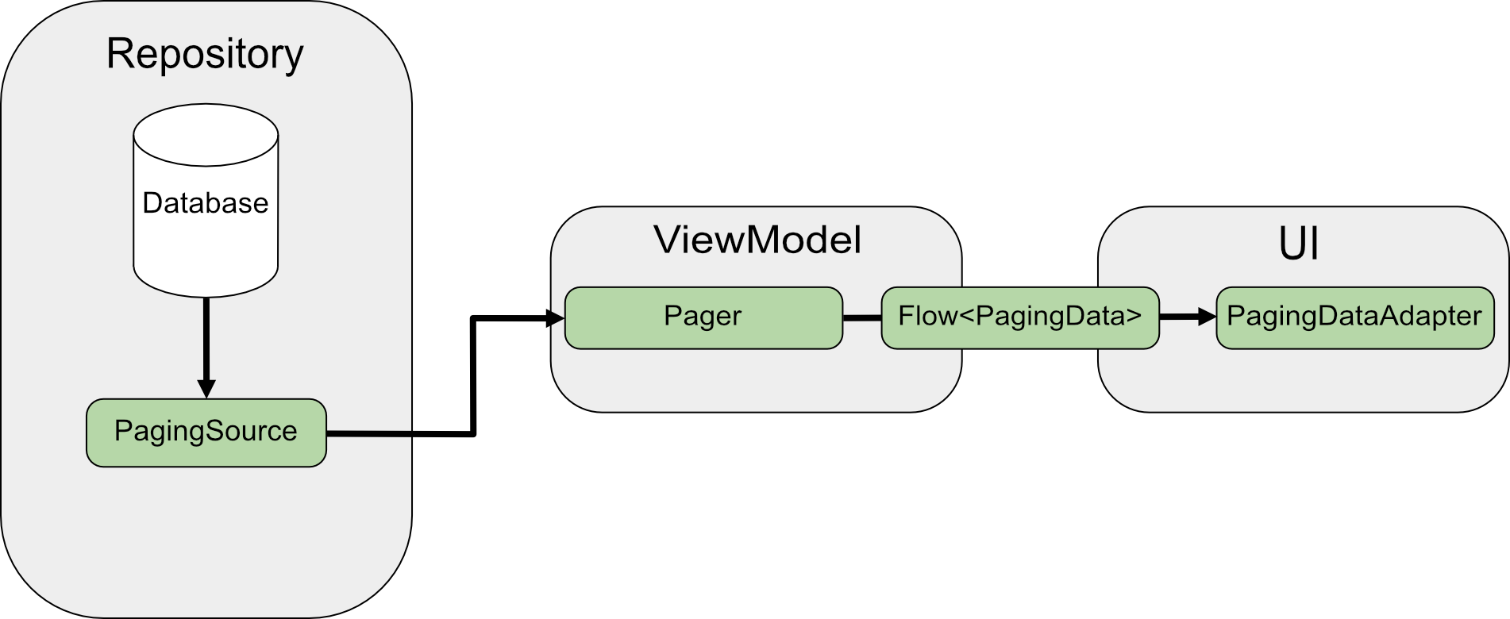
Paging

Slide 3
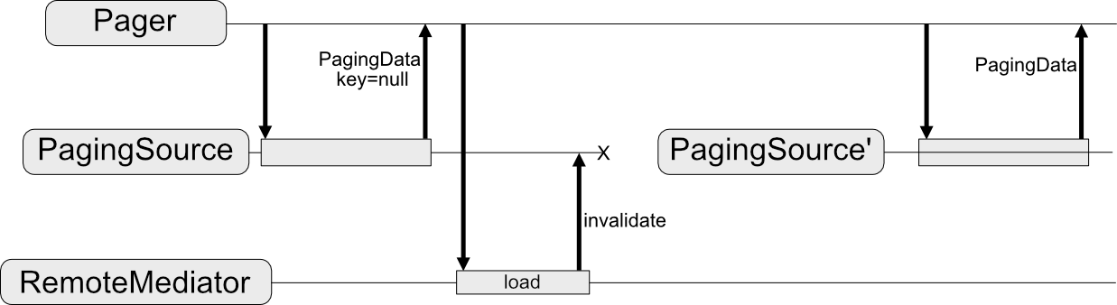
Paging

Slide 4
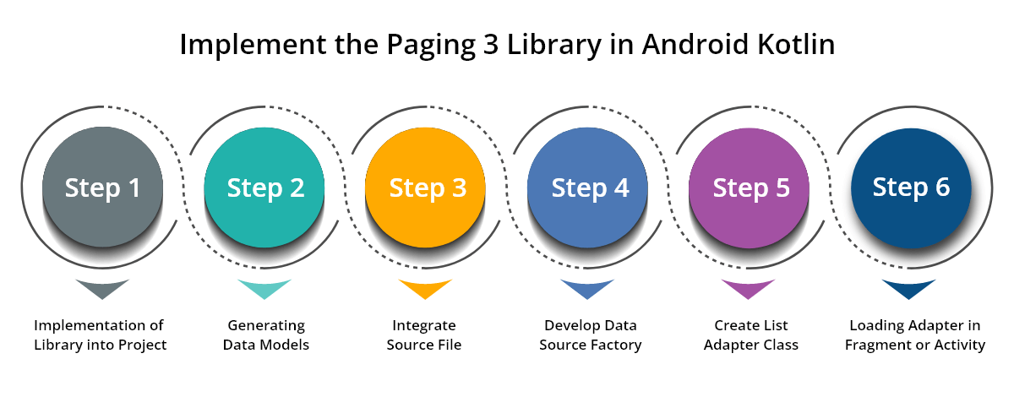
Paging
https://www.google.com/url?sa=i&url=https%3A%2F%2Fwww.oneclickitsolution.com%2Fblog%2Fpaging-3-library-in-android%2F

Slide 5
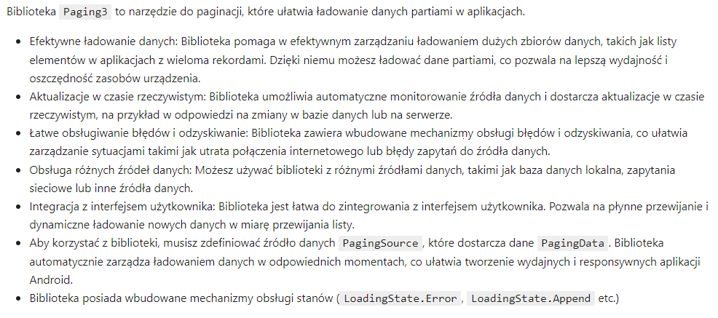
Paging

Slide 6
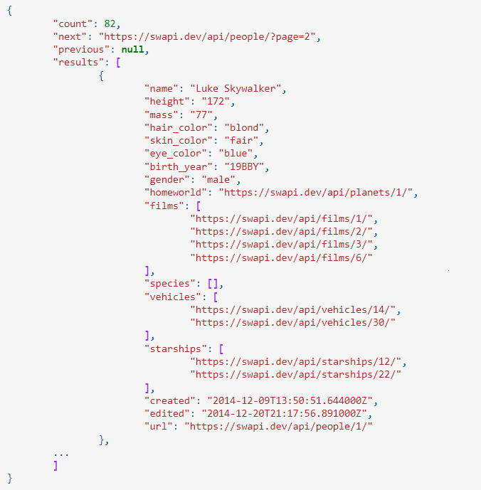
SWAPI

Slide 7
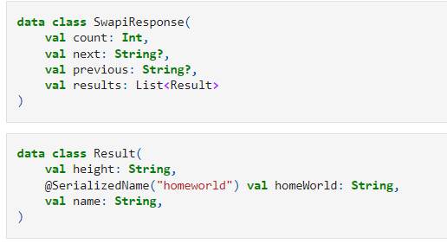
Model

Slide 8
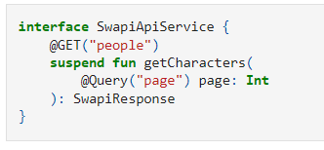
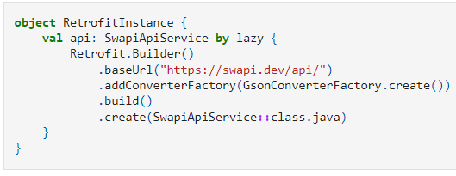
Retrofit

Slide 9
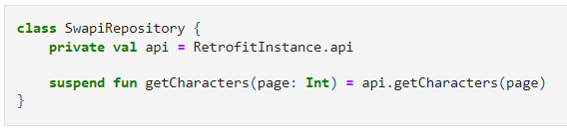
Retrofit

Slide 10
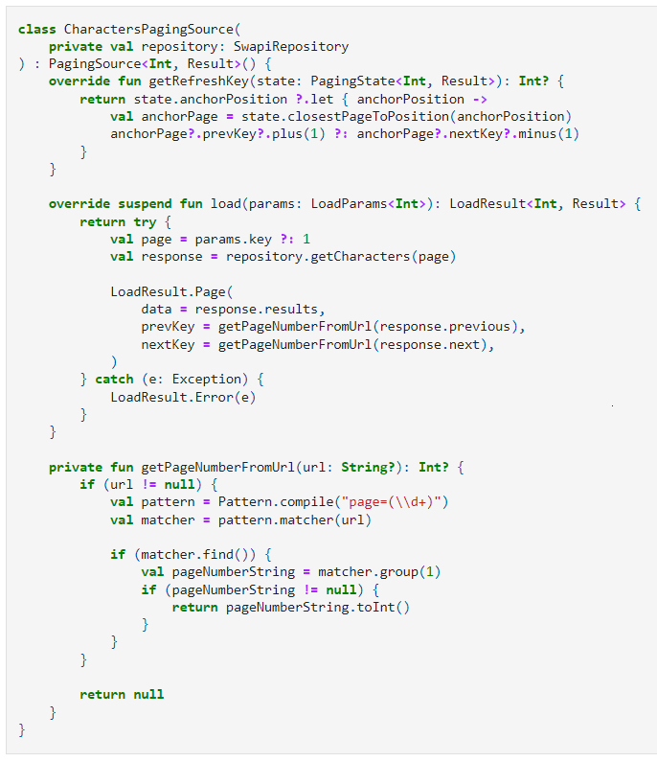
PagingSource

Slide 11
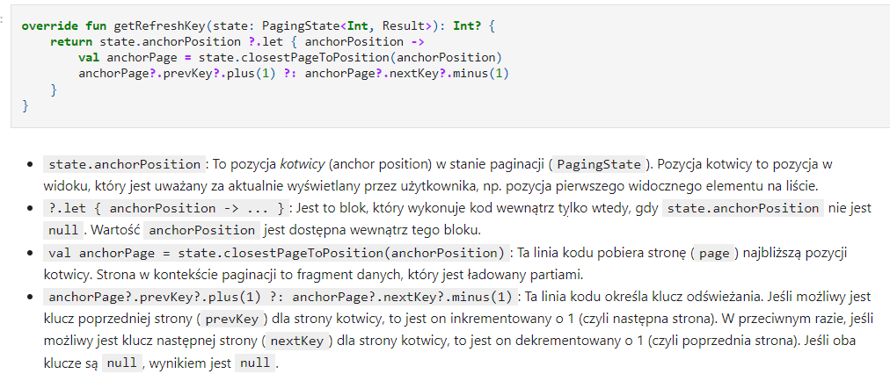
PagingSource

Slide 12
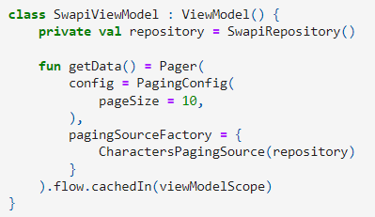
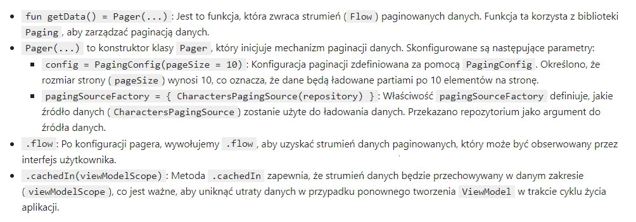
ViewModel

Slide 13
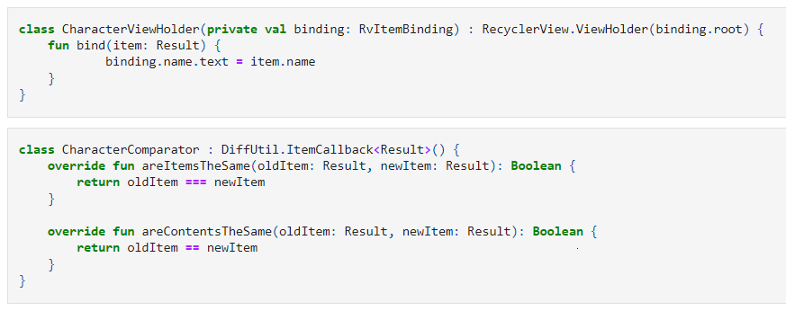
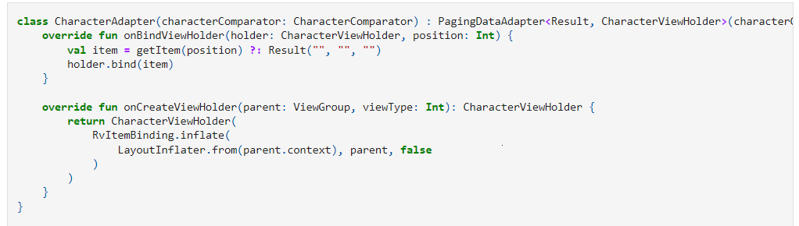
RecyclerView + Paging

Slide 14
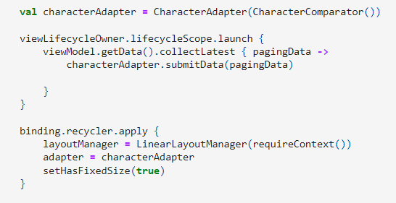
RecyclerView

Slide 15
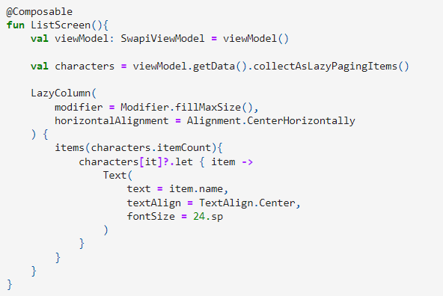
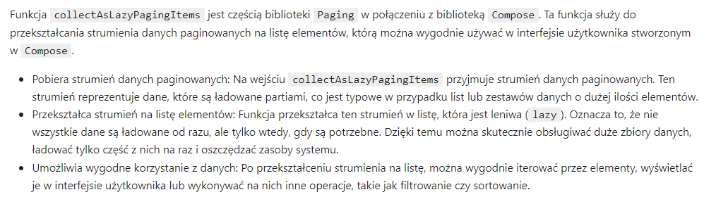
Paging + Compose

