Slide 1

PROGRAMOWANIE URZĄDZEŃ
MOBILNYCH
WYKŁAD 5
ViewPager2
Jetpack Navigation
BottomNavigation
TabLayout

Slide 2

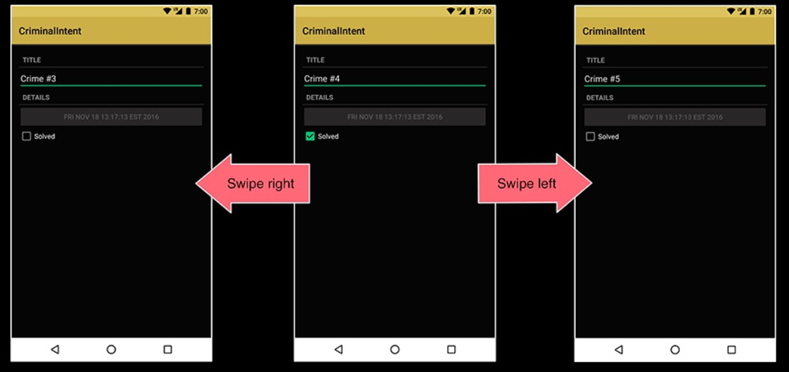
Criminal List

Slide 3
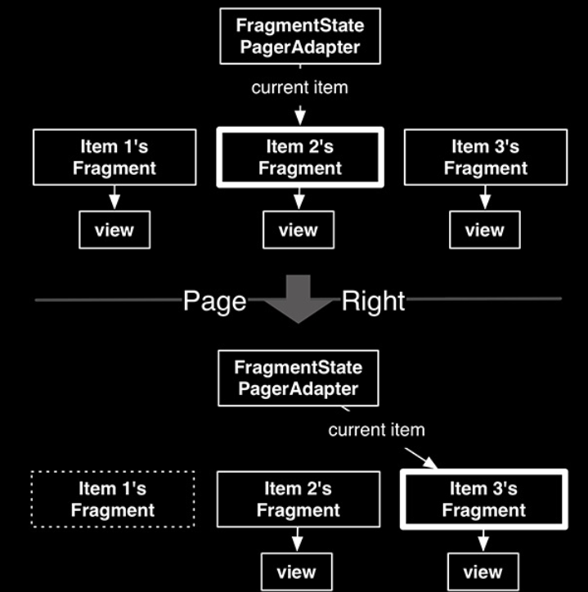
Criminal List

Slide 4
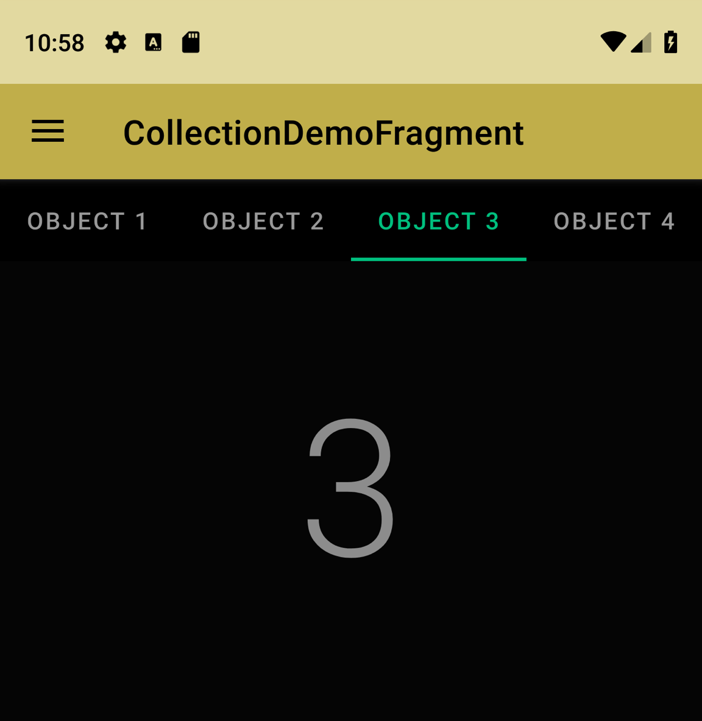
ViewPager2

Slide 5
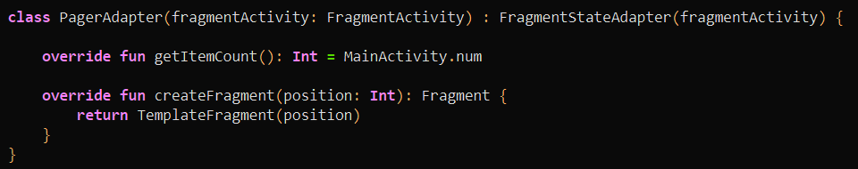
ViewPager2

Slide 6
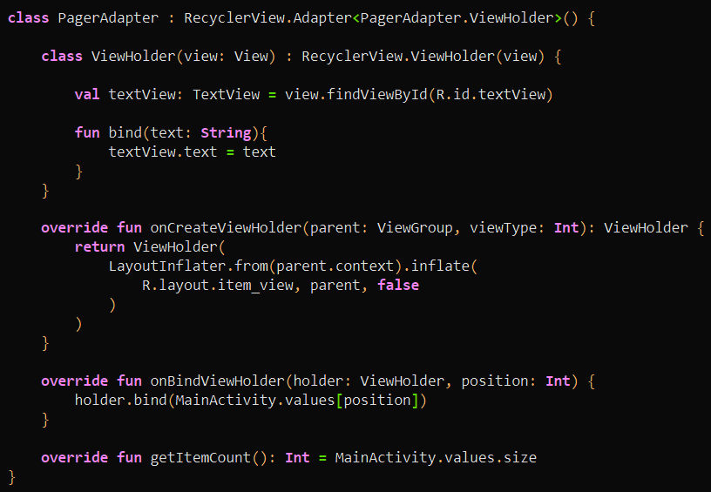
ViewPager2

Slide 7
ViewPager2 + TabLayout

Slide 8
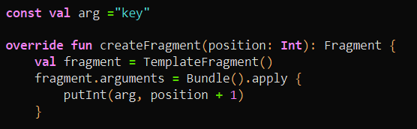
ViewPager2 + TabLayout

Slide 9
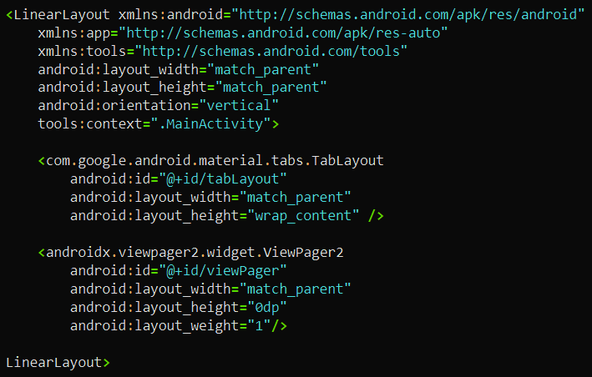
ViewPager2 + TabLayout

Slide 10
ViewPager2 + TabLayout

Slide 11

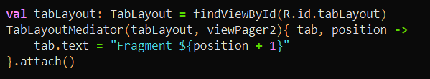
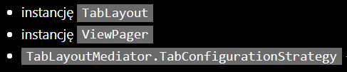
ViewPager2 + TabLayout

Slide 12
Jetpack Navigation + BottomNavigation

Slide 13
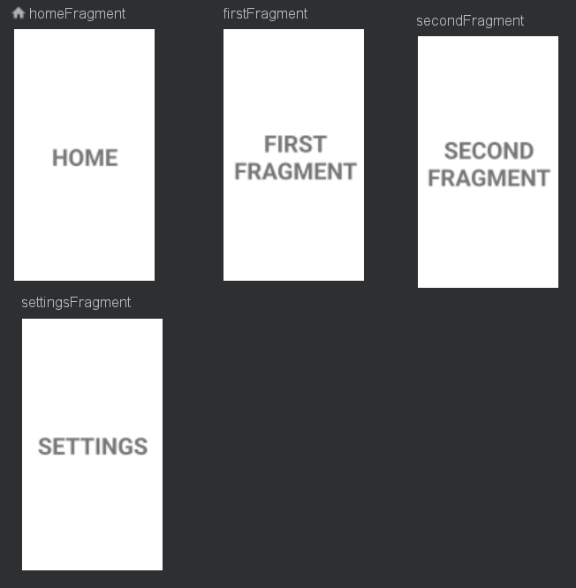
Jetpack Navigation + BottomNavigation

Slide 14
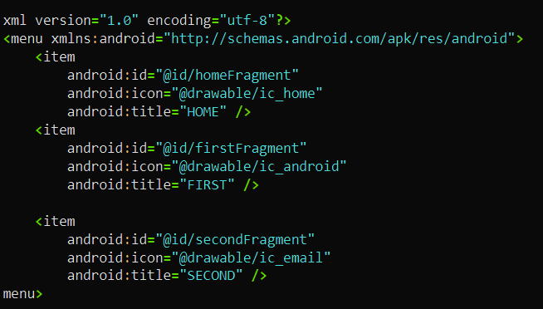
Jetpack Navigation + BottomNavigation

Slide 15
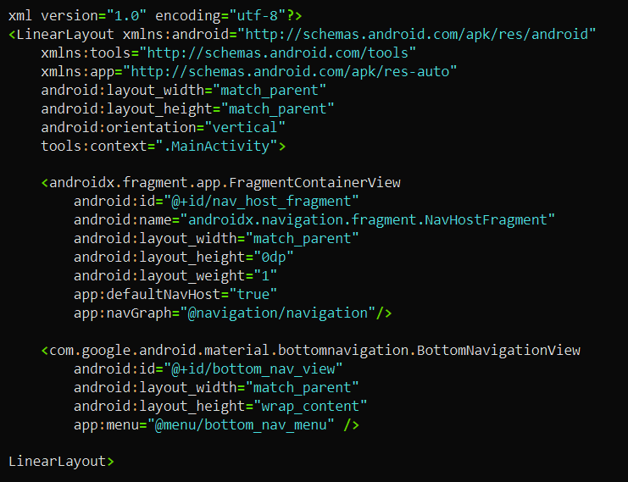
Jetpack Navigation + BottomNavigation

Slide 16
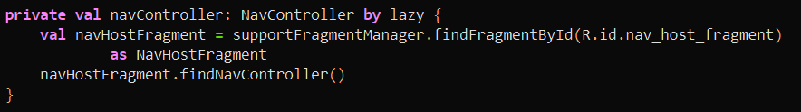

Jetpack Navigation + BottomNavigation

Slide 17
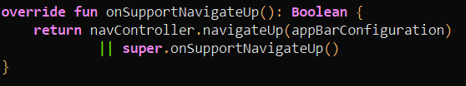
Jetpack Navigation + BottomNavigation

