Slide 1

PROGRAMOWANIE URZĄDZEŃ
MOBILNYCH
WYKŁAD 3
RecyclerView
Adapter
ViewHolder

Slide 2

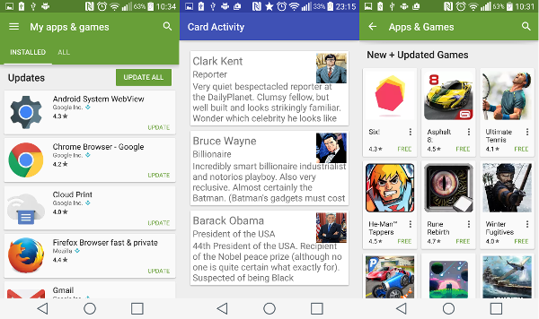
RecyclerView

Slide 3
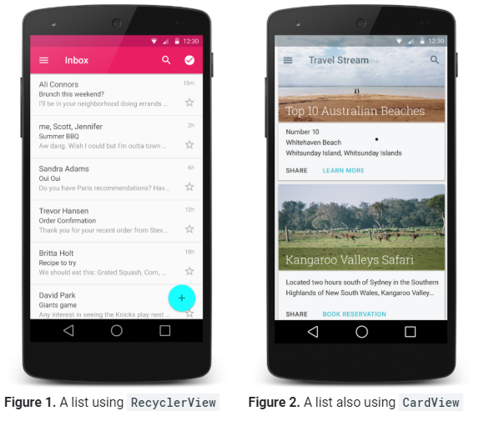
RecyclerView

Slide 4
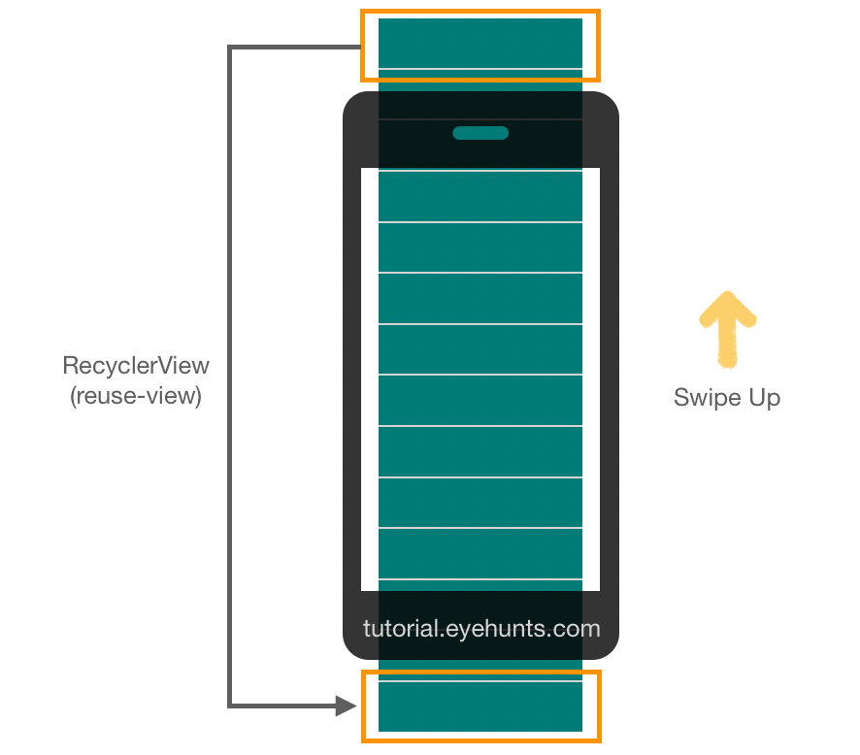
RecyclerView

Slide 5
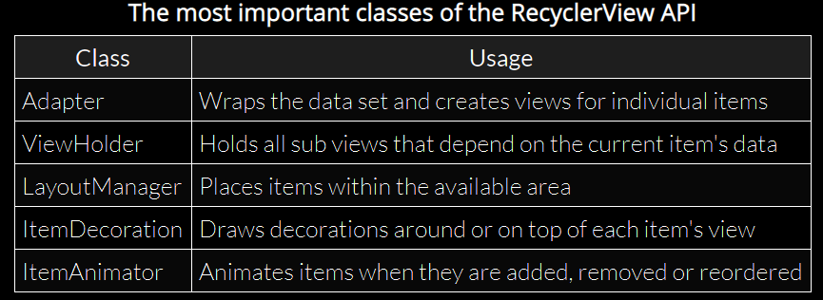
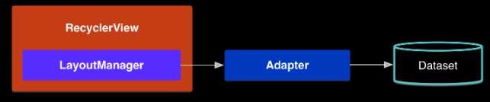
RecyclerView

Slide 6
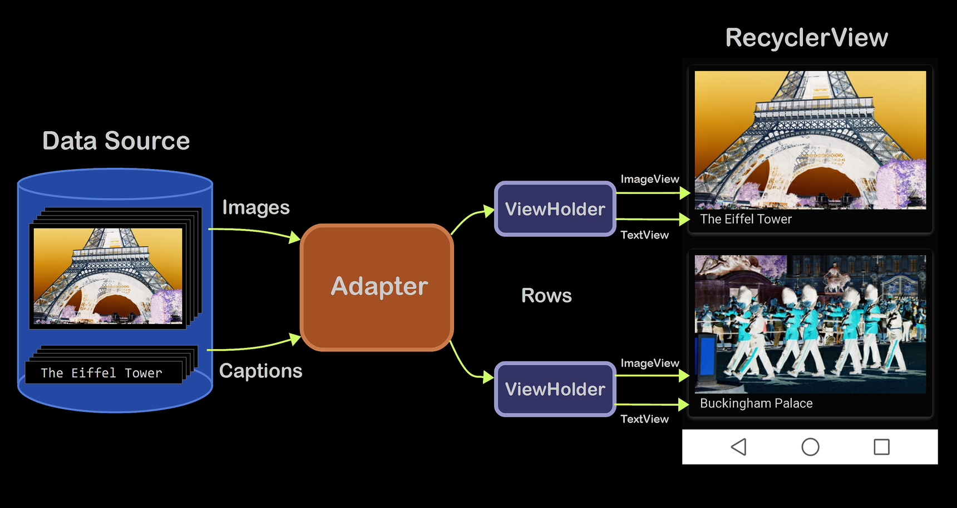
RecyclerView
https://www.google.com/url?sa=i&url=https%3A%2F%2Flearn.microsoft.com%2Fpl-pl%2Fxamarin%2Fandroid%2Fuser-interface%2Flayouts%2Frecycler-view%2Fparts-and-functionality&psig=AOvVaw15sXcomaaNh3j6e9kHPA07&ust=1697714574289000&source=images&cd=vfe&opi=89978449&ved=0CBMQjhxqFwoTCIiSnem9_4EDFQAAAAAdAAAAABAE

Slide 7
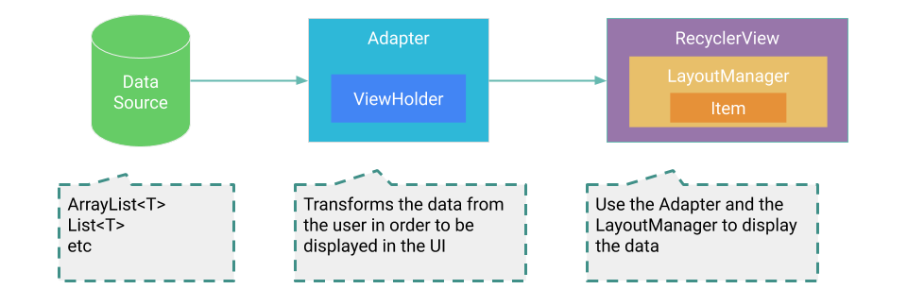
RecyclerView
https://www.google.com/url?sa=i&url=https%3A%2F%2Fmagdamiu.com%2F2020%2F12%2F29%2Frecyclerview-android%2F&psig=AOvVaw2rCgIBc19KNZcp16yznriF&ust=1720102639909000&source=images&cd=vfe&opi=89978449&ved=0CBcQjhxqFwoTCOCF2O2Hi4cDFQAAAAAdAAAAABAE

Slide 8
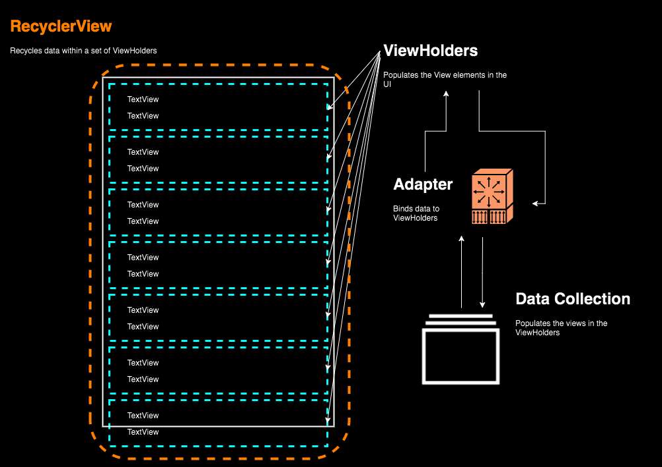
RecyclerView
https://hinchman-amanda.medium.com/working-with-recyclerview-in-android-kotlin-84a62aef94ec

Slide 9
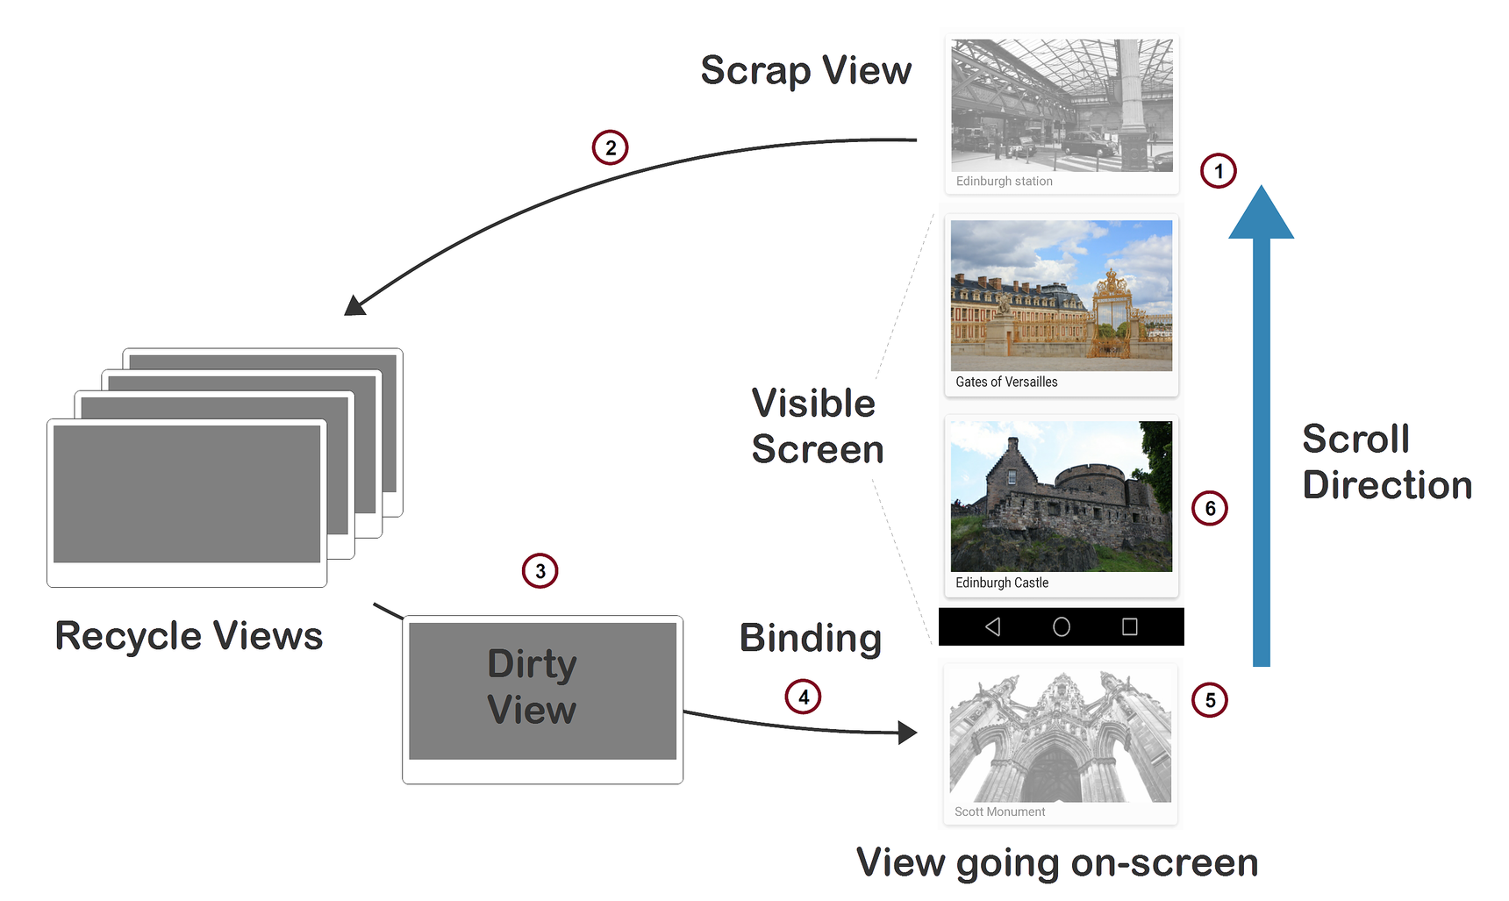
RecyclerView
https://www.google.com/url?sa=i&url=https%3A%2F%2Flearn.microsoft.com%2Fpl-pl%2Fxamarin%2Fandroid%2Fuser-interface%2Flayouts%2Frecycler-view%2Fparts-and-functionality&psig=AOvVaw2rCgIBc19KNZcp16yznriF&ust=1720102639909000&source=images&cd=vfe&opi=89978449&ved=0CBcQjhxqFwoTCOCF2O2Hi4cDFQAAAAAdAAAAABAJ

Slide 10
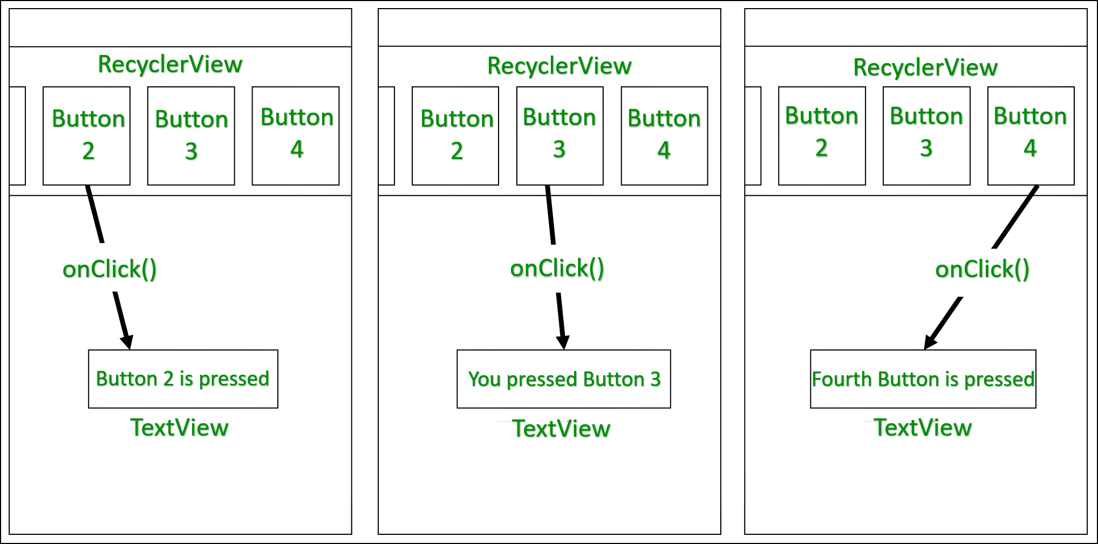
RecyclerView

Slide 11
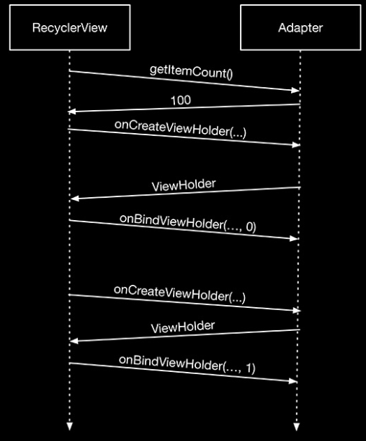
RecyclerView

Slide 12
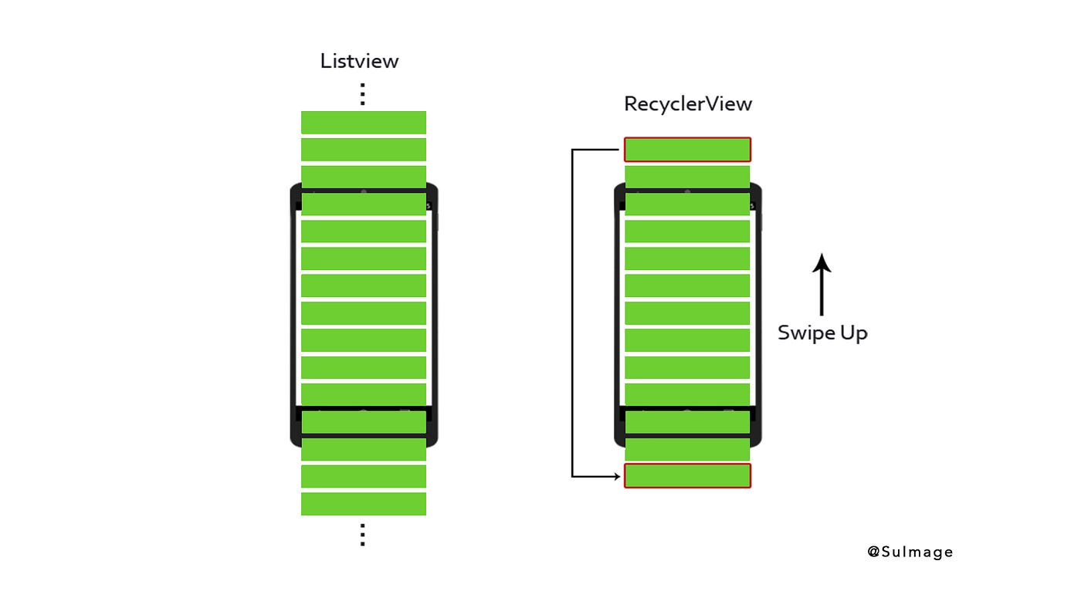
RecyclerView
https://www.google.com/url?sa=i&url=https%3A%2F%2Flevelup.gitconnected.com%2Fandroid-recycler-view-b1bc493cac53&psig=AOvVaw2rCgIBc19KNZcp16yznriF&ust=1720102639909000&source=images&cd=vfe&opi=89978449&ved=0CBcQjhxqFwoTCOCF2O2Hi4cDFQAAAAAdAAAAABAT

