Slide 1

PROGRAMOWANIE URZĄDZEŃ
MOBILNYCH
WYKŁAD 3
RecyclerView
Adapter
ViewHolder
ViewPager2

Slide 2

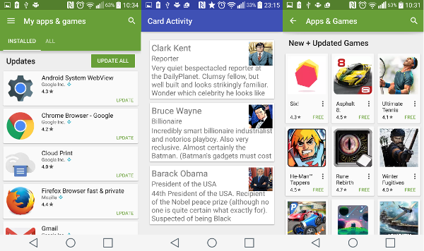
RecyclerView

Slide 3
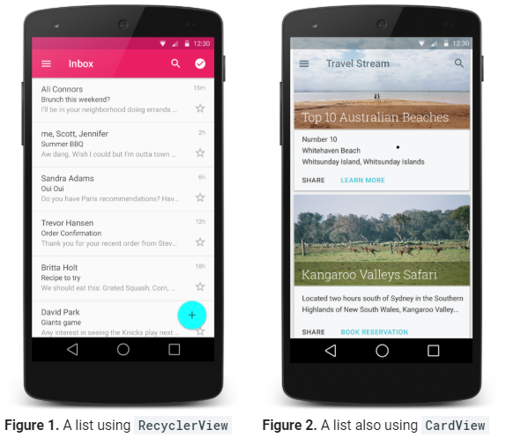
RecyclerView

Slide 4
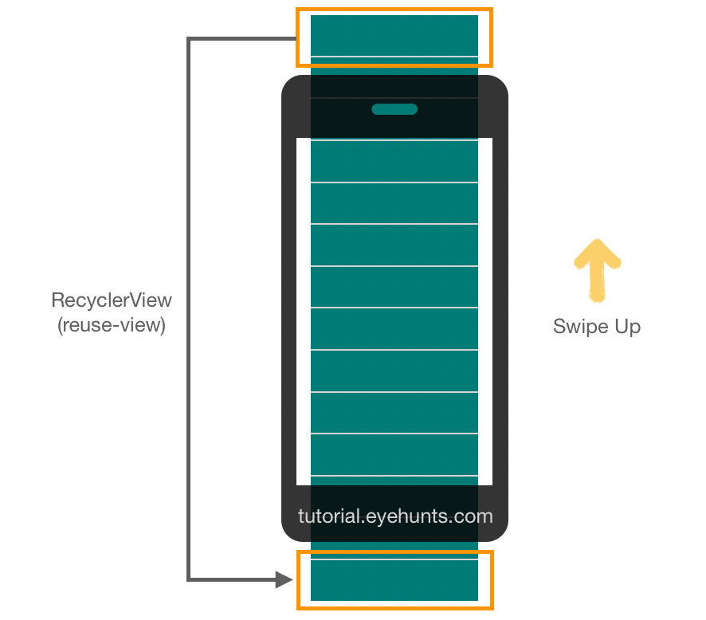
RecyclerView

Slide 5
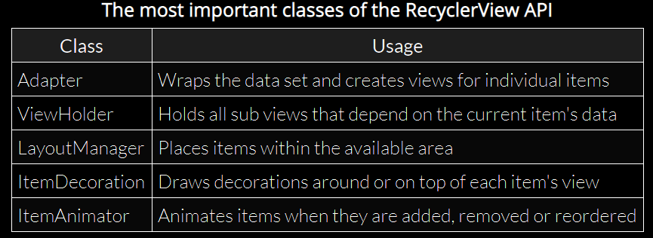
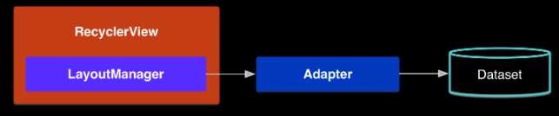
RecyclerView

Slide 6
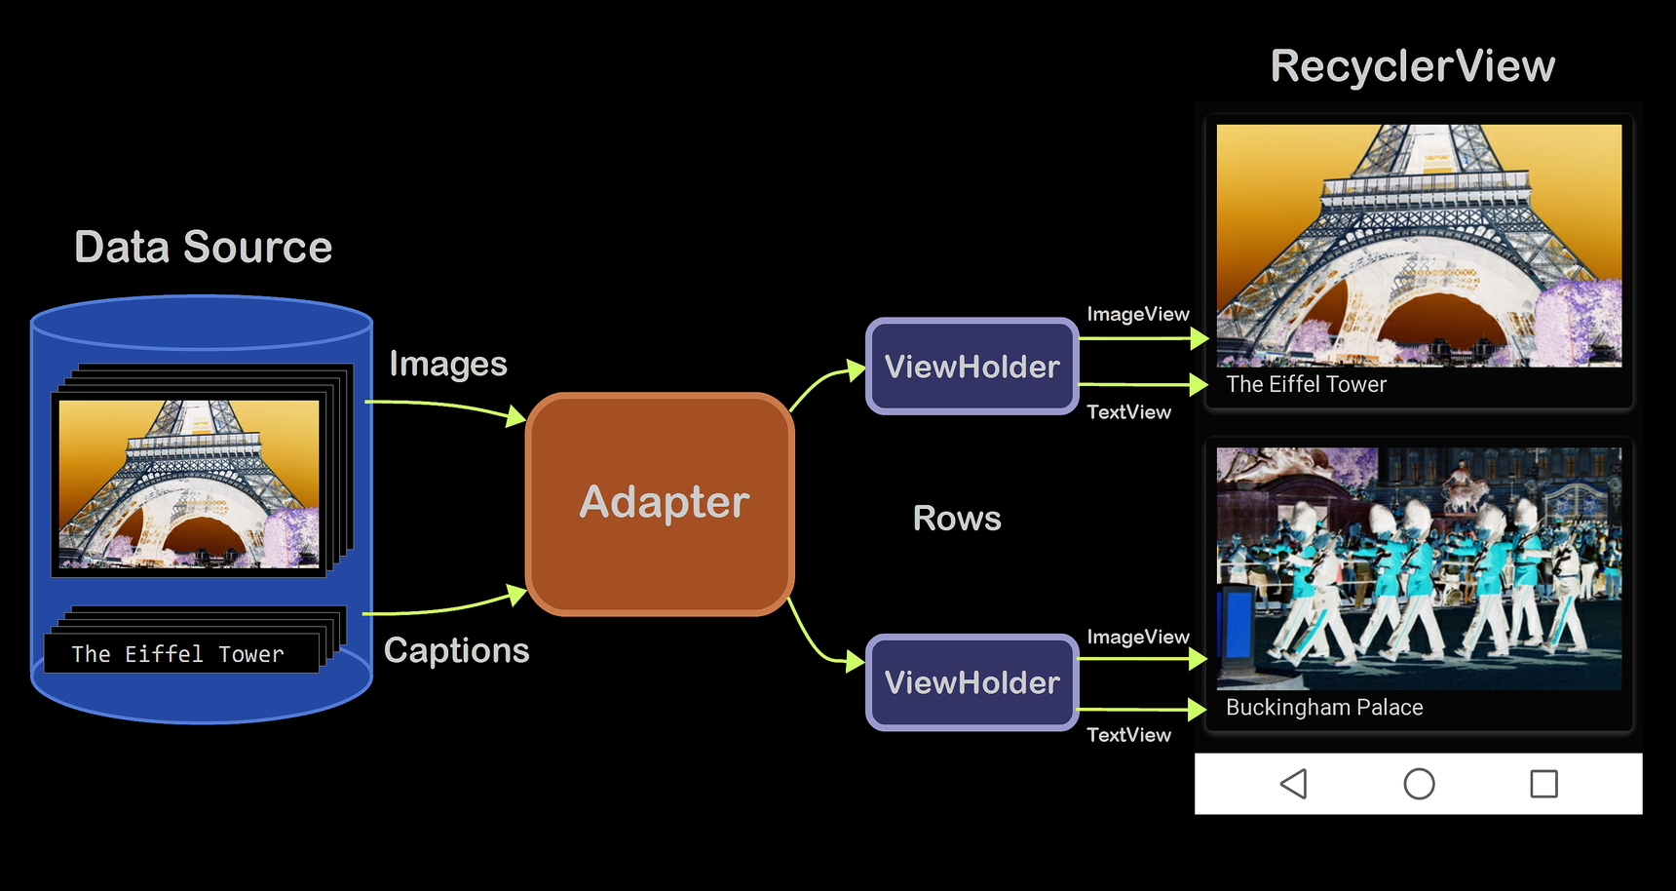
RecyclerView
https://www.google.com/url?sa=i&url=https%3A%2F%2Flearn.microsoft.com%2Fpl-pl%2Fxamarin%2Fandroid%2Fuser-interface%2Flayouts%2Frecycler-view%2Fparts-and-functionality&psig=AOvVaw15sXcomaaNh3j6e9kHPA07&ust=1697714574289000&source=images&cd=vfe&opi=89978449&ved=0CBMQjhxqFwoTCIiSnem9_4EDFQAAAAAdAAAAABAE

Slide 7
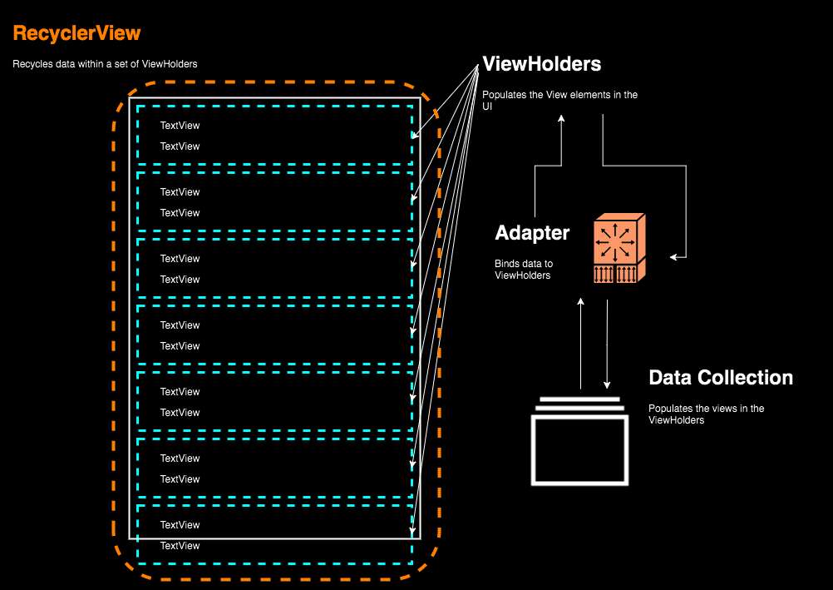
RecyclerView
https://hinchman-amanda.medium.com/working-with-recyclerview-in-android-kotlin-84a62aef94ec

Slide 8
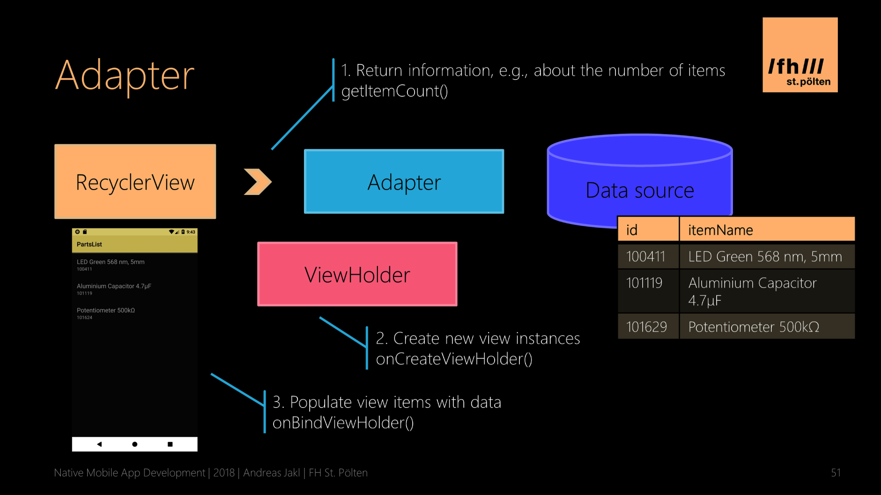
RecyclerView

Slide 9
RecyclerView

Slide 10
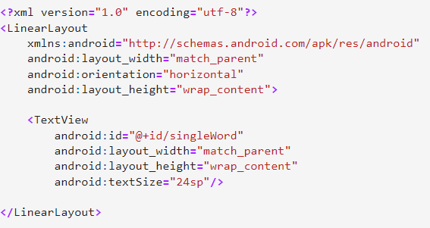
RecyclerView
word_list_item.xml

Slide 11
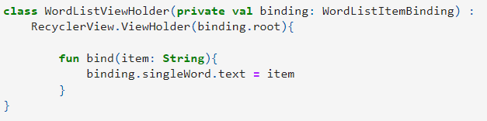
RecyclerView
word_list_item.xml

Slide 12
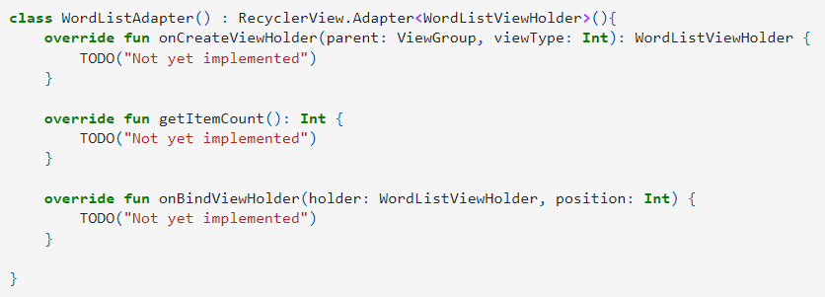
RecyclerView
word_list_item.xml
WordListViewHolder

Slide 13
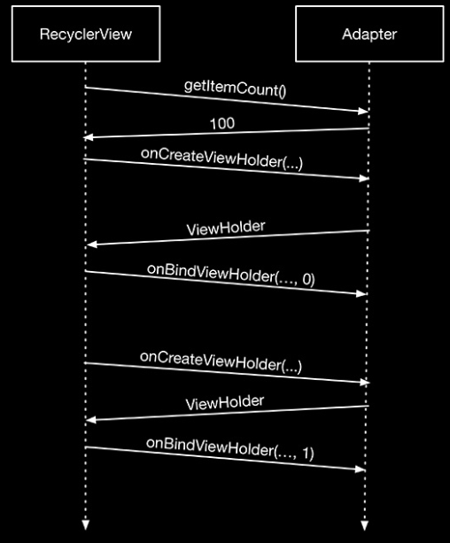
RecyclerView

Slide 14
RecyclerView
word_list_item.xml
WordListViewHolder

Slide 15
RecyclerView
word_list_item.xml
WordListViewHolder

Slide 16
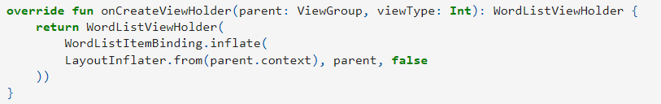
RecyclerView
word_list_item.xml
WordListViewHolder

Slide 17
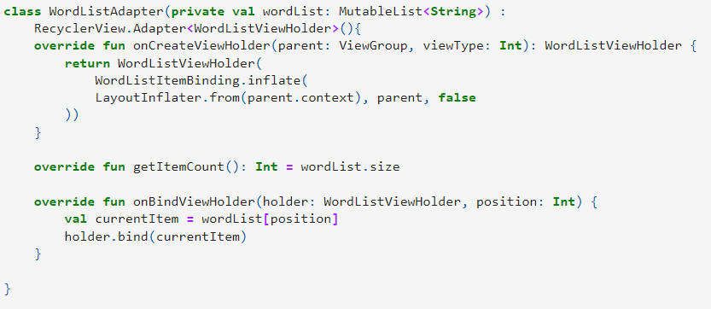
RecyclerView
word_list_item.xml
WordListViewHolder

Slide 18
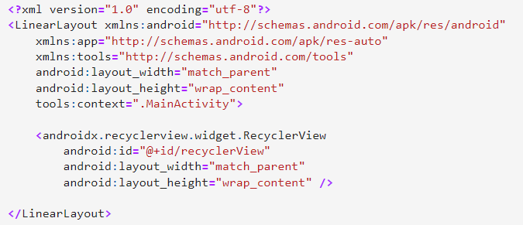

RecyclerView

Slide 19
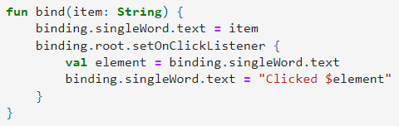
RecyclerView

Slide 20
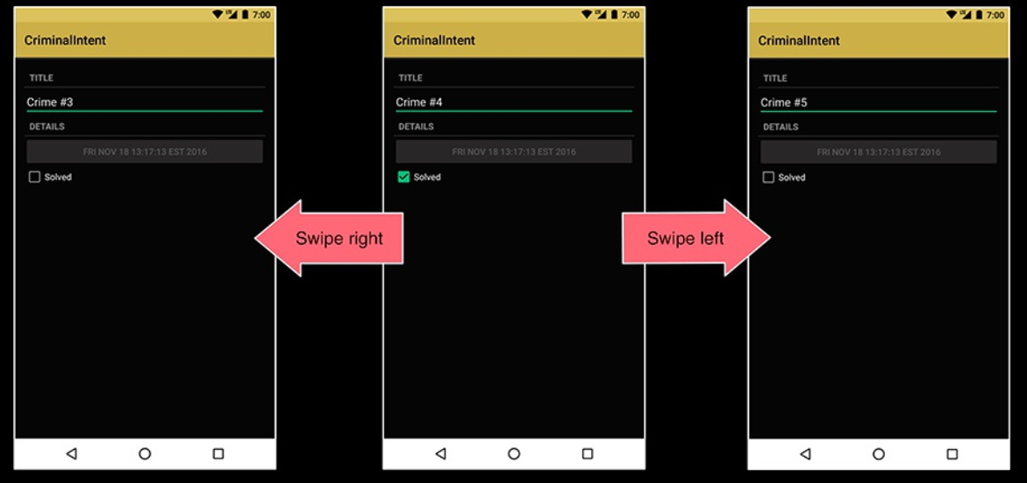
ViewPager2

Slide 21
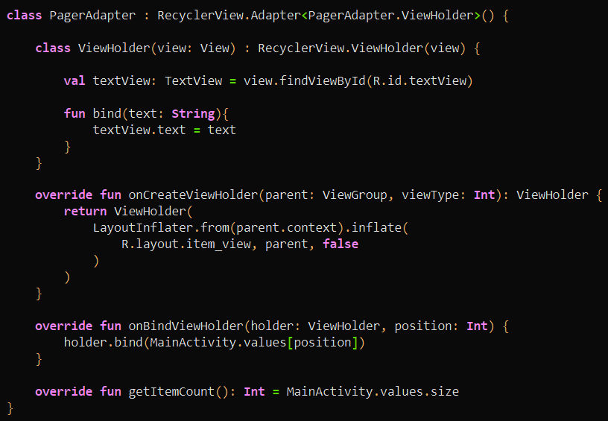
ViewPager2

Slide 22
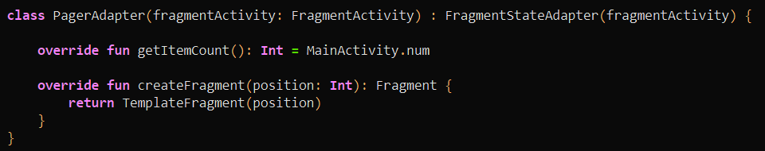
ViewPager2

Slide 23
ViewPager2 + TabLayout

