Slide 1

PROGRAMOWANIE URZĄDZEŃ
MOBILNYCH
WYKŁAD 5
Jetpack Compose
Fundamenty
Komponenty
@Composable
MutableState

Slide 2

Jetpack Compose

Slide 3

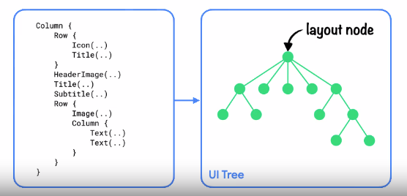
Jetpack Compose - Fazy

Slide 4
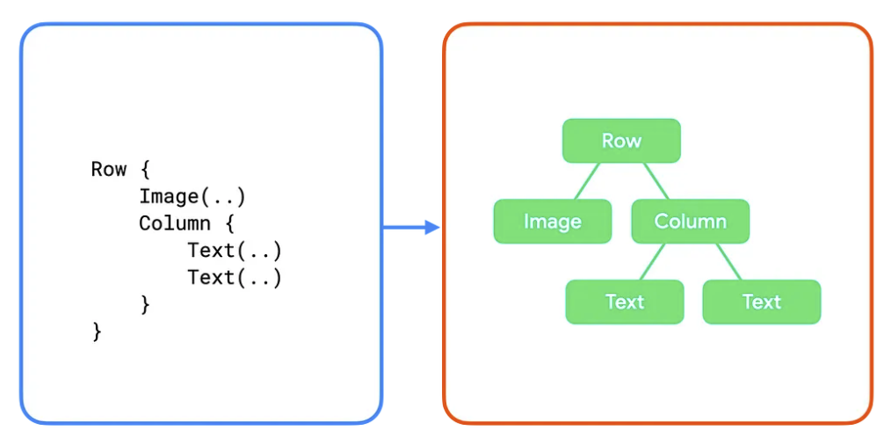
Jetpack Compose - Fazy

Slide 5
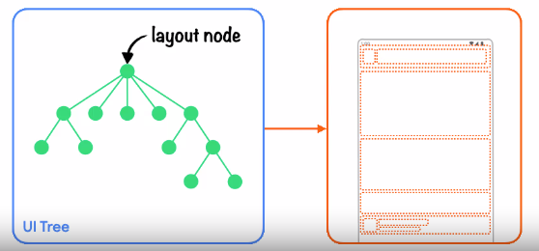
Jetpack Compose - Fazy

Slide 6
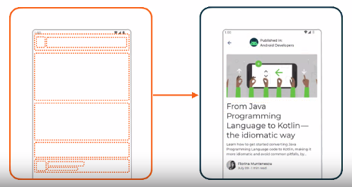
Jetpack Compose - Fazy

Slide 7
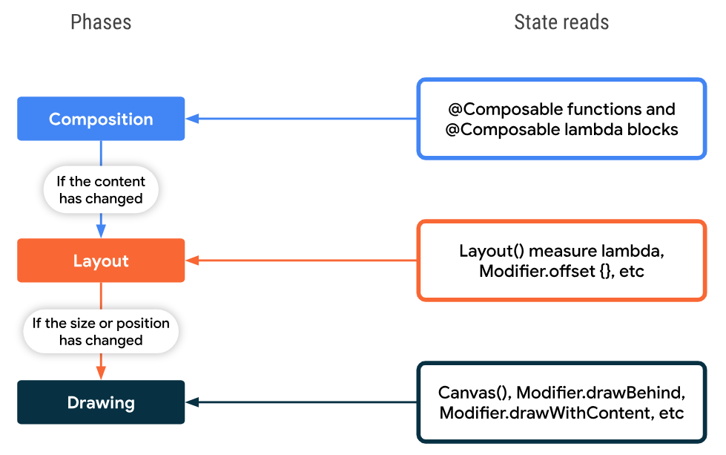
Jetpack Compose - Fazy

Slide 8
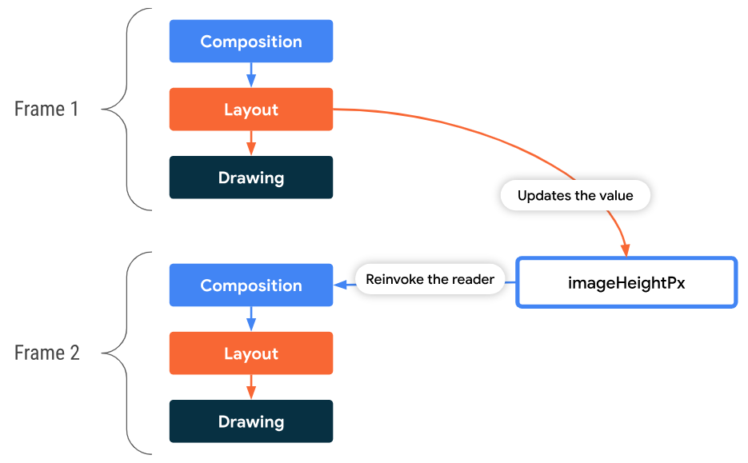
Jetpack Compose - Fazy

Slide 9
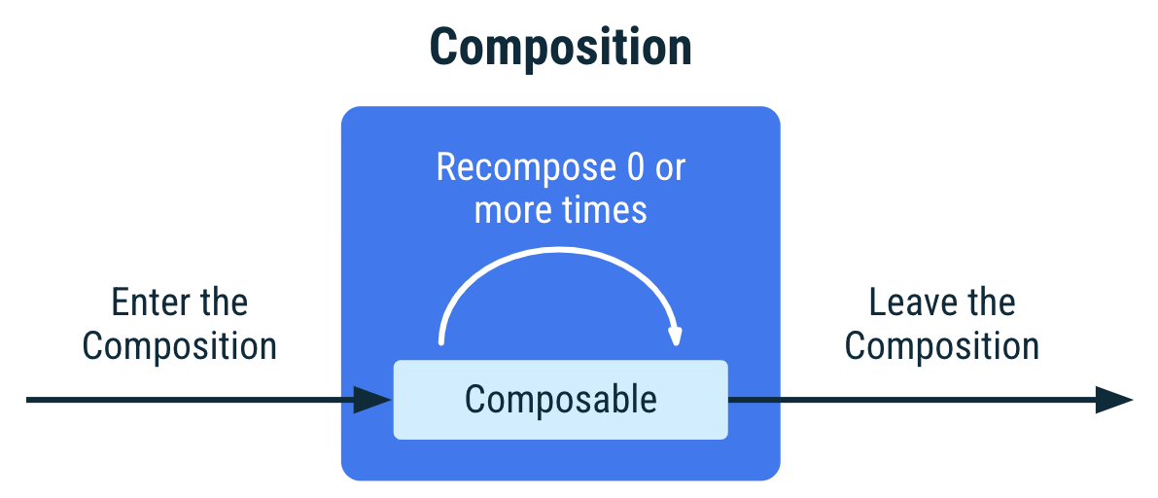
State

Slide 10
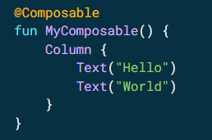
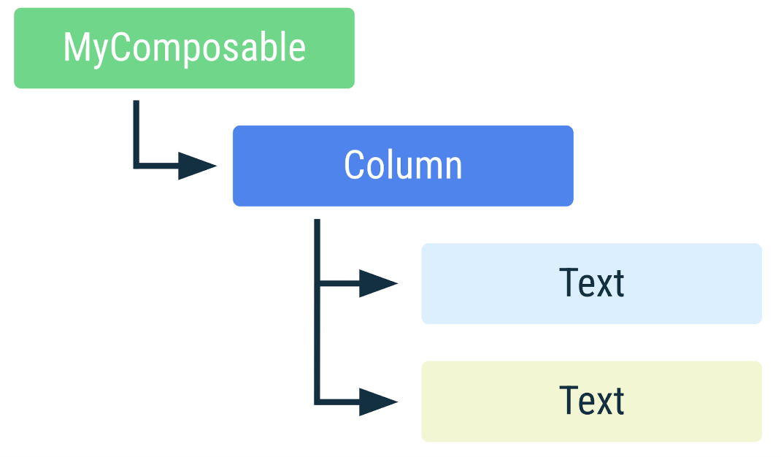
State

Slide 11

State

Slide 12
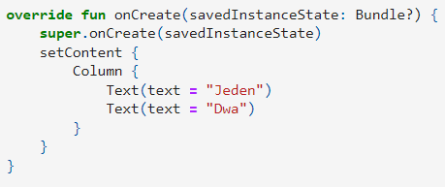
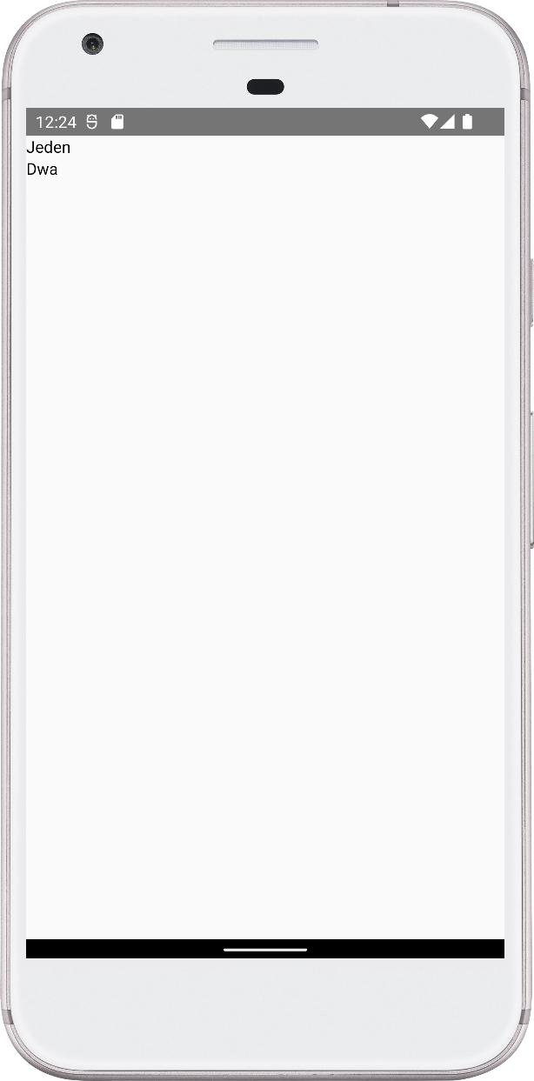
Jetpack Compose

Slide 13
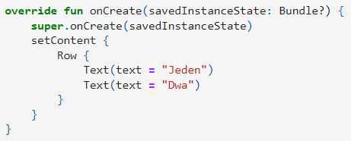
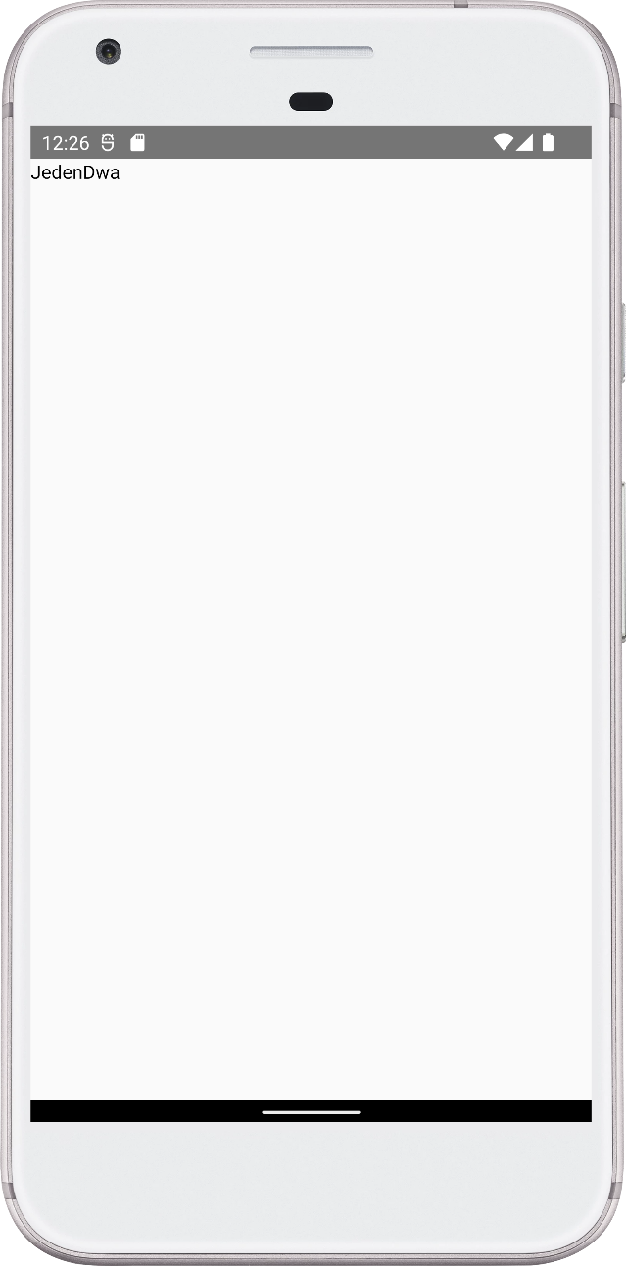
Jetpack Compose

Slide 14
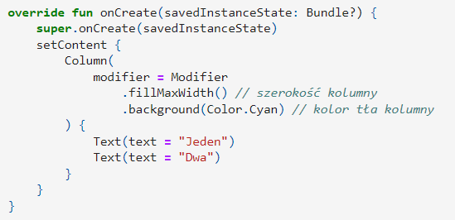
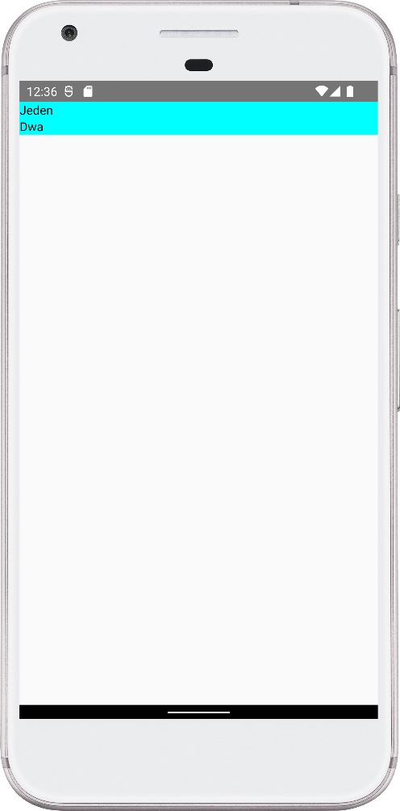
Jetpack Compose

Slide 15
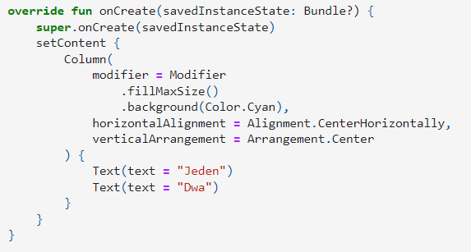
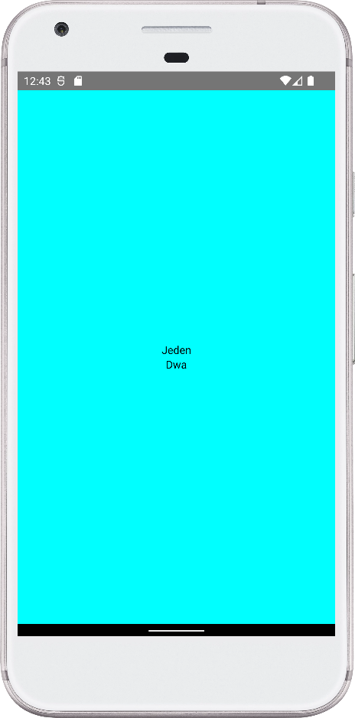
Jetpack Compose

Slide 16
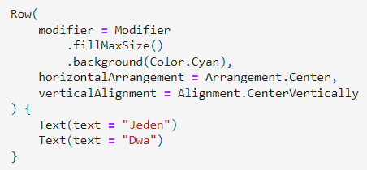
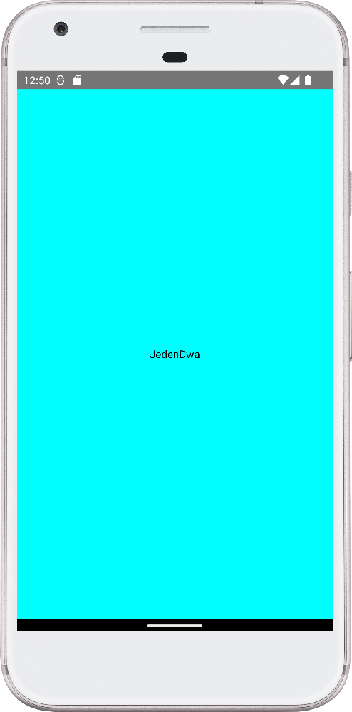
Jetpack Compose

Slide 17
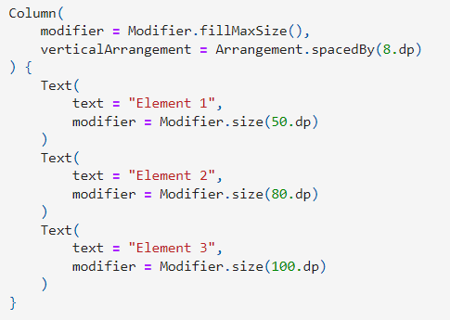
Jetpack Compose

Slide 18
Jetpack Compose

Slide 19
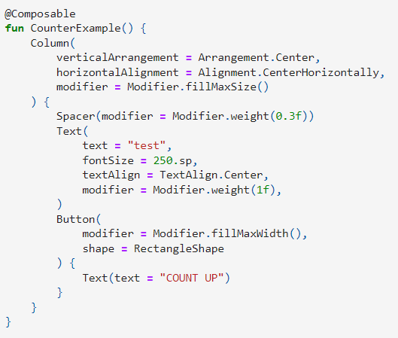
State

Slide 20
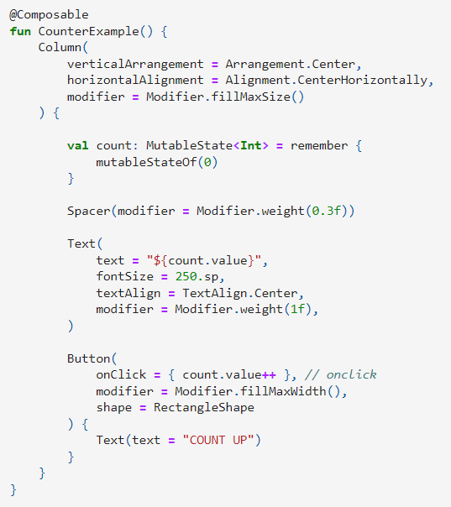
State

Slide 21
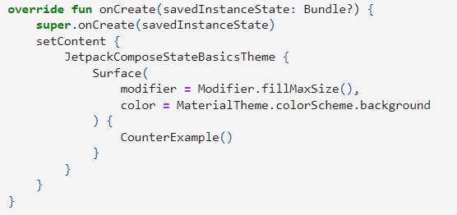
State

Slide 22

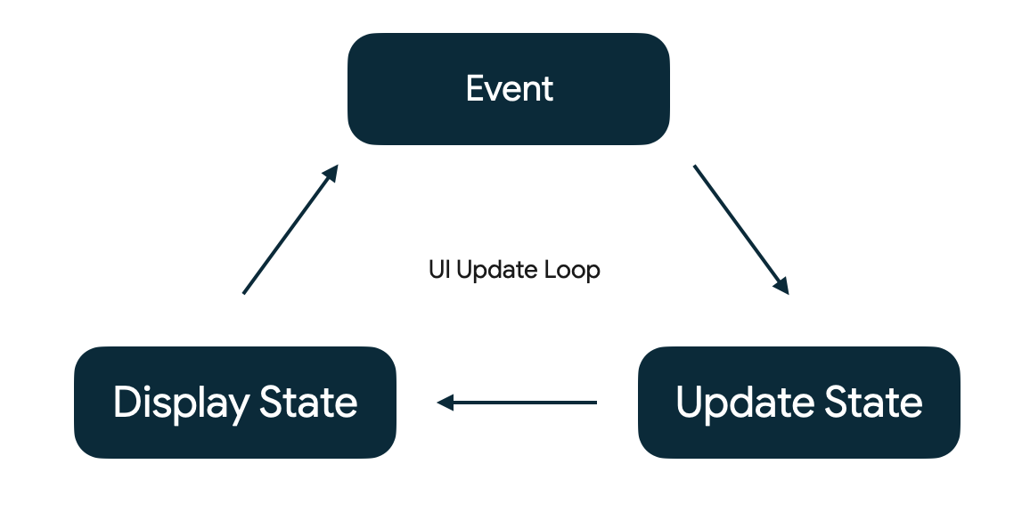
State

