Slide 1

PROGRAMOWANIE URZĄDZEŃ
MOBILNYCH
WYKŁAD 11
Bazy danych ROOM
Dao
Entity
SQL

Slide 2

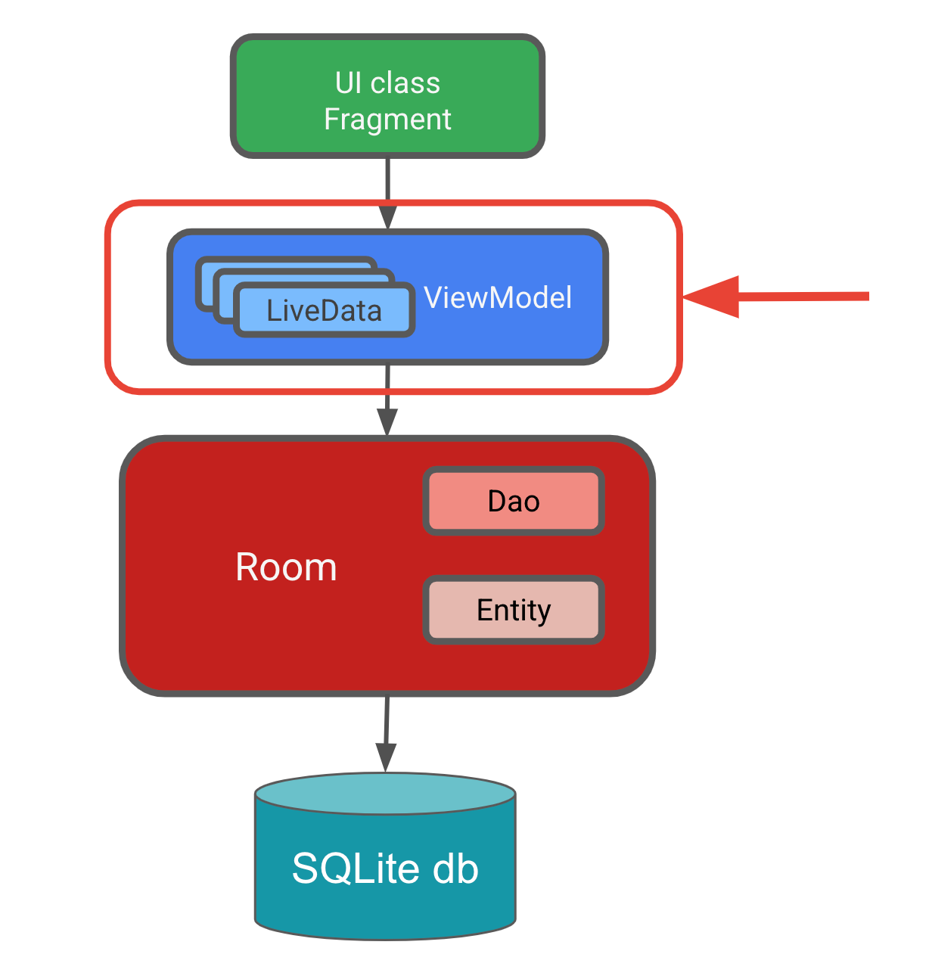
ROOM

Slide 3
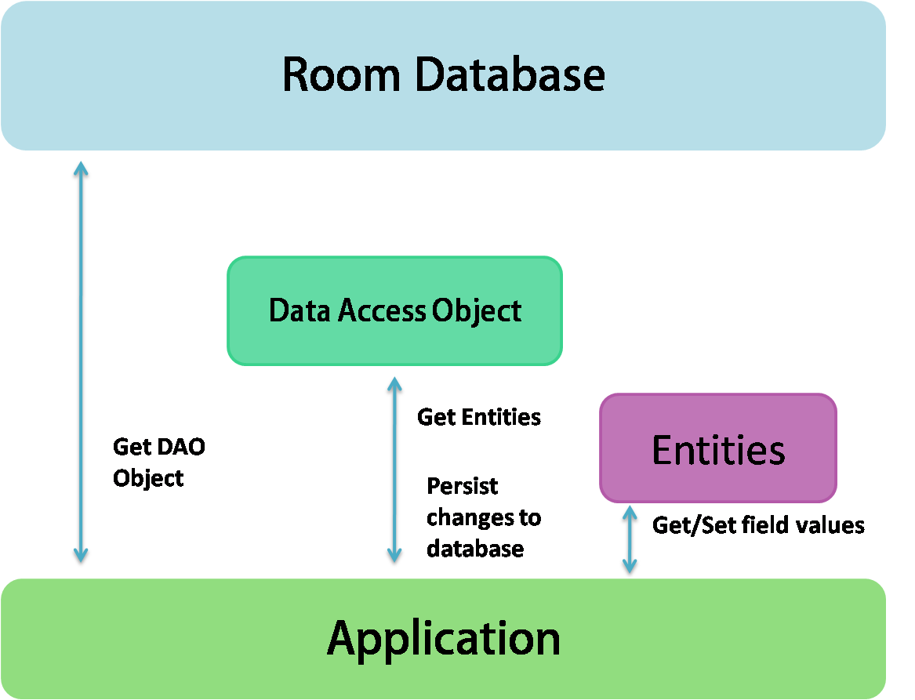
ROOM
https://www.google.com/url?sa=i&url=https%3A%2F%2Fmedium.com%2F%40kuldeepmakwana3977%2Froom-database-using-android-kotlin-8cd3cd854b15

Slide 4
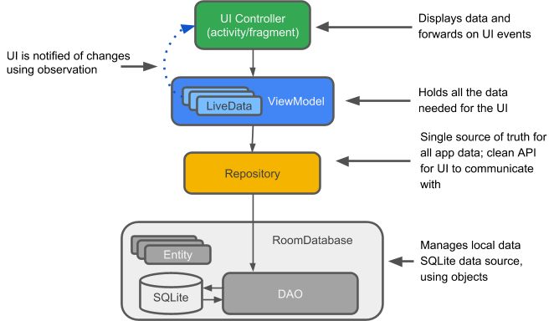
ROOM

Slide 5
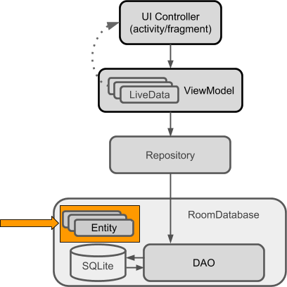
Entity
https://google-developer-training.github.io/android-developer-fundamentals-course-concepts-v2/unit-4-saving-user-data/lesson-10-storing-data-with-room/10-1-c-room-livedata-viewmodel/10-1-c-room-livedata-viewmodel.html

Slide 6
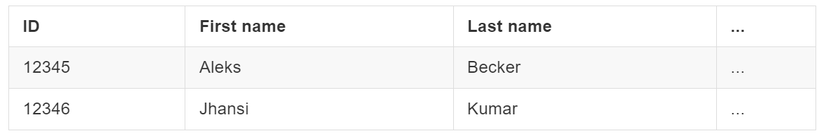
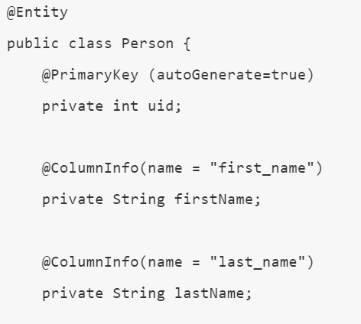
Entity
https://google-developer-training.github.io/android-developer-fundamentals-course-concepts-v2/unit-4-saving-user-data/lesson-10-storing-data-with-room/10-1-c-room-livedata-viewmodel/10-1-c-room-livedata-viewmodel.html

Slide 7
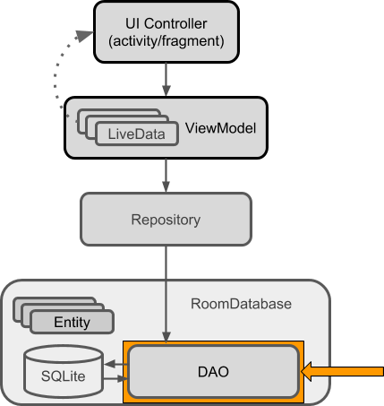
Dao
https://google-developer-training.github.io/android-developer-fundamentals-course-concepts-v2/unit-4-saving-user-data/lesson-10-storing-data-with-room/10-1-c-room-livedata-viewmodel/10-1-c-room-livedata-viewmodel.html

Slide 8
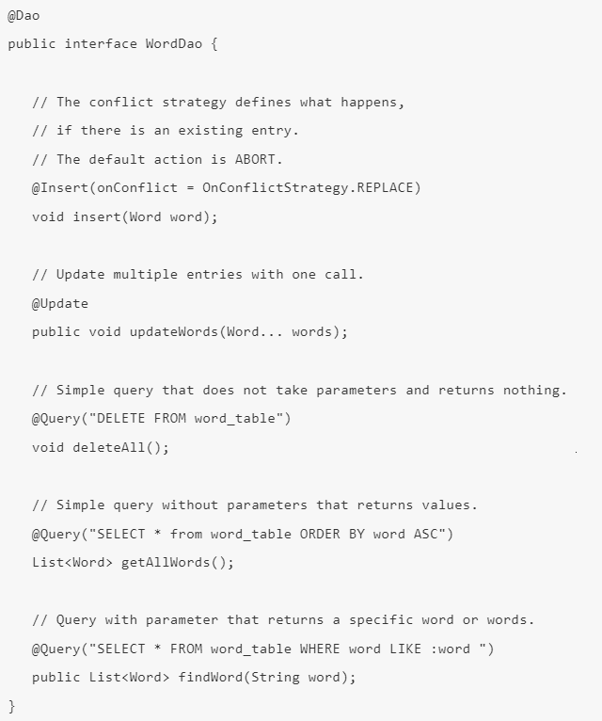
Dao
https://google-developer-training.github.io/android-developer-fundamentals-course-concepts-v2/unit-4-saving-user-data/lesson-10-storing-data-with-room/10-1-c-room-livedata-viewmodel/10-1-c-room-livedata-viewmodel.html

Slide 9
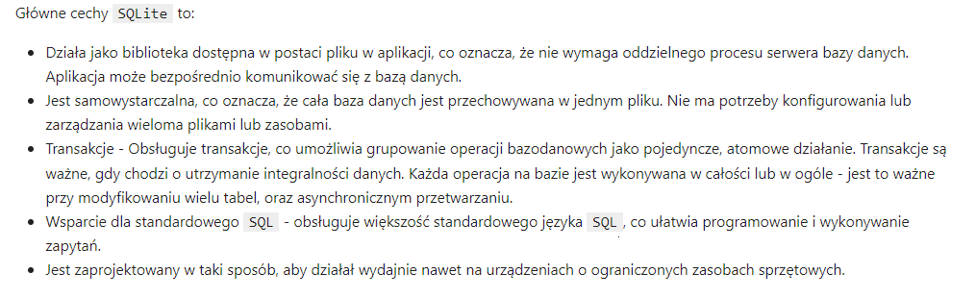
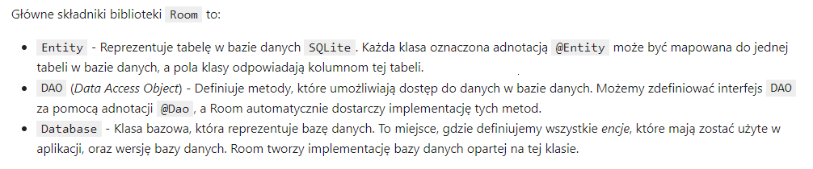
SQLite

Slide 10
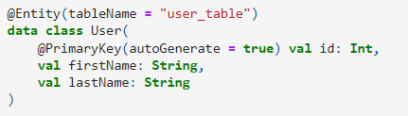
ROOM + MVVM

Slide 11
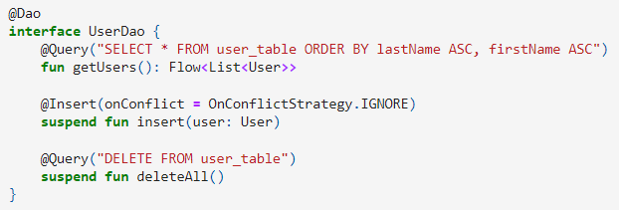
ROOM + MVVM

Slide 12
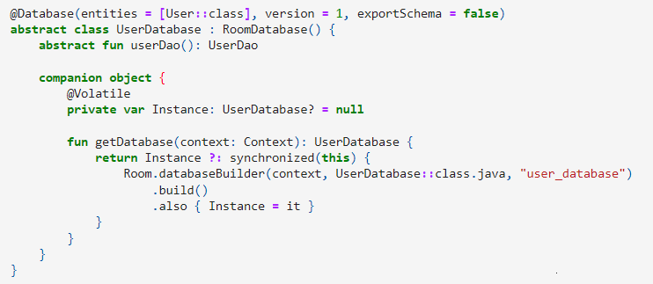
ROOM + MVVM

Slide 13
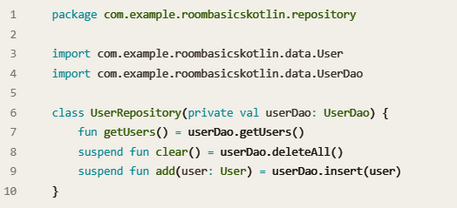
ROOM + MVVM

Slide 14
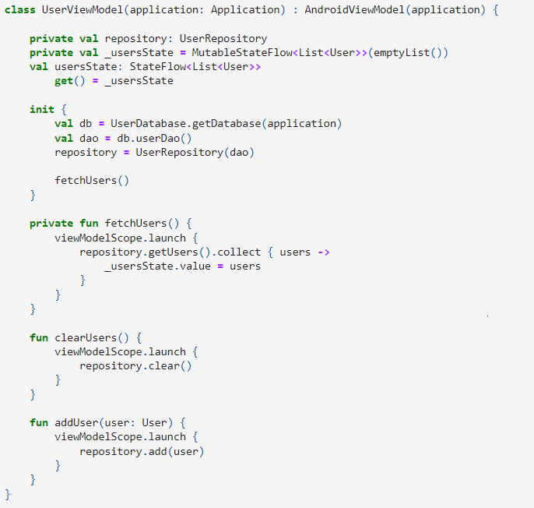
ROOM + MVVM

Slide 15
ROOM + MVVM

