Slide 1
Media Mix Modeling – Understanding Drivers of Sales
Project Objective:
Build a Media Mix Model to understand how media channels and other influencing factors (e.g., geography, competition) affect weekly sales performance.
Business Context: While attribution is key, the primary goal is to measure effectiveness
Deliverables:
Clean, interpretable regression model.
Granular insights by media channel, geography, and time.
A base framework for validation and future extensions.

Slide 2

Data Preparation and Feature Design
Data Overview:
6,240 weekly records across 40 geographic regions.
No missing or duplicate valuesEDA_2_enhanced.
Preprocessing:
Converted date to extract year, month, quarter, week.
Removed impressions due to high collinearity with spend — spend better reflects strategic intentReport.
Feature Engineering:
geo → dummies (fixed regional effects). To capture fixed regional effects, such as differences in base sales levels, local consumer behavior, infrastructure, and historical media responsiveness.
Seasonality: month_sin and month_cos to model cyclical patterns.

Slide 3
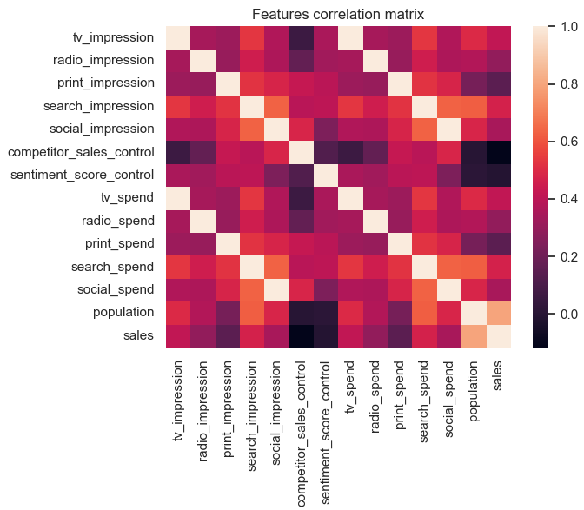
Understanding Which Variables Explain Sales
Pearson Correlation Analysis
A full correlation matrix was computed among all numerical features.
Key correlations with the target variable sales:
Population
search_spend
tv_spend
competitor_sales_control
Takeaways:
Population: Essential control variable; adjusts for market size differences, ensuring that media coefficients reflect relative effectiveness, not scale.
Competitor Activity: Negative and significant — confirms business intuition that aggressive competition in a region hurts our sales.
Sentiment: Weak signal, though still included for completeness and to control potential macroeconomic mood.

Slide 4
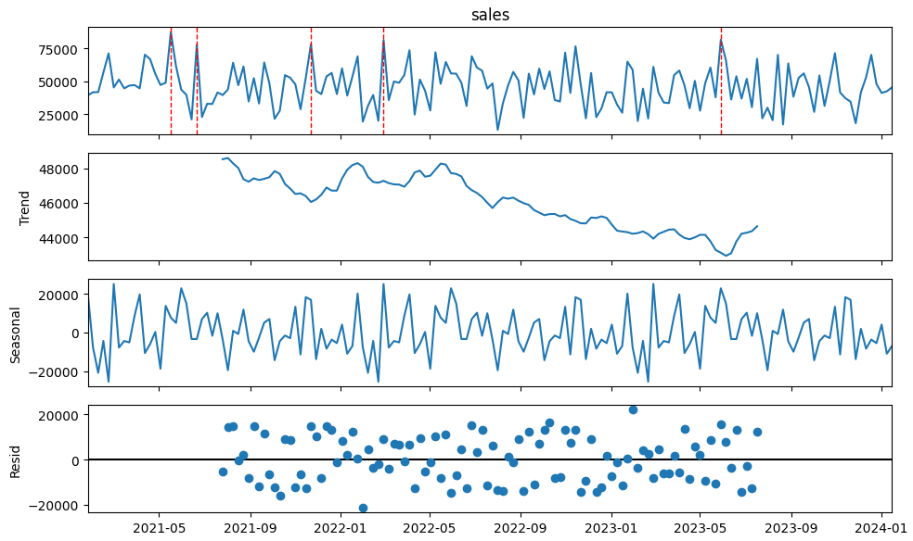
Understanding Temporal Patterns Before Modeling
Time Series Decomposition
Applied additive decomposition on weekly sales from Geo0 (as a representative region).
Found clear temporal structure:
Trend: Slight downward trend from mid-2022 to late 2023.
Seasonality: Strong weekly cycles, visible across all years.
Residuals: Randomly distributed, with some spikes—likely due to promotions or external events.
Outlier Detection
Boxplot of weekly sales highlighted extreme spikes, possibly from:
Specific campaigns.
Regional anomalies.
Season-driven demand (e.g., holidays or end-of-year boosts).
Seasonality Features in the Model
Introduced cyclical variables month_sin and month_cos to:
Capture monthly seasonality as a smooth cycle.
Prevent artificial gaps between months like December and January.
Enable the model to learn temporal rhythm without relying on linear time assumption

Slide 5

What Analysis Was Performed and Why
Type of Analysis:
A Media Mix Modeling (MMM) approach using regression analysis.
Why OLS Fits MMM:
Ordinary Least Squares (OLS) regression provides:
Transparent, interpretable coefficients, ideal for ROI analysis.
Compatibility with domain-based transformations like adstock and saturation.
Strong diagnostic tools to validate assumptions (residuals, significance, multicollinearity).
Allows for granular insights without requiring overly complex or black-box modeling.
Data Used:
6,240 weekly observations across 40 geographic regions.
Variables included:
Media spend (TV, Radio, Print, Search, Social)
Control features (population, competitor activity, sentiment)
Time features (month, week, quarter)
Geographical identifiers

Slide 6
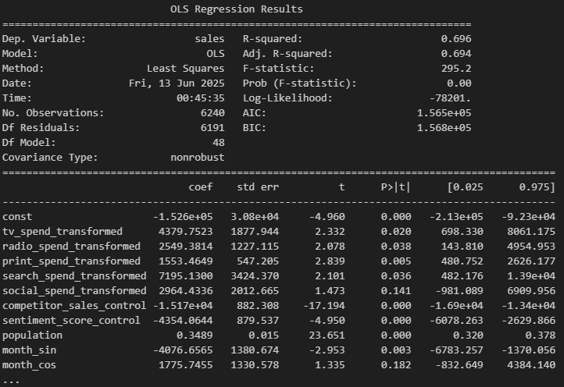
What the Regression Tells Us About Sales Drivers
Model Performance and Insights
The model explains almost 70% of weekly sales variation — a strong result that supports the credibility of its insights.
Key Findings:
TV, Print, and Search: positively and significantly linked to sales.
Social: not significant globally — may depend on region or timing.
Control Variables:
Population: strongest baseline driver — bigger regions sell more.
Competitor Activity: clearly negative effect on our sales.
Sentiment: statistically relevant, but low practical impact.

Slide 7
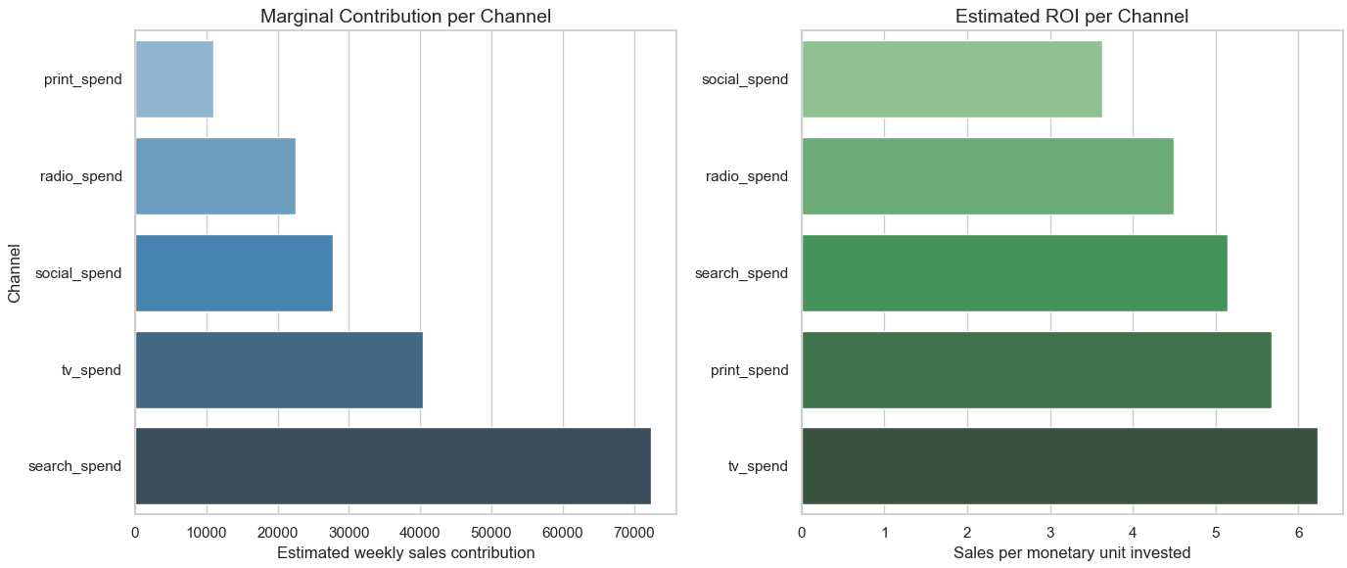
ROI & Contribution Analysis
Channel Effectiveness at Global and Local Levels
What Was Calculated:
For each media channel:
Contribution = model coefficient × avg transformed spend
ROI = Contribution / avg actual spend
Global Results:
TV: ROI = 6.23 | Contribution = 45,166
Print: ROI = 5.68 | Contribution = 10, 995
Radio: ROI = 4.49 | Contribution = 22, 575
Localized Insight:
Generated a detailed CSV with ROI and Contribution per channel, geo, year, month, and quarter.
Example findings:
Print performs exceptionally well in Geo9 during Q4.
Radio has higher ROI in some smaller regions vs. national average.

Slide 8

Conclusions
What We Learned From the Model
The model captures real, interpretable relationships between spend and sales.
Media effectiveness varies widely across channels and regions — a global ROI is not enough.
Population and competitor activity are essential to isolate true media impact.
Seasonality plays a meaningful role — incorporated smoothly via cyclical features.
The model provides a solid base for strategic and tactical marketing decisions, even if not predictive.

Slide 9

Next Steps and Potential Enhancements
Modeling Enhancements:
Tune adstock decay per channel (instead of fixed 0.5).
Use Hill functions for nonlinear saturation.
Introduce Bayesian hierarchical models for uncertainty per region.
Add RNN models (LSTM/GRU) for forecasting weekly sales per geo-channel.
Operational Improvements:
Build interactive dashboards (Streamlit / Power BI) for scenario planning.
Simulate budget shifts and visualize expected ROI by region and quarter.
Validation:
Backtesting on historical campaign periods (e.g., Q4 2022).
Scenario-based sanity checks for coefficient realism.
Optional: run controlled geo-budget experiments to validate ROI guidance.

