Slide 1
HANGMAN
PROJECT 03 Group Members: Faculty: Rafa Tasnim Ahmed Wasif Reza 2019-1-60-081
Associate Professor Malyha Bintha Mabud East West University 2019-1-60-128
Humaira Anan Neela 2019-1-60-218

Slide 2
How to play:
It’s a simple Hangman game. The player has to guess the letters int the word. If you get a letter wrong , a body part ill added to the hangman. There are three levels (easy , medium, hard)
Maximum 10 mistakes are allowed for easy level, 6 mistake allowed for medium level and 4 mistakes are allowed in hard level All alphabet are in lower case except the first letter. If you enjoy continue, otherwise close it. Syntax : Alphabet Example : Ab.

Slide 3
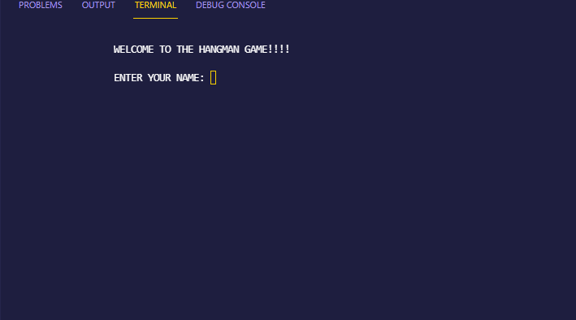
Start game:

Slide 4
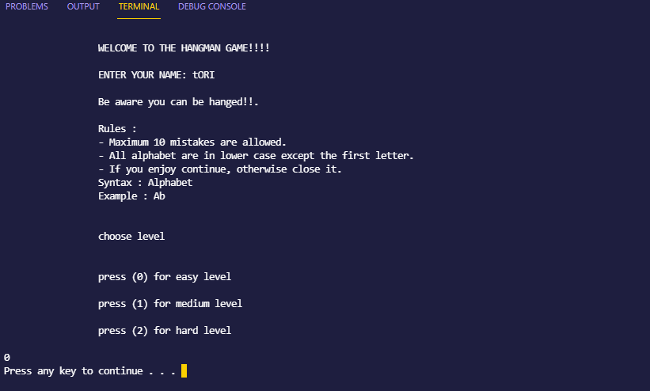
Level Choose:

Slide 5
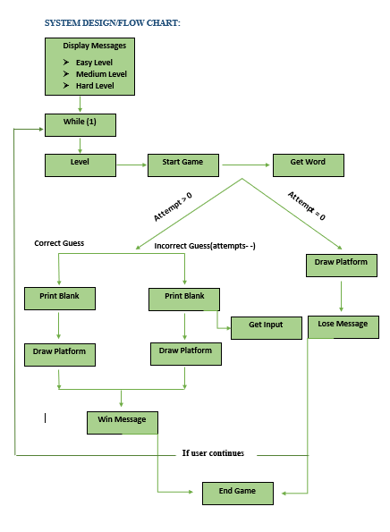
If user continues

Slide 6
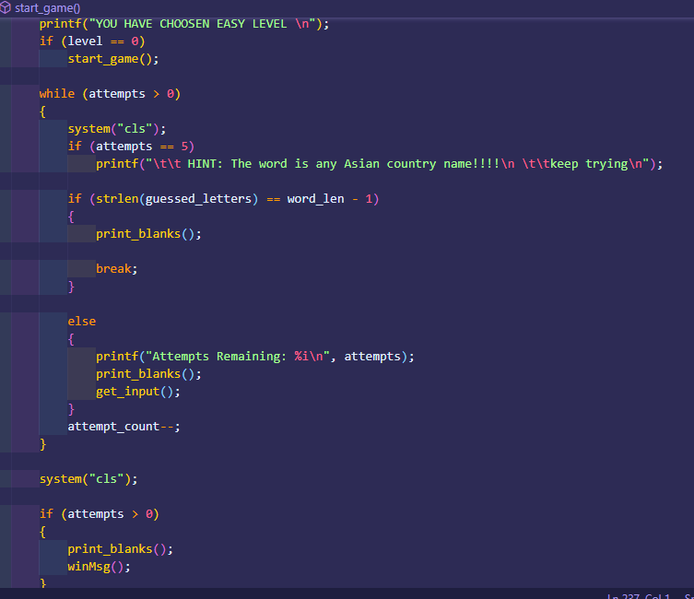
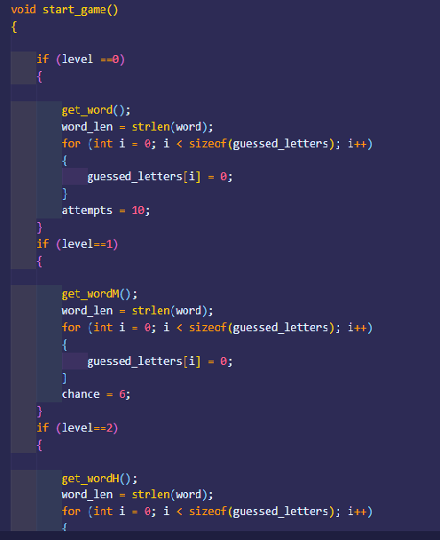

Slide 7
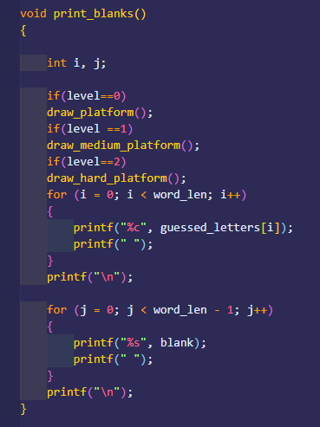
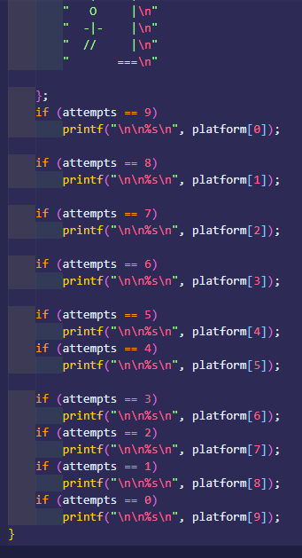
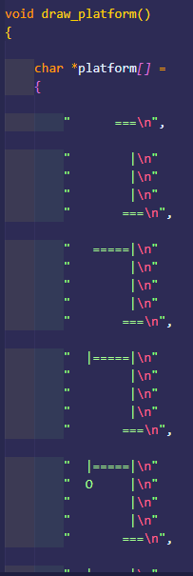

Slide 8
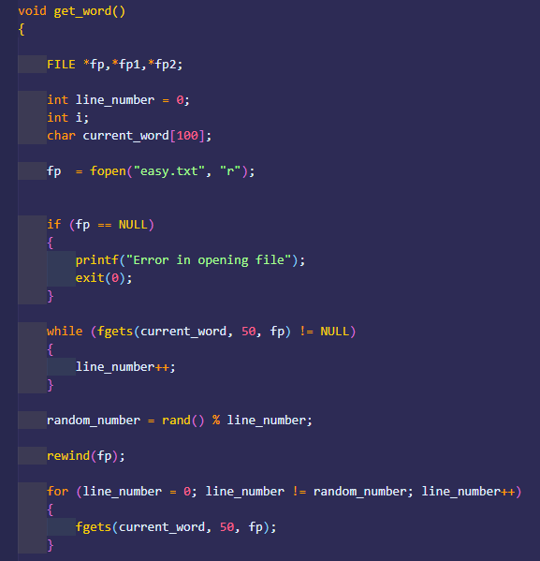
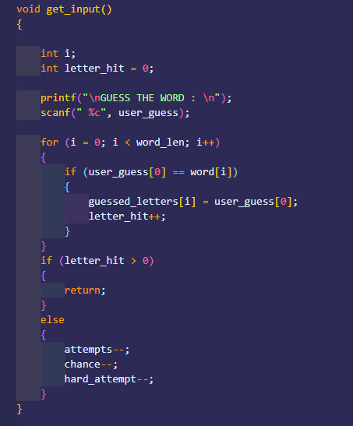
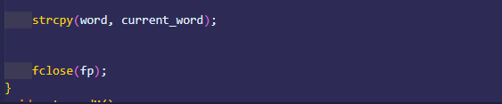

Slide 9
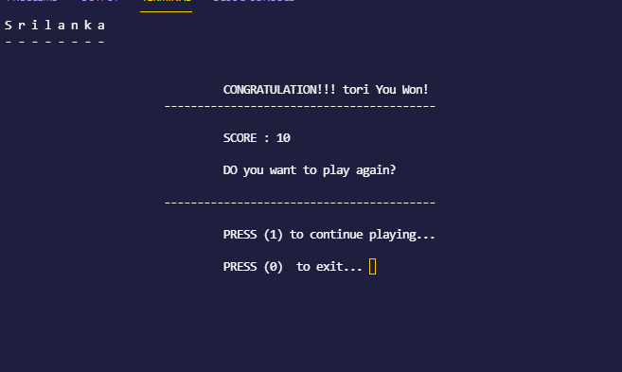
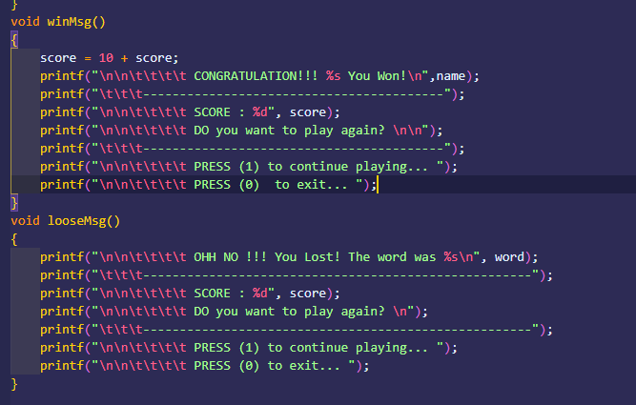
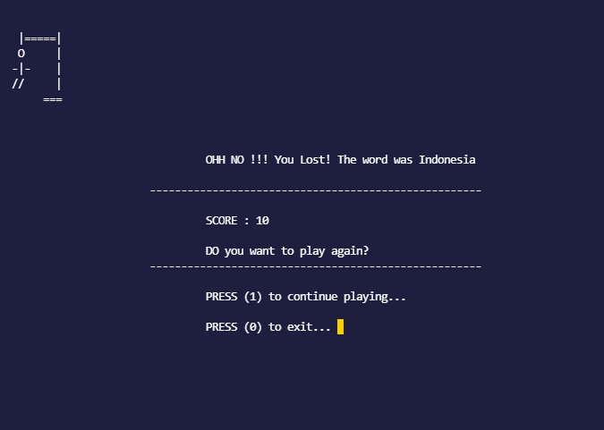

Slide 10
THANK YOU SIR

