Slide 1
MIMIC Multimodal Fusion
Predicting ICU mortality from first-day vitals, labs and clinical notes
Notes:
Code: <paste the shared link to the code here> The notebook (and the PDF of it) is the full tutorial. To rerun it you need MIMIC-III v1.4 access. Set DATA_DIR in the first code cell to the folder with the csv.gz files and run top to bottom. CHARTEVENTS takes ~15 minutes and the ClinicalBERT step needs a GPU (a Colab T4 works). In this tutorial we predict in-hospital mortality from the first 24 hours of an ICU stay, once with the numbers, once with the notes, and then with both combined.

Slide 2
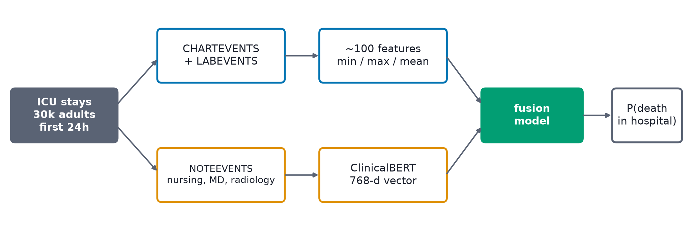
OVERVIEW
What we're building
Two kinds of data from the first 24 hours of an ICU stay, a model for each, and then a model that uses both.
WHY IT MATTERS Clinicians look at the numbers and read the notes. Most mortality models only use the numbers, so the question is whether the notes add anything.
Notes:
The outcome is in-hospital death (HOSPITAL_EXPIRE_FLAG in ADMISSIONS). We only use data from the first 24 hours in the ICU, so the model could actually be used at hour 24. The top path is the structured data and the bottom path is the text. At the end we combine them.

Slide 3
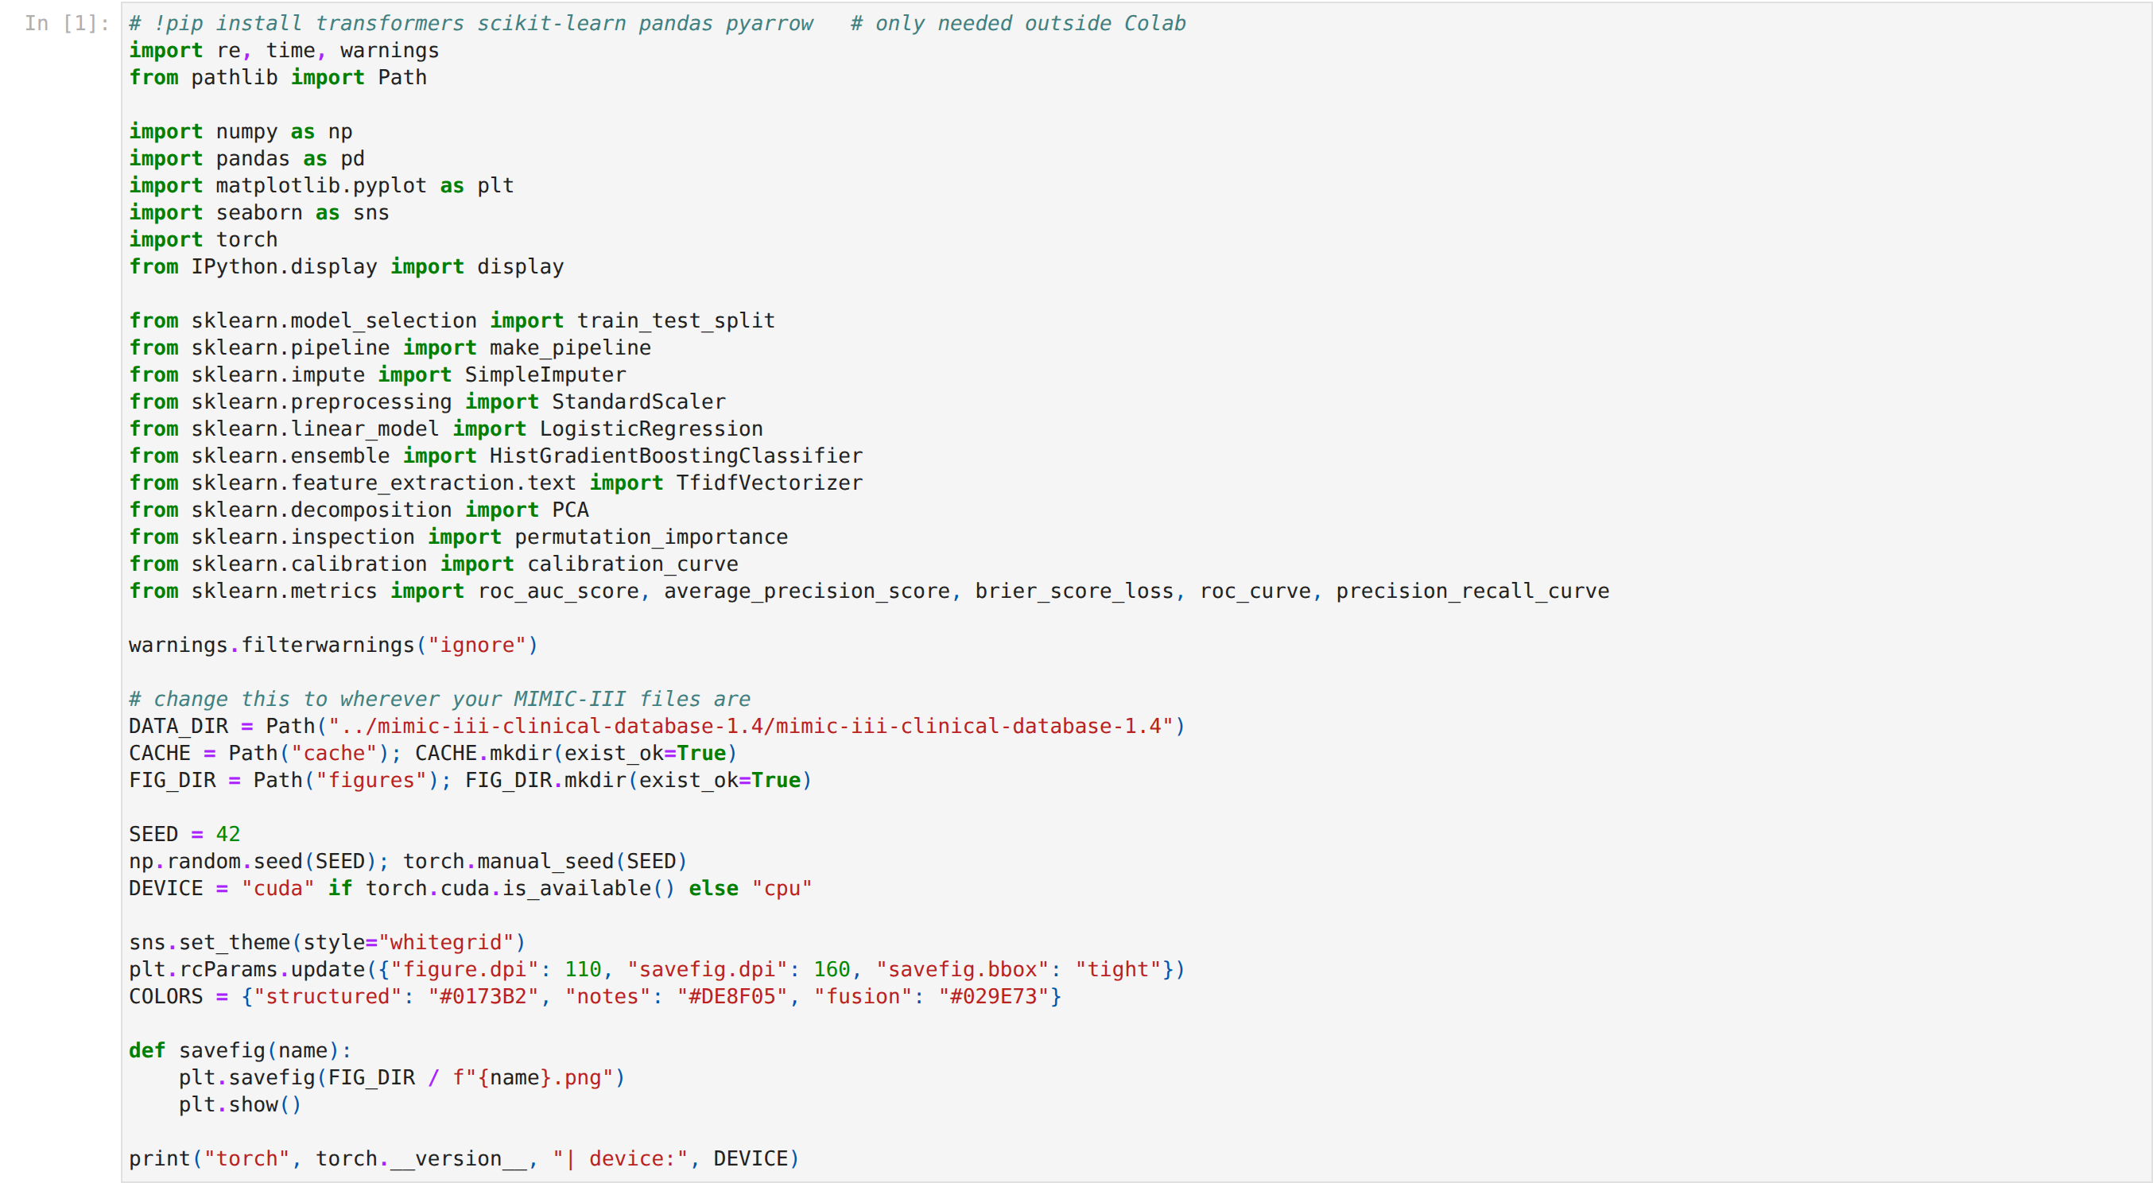
STEP 1 · SETUP
Imports and settings
Everything is standard pandas / scikit-learn / PyTorch / transformers. DATA_DIR is the only thing you need to change.
WHY IT MATTERS Big intermediate results are cached in cache/, so if something breaks later you don't redo the slow steps.
Notes:
If you're in Colab, upload or mount the MIMIC-III files and set DATA_DIR to that folder. Turn on a GPU runtime before you start, the ClinicalBERT step needs it. The seed is fixed so the split and models come out the same every time.

Slide 4
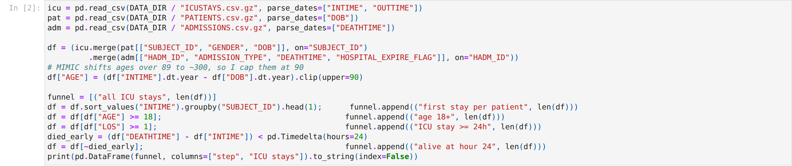
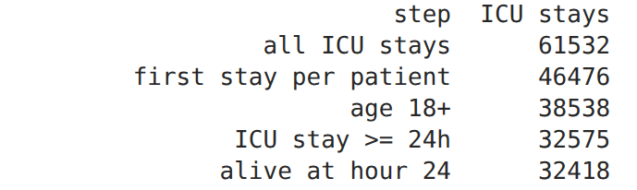
STEP 2 · ICUSTAYS + PATIENTS + ADMISSIONS
Building the cohort
Joins the three tables, then applies the exclusion rules one at a time and prints how many stays are left.
WHY IT MATTERS First stay per patient means the same person can't be in train and test. Dropping patients who die before hour 24 avoids predicting something we already know.
Notes:
Age is computed from DOB and INTIME. MIMIC shifts anyone over 89 to around 300, so I cap at 90. LOS in ICUSTAYS is in days, so LOS >= 1 means the stay is at least 24 hours long.

Slide 5
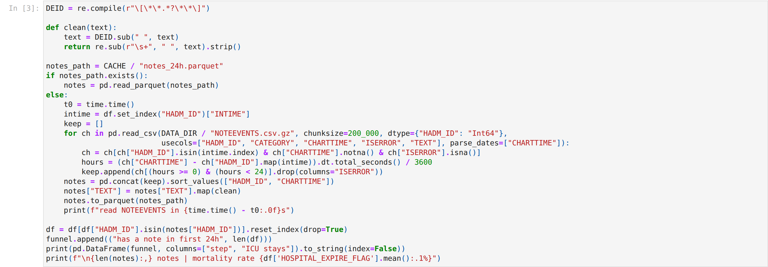
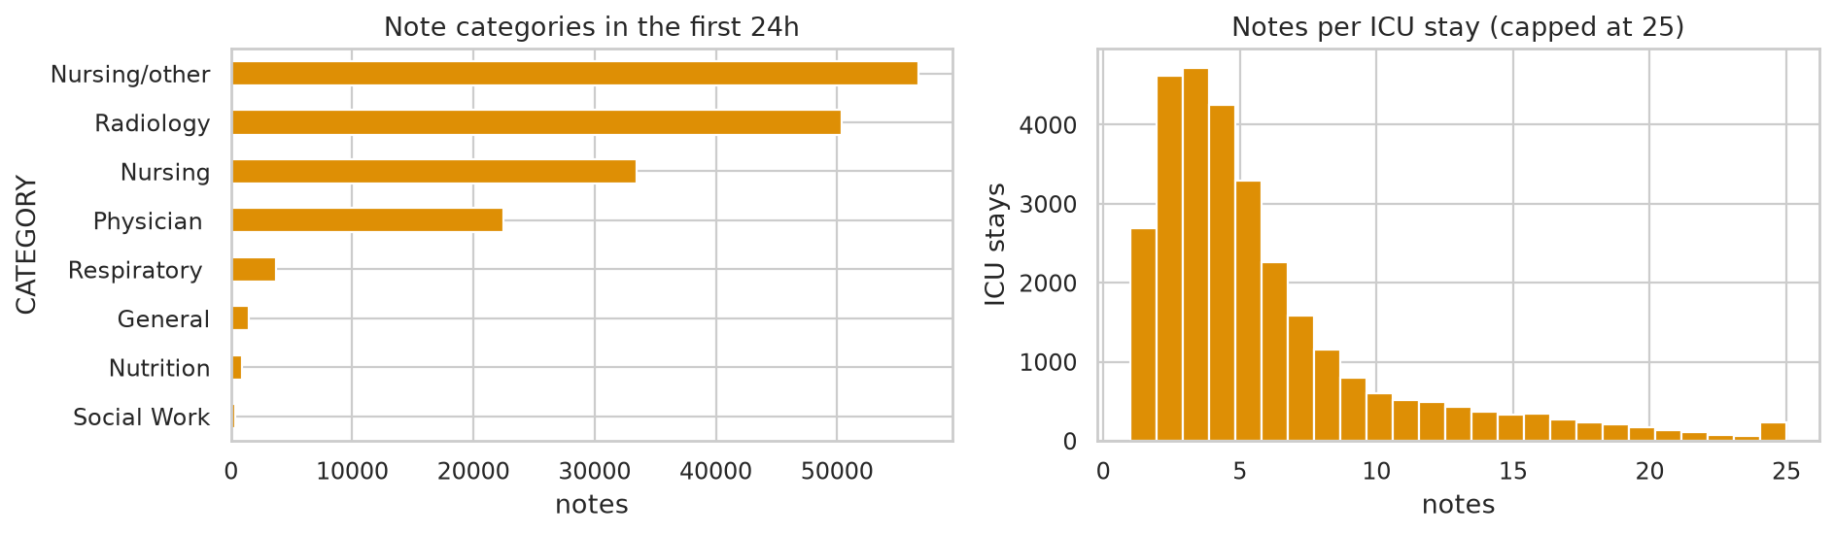
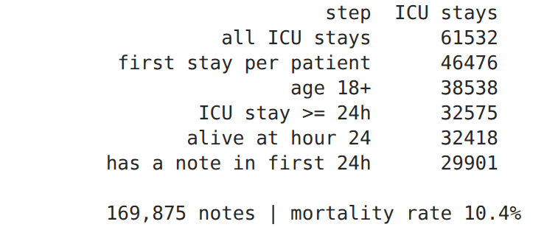
STEP 3 · NOTEEVENTS
Notes from the first 24 hours
Reads NOTEEVENTS in chunks and keeps notes with a CHARTTIME between ICU admission and hour 24.
WHY IT MATTERS 29,901 stays have at least one note (169,875 notes, about 6 per stay). Mortality is 10.4%. Requiring a CHARTTIME keeps discharge summaries out, since they basically state the outcome.
Notes:
This is the most important leakage check in the whole project. Discharge summaries are written at the end of the stay and basically state the outcome, but they only have a CHARTDATE, so requiring a CHARTTIME drops them. I strip the [** **] de-id placeholders and never print any note text.

Slide 6
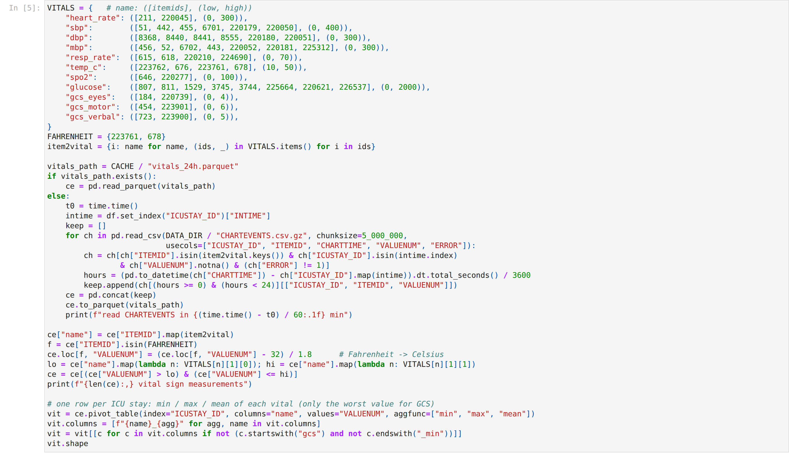

STEP 4 · CHARTEVENTS
Vital signs
Pulls 11 vitals (both CareVue and MetaVision ITEMIDs), removes impossible values, and takes min / max / mean per stay.
WHY IT MATTERS CHARTEVENTS has 330M rows. Reading only four columns and filtering each chunk keeps memory low.
Notes:
The ITEMIDs come from the first_day_vitals query in the MIMIC code repository. Most vitals have two or more ITEMIDs because the hospital switched charting systems. Temperature in Fahrenheit gets converted to Celsius. For GCS I only keep the worst (minimum) value.

Slide 7
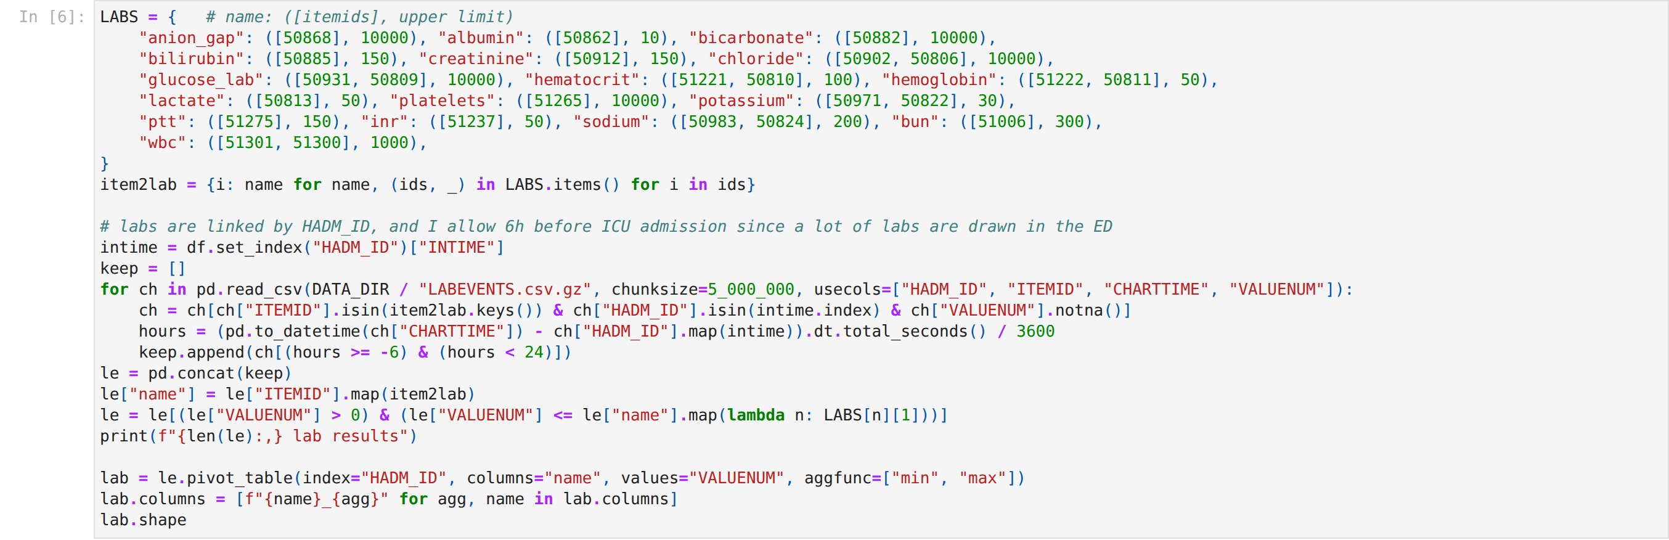
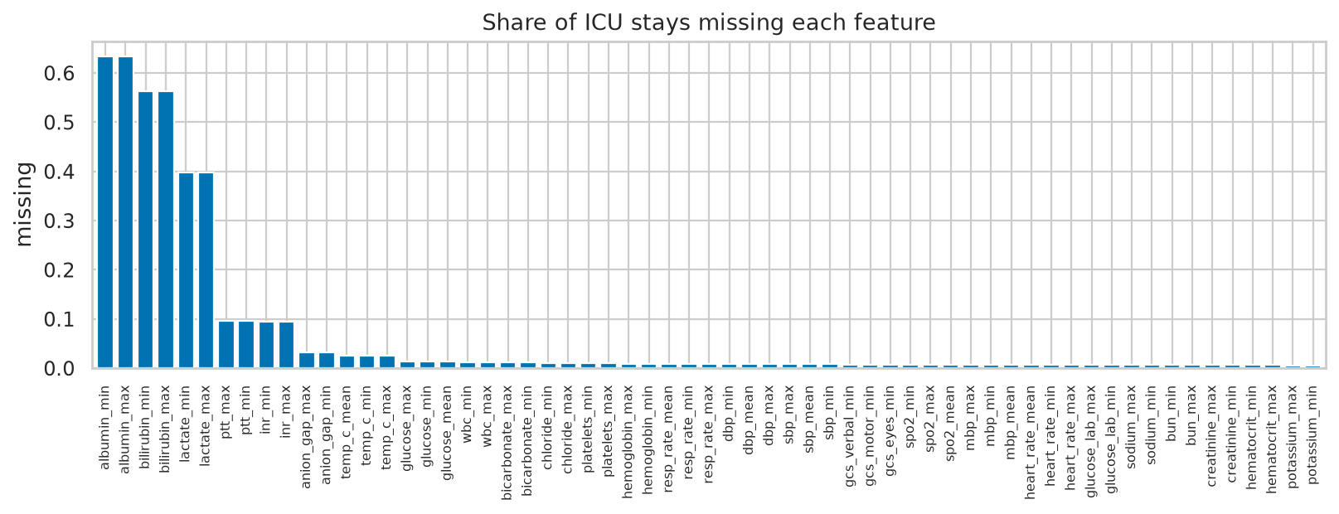
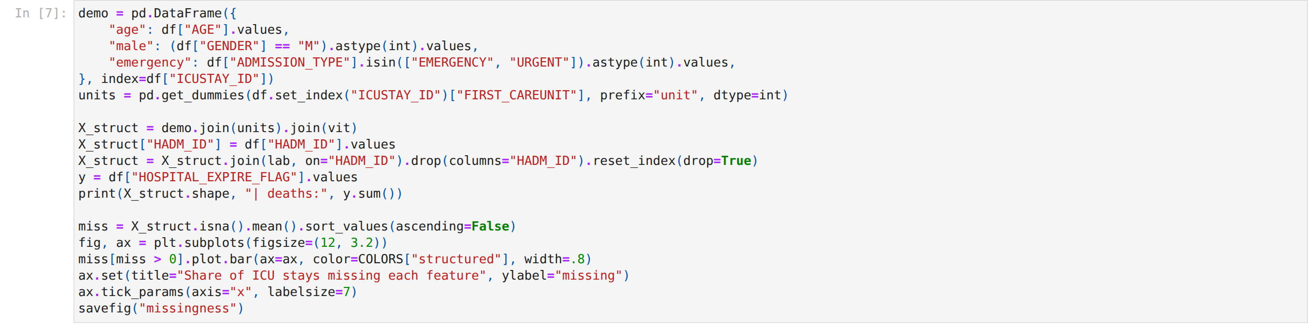
STEP 5 · LABEVENTS
Labs and the feature table
Same idea for 17 labs (6h before ICU admission to hour 24), then everything is joined into one row per stay.
WHY IT MATTERS Missing labs are left as NaN on purpose. Lactate or albumin often isn't measured, and that itself says something.
Notes:
Labs are linked by HADM_ID instead of ICUSTAY_ID, and many are drawn in the emergency department before the patient reaches the ICU, which is why the window starts 6 hours early. The missingness plot shows that a few labs are missing for most patients.

Slide 8
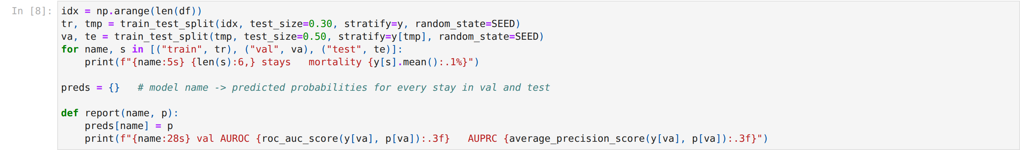
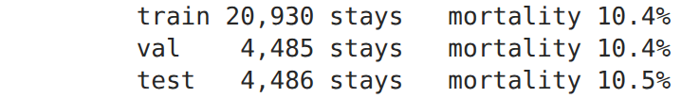
STEP 6 · SPLIT
Train / validation / test
70 / 15 / 15, stratified so each set has the same mortality rate.
WHY IT MATTERS The validation set picks hyperparameters and fusion weights. The test set is only used once at the end.
Notes:
The report helper stores each model's predictions in a dictionary, so all the models can be compared at the end with the same code.

Slide 9
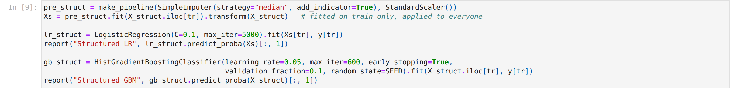
STEP 7 · STRUCTURED BASELINES
Logistic regression and gradient boosting
Logistic regression needs imputing and scaling first. Gradient boosting handles NaN by itself.
WHY IT MATTERS Gradient boosting wins on validation (AUROC 0.890 vs 0.868). It can learn that both very low and very high values are bad, which a linear model can't.
Notes:
add_indicator=True adds a 0/1 column for each feature that had missing values, so the linear model can still use the missingness. Everything is fitted on the training rows only and then applied to everyone.

Slide 10
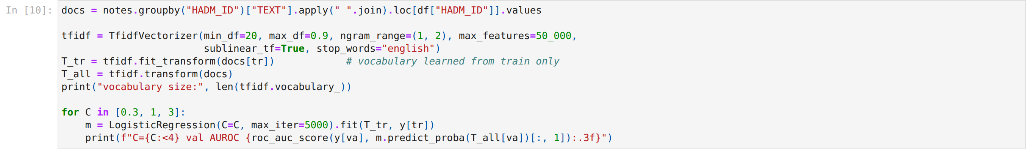
STEP 8 · NOTES BASELINE
TF-IDF + logistic regression
Joins each stay's notes into one document, builds a TF-IDF matrix of words and word pairs, and tunes C on validation.
WHY IT MATTERS Plain bag-of-words on the notes gets a validation AUROC of 0.879, almost as good as all the vitals and labs.
Notes:
min_df=20 means a word has to show up in at least 20 different stays, which removes typos and anything rare. The vectorizer is fitted on the training documents only.

Slide 11
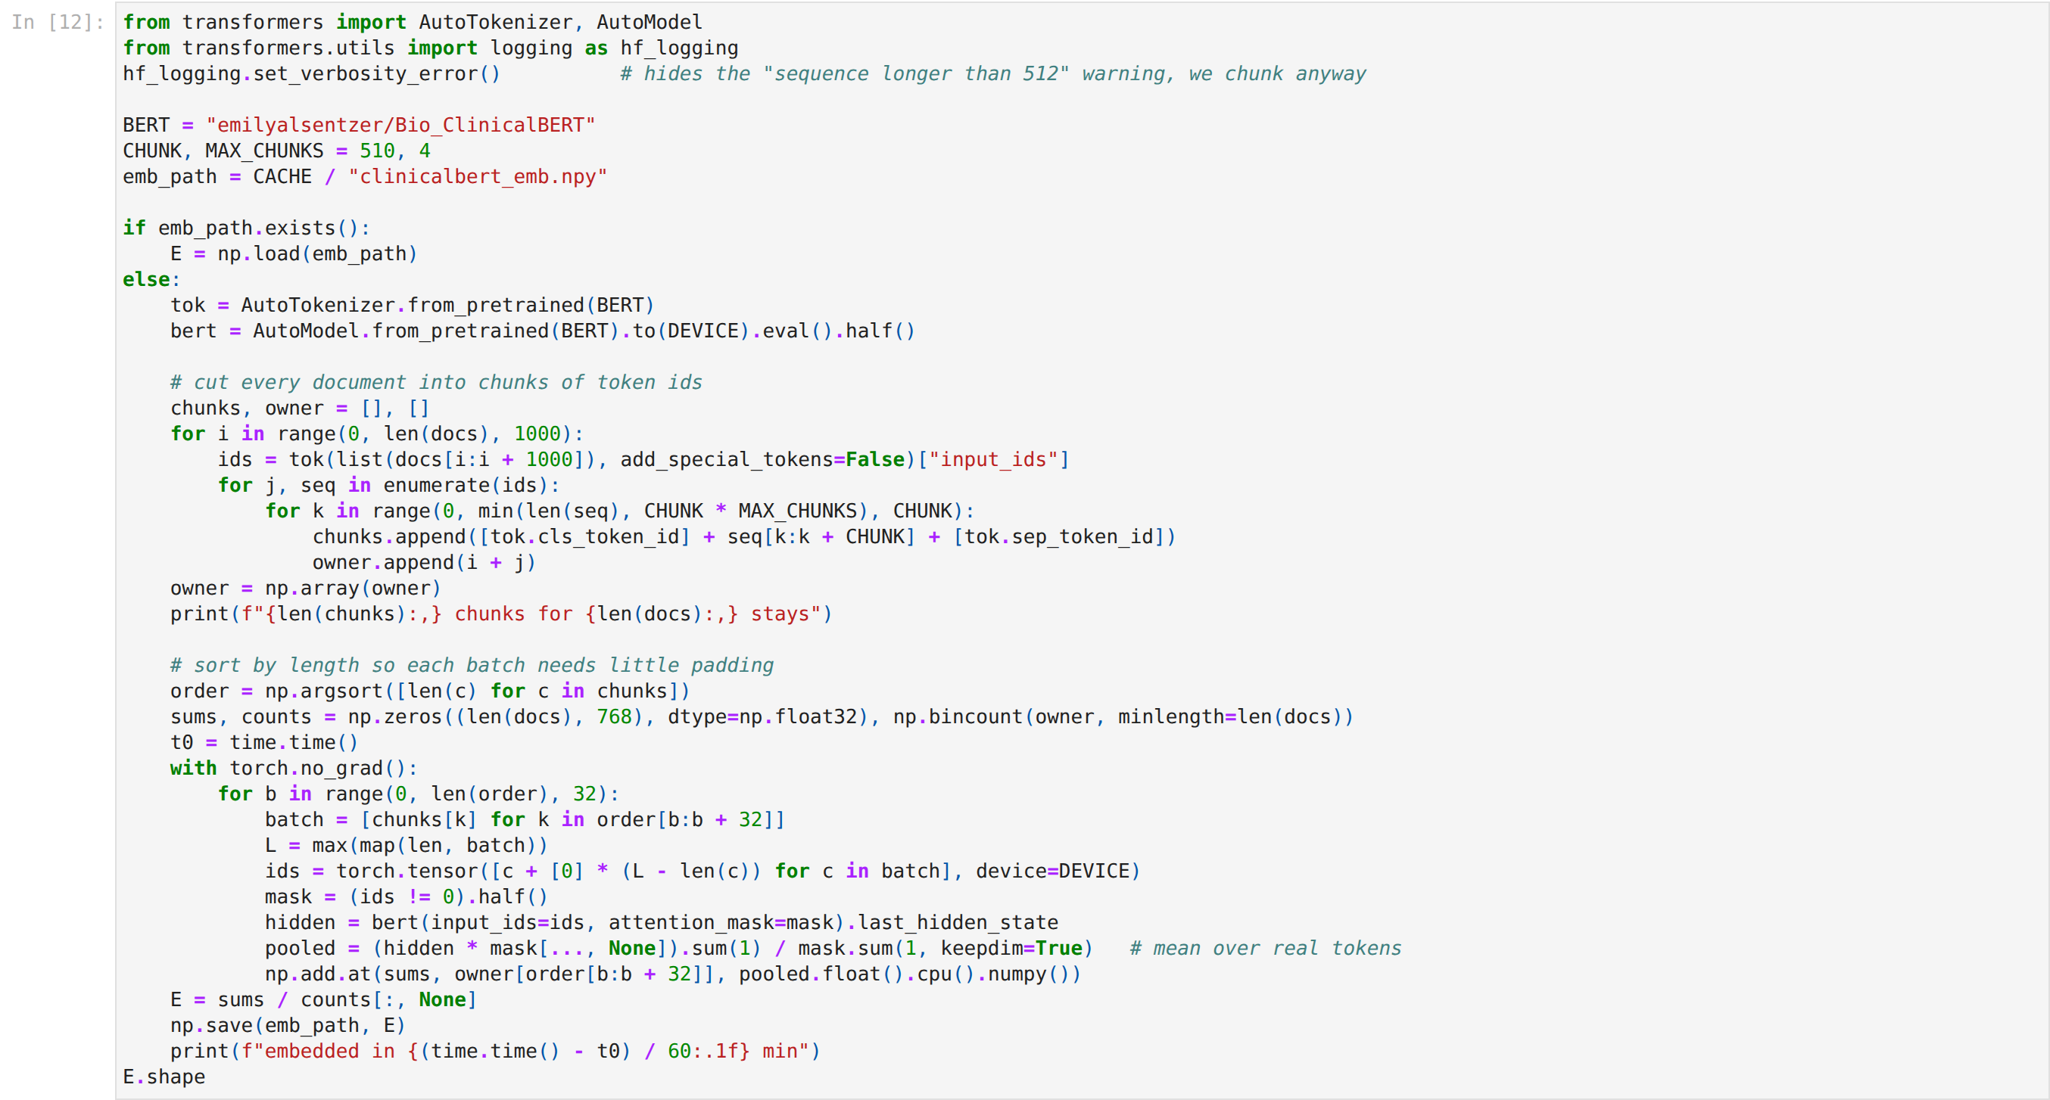
STEP 9 · BIO_CLINICALBERT
Turning notes into vectors
Splits each document into 512-token chunks, runs them through ClinicalBERT and averages the token vectors.
WHY IT MATTERS 92,604 chunks embedded in 2.7 minutes on a GPU. But frozen ClinicalBERT only reached 0.821, worse than TF-IDF. Averaging everything into one vector loses detail.
Notes:
BERT can only read 512 tokens at once, so long documents are cut into pieces and the piece vectors are averaged. We don't fine-tune BERT here, it's used frozen as a feature extractor, which only needs one forward pass. Sorting chunks by length before batching cuts down on padding.

Slide 12
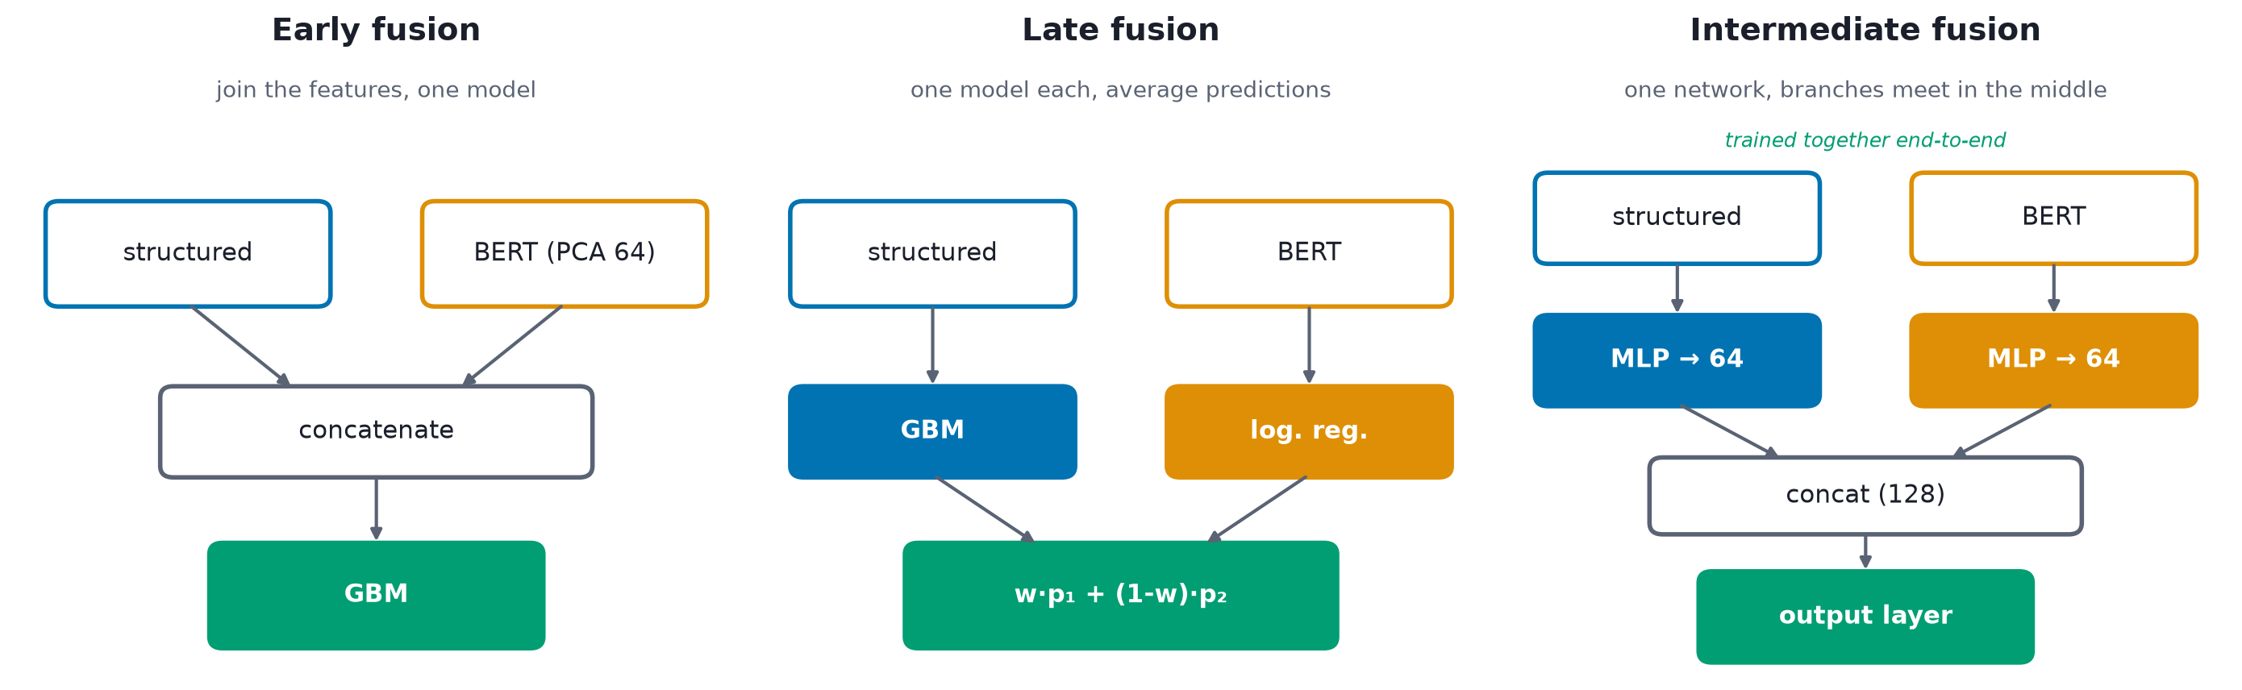
STEP 10 · FUSION
Three ways to combine the data
Early fusion joins the features, late fusion averages the predictions, intermediate fusion joins the networks.
WHY IT MATTERS These are the three standard options in the multimodal literature, and they trade simplicity against flexibility.
Notes:
Early fusion is the easiest to code but one modality can drown out the other, so I shrink BERT to 64 dimensions with PCA first. Late fusion keeps the two models separate and only mixes their outputs. Intermediate fusion lets a neural network learn how the two inputs interact.

Slide 13
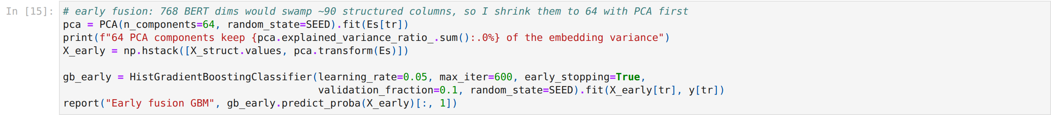
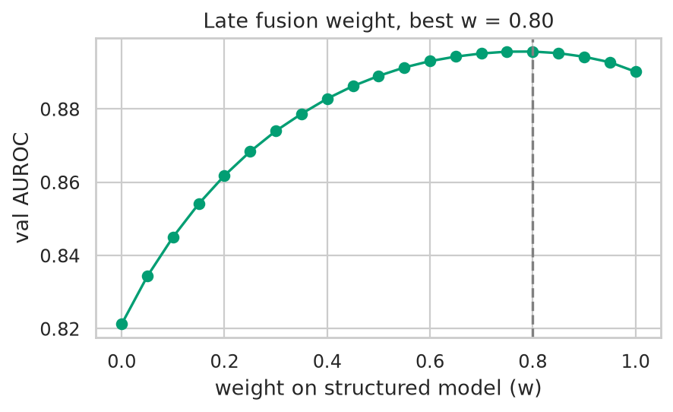
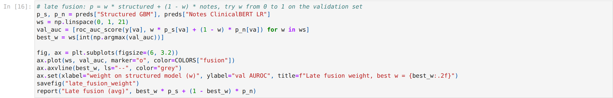
STEP 11 · EARLY + LATE FUSION
Early and late fusion
Gradient boosting on structured features + 64 PCA components, and a weighted average with the weight tuned on validation.
WHY IT MATTERS Early fusion barely moved (0.889). Late fusion did best on validation (0.896) with w = 0.80, so the structured model does most of the work and the notes add a bit on top.
Notes:
The late fusion curve is a nice way to see the value of each modality: w = 1 is structured only, w = 0 is notes only, and the bump in the middle is the gain from combining them.

Slide 14
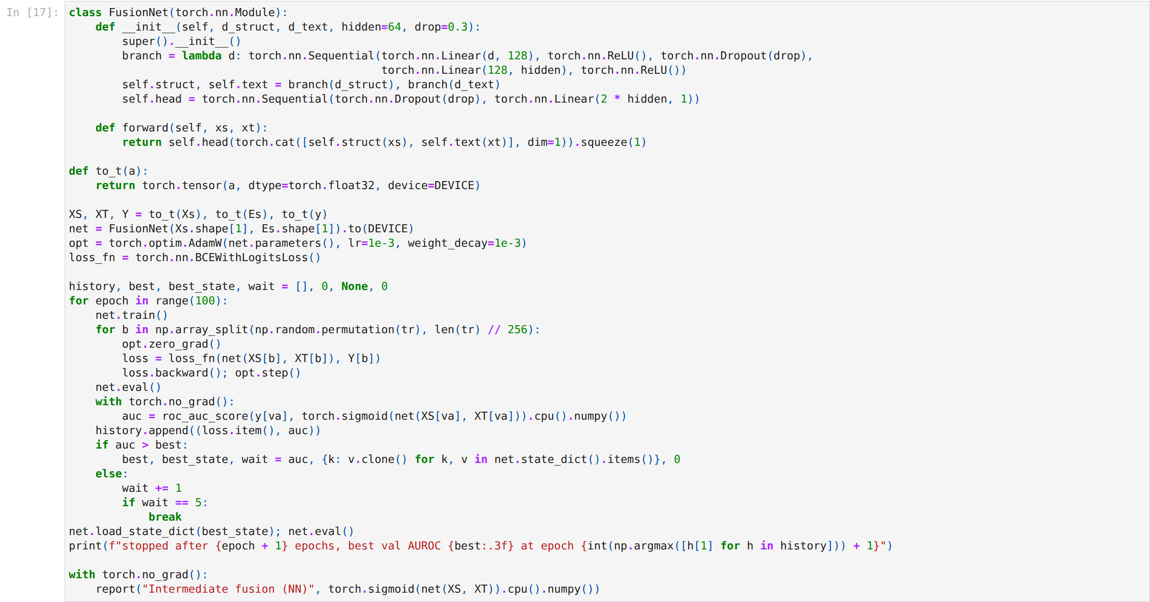
STEP 12 · PYTORCH
Intermediate fusion network
One small MLP per modality squeezes it to 64 numbers, the two are concatenated, and a final layer predicts.
WHY IT MATTERS Stopped after 14 epochs with the best at epoch 9 (val AUROC 0.891). It beats each modality alone, but it isn't better than the simple weighted average.
Notes:
Early stopping on validation AUROC with patience 5 keeps it from overfitting, and the best epoch's weights are restored at the end. Dropout and weight decay help too. It trains in seconds on a GPU since the inputs are already vectors.

Slide 15
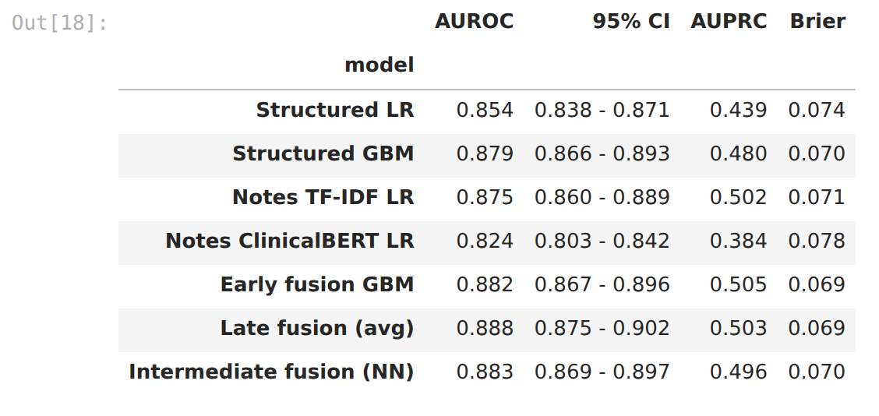
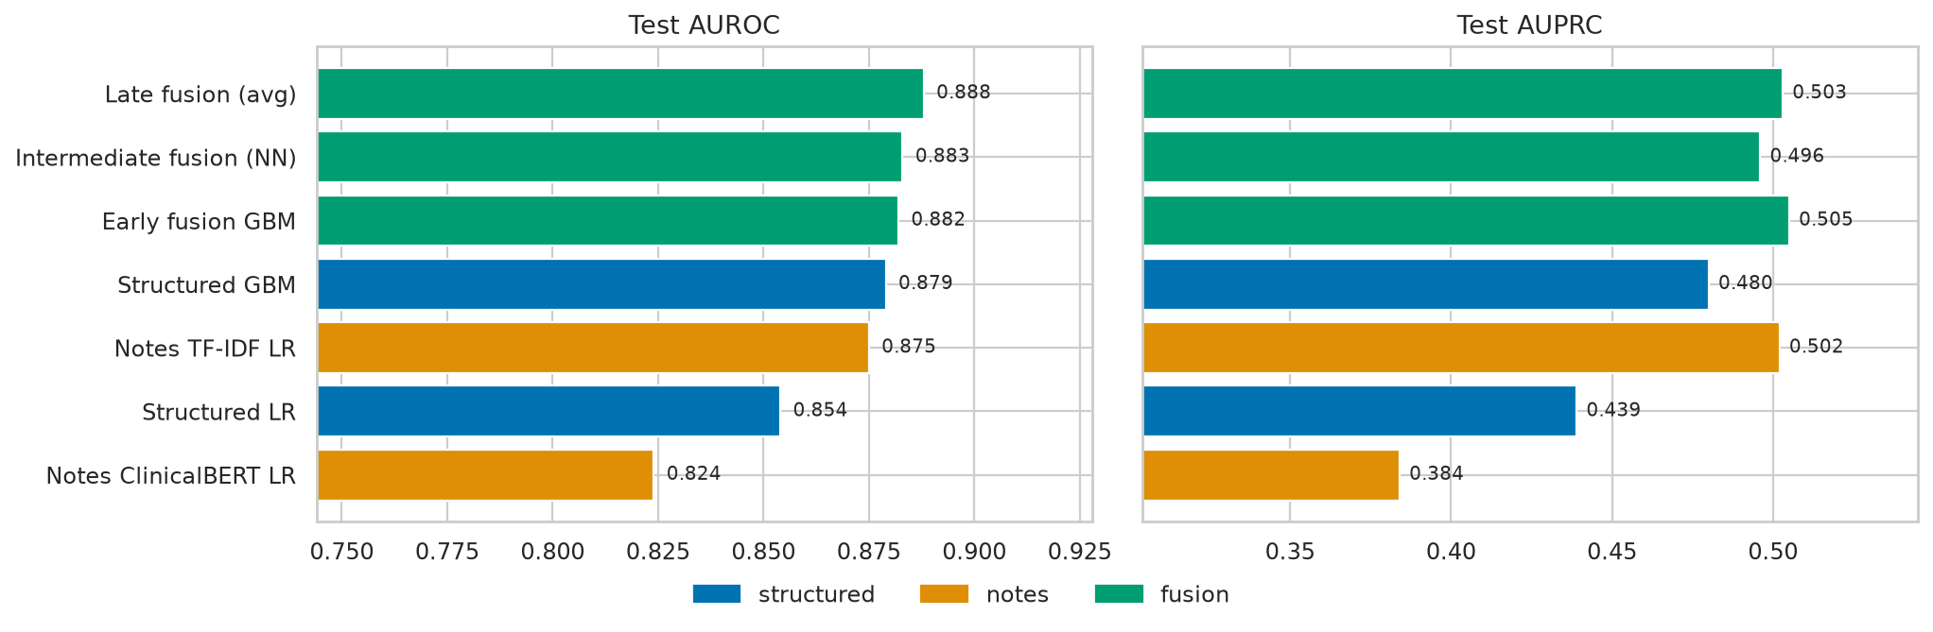
STEP 13 · TEST SET
Results
All models on the held-out test set, with 1,000-sample bootstrap confidence intervals for AUROC.
WHY IT MATTERS On the test set late fusion is best (AUROC 0.888 vs 0.879 for structured only). All three fusion models beat the structured GBM, and TF-IDF beats ClinicalBERT on the notes.
Notes:
AUPRC matters here because only about 11 percent of patients die; a random model would get an AUPRC of about 0.11. Brier score checks the probabilities themselves, lower is better.

Slide 16
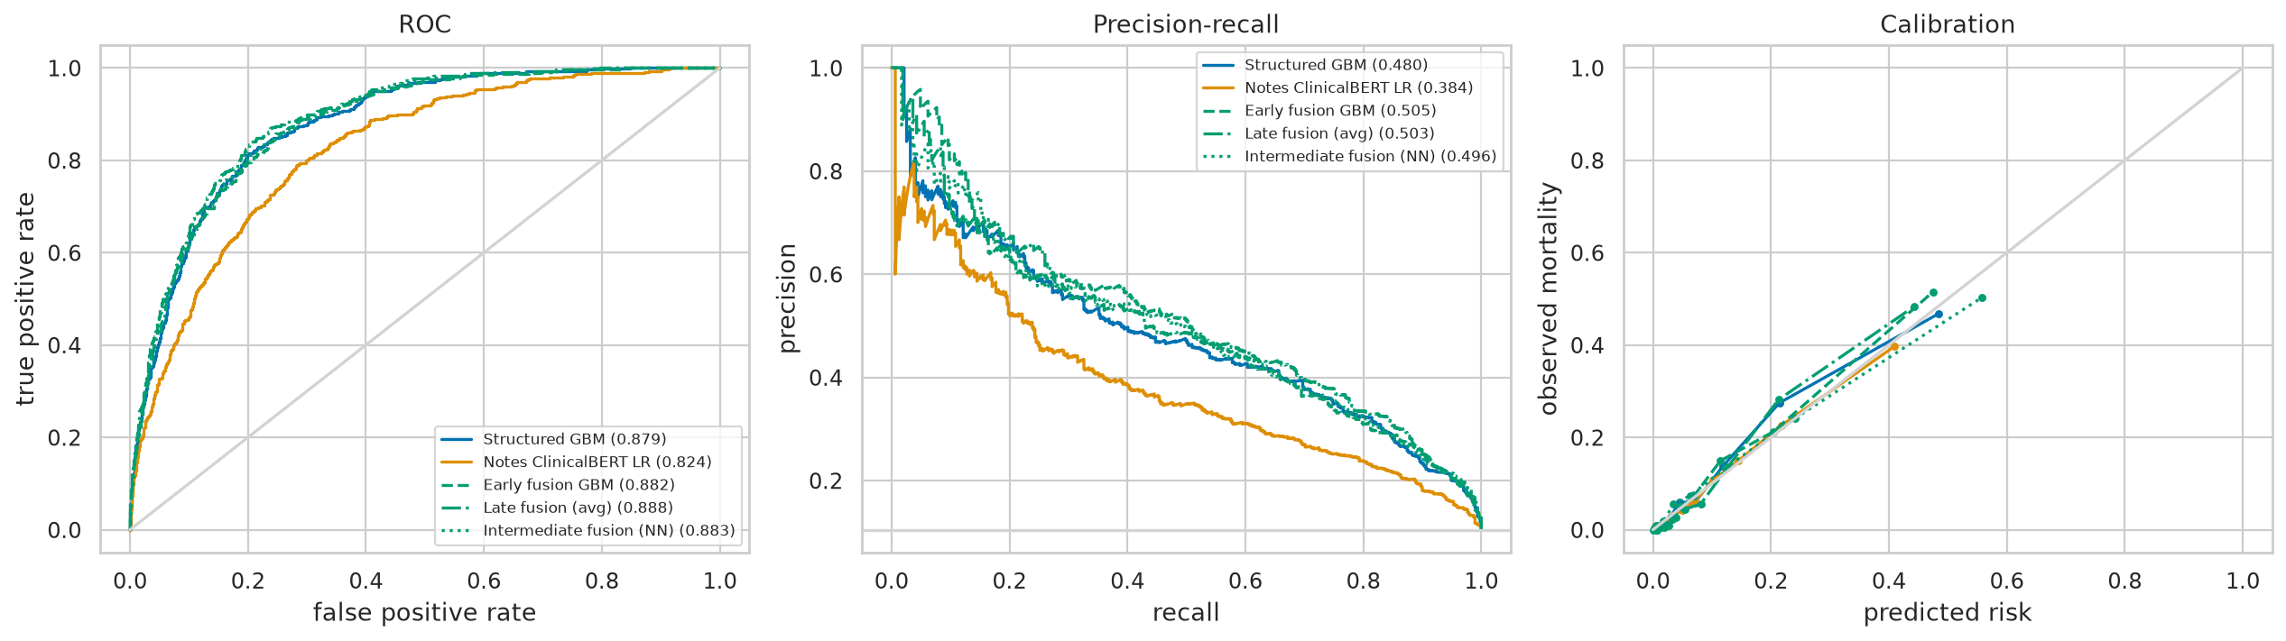
STEP 13 · TEST SET
ROC, precision-recall and calibration
Curves for the best model of each kind. Blue is structured, orange is notes, green is fusion.
WHY IT MATTERS The fusion curves sit slightly above the structured one across the whole range, and all the models are reasonably well calibrated.
Notes:
The calibration plot compares predicted risk with the observed death rate in ten bins. Points on the diagonal mean the probabilities can be taken literally.

Slide 17
STEP 14 · PAIRED BOOTSTRAP
Is the improvement real?
Bootstraps the difference in AUROC between the best fusion model and the structured GBM on the same resamples.
WHY IT MATTERS Late fusion is +0.009 AUROC better (95% CI +0.006 to +0.013) and wins in every bootstrap sample. It's a small gain, but it's real.
Notes:
Comparing two confidence intervals by eye isn't enough, because the models are tested on the same patients. The paired bootstrap looks at the difference directly.

Slide 18
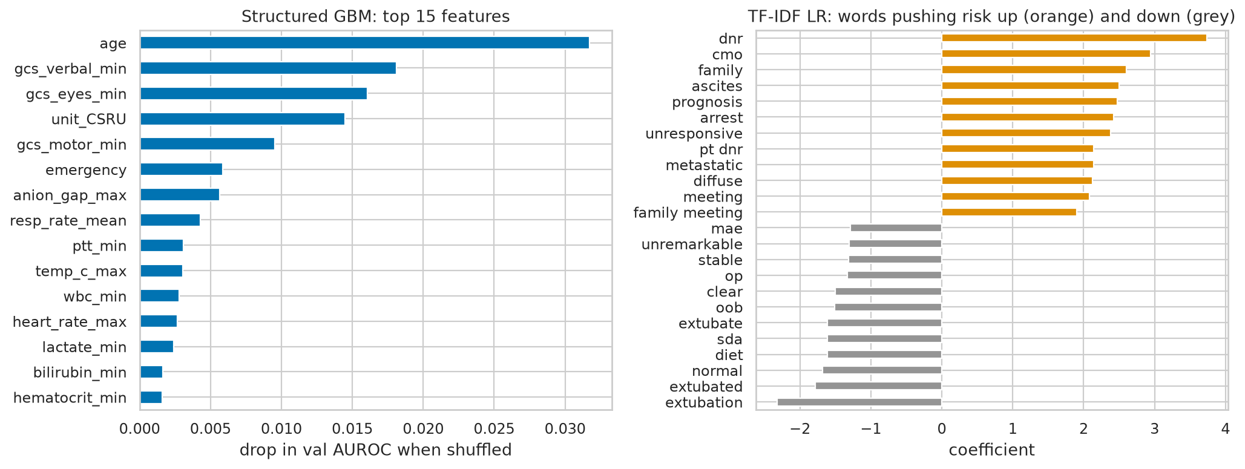
STEP 15 · INTERPRETATION
What the models look at
Permutation importance for the structured GBM and the largest TF-IDF coefficients.
WHY IT MATTERS The structured model leans on age and the GCS scores. The notes pick up words like dnr, cmo (comfort measures only) and family meeting, which the numbers can't capture.
Notes:
Permutation importance shuffles one column at a time and measures the drop in AUROC. The TF-IDF coefficients show which words push the predicted risk up or down. These are aggregated vocabulary terms, no note text is shown.

Slide 19
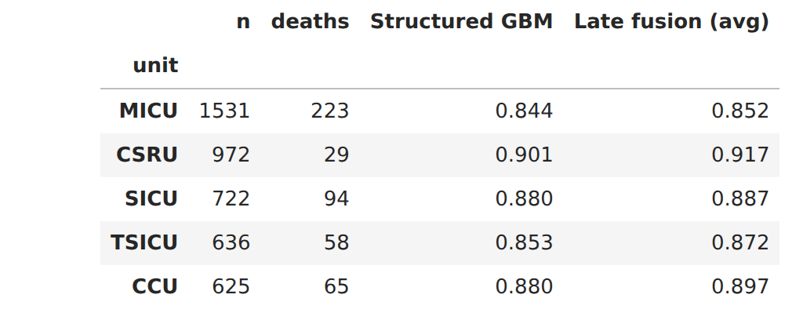
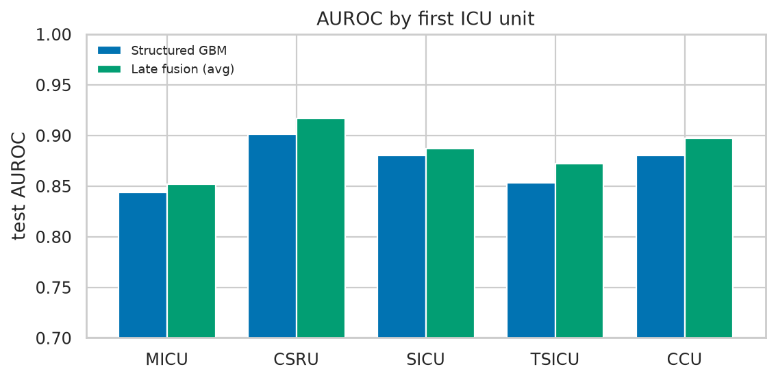
STEP 16 · SUBGROUPS
Where the notes help most
Test AUROC per first ICU unit, structured GBM vs. the best fusion model.
WHY IT MATTERS Fusion is better in every unit. The biggest gains are in the CSRU, TSICU and CCU (+0.016 to +0.019).
Notes:
To sum up: structured data alone is strong, TF-IDF on the notes was almost as strong, and combining them with a simple weighted average gave a small but real improvement. Limitations: one hospital, one split, and stays without early notes were dropped. Some words like cmo or DNR reflect decisions, not just physiology. If you want to extend this, try fusing the TF-IDF model instead of ClinicalBERT, or fine-tune ClinicalBERT instead of freezing it.

