Slide 1
Object-Oriented Programming in R
Three main systems:
S3: based on “class” attributes added to base types, generic functions and method dispatch
S4: more formal extension of S3 with “slots” (named components of objects)
Reference Classes (RC)/R6: encapsulated objects paradigm (i.e., methods belong to the objects, not defined as generic functions) and mutable objects/reference semantics (objects can be modified in place and are not copied when modified).
R6 is similar to OOP in other languages.
R6 implementation is much faster than native RC system
Available through the R6 package

Slide 2
R6 classes
Reference class created with R6Class(), with the following arguments
First argument: class name
“public”: named list of methods (functions) and fields (all other variable types). Access current object with ~$self.
Always return the object itself at the end of each method: call invisible(self)
Special methods:
“print”. Defines how the object is printed
“initialize”. Defines a default constructor (can give defaults, perform checks, etc.)
“private”: fields and methods accessible only from within the class. Access with ~$private
Assign the reference class to an object of the same name, and unitialize instances with reference$new(args)
Useful to model complex systems and create portable structures

Slide 3
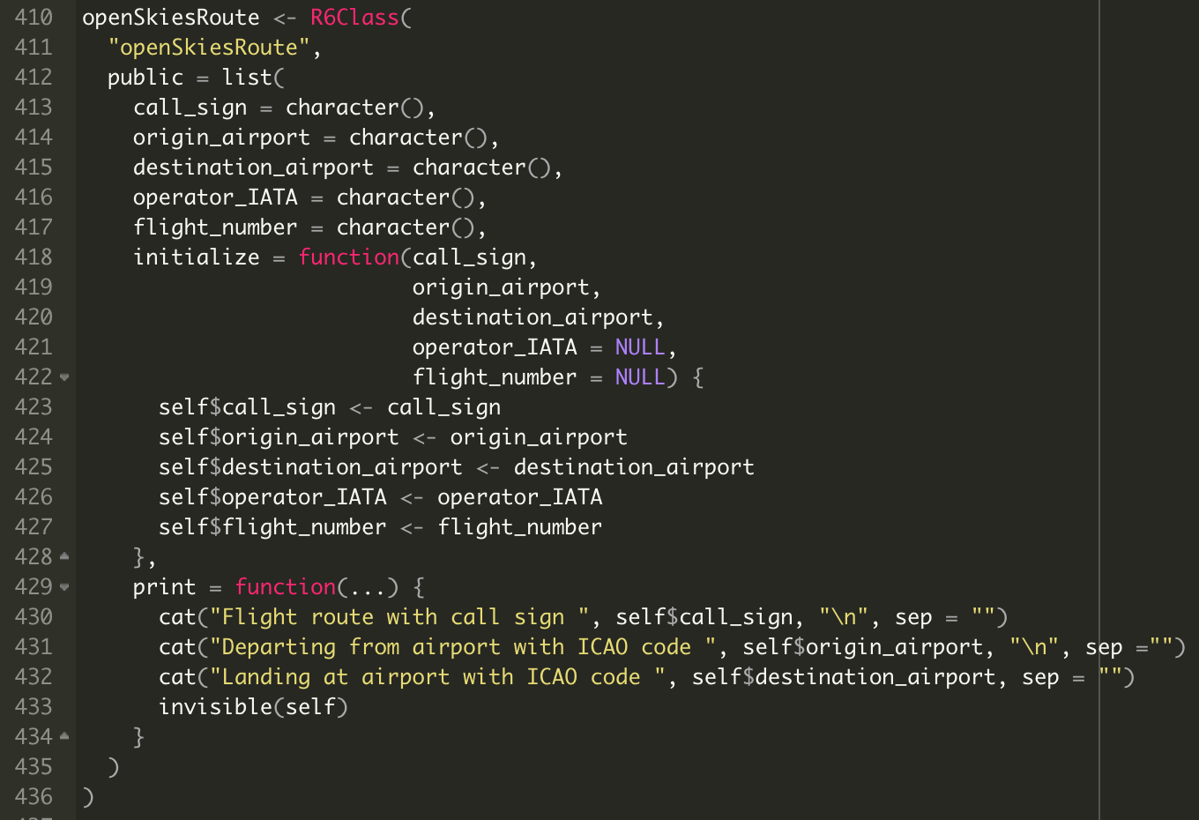
R6 classes

Slide 4
Accessing web resources in R
Most frequently: httr package
Identify structure of queries to access the resource:
Base URL
API endpoint
HTTP methods (GET, POST, PUT, etc.)
Query parameters
Authentication, cookies, etc. are easily implemented
Identify structure of the response and parse it
Automatic parsing of json and other content types available
Implement checks for unexpected unavailability of resource, malformed responses, timeouts, etc.

Slide 5
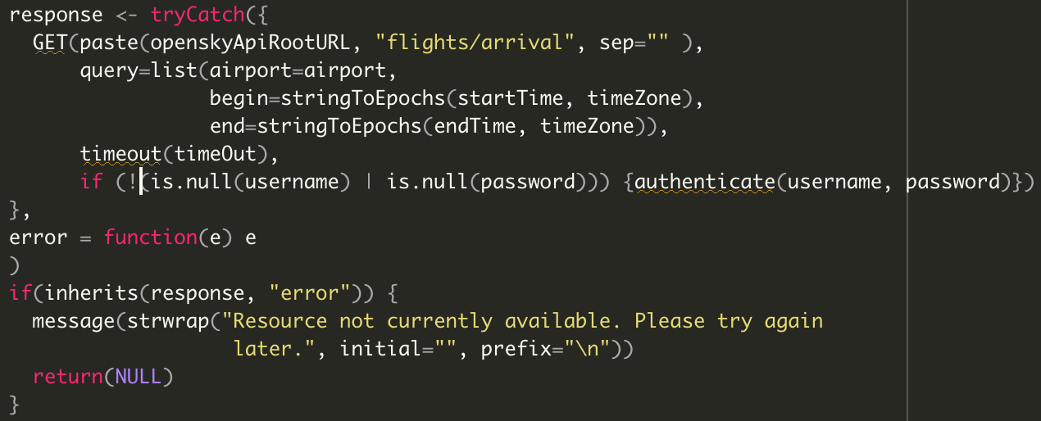
Accessing web resources in R
Example: GET query
GET function:
First argument: target URL
query: named list with query parameters (in a web browser, what goes after “?”)
Additional named/unnamed parameters, usually result of other functions from httr package (timeout(), authenticate(), etc.)

