Slide 1
Team Project: Graphing Calculator
Parker Gabel, Rafael Jeffery, Zack Leibowtz, Noah Sugden

Slide 2
Features
Perform simple calculations
Expressions use the correct order of operations
Graph linear and parametric equations
Set the ranges of x, y, and t
Change the colors of the line
Trace each line, computing the tangent at each point
Saves the model when the program closes

Slide 3
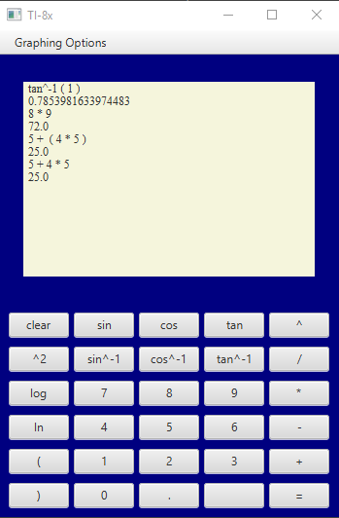
Simple Calculations
Use the buttons to type expressions on the calculator
Use the menu to select graphing option

Slide 4
Linear Graphing
Use the field to write the expression
Run and Run All draw the equations
Trace allows you to trace the graph
You can change the color of the graph

Slide 5
Parametric Graphing
Enter the x(t) and y(t) expressions
You can set the minimum and maximum values for t

Slide 6
Other Graphing
You can drag the graph to move it
You can set the bounds and the step size of each point

Slide 7
Known Bugs

