Slide 1
FSS HorizontalVerticalOutputAdjustment
RLKM
25-06-2018
Sprint 106

Slide 2
Document history
Maintainer | Modified date | Status | Comment
JUDI | 25/06/2015 |  | Creation
RLKM | 24/12/2018 | For Review | Update

Slide 3
Reference documents
Document ID | Title
D000350053/01-EDS EPDS | D000350053/01-EDS EPDS YS350E H/V Output Adjustment and Performance Tasks
D000586899/03-EDS | D000586899/03-EDS- EDS YS1375 task 402 - HV Output Adjustment task

Slide 4
Open issues
ID | Description | AIR ID | Action Holder | Status
1 | 1375 Task 402 H V adjustment must be adapted for Pupil camera and to maximize H &V iso mimizing delta H&V | P340972 | RLKM | Closed
2
3
4

Slide 5
Contents
Scope
Goal & Context
Procedure
Input / Output
Spec, SPC and SDT parameters
Task dependencies and sequence

Slide 6
Scope
The information in this document is applicable as of:
AIR ID | Release | Service Pack
P181201 | ys300c | ys300c_sp_04
P340972 | ys300c | ys300c_sp_19

Slide 7
Goal & Context
The YS350 system has two Illumination fibers which each are equipped with a shutter-box assy. Apart from their shutter function (to select illumination polarization state by opening or closing the required shutter), these shutter-boxes have a function to compensate intensity differences between the two polarizations at Darkfield camera level.
Update in YS1375 : The used camera is changed into Pupil Camera instead of Darkfield camera.

Slide 8
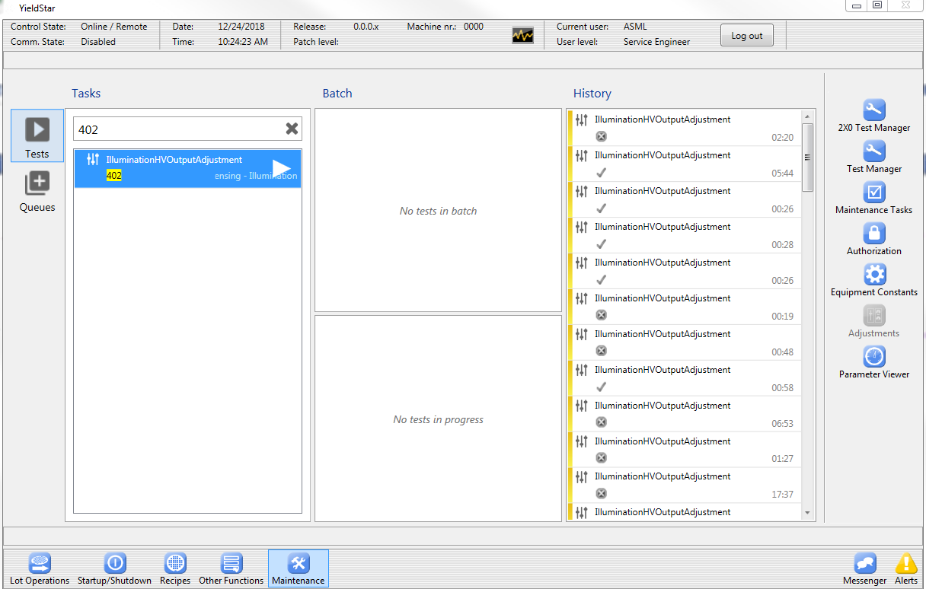
Task location in test manager(Update in SP19)
The task can be found by typing #402

Slide 9
Procedure
Determine the optimal relative output difference for H/V polarized light
Acquire camera images for H/V polarization
Determine average intensity levels on dark field image for negative and positive first order images
Calculate relative difference between H/V polarized images.
Store maximum reached intensity levels for both H/V polarized light
Spec is valid whenever relative difference levels between H/V are within -2 and +2 percent.
Note: camera type is different according to machine type
- YS1375 : Pupil camera
- YS375 : Dark field camera

Slide 10
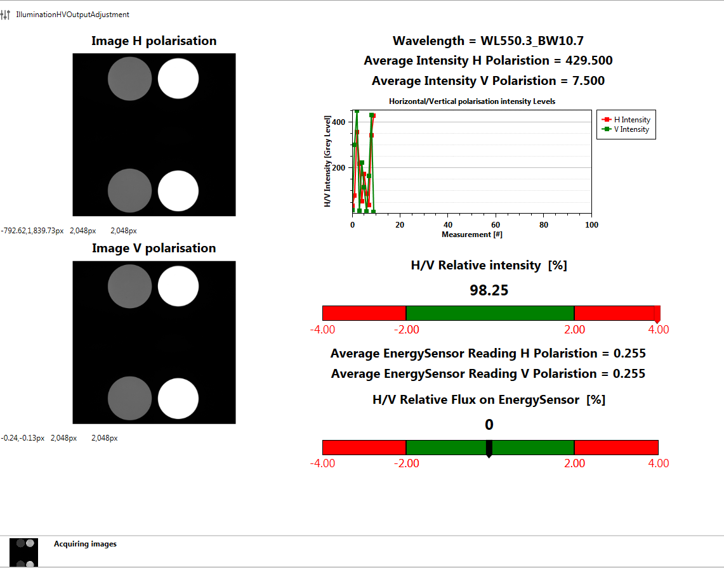
UI Update in SP19 :

Slide 11
Input/Output
Input settings
Output report
New diagnostic settings

Slide 12
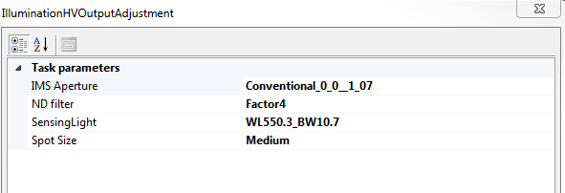
Input settings
YS375 :
Attenuator: Attenuator to be used for measurement ‘factor10’
Repeat count: The number of repeating measurement sequences
SensingLight: Wavelength to be used for measurement ‘550NB’
YS1375:

Slide 13
Output report values
Integration time used
Final intensity level for H Polarized light
Final intensity level for V Polarized light
Maximum measured intensity level for H Polarized light
Maximum measured intensity level for V Polarized light
Relative intensity difference

Slide 14
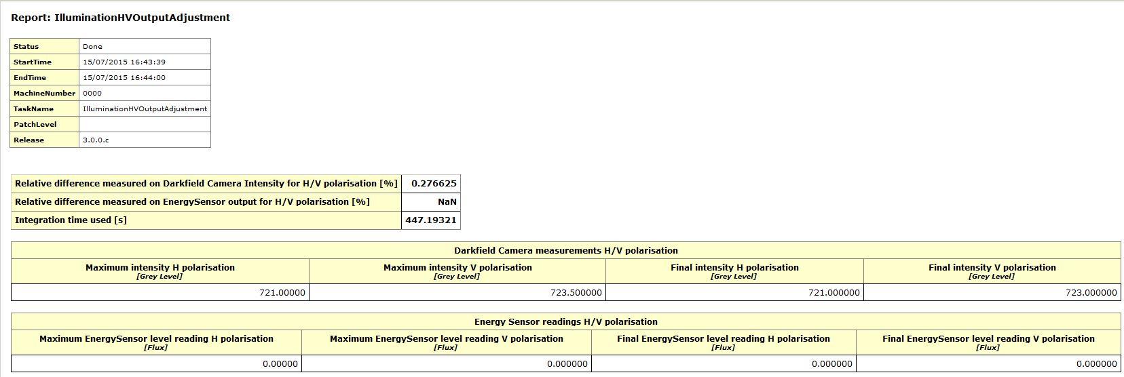
Output report
YS375 :

Slide 15
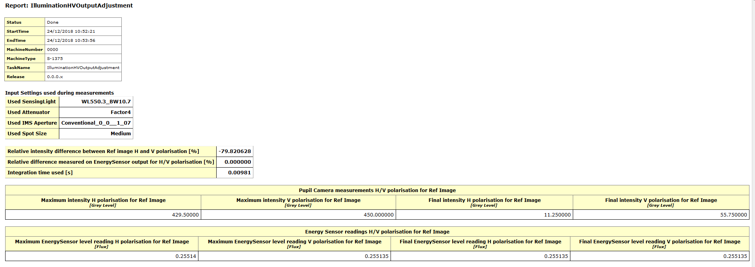
Output report
YS1375 :

Slide 16
New diagnostic settings
Optimal integration time
Number of H Polarized images used
Number of V Polarized images used
Relative intensity level, Latest intensity levels H/V, Maximum measured intensity level H/V of camera images
Relative energy sensor reading level, Latest energy sensor reading H/V, Maximum measured energy sensor reading H/V

Slide 17
Spec, SPC and SDT parameters
New spec parameters available in SpecChecker
New SPC parameters available

Slide 18
New spec parameters
RelativeIntensityDifference

Slide 19
New SPC parameters
NA

Slide 20
Task dependencies and sequence
Dependencies of task
NA
Position of task in build sequence
NA

