Slide 1
Design of a Novel Flash Translation Layer with Efficient Utilization of Spare Area

Slide 2
Outline
Introduction
Related works
Motivation
Design
Experiments
Conclusion

Slide 3
Introduction
Flash memory
Small size
Shock resistance
Power-saving
Light weight
Notes:
In place update : 一筆 data 在某個 page 當中被寫入了，如果這筆 data 被 update 了，不能在同一個 physical page 中再寫一次，而必須在另一個 free page 寫入更新的資料。這就是 out-of-place update.
如果這個已經被寫過的 page 如果還要再被寫入新資料，就那要先 erase 過一次，才能再寫入新資料，就這就叫做 erase before write 的特性

Slide 4
Introduction
2 - 4 KB
64 – 128 B
......
Main area
Spare area
........
Physical page
......
Read / write access unit
physical block
( 32-128 pg )
Flash Memory
erase unit
2015/1/30
4
Notes:
4

Slide 5
Introduction
Drawback : The erase-before-write property
Out of place update
Data C
Data C
........
........
physical block A
physical block B
2015/1/30
5
Notes:
5

Slide 6
Introduction
Flash Translation Layer
Address translation
Translate the logical page to the physical page in NAND flash memory
Garbage collection
Reclaim one free block for the current write request
Switch merge, partial merge, full merge

Slide 7
Introduction
Garbage collection
Switch merge ; Partial merge
1
2
Switch merge
3
4
5
1
6
2
partial merge
3
3
4
4

Slide 8
Introduction
Garbage collection
Full merge
1
5
2
6
3
7
4
8
3
4
Full merge
7
8

Slide 9
Related Work
Superblock scheme
Record page-mapping information in spare area and block-mapping information in main memory
LBN
Mem
page
Spare area
page
Spare area
PPN
LPN
Page offset

Slide 10
Related Work
Superblock scheme
Block-level spatial locality
One superblock is composed of N adjacent logical blocks
Page map N adjacent logical blocks into N + M physical blocks. ( N = 4 , 0<= M <= 4 )
N : data block; M : update block.
Rearranging pages in several blocks
Pages of one superblock could located at anywhere of N+M physical blocks
Hybrid mapping with 3-level mapping table
Fetch mapping info. from spare area two times and memory
Limited size of spare area ( 64 bytes )
Notes:
說明 M 個 physical block 的意義。為什麼 N 個 logical block 不能放在 N 個 physical block ?
理論上， 4 個 logical block 有 256 個 pages, 應該需要 256 PBN 才能完全定址到這 256 個 logical pages 才對。但是 Superblock scheme 把這 256 個 logical page 放在固定 ( N+M ) 個 PBNs 裡, 所以 256 個 logical page 全都會在這 ( n+m ) 個 physical block 裡面

Slide 11
Related Work
Superblock scheme
16
0
16
17
17
0 – 15
…..
16 - 31
32 - 47
48 - 63
31
63
31
Logical block
( 64 pages )
Logical block
( 64 pages )
Subgroup
( 16 pages )
Logical page
( 1 pages )
2015/1/30
11
Notes:
11

Slide 12
Related Work
Q : How to find logical page 17 ?
Superblock FTL
16
PGD table
Logical block
( 64 pg )
PTE page 0
16
17
LBN
PMD page
PTE page 1
…..
PTE page 2
……..
PTE page 3
31
31
0
0 – 15
Subgroup
( 16 pg )
PTE_SIZE : 16
16 - 31
32 - 47
63
48 - 63
PMD index
( LPN / PTE_SIZE)
PTE index
( LPN % PTE_SIZE)
2015/1/30
12
Notes:
12

Slide 13
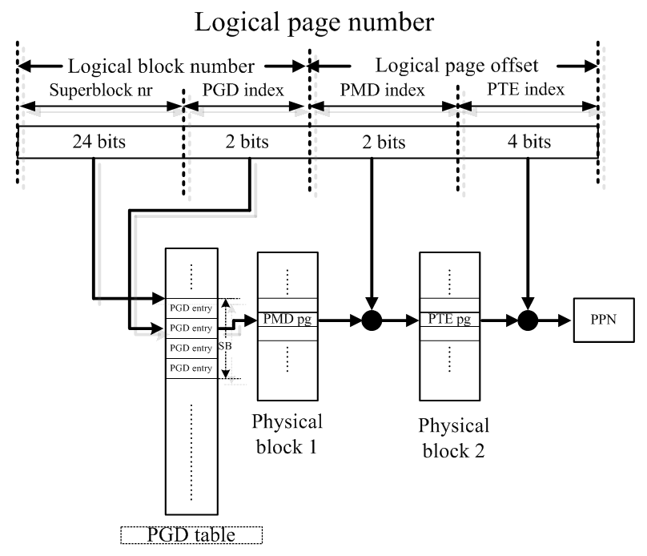
Related Work

Slide 14
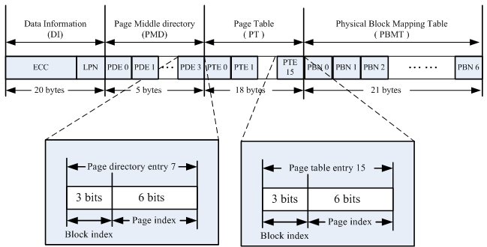
Spare area In Superblock scheme
All pages belonging to one superblock use the same PBMT
Block index
PBMT( 7PBNs)
Physical block
PPN
Page index

Slide 15
Motivation
The limitation of Superblock scheme
Only 8 physical blocks could be allocated to one superblock
Restrict the superblock size.
Limited share degree of the update block.
Superblock scheme has to trigger self garbage collection if 8 physical blocks are full
Trigger garbage collection more early

Slide 16
Design goal
Extended-SuperBlock ( ESB ) FTL
Upholding the advantages and eliminating the limitations of the Superblock scheme
Covert the mapping structure for better flexibility
No upper bound of physical blocks for each superblock
Reconfigure superblock size

Slide 17
Design
Covert the mapping structure
Each subgroup has its own PBMT
Lower the subgroup size to 8 logical pages for containing 8 PBNs in spare area
ESB FTL plans two kind of spare area format
PTE page, PMD page
0
0
0 – 15
0 – 7
8 – 15
16 - 31
16– 23
32 - 47
24– 31
…
48 - 63
63
63
56 - 63
4 x 16
8 x 8

Slide 18
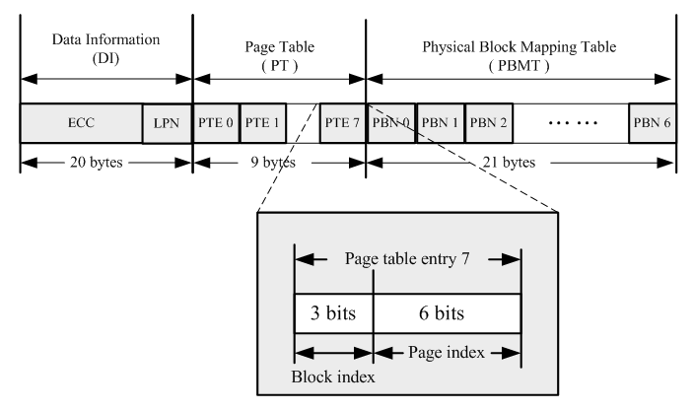
Spare area of PTE pages
Its PBMT primarily records PBNs related to the specified subgroup
PTE page
0
0 – 7
8 – 15
16– 23
24– 31
…
56 - 63
63
8 x 8

Slide 19
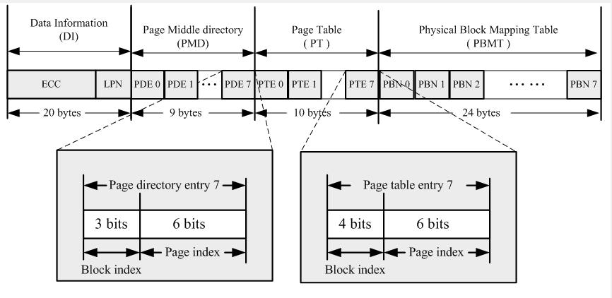
Spare area of PMD pages
Its PBMT primarily records PBNs related to PMD pages of the same logical block.
0
0 – 7
8 – 15
PMD page
16– 23
24– 31
…
56 - 63
63
8 x 8

Slide 20
Mapping structure
ESB FTL scheme
ESB FTL : 64 PBNs / LBN
PGD table
PMD page 0 →
PMD page 1 →
PMD page 2 →
PTE page 0
PTE page 1
PTE page 2
24
24
25
LBN
PTE page 3
PMD page
……
…..
7 PBNs
…
……..
PMD page 7 →
PTE page 7
31
31
0
Subgroup
( 8 pg )
PTE_SIZE : 8
0 – 7
8 – 15
16– 23
24– 31
…
63
56 - 63
2015/1/30
20
8 x 8
Notes:
20

Slide 21
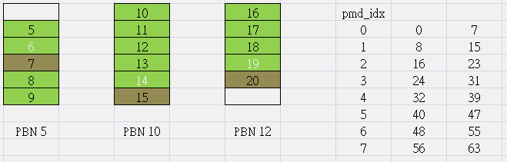
Mapping structure
How to decide the type of a written page ?
PMD page
The ending logical page of its related subgroup
The last written page in the write request
PTE page
Other than PMD pages, they are PTE pages
The most useful PTE pages comes before the PMD pages because it holds the most whole information about its subgroup
21
Notes:
21

Slide 22
Mapping structure
PMD pages sometimes have to point to its related logical page directly and use one PBN.
It’s good to write PMD page and PTE page at the same write request.
But there are exceptions that occur when single page write request coming.
0
1
6
0
1
2
..
1
2
0
0
3
..
2
3
1
7
1
4
4
..
3
..
2
..
2
5
5
..
4
..
3
..
3
..
5
..
4
..
4
..
5
..
phy_blk 63
5
..
phy_blk 255
22
phy_blk 127
phy_blk 31
Notes:
22

Slide 23
Mapping structure
Why write dummy ?
When the PBNs in PMD pages are all occupied, and upper case happened, ESB FTL has to copy the valid PTE page to the free page, and then write the PMD page

Slide 24
Write dummy example
Try to write logical page 7
0
1
6
0
1
2
..
1
2
0
0
3
..
2
3
1
4
1
4
4
..
3
..
2
7
2
5
5
..
4
..
3
3
..
5
..
4
4
..
5
..
phy_blk 63
5
phy_blk 255
phy_blk 127
phy_blk 31
24

Slide 25
Evaluation
We develop a trace-driven simulator in order to evaluate the performance of ESB FTL
Parameters | Values
Number of Blocks | 655360 ( 80GB )
Update blocks | 16384 blocks ( 2.5% )
Pages Per Block | 64
Erase Block Time | 2000us
Page Write Time | 263 us
Page Read Time | 88 us

Slide 26
Evaluation
Traces characteristic :
Traces | Descriptor
Linux PC | Ten-days of user activities under Ext3 file system
Win PC | One weeks of user activities under NTFS
Postmark | Workload of the mail server
Large File | Workload of copying a 4.5 GB DVD ISO file

Slide 27
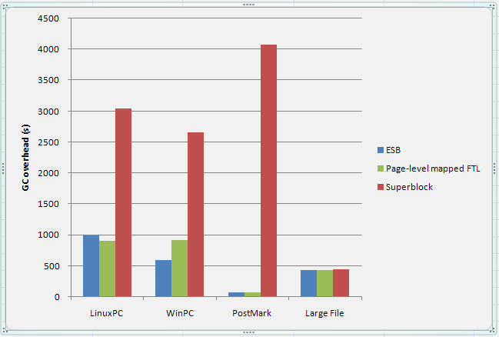
Experiment
GC overhead V.S. different Trace
ESB is composed of 32 logical block

Slide 28
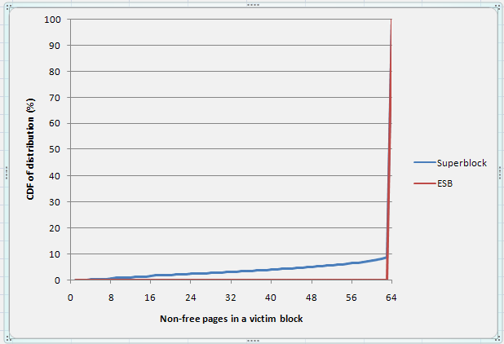
Experiment
Space utilization of victim blocks
ESB is composed of 32 logical block
Win PC trace

Slide 29
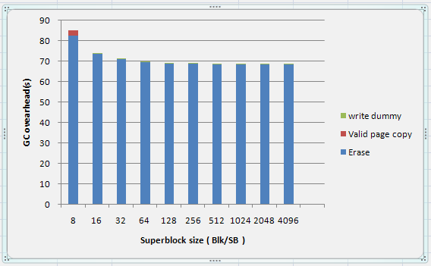
Experiment
GC overhead V.S. superblock size
PostMark trace

Slide 30
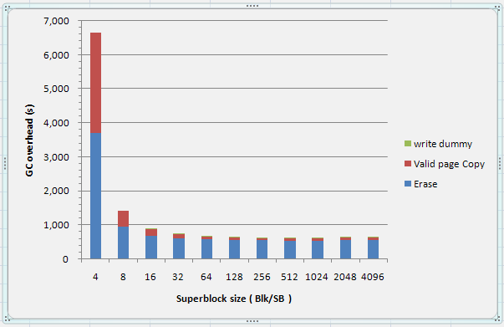
Experiment
GC overhead V.S. superblock size
WinPC trace

Slide 31
Conclusion
We have developed an ESB FTL upholding the advantages and eliminating the limitations of the Superblock scheme.
We have lower the garbage collection overhead compared to Superblock scheme.
ESB FTL achieves page-level mapping for each logical page by utilizing the spare area.
31
Notes:
31

