Slide 1
Spectrometer
OLOE
07/2018

Slide 2
Overview
Spectrometer Operation Principle
Embedding and Connectivity
Class Model(s)
Acquisition Modes
Operation Experiences (Le Petit Douloureuse)
Roadmap

Slide 3
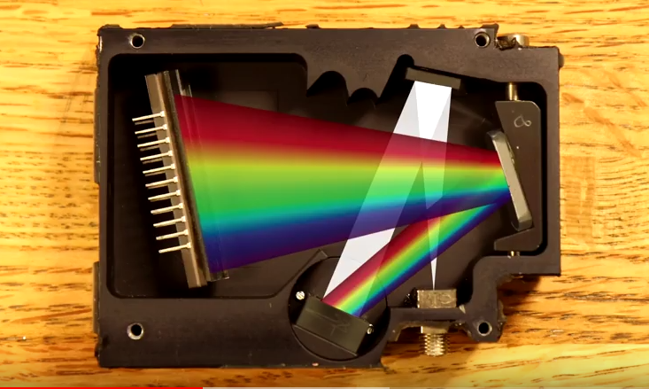
Spectrometer Operation
https://www.youtube.com/watch?v=xuwHsSJ5RZ0
Collimator
Detector
Focus Mirror
Diffraction Grating
Entry Slit

Slide 4
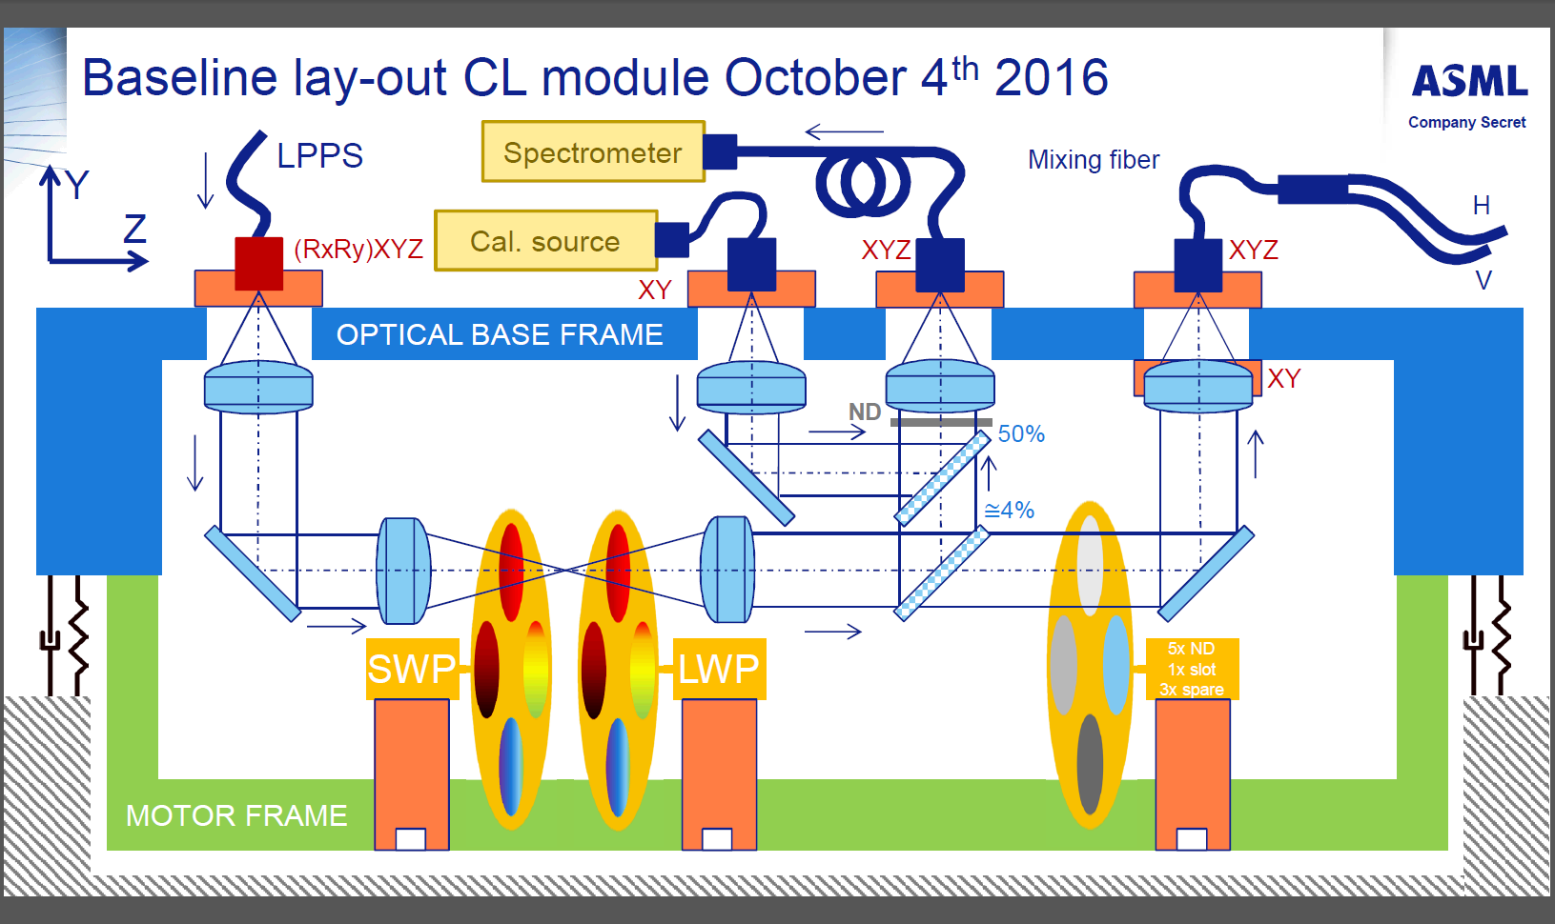
Embedding in CL-Module
Spectrometer
Calibration Source
CL module
SWP axis
LPW axis
Attenuator

Slide 5
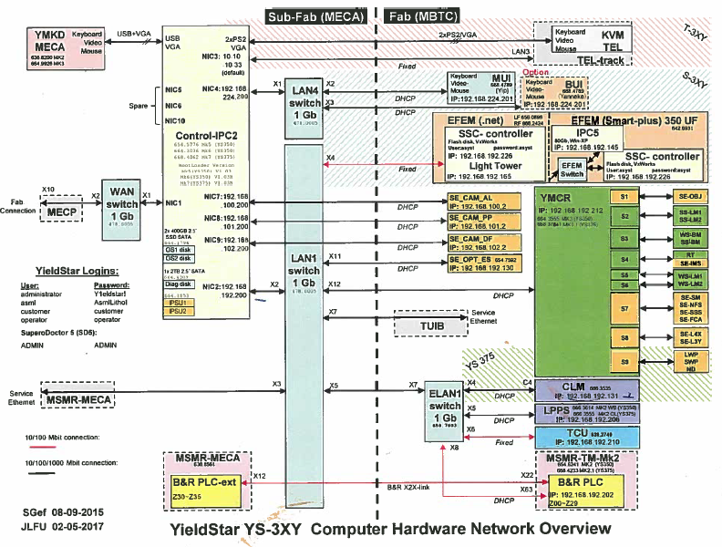
Spectrometer Connectivity
Spectrometer

Slide 6
Acquirement Class Model
Spectrometer
Spectrometer Data Retriever

Slide 7
Spectrometer Class Model

Slide 8
Type Placement
MachineControl.InternalInterfaces.R3
MachineControl.InternalInterfaces
MachineControl
Hal.Interfaces.Spectrometer
Sensing.Hal.Spectrometer
Sensing.Hal.AvaSpec

Slide 9
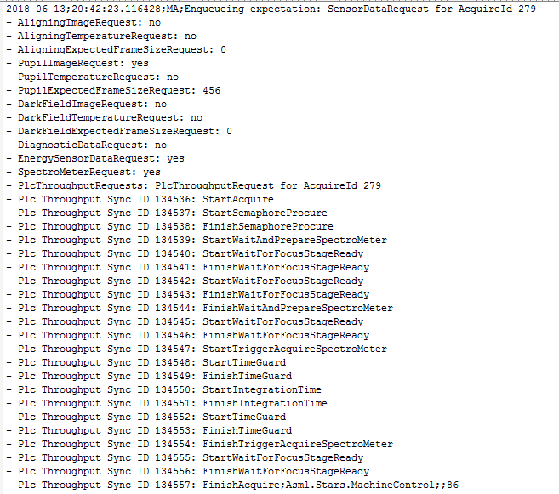
Acquisition Mode: Non-Queued
QNQ
QNQ

Slide 10
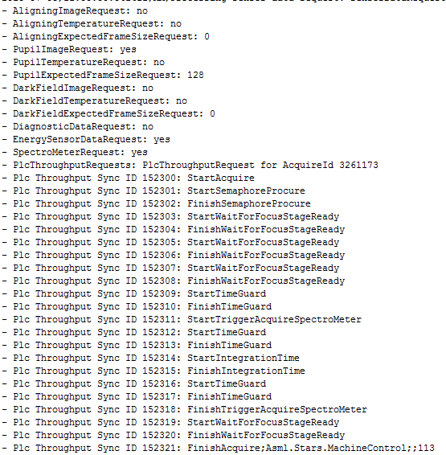
Acquisition Mode: Queued
NO QNQ

Slide 11
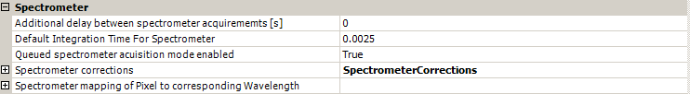
Acquisition Mode: Selection
Acquisition Mode EC

Slide 12
Operation Experience
Failure Mode | AIR ID | Description
Reactivation I Re-Initialization error | P336985 | SP15.a18 After re-initialize the Spectrometer goes in ERROR
 | P339792 | 1375 driver re-initialize does not work because spectrometer goes into error
 | P357530 | YS375 (SP15/m5144/Micron): SPEM-0008 Spectrometer error: spectrometer activation failed.
 | P357530 | YS375 (SP15/m5144/Micron): SPEM-0008 Spectrometer error: spectrometer activation failed.
 | P356323 | Need RPESpectrometer reinitialization fails due to unknwonw interaction between the spectrometer software controller and the report builder software controller.
Reactivation II Initialization error | P341492 | [Beta 300c SP15] Unable to initialize system after 300c SP15.b01 install due to WP and spectrometer errors
 | P345665 | Spectrometer can't be initialized after unknown error scenario.
 | P357474 | #484 fails after #142 on update from HardwareSequenceGenerator. First Positioning error, timeout, then Spectrometer won't initialize.
 | P357823 | After positioning error the PLC puts Spectrometer in error state
Connection Dropout | P337039 | SP15.a18 During recovery LPPSmk3 swap running task 87 Exception occurs with Spectrometer
 | P334109 | SP15: Spectrometer communication error (-16) [:
 | P334717 | SP15 alpha test 375 Spectrometer error (connection lost) after reinitialize
 | P348698 | ApplicationException "PrepareMeasurement Failed" puts the Spectrometer in Error State (SPEM-0001 / MA-0032)
 | P356874 | 1375/SP16 Error; Prepare measurement ERR_COMMUNICATION -16
QNQ Time-out | P342613 | MA-0031 + ER-0FFE TimeoutException "QNQ action SpectroMeter PrepareMeasurement Start"
 | P331186 | SpectrometerException results in Error WP-C290 puts MC Acquire in Error State (MA-0031) just after successful Wafer Alignm. of the DBF Dyn Repro Job
 | P334335 | Error MA-C061 "SpectroMeter Data was not received in Time" occurs while running OV KPI Recipe - Part 2
 | P340403 | WaitForSpaceInHWQueue causes a delay in the MA actions of DBF, resulting in a MAM time increase of 16ms
 | P346160 | 1375 During Si KPI for 3sigma values encounter Exception error -> Timeout while performing QNQ
 | P346806 | YS-375 TPT severly impacted by WaitAndPrepareSpectrometer action in SP16
 | P332997 | Task #602 running time varies a lot
 | P354826 | 375 and 1375: Stress test 100K: TimeoutException - Timeout while performing QNQ action 'SpectroMeter PrepareMeasurement Start'
 | P356467 | 1375 SYSTEM ERROR: WP-C275

Slide 13
Roadmap
SP16
SP17
SP18
SP19
SPX
Fixed version checking
New Spectrometer FW
Automatic FW Update
Type Name Normalization
Decrease Coupling
Remove Non-Queued Mode
Reinit I fixed (FAFI delivery)
Queue mode default (refactoring)
Static memory usage (queue mode)

