Slide 1
LightSourceController KT
Jurgen van Dijck
7/14/2016

Slide 2
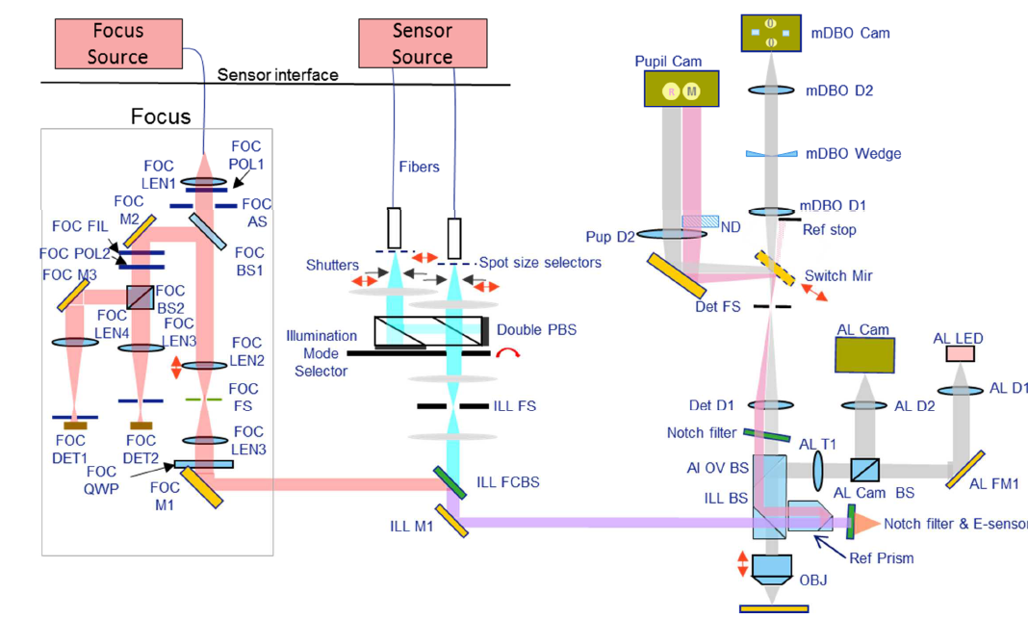
Location within YS system 350

Slide 3
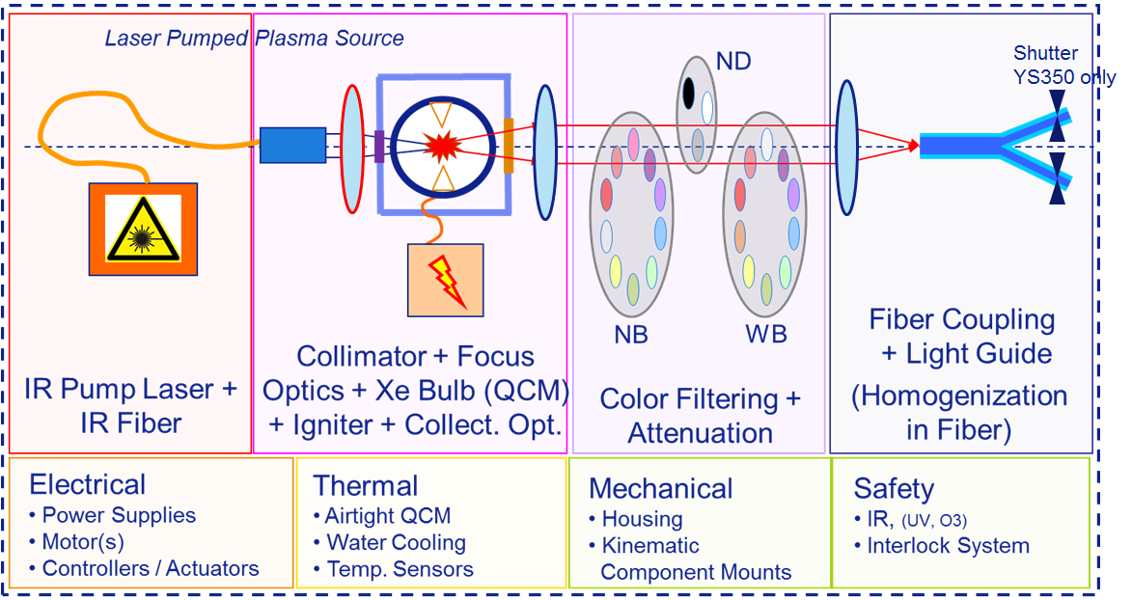
Illumination Module Assembly schematic overview

Slide 4
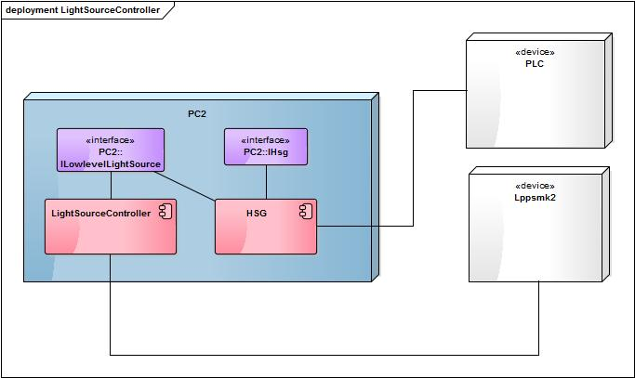
Illumination Module Assembly software deployment

Slide 5
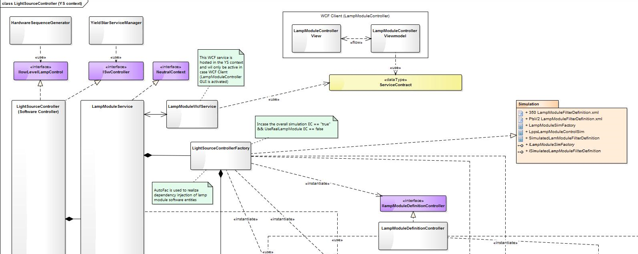
Software layout (LightSourceController)
AutoFac

Slide 6
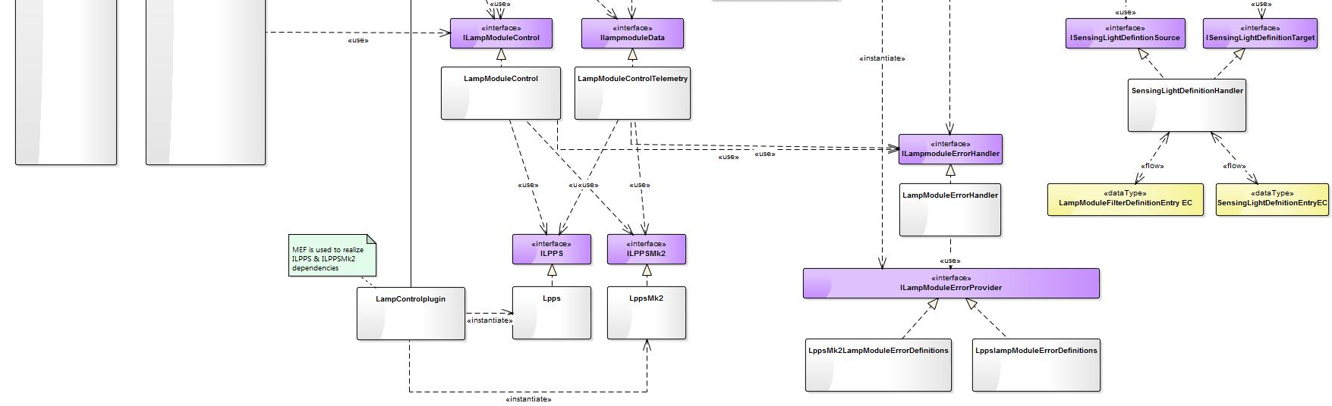
Software layout lamp module entities
EC definition
validation
MEF is used to instantiate lamp module hardware assemblies

Slide 7
Parameter Viewer
Parameter viewer data is distributed via “neutral context” by LampModuleService
Error handler
For as well Lpps as LppsMk2 a specific error handler implementation is available for determination of root cause and root cause analysis
LppsMk2 Firmware and Hardware have extended error reporting capabilities

Slide 8
Simulation
For simulation purposes the 350 datastores contain a filter definition file: STARSvb0\DataStore\Illumination\IlluminationSimulationData
All EC’s related to the lightsourcecontroller are by default empty.
LampModuleFilterDefinitionEntry (defines hardware layout)
SesingLightDefinitionEntry (defines application layout)
During first initialize of YS the IMA filterdefinition is used to define these EC’s.
Each subsequent initialize will use EC values stored during first initialize.
With a simulation force flag the subsequent behavior can be overruled to make sure the “altered” filter definition file will be used

Slide 9
Tasks related to IMA (Illumination Module Assembly)
IluminationHorizontalVerticalOutput (adjustement/performance)
IluminationLampAdjustment (adjustement)
IluminationLampIntensityStability (performance)
IluminationShutterCableHV (performance)
IluminationShutterOpenClose (performance)

