Slide 1
FSS System Hardware Setup Tool
07-01-2019

Slide 2
Document history
Maintainer | Modified date | Status | Comment
TSDF | 06/06/2016 | Creation
RHCE | 13/07/2016 | Updated | Screenshot slide 9
RBEK | 20/06/2017 | Updated | Screenshot slide 9
TSDF | 26/04/2018 | Redesign
RLKM | 07/01/2019 | Updated | slide 9 & slide 10

Slide 3
Reference documents
Document ID | Title
D000462728 | EDS SystemHardwareSetupTool
D000609816 | EDS SW SystemHardwareSetupTool

Slide 4
Open issues
ID | Description | AIR ID | Action Holder | Status
1
2
3
4

Slide 5
Contents
Goal & Context
Scope
Procedure
Error Codes / EC’s
Help
PMA / SDT EventLog footprint
Tweaking

Slide 6
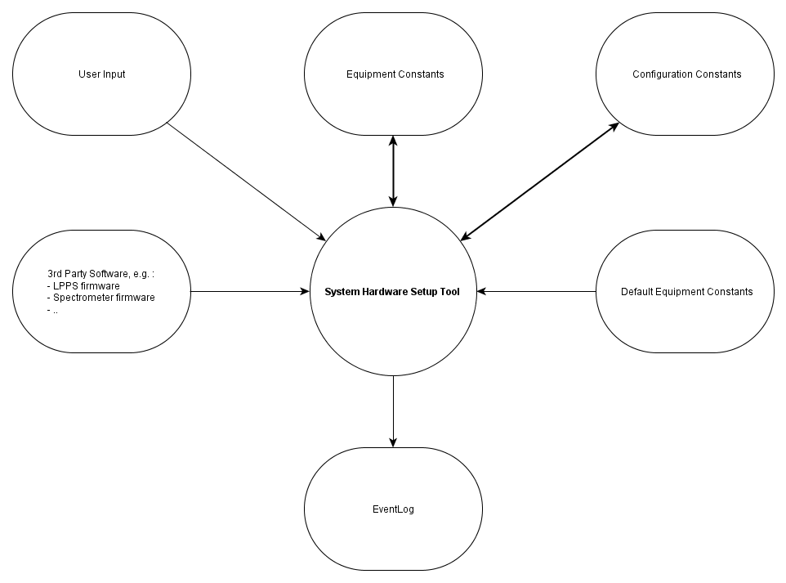
Goal & Context
The hardware setup tool prepares the system for recovery after a spare part swap or hardware upgrade. This is achieved by setting the correct configuration and equipment constants.
The tool is run whenever a hardware swap has been performed, before any calibrations are done (even before the YieldStar software is started).

Slide 7
Scope
This document describes the Functional Sequence (or Service) Specification of the System Hardware Setup Tool.
The information in this document is applicable as of:
AIR ID | Release | Service Pack
P242373 | YS350 | SP08
P344954 | YS1375 | SP18
P387461 | YS1375 | SP19

Slide 8
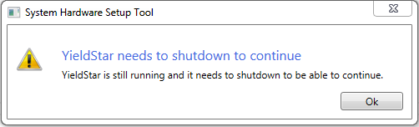
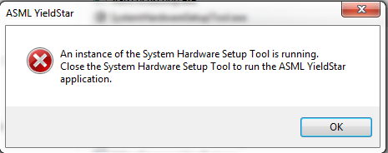
Procedure
Two-way prevention of data corruption:
The SystemHardwareSetupTool will NOT start when YieldStar is active
YieldStar will NOT start when the SystemHardwareSetupTool is active

Slide 9
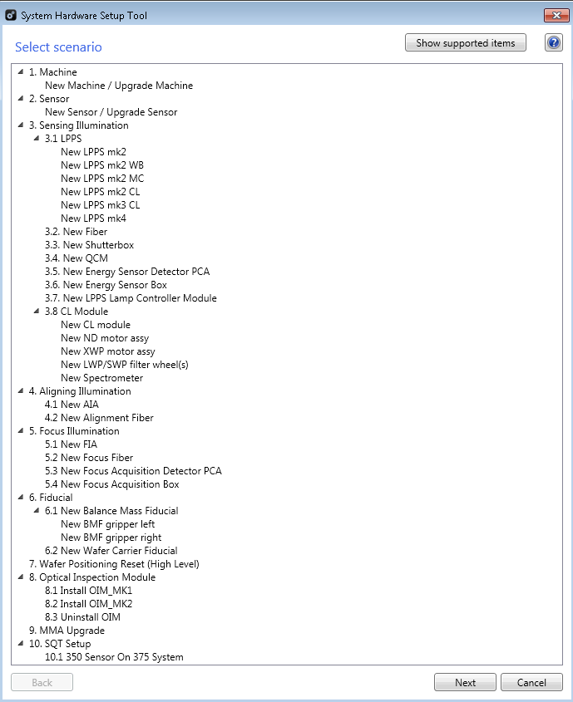
Procedure
Make SURE to have a recent backup of the Equipment- and Configuration Constants before using the tool !
Start the SystemHardwareSetupTool.exe from ..\ASML\Yieldstar\Bin\ on the machine. Dependent on your specific situation choose a scenario and click ‘Next’. (E.g. : Choose New Machine/Sensor.)

Slide 10
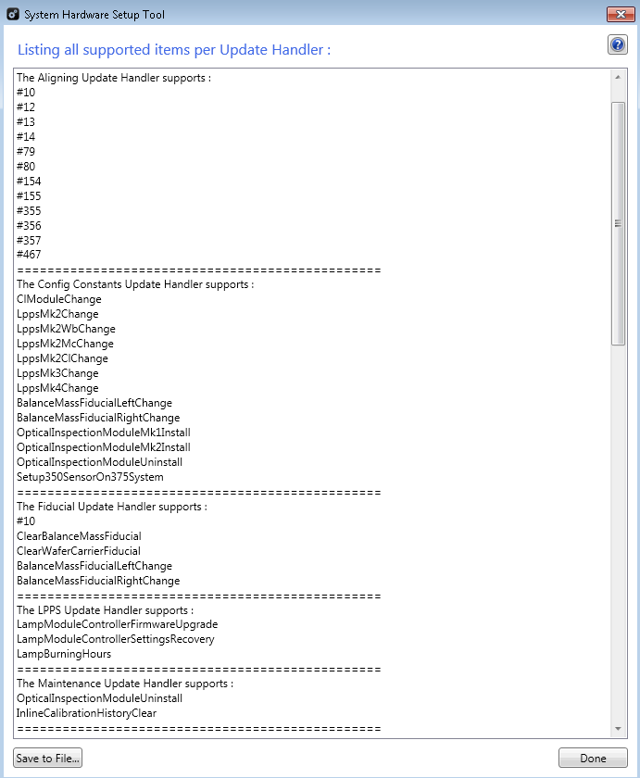
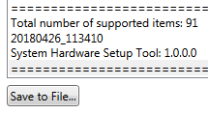
Procedure : Advanced usage for Tweaking
More information on the Tweaking process is provided later in the doc.
When clicking on ‘Show supported items’, the tool shows the following dialog in which per Update Handler the supported items are shown.
An Update Handler has effect on a specific part of the Yieldstar configuration, e.g. the Aligning Update Handler is able to handle updates for the Aligning Equipment Constants and is able to check whether the requested updates were successful.
The example shows that both the Aligning Update Handler and the Fiducial Update Handler are able to reset/update data for task #10
( FiducialPositionCalibration ).
The supported items can be stored for your reference using the button:
‘Save to File’.
The tool will also show its current version, e.g. :

Slide 11
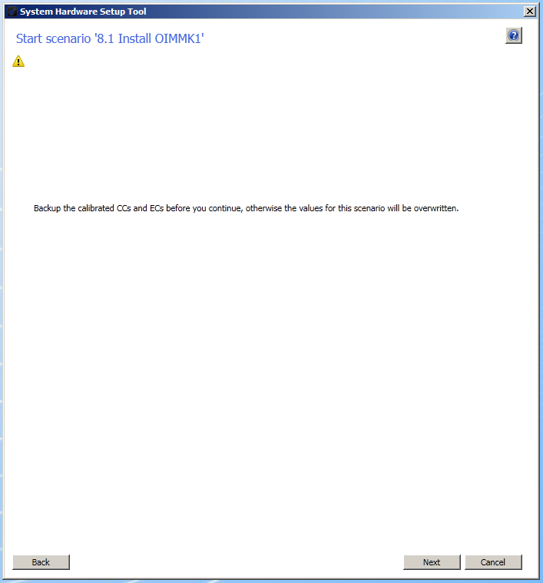
Procedure
The tool issues a warning to make sure the user creates backups for the Equipment- and Configuration Constants
( as these will be overwritten by the tool ! ).
When backups have been made continue by clicking ‘Next’.

Slide 12
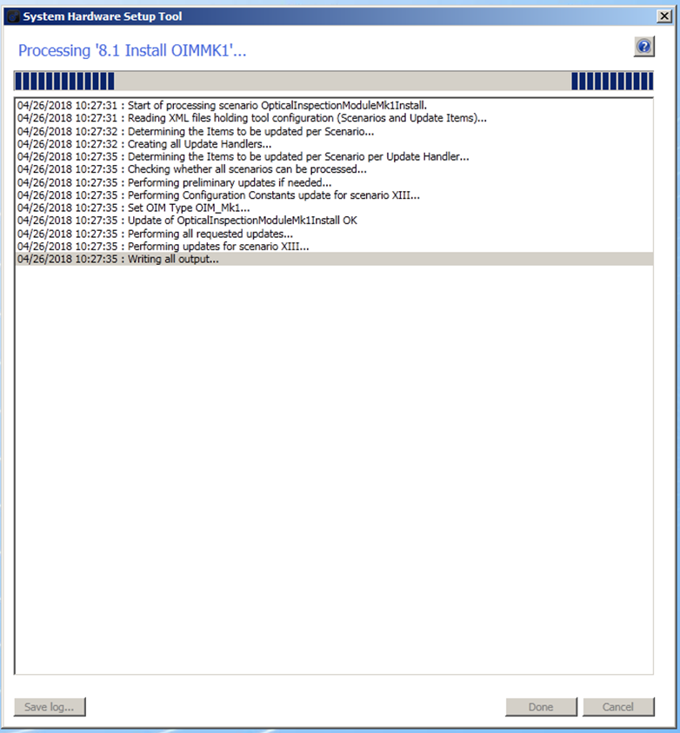
Procedure
The tool starts processing the requested scenario:

Slide 13
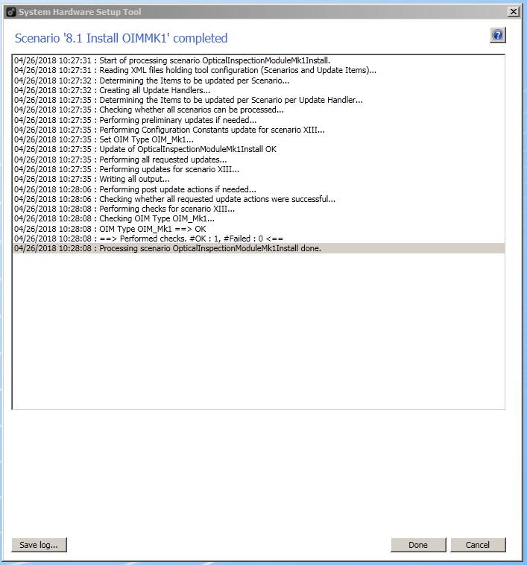
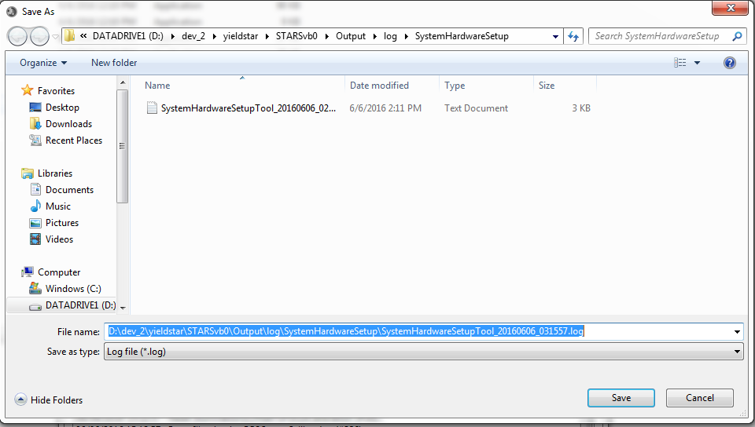
Procedure
When processing is finished, the user can save the generated log (as shown in the list box) by clicking ‘Save log’.

Slide 14
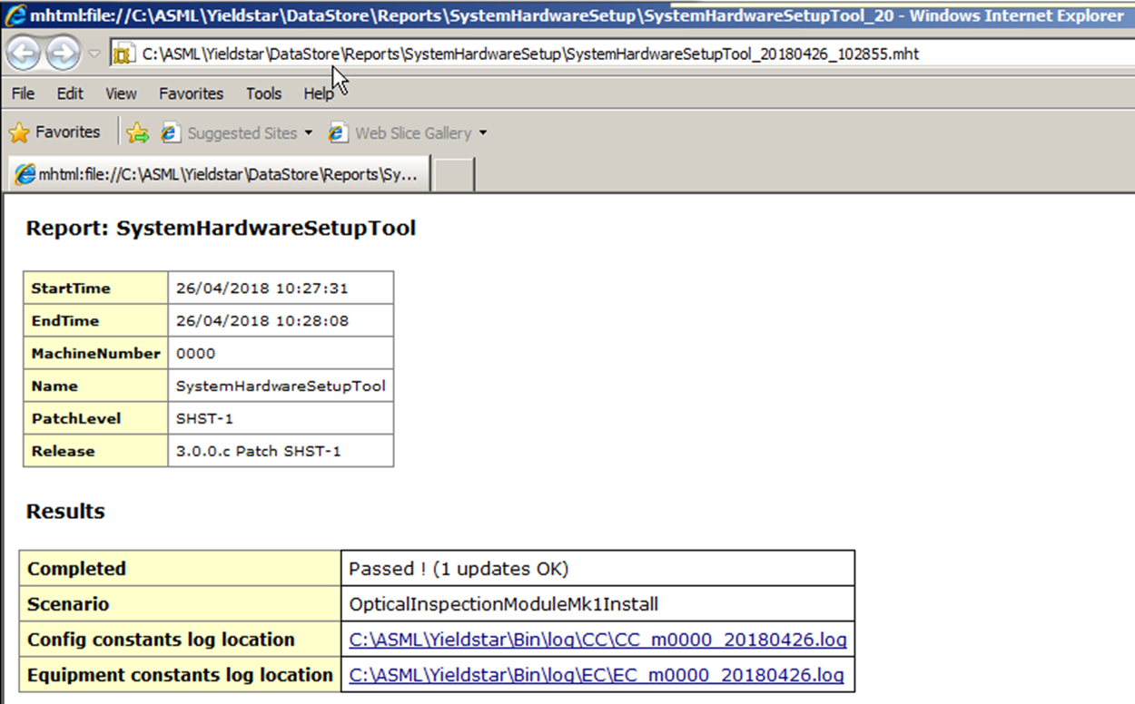
Procedure
When clicking ‘Done’ an output report will be generated and will appear in the default browser
(it may be required to click a few times on ‘Allow Blocked Content alike warnings’):

Slide 15
Error Codes / EC’s
System Event 0xA000 – Indicates the start of the SystemHardwareSetupTool in the YieldStar event log.
System Warning 0xB000 – Indicates a scenario start (scenario name is logged as well)
System Warning 0xB001 – Indicates successful validation of the scenario that was run.
System Error 0xC0000 – Indicates that ‘SystemHardwareSetupReport.xslt’ could not be found
Problem : Embedded Resource unavailable, output report cannot be generated.
Cause : Executable creation partly failed / Executable ‘damaged’
Solution : Re-install SystemHardwareSetupTool and if failure persists contact development
System Error 0xC0001 – Indicates that the system’s list of active processes could not be retrieved.
Problem : Program cannot determine if preconditions are met (e.g. YS not running)
Cause : System issue
Solution : Check Windows Task Manager to determine the cause. Restart the SystemHardwareSetupTool
and if that does not solve the problem restart the PC.

Slide 16
Error Codes / EC’s
System Error 0xC0002 – Indicates an unknown hardware change option was encountered
Problem : The program encounters an unknown option and cannot continue.
Cause : Programming error
Solution : Restart the SystemHardwareSetupTool and retry. If problem persists contact development.
System Error 0xC0003 – Indicates the validation of the scenario that was run failed
Problem : The scenario validation of the SystemHardwareSetupTool found an issue.
Cause : Storing Ecs /CCs failed or cleaning up directories failed
Solution : Make sure no other programs hold the files touched by the
SystemHardwareSetupTool. Retry running your scenario. If the problem persists contact development.
System Error 0xC0004 – Indicates an unsupported change was requested
Problem : The scenario validation of the SystemHardwareSetupTool found an issue.
Cause : The XML configuration holds a request that the tool does not support
Solution : Check whether the changes recently made are also covered in the Supported Items which can be shown when clicking ‘’ on the first dialog of the SystemHardwareSetupTool

Slide 17
Error Codes / EC’s
System Error 0xC0005 – Indicates a failure in the Pre-update phase (e.g. Lpps firmware download )
Problem : The program encountered a failure of one of the updates in the Lpps Update Handler
Cause : Programming error
Solution : Restart the SystemHardwareSetupTool and retry. If problem persists contact development.
System Error 0xC0006 – Indicates a failure in the Pre-update phase (e.g. change of LampModuleType in Config Constants)
Problem : The program encountered a failure of one of the updates in the Config Constants Update Handler
Cause : Programming error
Solution : Restart the SystemHardwareSetupTool and retry. If problem persists contact development.
System Error 0xC0007 – Indicates a failure in the Post-update phase (e.g. Recovery of Lamp Module Settings)
Problem : The program encountered a failure of one of the updates in the Lpps Constants Update Handler
Cause : Programming error
Solution : Restart the SystemHardwareSetupTool and retry. If problem persists contact development.

Slide 18
Error Codes / EC’s
The Update Handlers have effect on the following items:
Aligning - AligningEquipmentConstants.xml
ConfigConstants - ConfigConstants.xml
Fiducial - FiducialEquipmentConstants.xml
Lpps - Lpps firmware related files
Maintenance - MaintenanceEquipmentConstants.xml
Positioning - PositioningEquipmentConstants.xml
Sensing - SensingEquipmentConstants.xml
SensorFocus - SensorFocusEquipmentConstants.xml
This information might help when resolving the errors indicated on the next pages.

Slide 19
Error Codes / EC’s
System Error 0xC010 – Indicates a failure in the update phase of the Aligning Update Handler
System Error 0xC020 – Indicates a failure in the update phase of the Config Constants Update Handler
System Error 0xC030 – Indicates a failure in the update phase of the Fiducial Update Handler
System Error 0xC040 – Indicates a failure in the update phase of the Lpps Update Handler
System Error 0xC050 – Indicates a failure in the update phase of the Maintenance Update Handler
System Error 0xC060 – Indicates a failure in the update phase of the Positioning Update Handler
System Error 0xC070 – Indicates a failure in the update phase of the Sensing Update Handler
System Error 0xC080 – Indicates a failure in the update phase of the Sensor Focus Update Handler
Problem : The program encountered a failure of one of the updates in the Update Handler
Cause : E.g. file access problem or driver/connection problem in case of firmware update
Please check the error logging to find the specific failure. It will also be visible on the UI.
Solution : Restart the SystemHardwareSetupTool and retry. If problem persists contact development.

Slide 20
Error Codes / EC’s
System Error 0xC011 – Indicates a failure in the checking phase of the Aligning Update Handler
System Error 0xC021 – Indicates a failure in the checking phase of the Config Constants Update Handler
System Error 0xC031 – Indicates a failure in the checking phase of the Fiducial Update Handler
System Error 0xC041 – Indicates a failure in the checking phase of the Lpps Update Handler
System Error 0xC051 – Indicates a failure in the checking phase of the Maintenance Update Handler
System Error 0xC061 – Indicates a failure in the checking phase of the Positioning Update Handler
System Error 0xC071 – Indicates a failure in the checking phase of the Sensing Update Handler
System Error 0xC081 – Indicates a failure in the checking phase of the Sensor Focus Update Handler
Problem : The program encountered a failure of one of the updates in the Update Handler
Cause : E.g. file access problem or driver/connection problem in case of firmware update
Please check the error logging to find the specific failure. It will also be visible on the UI.
Solution : Restart the SystemHardwareSetupTool and retry. If problem persists contact development.

Slide 21
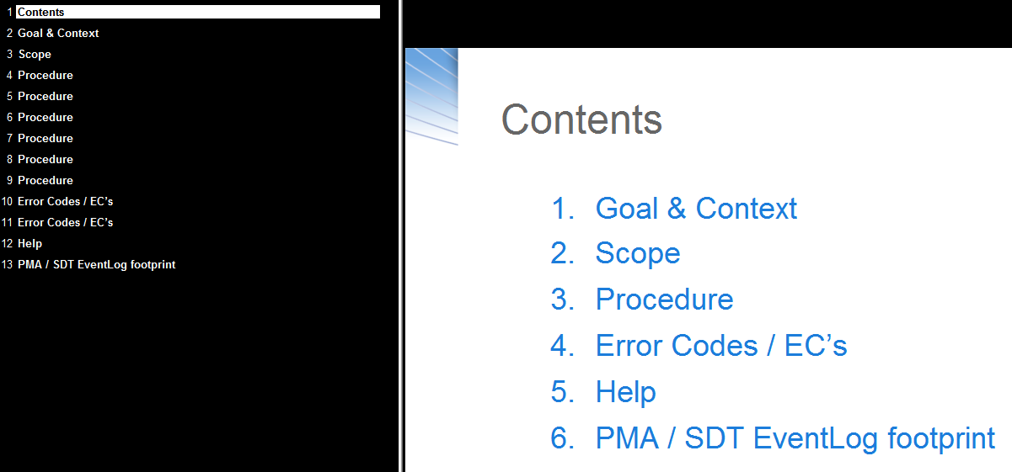
Help
The SystemHardwareSetupTool holds a help-icon on each page of the wizard:
Clicking it will launch the default web-browser and display the respective wizard-page contents of the help.

Slide 22
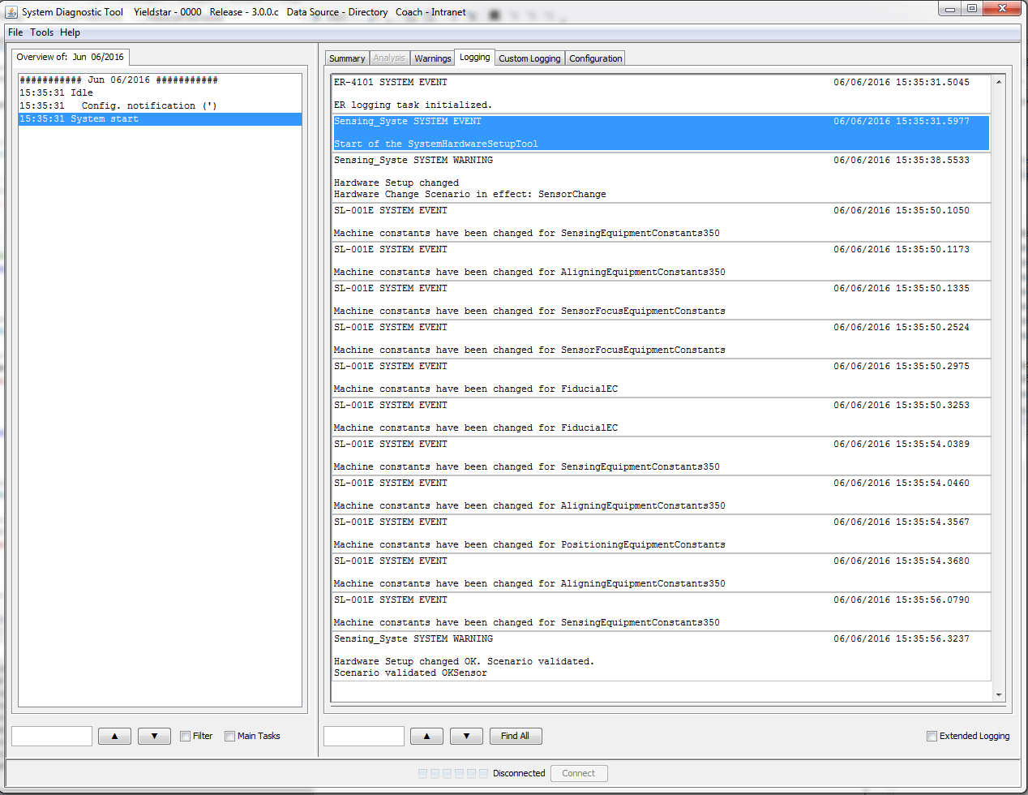
PMA / SDT EventLog footprint
When starting the tool, this will be indicated in the YieldStar event log.
When a scenario starts this will be logged as well (in this case: SensorChange).
When all went fine the event log will hold a SYSTEM WARNING indicating the scenario was validated to be OK. In case of an error this will be logged as an SYSTEM ERROR in the event log.
By logging this flow the respective change will be available in PMA for reference.

Slide 23

Tweaking
When the situation on the machine at hand is such that you need to execute more or different update items under a specific Change Option then there might be a solution in tweaking the configuration files.
In general there are two options:
Add or change the scenarios belonging to a Change Option
Add more items under a given scenario for a specific machine type
The configuration files can be found where the SystemHardwareSetupTool.exe is situated:
C:\ASML\Yieldstar\bin\
Note that here ‘SystemHardwareSetupToolScenariosYs375.xml’ is shown because the tool was deployed on 375.

Slide 24
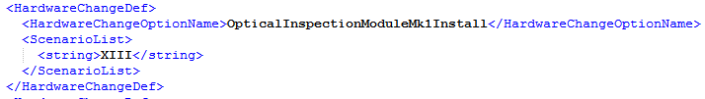
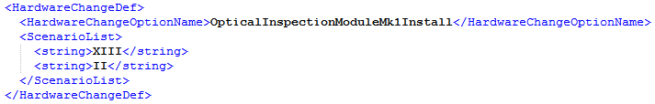
Tweaking : Add or change the scenarios belonging to a Change Option
NB: The following is just an example, and for Advanced Users :
When a Change Option, e.g. ‘8.1 Install OIM_Mk1’ needs to perform an extra scenario, e.g. scenario II
Open ‘SystemHardwareSetupToolHardwareChangeOptions.xml’
Change from:
To:
Save the file and restart the tool. Rerunning the 8.1 Change Option will now perform scenario II as well. The items of scenario II are defined in the ‘SystemHardwareSetupToolScenariosYsxxx.xml’ where xxx stands for the machine type on which the tool is deployed.

Slide 25
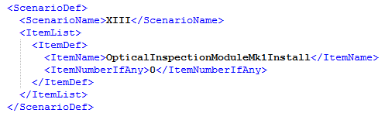
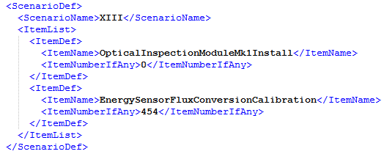
Tweaking : Add more items under a given scenario for a specific machine type
NB: The following is just an example, and for Advanced Users:
When a Scenario, e.g. ‘XIII’ needs to perform an extra update item, e.g. EnergySensorFluxConversionCalibration
Open ‘SystemHardwareSetupToolScenariosYsxxx.xml’ where xxx stands for the machine type on which the tool is deployed.
Change from:
To:
Save the file and restart the tool. Rerunning (e.g.) the 8.1 Change Option will now perform the update for EnergySensorFluxConversionCalibration as well.

