Slide 1

Sales Report

Slide 2
Detailed Profit Report

Slide 3
Detailed Sales Report

Slide 4
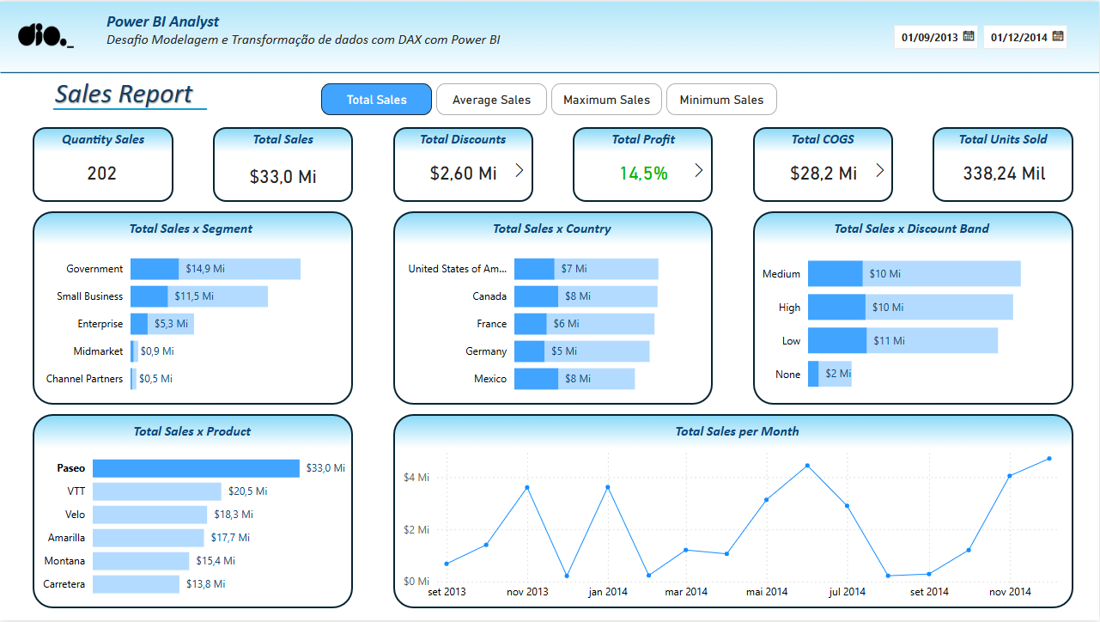

Slide 5
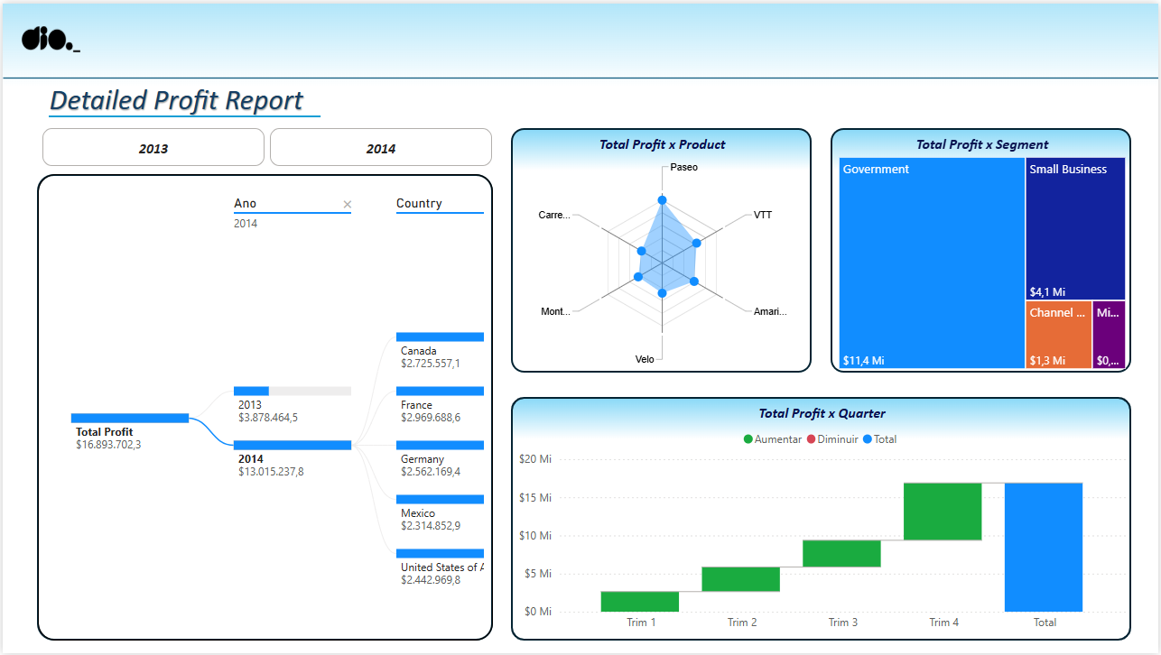

Slide 6
