Slide 1

Atmospheric Scattering Visualization and Illumination 1 University of Minho
Bruno Barbosa (a67646)
Carlos Gonçalves (a67650)
Rafael Antunes (a67711)

Slide 2
Structure of the presentation
Introduction
Atmospheric Scattering
Atmospheric Effects
Examples

Slide 3
Introduction
The atmospheric scattering is a essential to render realistic outdoors environments
The atmospheric scattering is responsible for blue color of the sky as well as reddish sunset color
We tried to adapt an Unity shader already existent to the Nau3D Engine
In the following slides we will explain how the atmospheric scattering works and how the shaders simulate the atmospheric effects

Slide 4
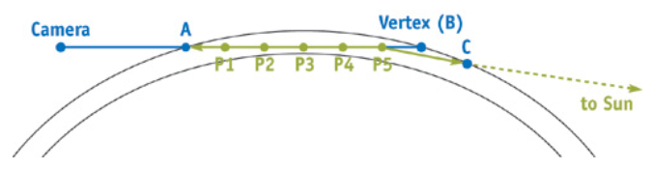
Atmospheric Scattering

Slide 5
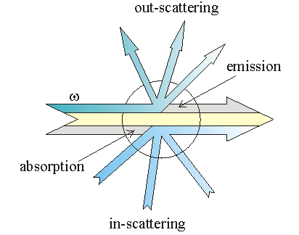
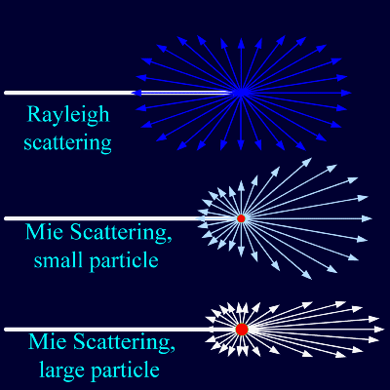
Atmospheric Scattering
The atmospheric scattering is based on these atmospheric effects
Rayleigh scattering
Mie scattering
Out-Scattering
In-Scattering

Slide 6
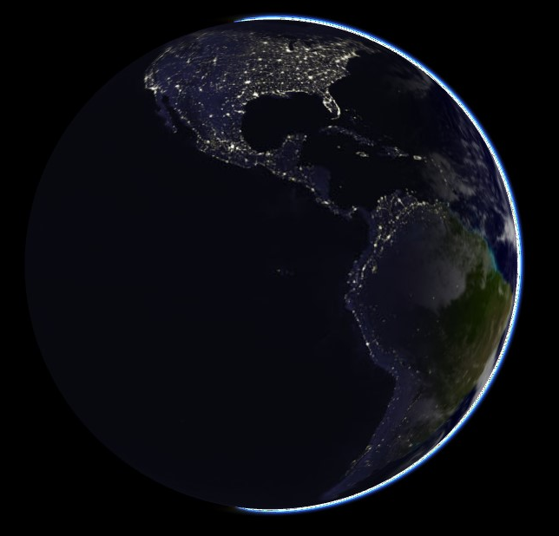
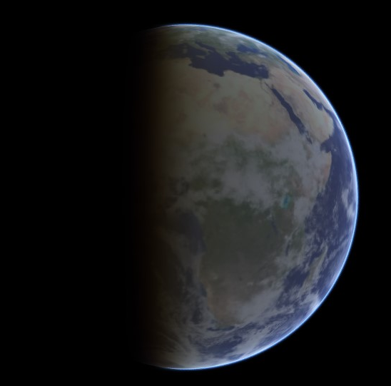
Nau 3D
Unity 3D

Slide 7
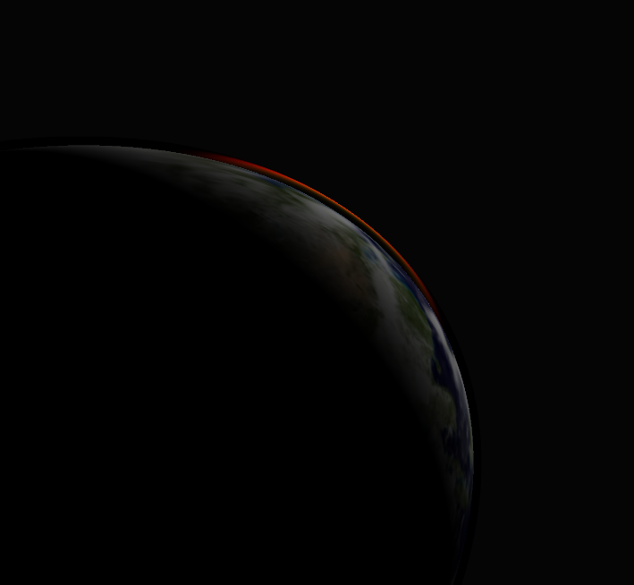
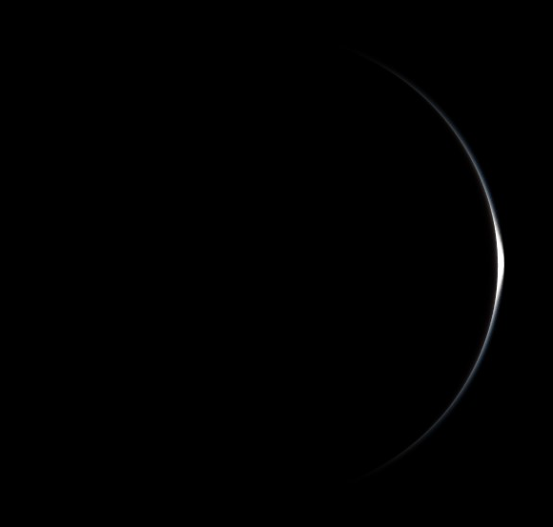
Nau 3D
Unity 3D

Slide 8
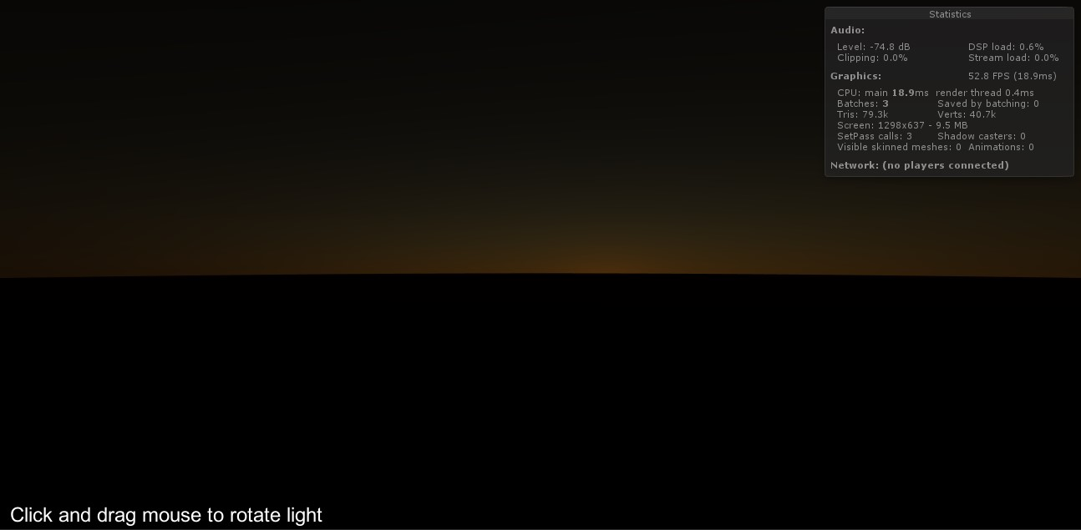

Slide 9
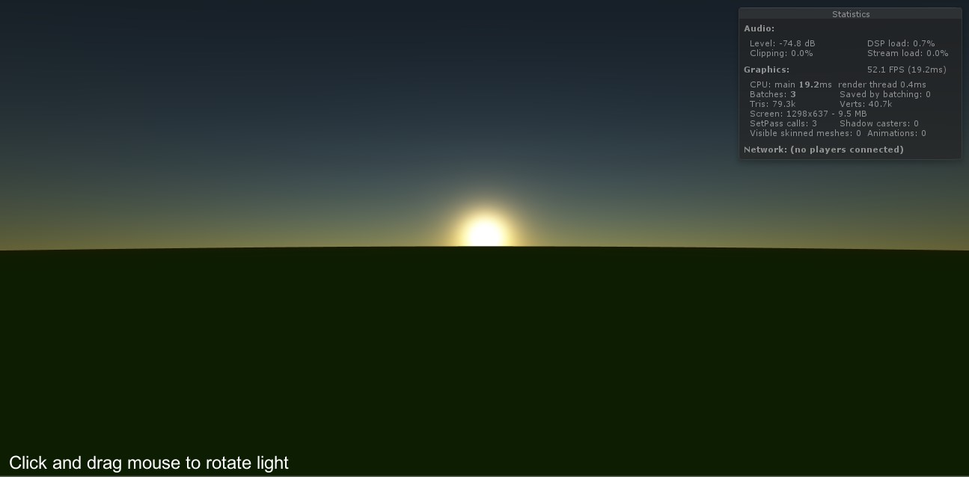

Slide 10
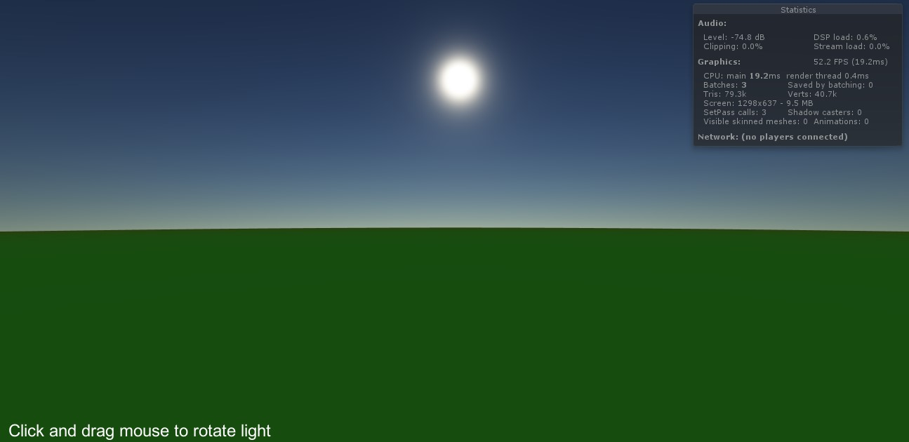

Slide 11
Atmospheric Scattering Visualization and Illumination 1 University of Minho
Bruno Barbosa (a67646)
Carlos Gonçalves (a67650)
Rafael Antunes (a67711)

