Slide 1
Work Assignment
Distributed Parallel Computing
Advanced Architectures
University of Minho
Carlos Antunes 67711
Nuno Oliveira 67449

Slide 2
Testing Environment
MSI GE60 2QE 1026XPT Apache Pro
Intel Core i7-4720HQ
4 Physical Cores
2 logical core per physical core
2,6 GHz Base Frequency
Haswell Architecture
128 GFLOPS (double precision)

Slide 3
Testing Environment
Cache
L1 Data Cache Size: 4 x 32 KB
L1 Instructions Cache Size: 4 x 32 KB
L2 Unified Cache Size: 4 x 256 KB
L3 Unified Cache Size: 6144 KB
RAM
Size: 8 GB
DDR3L
1600 MHz
Maximum Memory Bandwidth: 13 GB/s

Slide 4
Benchmarks
Linpack (CPU)
Bandwidth (Memory)

Slide 5
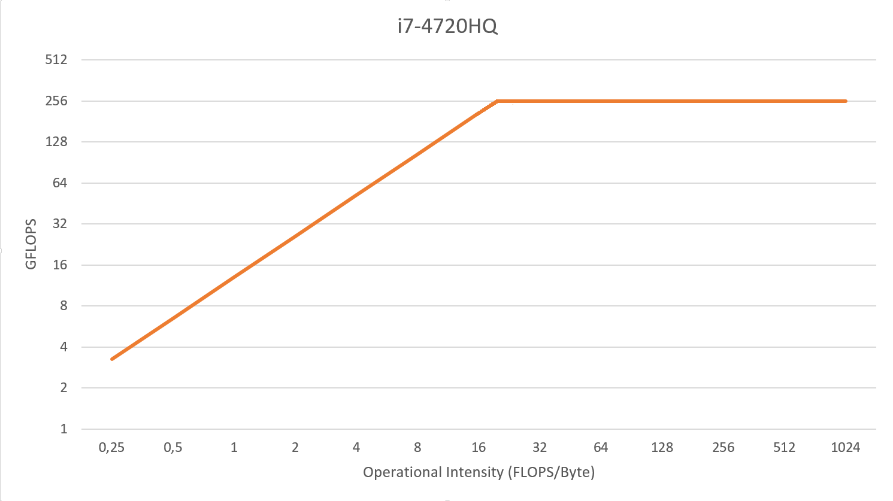
Notes:
Roofline Model
Single precision

Slide 6
Testing
All test were executed 8 times.
Values were chosen according to the k-best scheme (k=3).

Slide 7
Matrix
Elements | Size | FLOP | L3 Misses | GFLOPS
40 x 40 | 18.75 KB | 128 000 | 2 | 2,649
120 x 120 | 168.75 KB | 3 456 000 | 0 | 2,377
600 x 600 | 4.12 MB | 432 000 000 | 9 962 | 1,971
1000 x 1000 | 11.444 MB | 2 000 000 000 | 3 428 183 | 0,620
Notes:
GFLOPS obtidos na mmult
i j k

Slide 8
The Code
void mmult(float **a, float **b, float **result, int N ) {
...
for ( i = 0; i < N; i++)
for ( j = 0; j < N; j++)
for ( k = 0; k < N; k++)
result[i][j] += a[i][k] * b[k][j];
}

Slide 11
Work Assignment
Distributed Parallel Computing
Advanced Architectures
University of Minho
Carlos Antunes 67711
Nuno Oliveira 67449
Notes:
conclusão
Vetorização nao feita
Memory bound
performance baixa
dificuldades a calcular intensidade operacional

