Slide 1
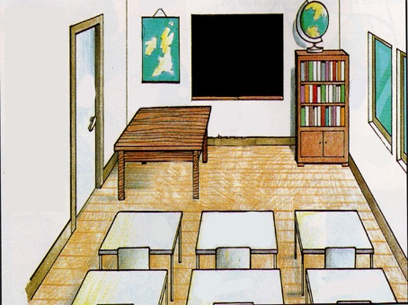
School
Objects

Slide 2
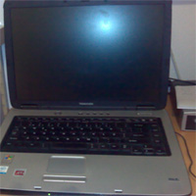
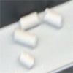
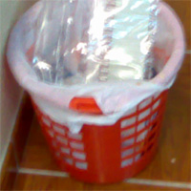
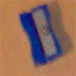
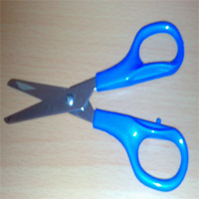
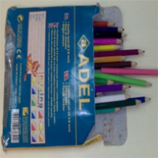
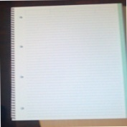
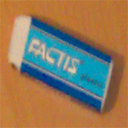
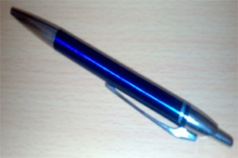

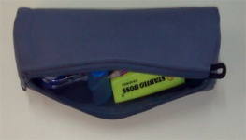
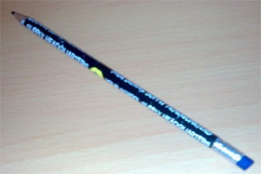
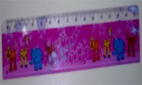

Slide 3

How to write
14.Blackboard
1.Chalk
3.Computer
13.Wastepaper
basket
8.Pencil
sharpener
12.Scissors
7.Notebook
11.Ruler
2.Colour pencils
5.Pencil
case
6.Pen
4.Glue
10.Rubber
9.Pencil

Slide 4
Copy to your notebooks
1 – Chalk
2 – Colour pencils
3 – Computer
4 – Glue
5 – Pencil case
6 – Pen
7 – Notebook
8 – Pencil sharpener
9 – Pencil
10 – Rubber
11 – Ruler
12 – Scissors
13 – Wastepaper basket
14 - Blackboard
1 – Giz
2 – Lápis de cor
3 – Computador
4 – Cola
5 – Estojo
6 – Caneta
7 – Caderno
8 – Apara-lápis
9 – Lápis
10 – Borracha
11 – Régua
12 – Tesoura
13 – Balde do lixo
14 - Quadro

Slide 5
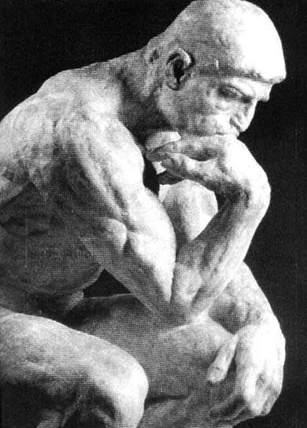

?
What is this?
This is a pen.

Slide 6
?
What is that?
That is a pen.

Slide 7
Copy to your notebooks:
1.What is this?
This is a pen.
2.What is that?
That is a pen.

Slide 8
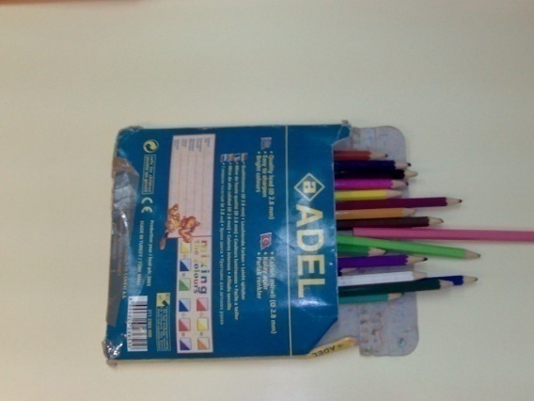
?
What are these?
These are colour
pencils.

Slide 9
?
What are those?
Those are colour
pencils.

Slide 10

Copy to your notebooks:
1.What are these?
These are colour pencils.
2.What are those?
Those are colour pencils.

