Slide 1
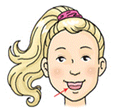
THE BODY RIDDLES
NOSE
MOUTH
GO
YES
EAR
It is used to
eat and talk.

Slide 2
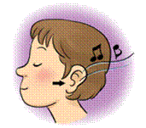
THE BODY RIDDLES
NOSE
MOUTH
GO
YES
EAR
The part of
the body that
senses sound.

Slide 3
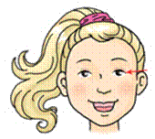
THE BODY RIDDLES
EYE
NECK
GO
YES
EAR
The part of
the body that
gives us sight.

Slide 4
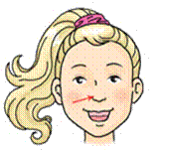
THE BODY RIDDLES
NOSE
MOUTH
GO
YES
HANDS
We sense smells
with this part
of the body.

Slide 5
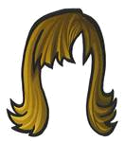
THE BODY RIDDLES
BEARD
EYES
GO
YES
HAIR
The long
strands that
grow on the top
of our head.

Slide 6
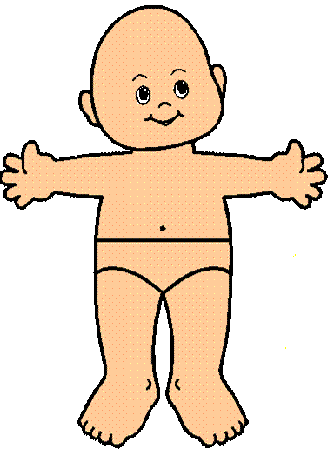
THE BODY RIDDLES
BODY
FEET
GO
YES
HANDS
The entire
structure of an
organism.

Slide 7
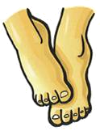
THE BODY RIDDLES
KNEES
HANDS
GO
YES
FEET
We walk on
these.

Slide 8
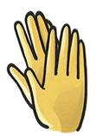
THE BODY RIDDLES
TOES
HANDS
GO
YES
EYES
We can do
amazing things
with them.

