Slide 1



Slide 2
Structure:
1- To / From
2- Subject
3- Salutation
4- Body of Message
5- Signature

Slide 3

Don’t forget to write to whom and from whom.
Write in email address format:
Example: maria_jose@yahoo.com

Slide 4

Should be brief, like a summary of your message.
For instance,
  if you’re giving advice:
  “A piece of advice”; “Some advice” or “Giving advice”
  if you write about cyberbullying:
  “My opinion about cyberbullying".

Slide 5

Informal:
. Hello,
. Hi,
. Dear Anne/ Paul/ Simon, …
. Dear friend, …

Slide 6

Begin with a positive statement (eg.: say thank you for something)
State the purpose of the communication
State what you want the receiver to do (or not do) – when, where, how
State why this is necessary
End with a positive statement (eg.: hope to see you soon/ looking forward to meeting you soon, …)

Slide 7
You can choose to END your e-mail like this (you should always include your name at the end of your message):
I look forward to
_____________ing from you.
_____________ing you.
_____________ reply.
hear
meet
your
Kind regards, Regards,
__________ ________
Warm wishes, Yours truly,
__________ ________
name
name
name
name

Slide 8

As short as possible
As clear as possible
Straight to the point
No flowery language
Use polite language
Use neutral language (nothing that might be offensive to other cultures)

Slide 9

1
To: dave_17@yahoo.com
2
From: rui_2000@gmail.com.pt
3
Subject: A kind piece of advice
4
Hi Dave,
How are you?
It has been a while since we last met. Kristen showed me the letter you sent her. She was stiff worried about you. That’s why I decided to send you this email instead of calling you as you might not feel in the mood to speak.
Well, as your friend since kindergarten, I’d strongly advise you to try to clear up any misunderstandings with your mom. If it doesn’t work, why don’t you go to live with your dad? You’re 17 after all. You have the right to decide what to do with your life and what’s best for you. You can’t live like that! And, please, don’t do anything stupid! Be wise! Be sensible!
Take care and remember that you have good friends you can rely on.
I look forward to hearing from you.
5
Best wishes,
Rui

Slide 10
Giving Advice: ‘If I were in your place,...’
Language function: giving advice and recommendations.
I think/I really think you need to/should ...
How about ...?
It is usually a good idea to ...
My suggestion/advice is (to) ...
Why don't you ...?
You could (try) ...
You probably/definitely/really should ...
My (personal) recommendation is/would be ...
You'd better ...
In this (kind of) situation, I (would) always recommend/advise …

Slide 11

Greet the person
Ask his/her well-being
Explain the reason why you are writing to him/her
Reasons/ concerns to support your writing
Practice: answer to issues presented on a teens’ problem page.

Slide 12
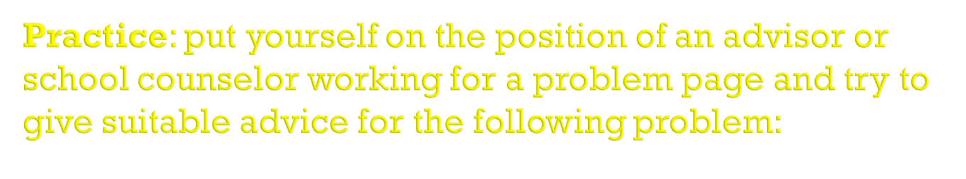
Dear counsellor,
Yesterday, my best friend posted on TikTok a very unflattering photo of me and today I was laughed at in school. I want to talk about this with my friend, but I don’t want to hurt her. What should I do?
Rachel
(rachel_smith2007@gmail.com)

