Slide 1
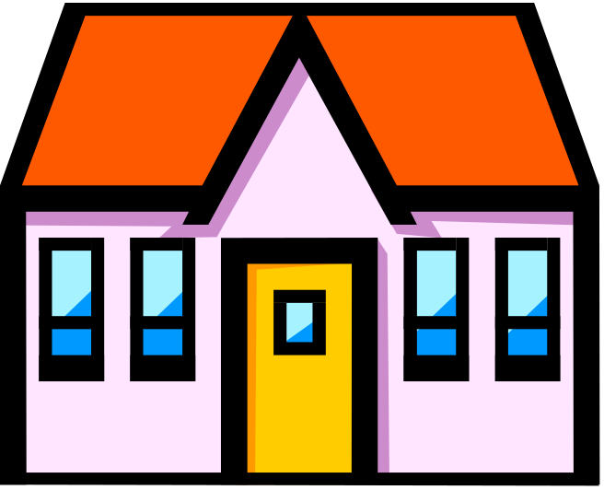

Houses and Homes

Slide 2
Contents
Click the textboxes to jump to the section you require
Different homes
Types of Houses
Building Materials
Label the House

Slide 3
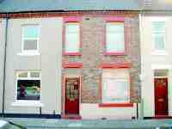
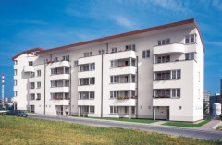
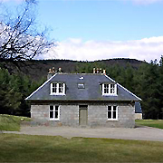
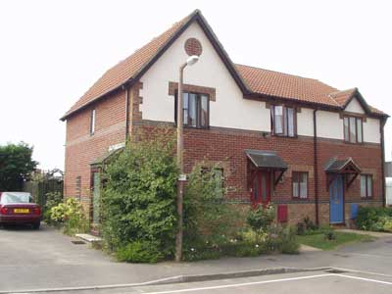
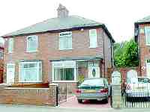
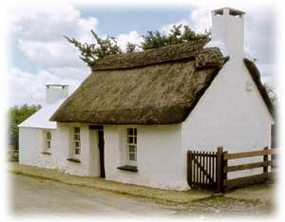
There are all sorts of different houses and homes that we can live in.
What does your home look like?

Slide 4
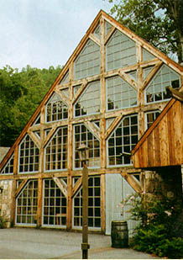
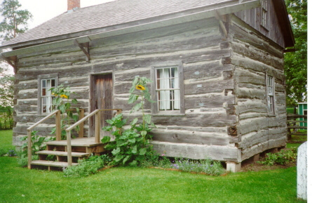
Some people live in unusual homes.
This house has walls made of glass and wood.
This is a log cabin.

Slide 5
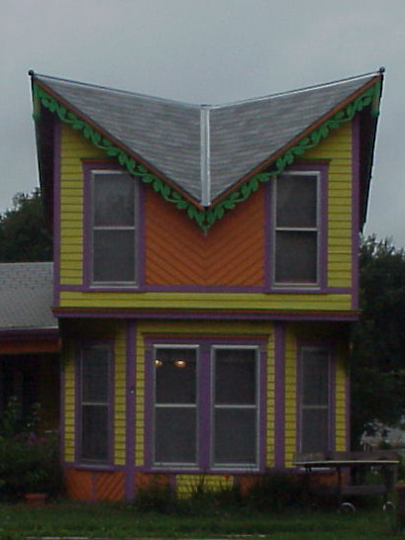
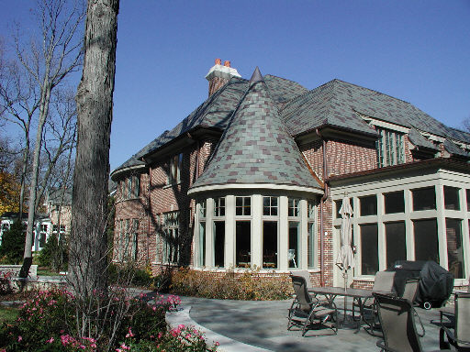
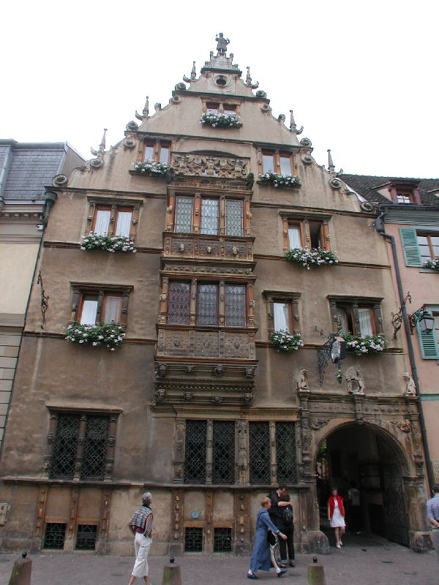
Here are three more unusual homes from around the world.

Slide 6
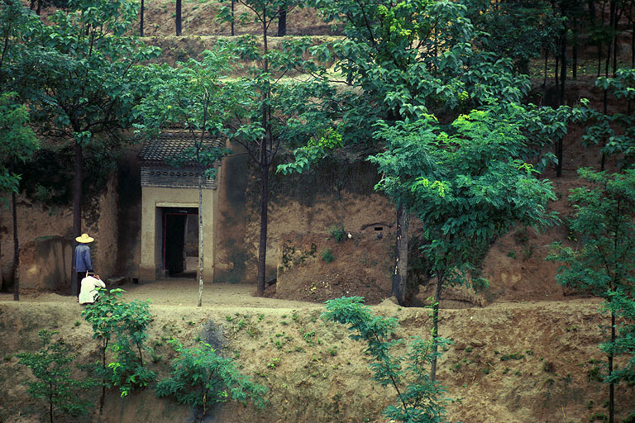
This house in China is built inside a hill.

Slide 7
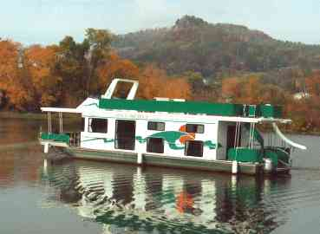
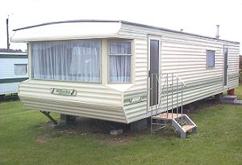
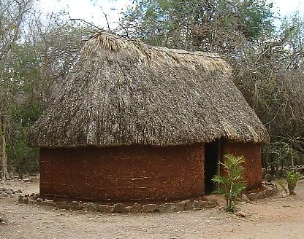
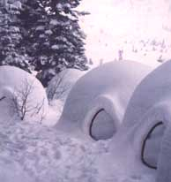
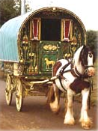
Some people don’t live in a house. They live in a different sort of home.
What is your house like?

Slide 8
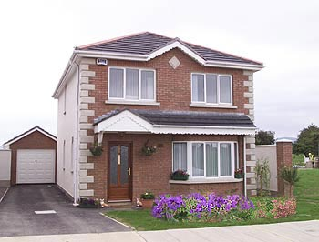
Types of houses .
This house does not have any other houses touching it. It is called a detached house.

Slide 9
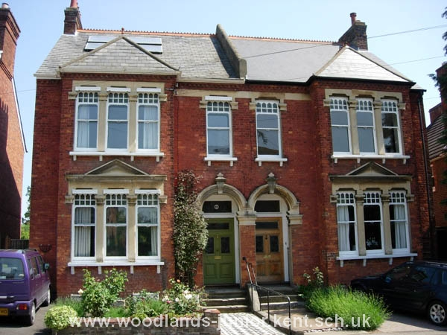
Here are two houses that are joined together. They are called semi-detached houses.
Photo ©www.woodlands-junior.kent.sch.uk

Slide 10
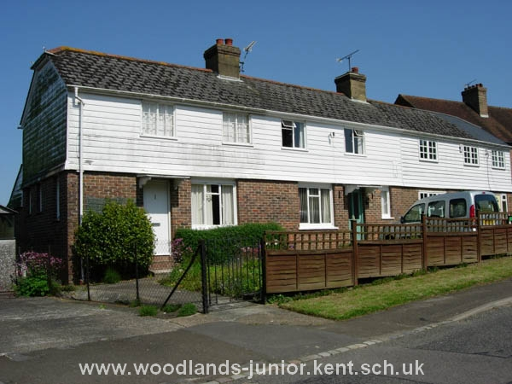
Lots of houses joined together are called terraced houses.
Photo ©www.woodlands-junior.kent.sch.uk

Slide 11
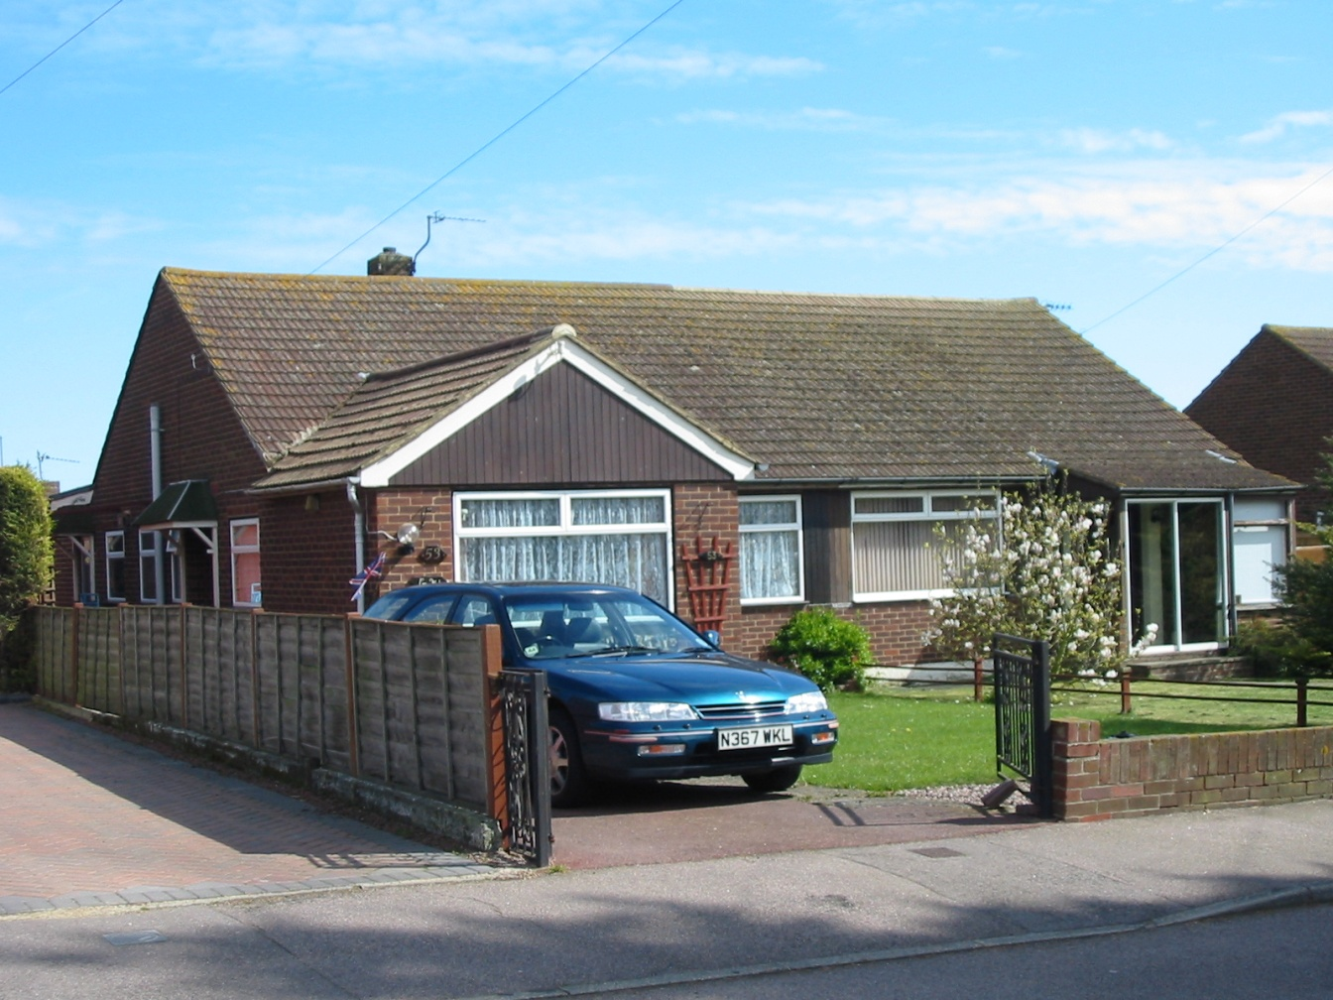
This house has no upstairs. It is called a bungalow.

Slide 12
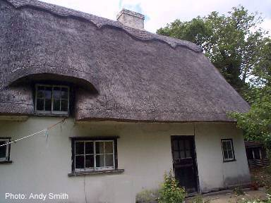
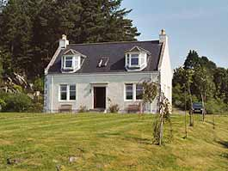
These two houses are usually found in the countryside. One of them has a thatched roof They are called cottages.

Slide 13
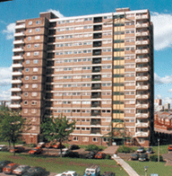
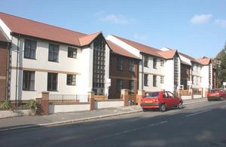
Sometimes lots of families can live in one big building! Sometimes they can be very high up! These are called flats.

Slide 14

bungalow
flats
detached
cottage
terrace
semi-detached
Click the pictures to see the labels appear.

Slide 15
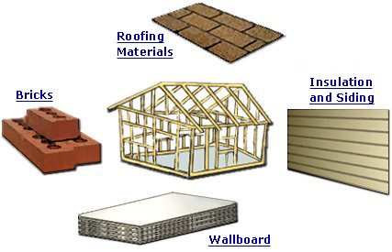
Building Materials
Let’s look at some of the materials we can use to build a house.

Slide 16
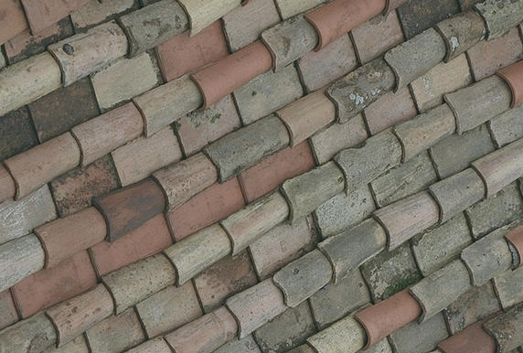
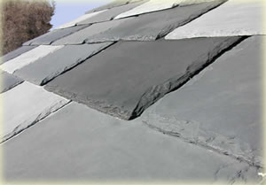
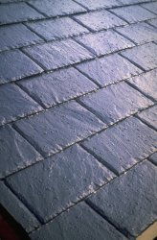
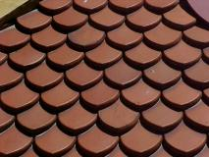
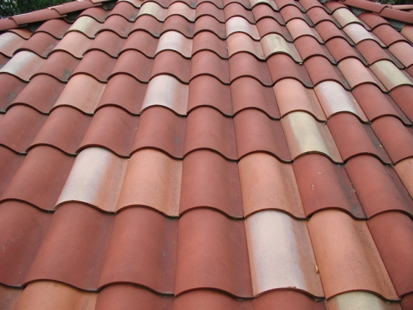
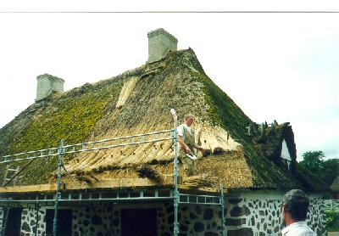
The Roof.
Look at all the different materials that can be used to make a roof.

Slide 17
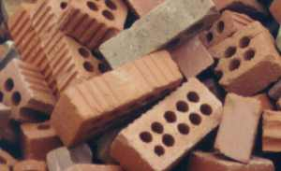
The Walls
Most houses in Britain are built using bricks……

Slide 18
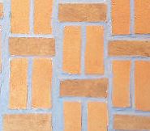
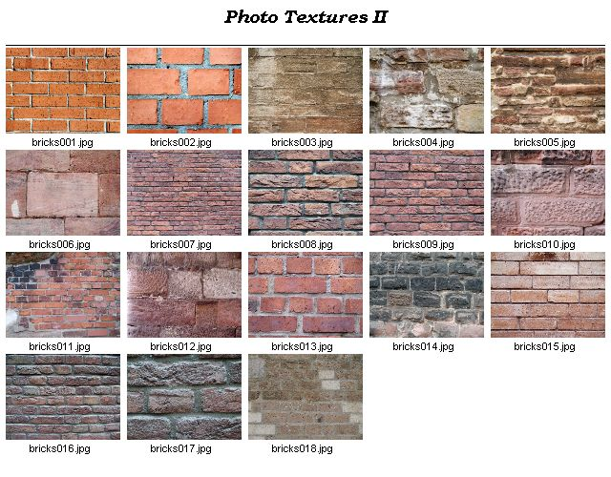
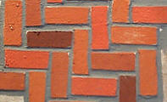

…and there are lots of different colours types.

Slide 19
Parts of a house.
Click the arrows to label the house
chimney
roof
window
wall
door
We have seen some of the building materials. Let’s have a look at the windows and doors.

Slide 20
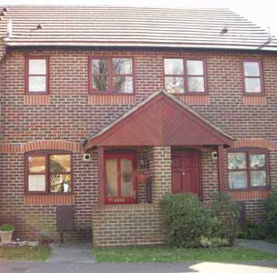
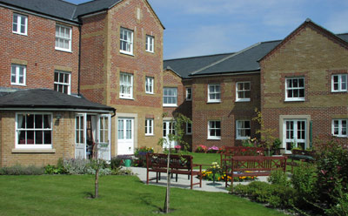
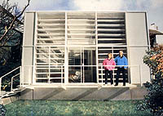
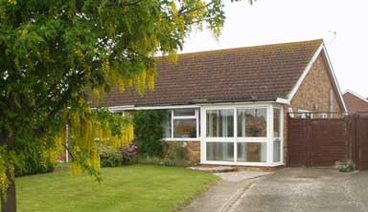
As you can see there are lots of different types of houses and homes. I hope you have enjoyed looking at them.

