Slide 1
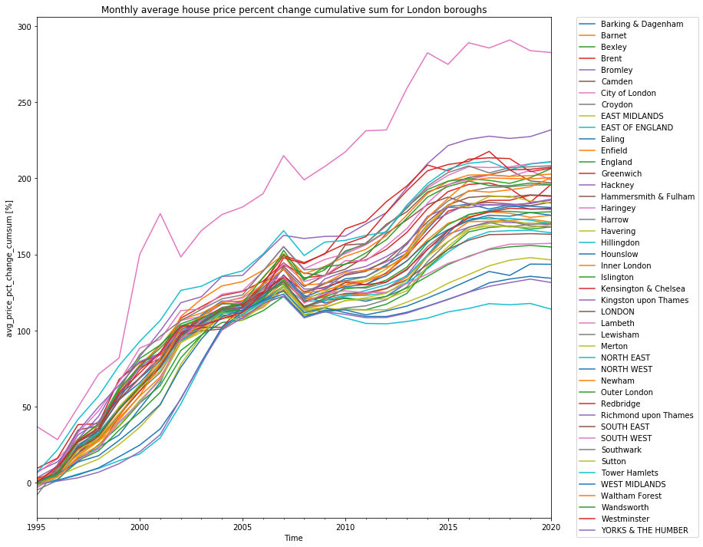
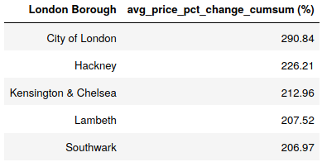
Findings and Trends
1) Best time to invest in City of London: 1996
2) 2008 financial crisis. Marks the start of larger spread in house price per borough, hinting into economy change towards inequality.
3) Massive static shift in City of London house prices, possibly due to external agents to market (e.g. policy change).
4) Nice recovery of the three bottom boroughs (North East, Yorks & The Humber, North West). Unfortunately, it didn’t last long past financial crisis.
2018 Top 5 expensive boroughs
2
2008 Financial Crisis
City of London
3
Larger spread of inequality
1
4

Slide 2
How did you arrive at your conclusion?
1) Download and clean the data from:
"https://data.london.gov.uk/download/uk-house-price-index/70ac0766-8902-4eb5-aab5-01951aaed773/UK%20House%20price%20index.xls"
2) Take the percent change of house price on a monthly basis for each borough. Then take the cumulative sum of this column (by borough).
3) Down sample the frequency of observations by selecting the accumulated percent change on December of each year.
4) Create a pivot table for easily plotting each borough (columns) cumulative price percent change over time (index).
What were the main challenges you encountered?
It took me a while to figure out how to apply the create_price_ratio custom function to the groupby object. Since the function is an aggregation by definition I was trying to use the .agg() method.
How did you overcome them?
Trial and error, reading my notes on the DataCamp groupby class, and StackOverflow. In the end I used .apply() instead of .agg().
What could you not overcome?
I’m still puzzled on why the City of London borough didn’t show in the top five list when following the price ratio method suggested in the exercise.
Is there anything you’d like to investigate deeper?
It will be interesting to go on a literature research to find industry metrics that make sense to real state investors and see how these compare with the cumulative percent change of house price used in this exercise.

