Slide 1
Big Mountain Resort Weekend Ticket Price Analysis
June 7th 2020

Slide 2
Problem Identification
$1.54M/year deficit to operate new lift
300k/year park visitors
To keep ROR constant we must raise ticket prices at least $1.54M/300k = $5.14/ticket
Is this price increase reasonable given Big Mountain Resort’s amenities and competitor’s pricing?

Slide 3
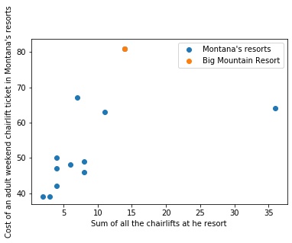
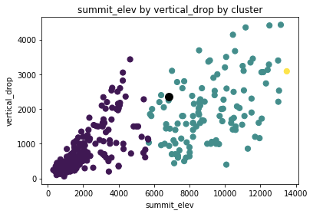
Recommendation and Key Findings
Big Sky
Yes, the data supports an increase of up to 7$.
Largest driver for price is a combination of vertical drop and summit elevation.
2018 Montana lift tickets
Big Mountain
Big Mountain
Average price for all USA resorts

Slide 4
Modeling and Analysis
Used 2018 ski data
  330 USA resorts samples
  26 variables: Resort’s characteristics
Target variable: Adult Weekend Chairlift Price
Missing price data was imputed with the sample mean. Big Sky Resort price data was missing (largest competitor in Montana).

Slide 5
Modeling and Analysis
IQR*1.5 proved to be too harsh for removing outliers.
Only a handful of outliers were removed in a case by case basis.
Base elevation variable was dropped as it correlates 98% with summit variable.
Data split: 75% training, 25% testing

Slide 6
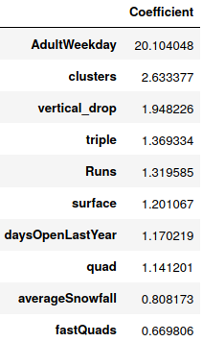
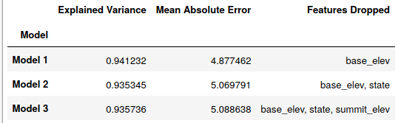
Modeling and Analysis
Used linear model regression.
Selected model explains 94% of the variance, and has a 5.1 Mean absolute error.
10 most important variables that drive chairlift price
Model Selected

Slide 7
Summary and Conclusions
It is reasonable to increase Big Mountain weekend chairlift ticket price up to 7$ to makeup for the new lift operation cost.
I suggest we study the history of Big Mountain resort price increases and past customer sentiment if available to minimize risk of temporarily losing customer base after price increase.

