Slide 1
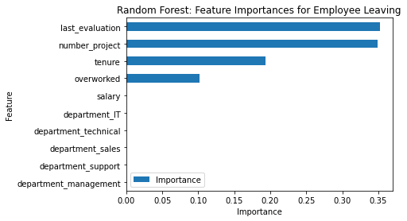
Predicting Employee Turnover at Salifort Motors
Prepared by Rafael Ribeiro Ferreira
Project Overview
This project leveraged machine learning to analyze employee data at Salifort Motors. We aimed to predict employee departures and identify key factors influencing turnover. The goal is to develop data-driven recommendations to reduce employee churn.
Our machine learning model achieved an accuracy of 96% in predicting employee departures.
Key factors identified by the model and analysis of employee data that influence turnover include:
Last Evaluation: Employees that left low evaluation scores during their time left more often.
Number of Projects: Employees that did too many projects or close to 0 left the company.
Tenure: Short-Tenured employees had lower salaries and left the company more frequently.
Implement Targeted Programs: Develop programs addressing workload, performance reviews, and departmental factors based on model findings.
Deepen Departmental Analysis: Investigate high-turnover departments to identify specific leadership or workload issues.
Refine Machine Learning Model: Continuously improve the model with additional data and explore new techniques for enhanced accuracy.
Collaborate and Evaluate: Communicate findings to HR and leadership for collaborative implementation and track program effectiveness through metrics like turnover rates.

