Slide 1


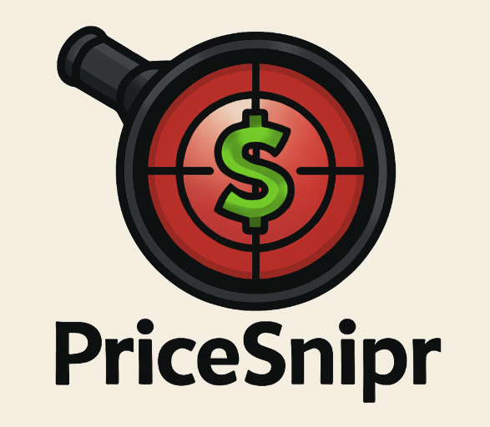



Team 10’s Midterm Semester Project Presentation: PriceSnipr
CS 3300-001 Intro to software engineering
Summer midterm semester 2025
Team 10’s members:
Rafael Rojero
dylan lareno
Professor: Dr. Armin Moin
Teaching Assistant (TA): Himon Thakur
Permission is granted for publication on the UCCS website.

Slide 2

Introduction: PriceSnipr
What is PriceSnipr?
PriceSnipr is a Python-based application that will help users track the price of online products across major retail sites like Amazon, Walmart, and eBay.
It will automatically check for price changes, trends and also notify users when a product's price drops below a chosen threshold so they can get the best deal.

Slide 3
Who is the Customer and End-User?
Customer / Audience: Everyday online shoppers including students, parents, deal-hunters, and anyone trying to save money on frequently browsed items.
End-User: Anyone who shops online and wants to monitor a product’s price without constantly checking manually. The end-user will interact with a simple, clean interface where they input a product URL and a price limit.

Slide 4

What Problem Are We Solving?
Online shoppers often:
Miss out on price drops or flash deals
Spend too much time checking and rechecking product pages
End up overpaying because they bought too early
PriceSnipr solves this by:
Watching product prices 24/7 in the background.
Alerting users when the price falls below their set target.
Helping users make smarter buying decisions and save money without extra effort.

Slide 5

What Value is Price$nipr Creating?
Convenience: Users don’t have to constantly check prices themselves.
Savings: Alerts help them buy at the lowest possible price.
Peace of Mind: They won’t miss a deal again

Slide 6
Related Works (Competitors & Tools)
Some of the most recognized tools in the price tracking space include:
Honey (by PayPal) – Applies coupons and shows some price history, but lacks multi-store tracking and is browser-extension only. https://www.joinhoney.com/paypal
CamelCamelCamel – Tracks Amazon prices with historical graphs but supports only one store and lacks real-time alerts. https://camelcamelcamel.com/
Keepa – Strong Amazon price tracking with a paid API, but limited customization and broader product tracking. https://keepa.com/#!
Slickdeals – Deal aggregator, not product-specific tracking. https://slickdeals.net/

Slide 7

What is Our Unique Selling Point (USP)? What Makes PriceSnipr Different?
Multi-store support: We are not limited to Amazon PriceSnipr will work with any site supported by SerpAPI (including Amazon, Walmart, eBay, BestBuy, and more).
Real-time alerts: Users can track product prices in real time and receive alerts when prices drop below a custom threshold.
No browser extension required: Unlike Honey or Keepa, PriceSnipr runs as a standalone Python app (CLI or GUI).
Customizable and open-source: Full control over tracked items, frequency, alert types, and expansion.

Slide 8
Functional & Non-Functional Requirements
Functional:
Store Selection: Users can select which store(s) they want to track prices from.
Track Price: The system fetches the current product price using SerpAPI and compares it to the target.
Display Current Price & Store Info: The GUI shows the product name, current price, and store name.
Start/Stop Tracking: Users can begin or end the price tracking for selected products.
Non-Functional:
Usability: The interface must be simple, intuitive, and beginner-friendly.
Performance: Price checks should complete within 2–3 seconds under normal network conditions.
Maintainability: The code should be modular and well-commented so it’s easy to update or expand.
Portability: The app should run on Windows, macOS, and Linux with Python installed.

Slide 9

Work Breakdown: Agile, Scrum, Sprint Plan
We are using the Agile methodology with the Scrum framework, organized into weekly sprints. This ensures iterative progress, early feedback, and continuous improvement throughout the development of PriceSnipr.
Scrum Roles:
Product Owner: Rafael- Manages the product backlog and defines the value being delivered to the user.
Scrum Master: Dylan- Ensures the team follows Scrum practices, removes blockers, and facilitates sprints.
Scrum Team: Rafael & Dylan- Responsible for delivering sprint goals and completing assigned tasks collaboratively.

Slide 10
Sprint Plan (6 Weeks) – June 9 to July 26
Sprints: | Dates: | Task Description: | Assigned to:
Sprint 1 | June 9 – June 15 | Project setup, folder structure, initialize GitHub, plan core modules | Both
Sprint 2 | June 16 – June 22 | Build CLI + test SerpAPI integration (Amazon, eBay, Walmart) | Rafael
Sprint 3 | June 23 – June 29 | Build GUI (tkinter), input form, buttons, result display | Rafael
Sprint 4 | June 30 – July 6 | Hook GUI to backend, test real product tracking, write to CSV | Rafael
Sprint 5 | July 7 – July 13 | Add price threshold logic + notifications (popups) | Both
Sprint 6 | July 14 – July 20 | Price history log viewer, polish codebase, error handling, test cases | Rafael
Final Touches | July 21 – July 26 | Final bug fixing, UI polish, prepare demo for presentation, Documentation | Both

Slide 11

Will PriceSnipr be Open Source?
Yes, PriceSnipr will be released as an open-source project on GitHub.
Why Open Source?
Transparency – Users and developers can see how the app works
Collaboration – Other developers can suggest improvements or contribute features
Learning Tool – Students and beginners can study the code to learn about APIs, GUIs, and automation
The full project code will be hosted at: https://github.com/RafaelRoj8/CS_3300_Grp10_Project
MIT Open-Source License

Slide 12
How PriceSnipr Relates to CS3300 Course Concepts
Course Concept | How It Applies to PriceSnipr
Agile & Scrum Methodologies | We use Agile with Scrum framework: defined sprints, roles (Scrum Master, Product Owner), backlog
Sprint Planning & Team Roles | Work is broken down weekly (sprints), with handling backend and the frontend
Software Process Models | We follow an iterative process (Agile) vs. traditional models like Waterfall
Team Collaboration & Management | Our weekly standups, shared GitHub repo, and task distribution mirror professional team practices
Open Source & Licensing | We’re releasing our project on GitHub, aligning with course ethics
Project Documentation & Planning | We’ve created user stories, a task breakdown, and maintain sprint reviews & retrospectives
Real-World Problem Solving | PriceSnipr solves a common user pain point (price watching) using scraping/APIs and automation

Slide 13

Thank You For Your Time!
Questions?

