Slide 1
07/26/17

Slide 2
next, try to fit ³H(d,n)⁴He data using what we have learned in these tests:
RESONANCE ENERGY
restrict to positive values [since we see that the S-factor peaks at E>0]
use a uniform positive or truncated Gaussian prior
REDUCED WIDTHS
try Porter-Thomas distributions for reduced width priors
to break degeneracy, chose in the prior construct one width always
larger than the other one [see earlier]
- use initial starting values for the MCMC

Slide 3
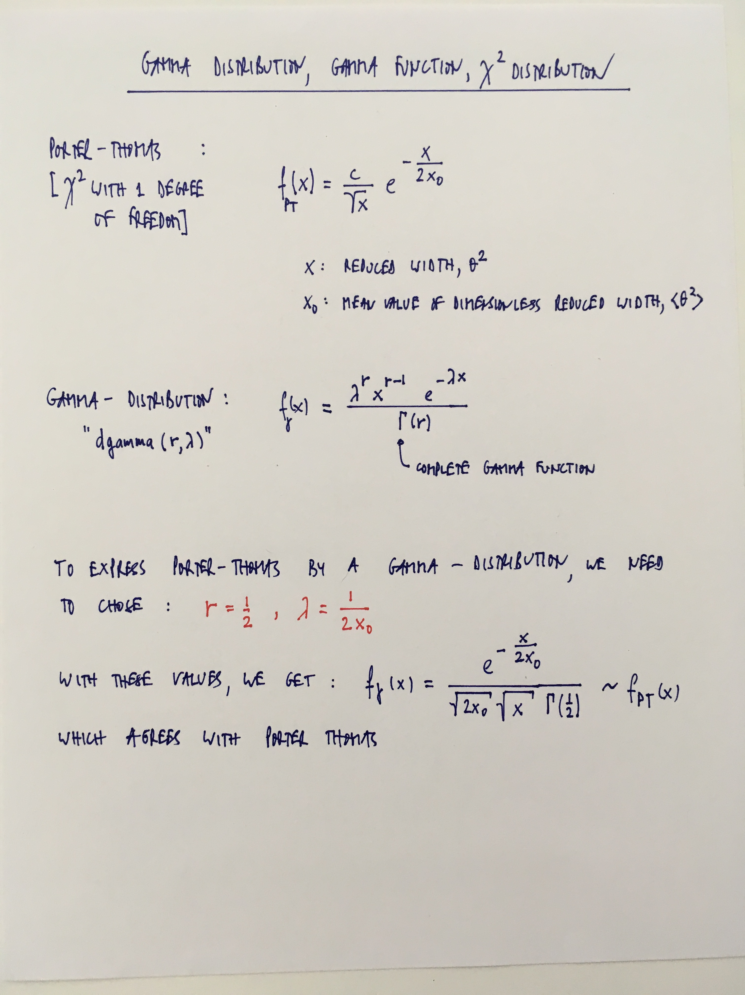
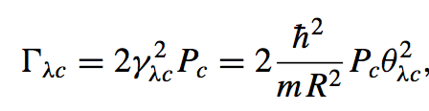
Comments regarding priors for
the widths
one additional complication is that this applies
to dimensionless reduced widths, θ², whereas
the current C++ code uses reduced widths, γ²,
as input;
one could simply rewrite the distribution for γ²:
3.05 MeV [t+d]
4.99 MeV [n+⁴He]
but the channel radius occurs in the conversion,
which needs to be taken care of if the channel
radii for incoming and outgoing channels are to
be randomly sampled as well;
or we change the C++ function that calculates
the S-factor [recompile JAGS]

Slide 4
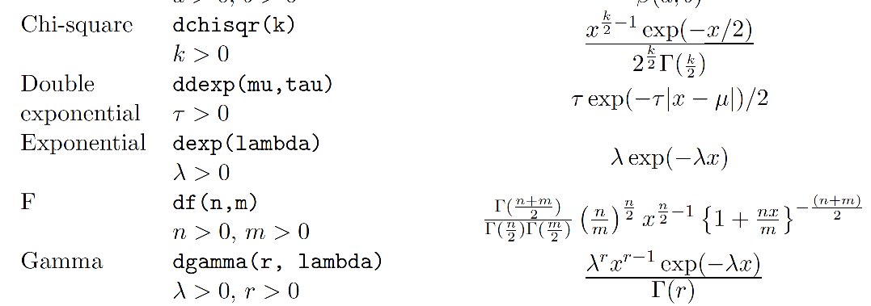
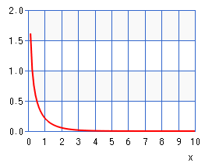
From the JAGS manual [just to make sure the notation is the same]
r=0.5
dgamma(0.5, 1.0)

Slide 5
For the following tests, the S-factor code is directly implemented as a new JAGS
function [requiring to recompile JAGS];
also, we generate artificial t(d,n)⁴He S-factor data using the parameters: Er=0.0912 MeV,
γ_{d}²=2.93 MeV, γ_{n}²=0.0794 MeV [these values were reported by Barker for the actual data];
for the artificial error bar, we use some values [e.g., 1 MeVb];
[see: SfactorTdn_fast_test folder]

Slide 6
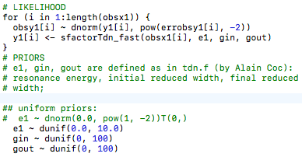
First try:
internal JAGS function [3 parameters]
all uniform priors

Slide 7
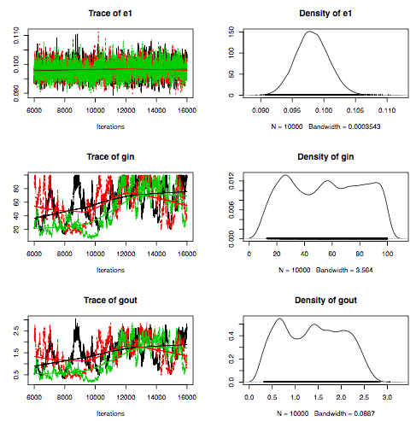
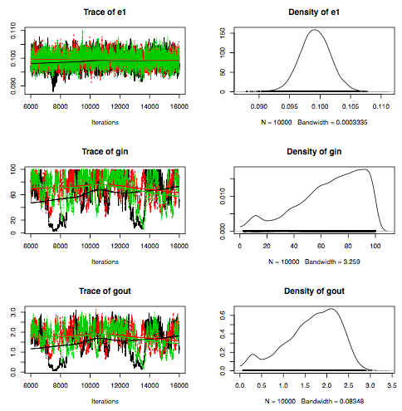
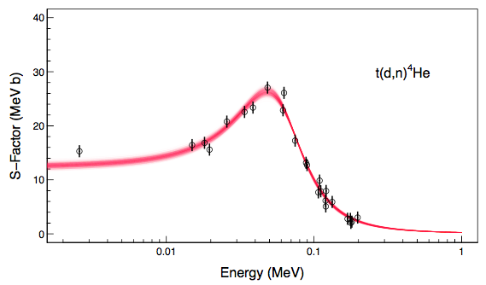
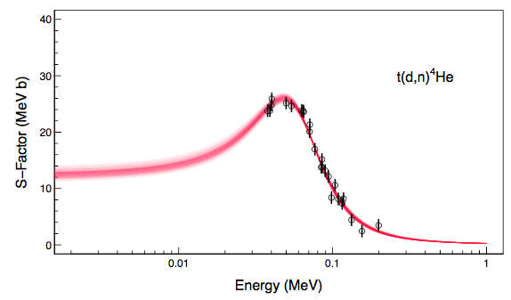
posteriors do not look good, but final fit looks fine; not sure why?!

Slide 8
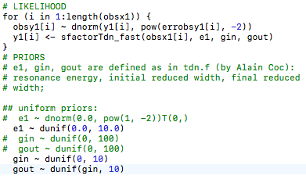
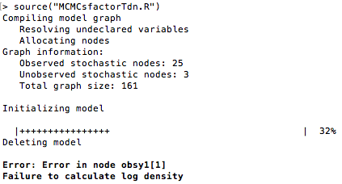
Second try:
choice of prior breaks
degeneracy
repeated attempts give error messages:

Slide 9
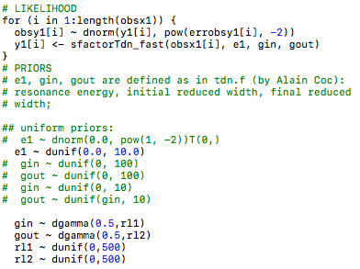
Third try:
see earlier: gamma distribution is used to model Porter-Thomas; assuming <θ²>=0.001
for both deuterons and neutrons [somewhat uncertain], we find for the parameters:
lambda = [2 <γ²>]⁻¹ = [2 x 0.001 x 3.05 MeV]⁻¹ = 164/MeV for t+d
lambda = [2 <γ²>]⁻¹ = [2 x 0.001 x 4.99 MeV]⁻¹ = 100/MeV for n+⁴He
since these mean values are somewhat uncertain, we use hyperpriors that are uniform on
a broad range;
the parameter r must be set to 0.5 [see earlier]

Slide 10
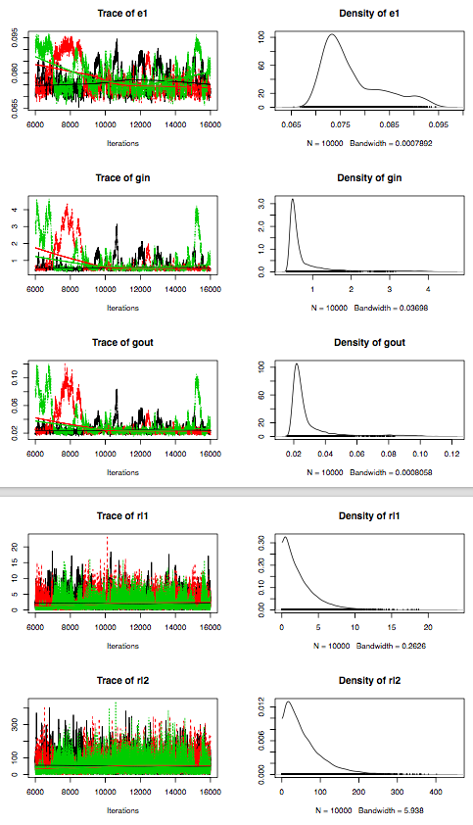
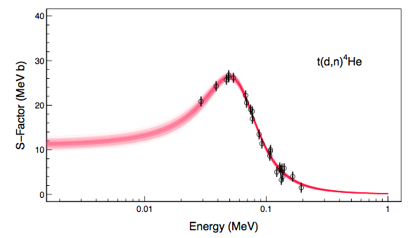
…these parameters are garbage...
not sure why?!

Slide 11
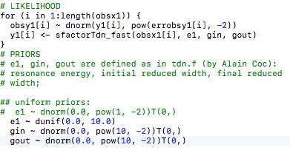
Third try:
truncated broad Gaussian priors for widths

Slide 12
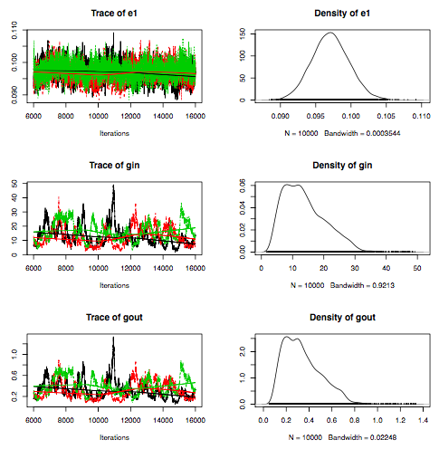
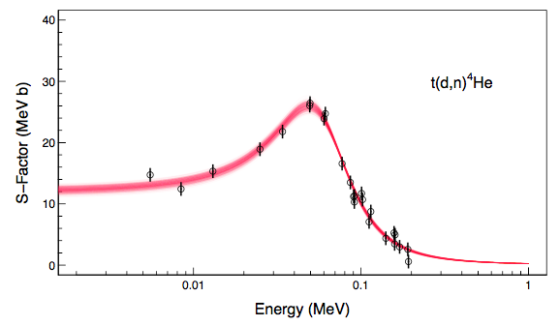
results are not particularly good…

