Slide 1


PATHFINDING ALGORITHM FOR SEXUAL HARASSMENT PREVENTION, APPLIED TO MEDELLÍN-COLOMBIA

Slide 2

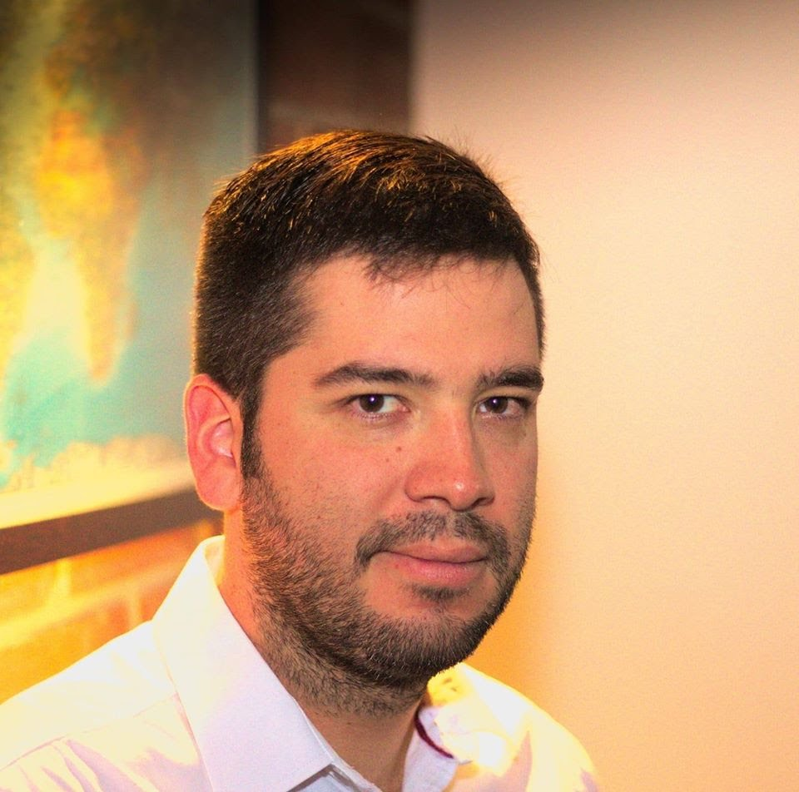
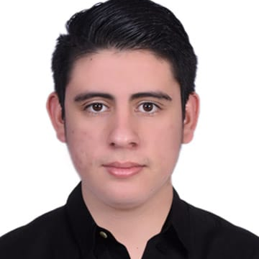
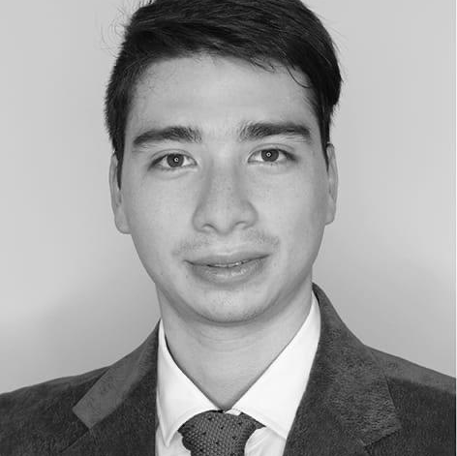


Presentation of the team
Carlos Mazo
Author
Rafael Urbina
Author
Andrea Serna
Literature review
Mauricio Toro
Data preparation
https://github.com/RafaelUrbina/st245-001

