Slide 1
Python Intermediate Final Project
Spring 2023

Slide 2
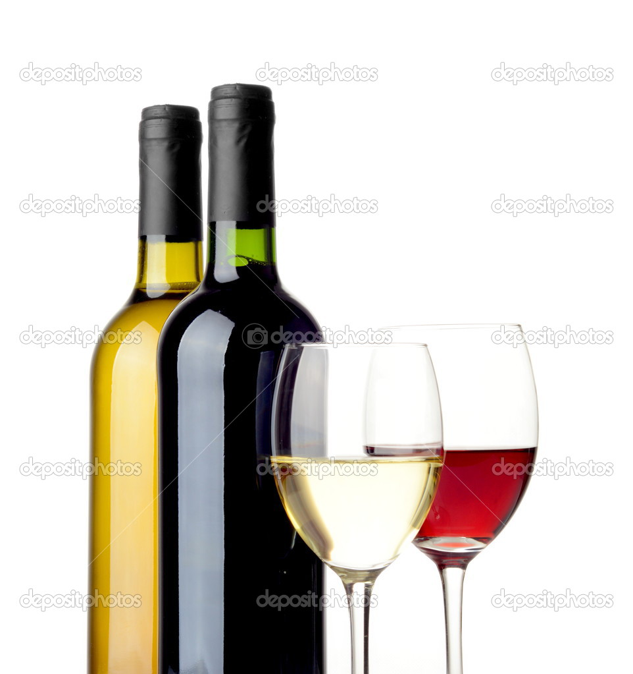
Wine classifier
muc-dcp-python-hybrid-s23
https://github.com/RafaelaAltermann

Slide 3


Hello, my name is Rafaela Altermann. I am from Brazil. Currently I am a student of Python Intermediate, and also a volunteer teacher for Python Block Programming for youth since two semesters. In addition to my studies and teaching, I am a professional pedagogue and mother of two children. My son, who is 12 years old, is also enrolled in the robotics course at ReDI. I am excited to continue learning and sharing my knowledge with others.
I have chosen the topic of data analysis for my project because it is an area that I am passionate about and where I want to specialize. Today, I am excited to present the final project that I have developed, which focuses on data analysis and visualization. I hope you enjoy it and find it informative!

Slide 4
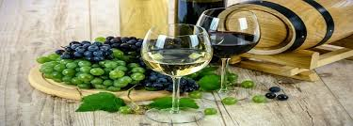
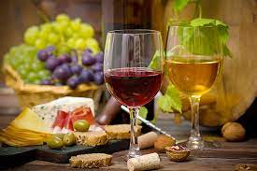
The Wine Classifier code in summary :
The code reads a wine dataset and trains a classification model, which is used to predict the color of a specific wine, based on its characteristics.
To test the classification model, a random entry from the dataset is used.
T

Slide 5
The Wine classifier code in 3 Steps

Slide 6


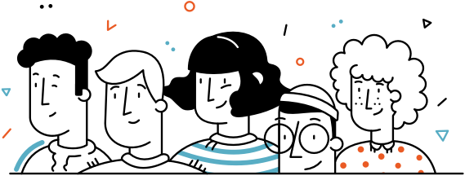

Step 1 : To perform the analysis, I used a dataset on wines obtained from Kaggle.com Using the dataset in CSV format I conducted tests using PyCharm and Jupyter Notebook. The dataset contains 13 columns, with various characteristics of red and white wines, such as acidity, volatility, alcohol content, among others.

Slide 7
Step 2 :
Data import and model training:
I used the Pandas library to import the dataset. Then, I performed data pre-processing by converting the 'style' column from string to integer values (0 for red, 1 for white). This was necessary for training the classification model.
I used the ExtraTreesClassifier algorithm from the sklearn.ensemble module to train a classification model. This algorithm is known for its efficiency and good performance on diverse datasets. To test the classification model accuracy, I used the ExtraTreesClassifier score() method.
wine_classifier = WineClassifier("wine_data.csv") wine_classifier.train_model() wine_classifier.test_model()

Slide 8
Step 3 : Data prediction: I also added a method to predict the wine color, given its characteristics, using the classification model predict function. Here is an example using a random entry of the dataset:
# Select a random wine from the dataset and predict its color random_entry = random.choice(range(0, wine_classifier.get_number_of_entries())) random_wine_characteristics = wine_classifier.get_wine_characteristics(random_entry) prediction = wine_classifier.predict(random_wine_characteristics)
# Check if prediction was correct
if prediction == wine_classifier.get_wine_color(random_entry):
print("The prediction was correct!")

Slide 9
Data Visualization Finally, I created graphs to visualize the results. I used the Matplotlib library to generate a bar chart showing the frequency of each wine color (red or white) and a histogram to analyze the distribution of the 'fixed_acidity' and 'alcohol' variables.

Slide 10
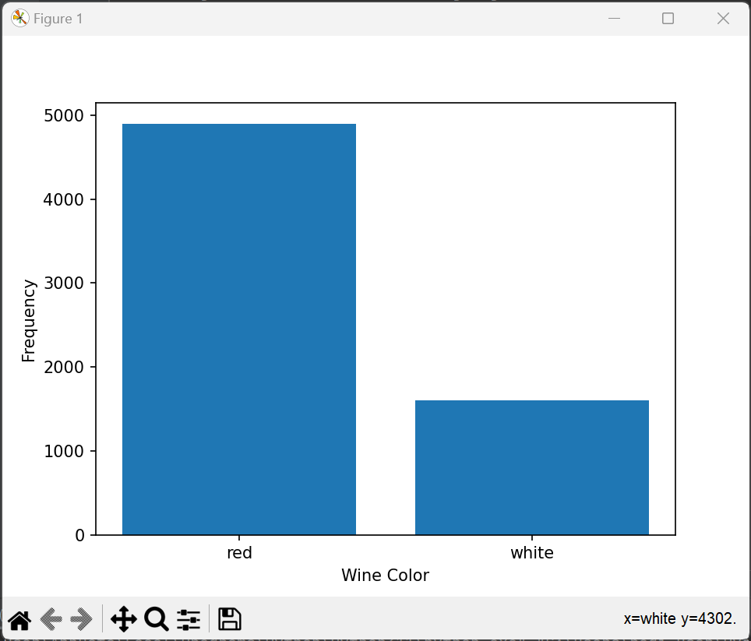
Data Visualization

Slide 11
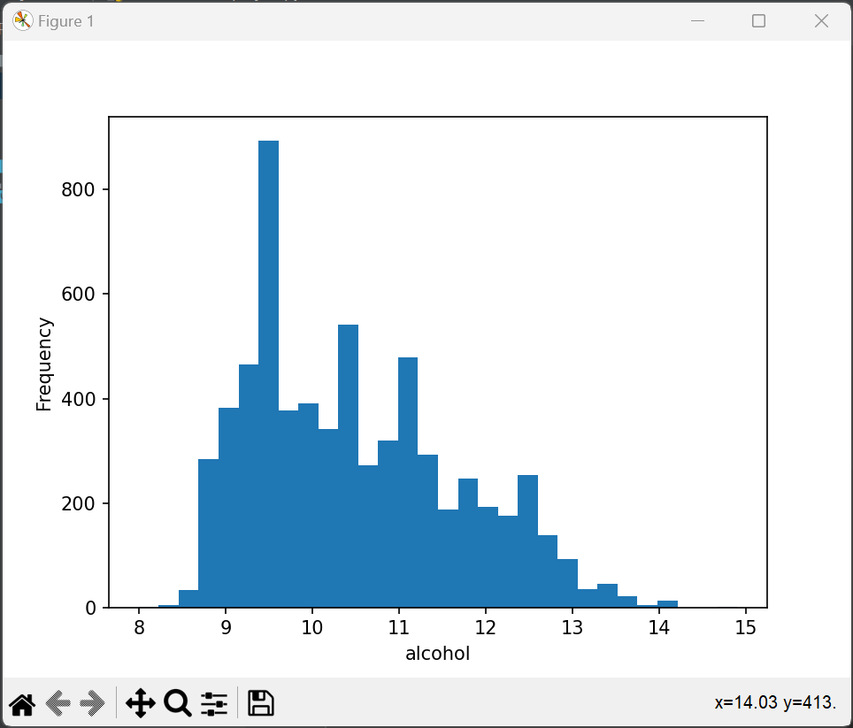
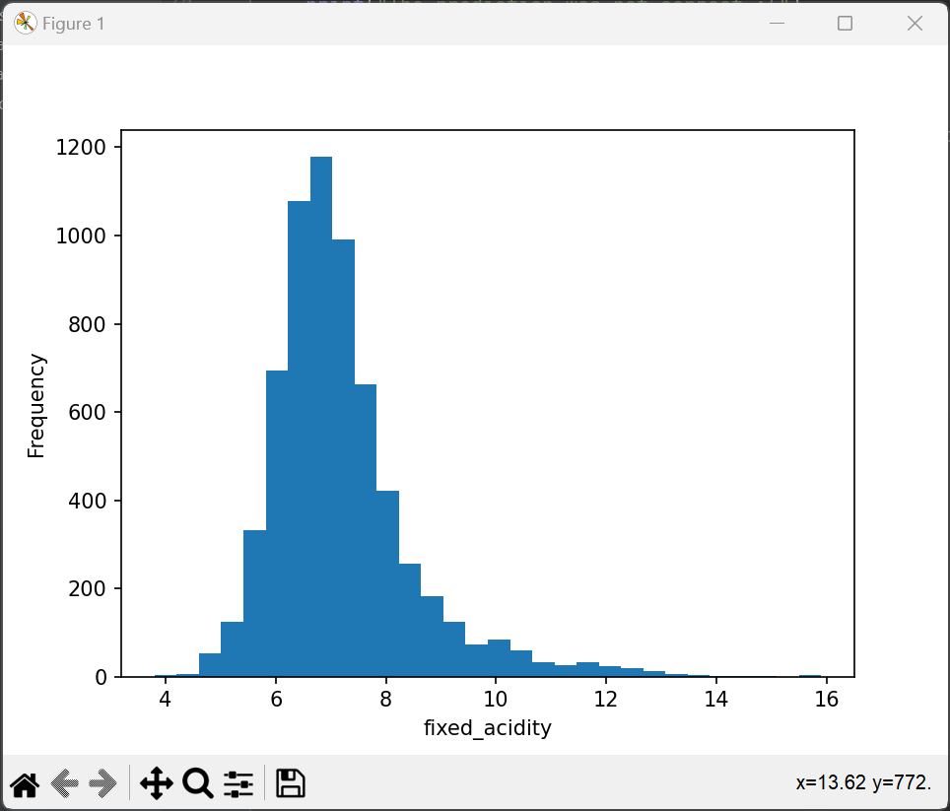
Data Visualization

Slide 12


I hope you enjoyed it, and I would like to take this opportunity to thank all the teachers for their dedication during the course and the support from ReDI School.
I hope you have understood and appreciated the process, the code, and the data visualization.

Slide 13
Thanks a lot! Obrigada !
Contact
Rafaela Altermann Student Python and Volunteer Teacher at ReDI School of Digital Integration MUC
rafaelaaltermann@hotmail.com
https://github.com/RafaelaAltermann

