Slide 1
DTSD 2nd Assignment «Office efficiency monitoring system »
Rafael Ferreira(rafa.ferreira@campus.fct.unl.pt)

Slide 2
Value Proposition
The main focus is to collect data from the office, then bypass that data remotely and work on it to provide the best service possible in terms of utility for the end user.
The objective of the product is to bring automation regarding the person location inside office by rejecting the need to interface with it physically .
This product brings funcionality of real time data monitoring, control ,decision and statistics by letting the user interfacing and managing diferente plataforms.

Slide 3
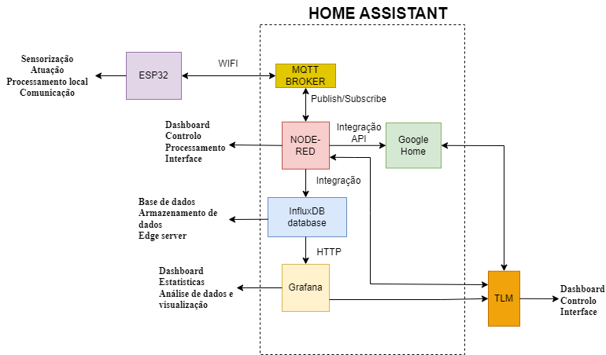
Technical Architecture

Slide 4
Performance
This solution is able to have 3 platforms integrations for the End User to interface with, being it Node-red Dashboard, Grafana Dashboard, Google Home.
Node-red is able to interface in both directions with the user, being it used for monitoring temperature humidity, light intensity, system state on/off, latency, addionally it can change the system state on/off, increase or decrease temperature threshold.
Grafana is used for statistics and data monitoring, being it the strong point the manipulation and versatilly of the statistics that is possible to generate.
Google Home is used for giving commands, like turn on/off the system or change the threshold of temperature.

Slide 5
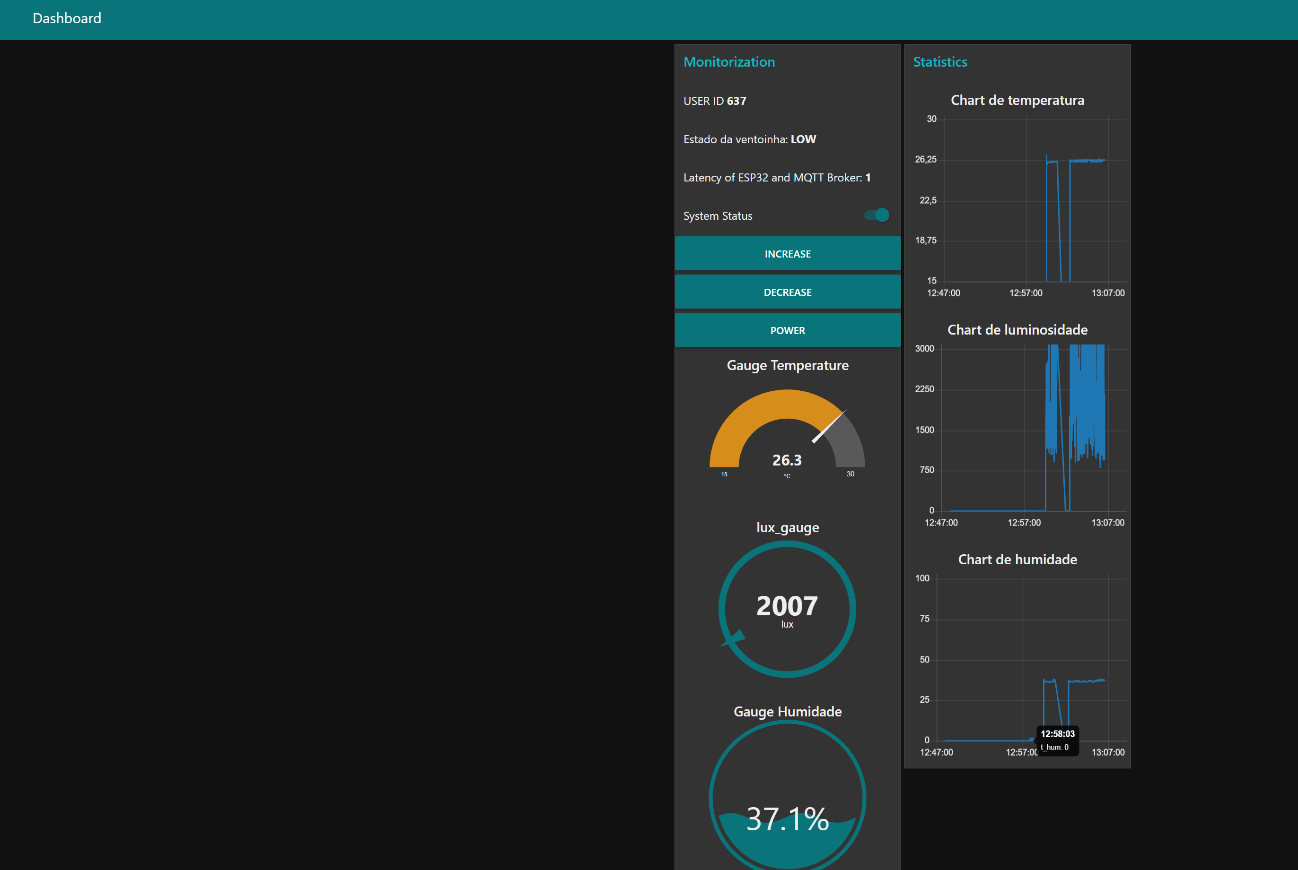
NODE-RED DASHBOARD

Slide 6
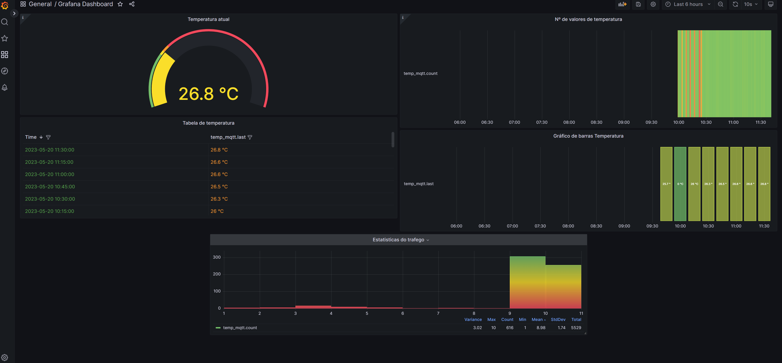
GRAFANA Dashboard

Slide 7
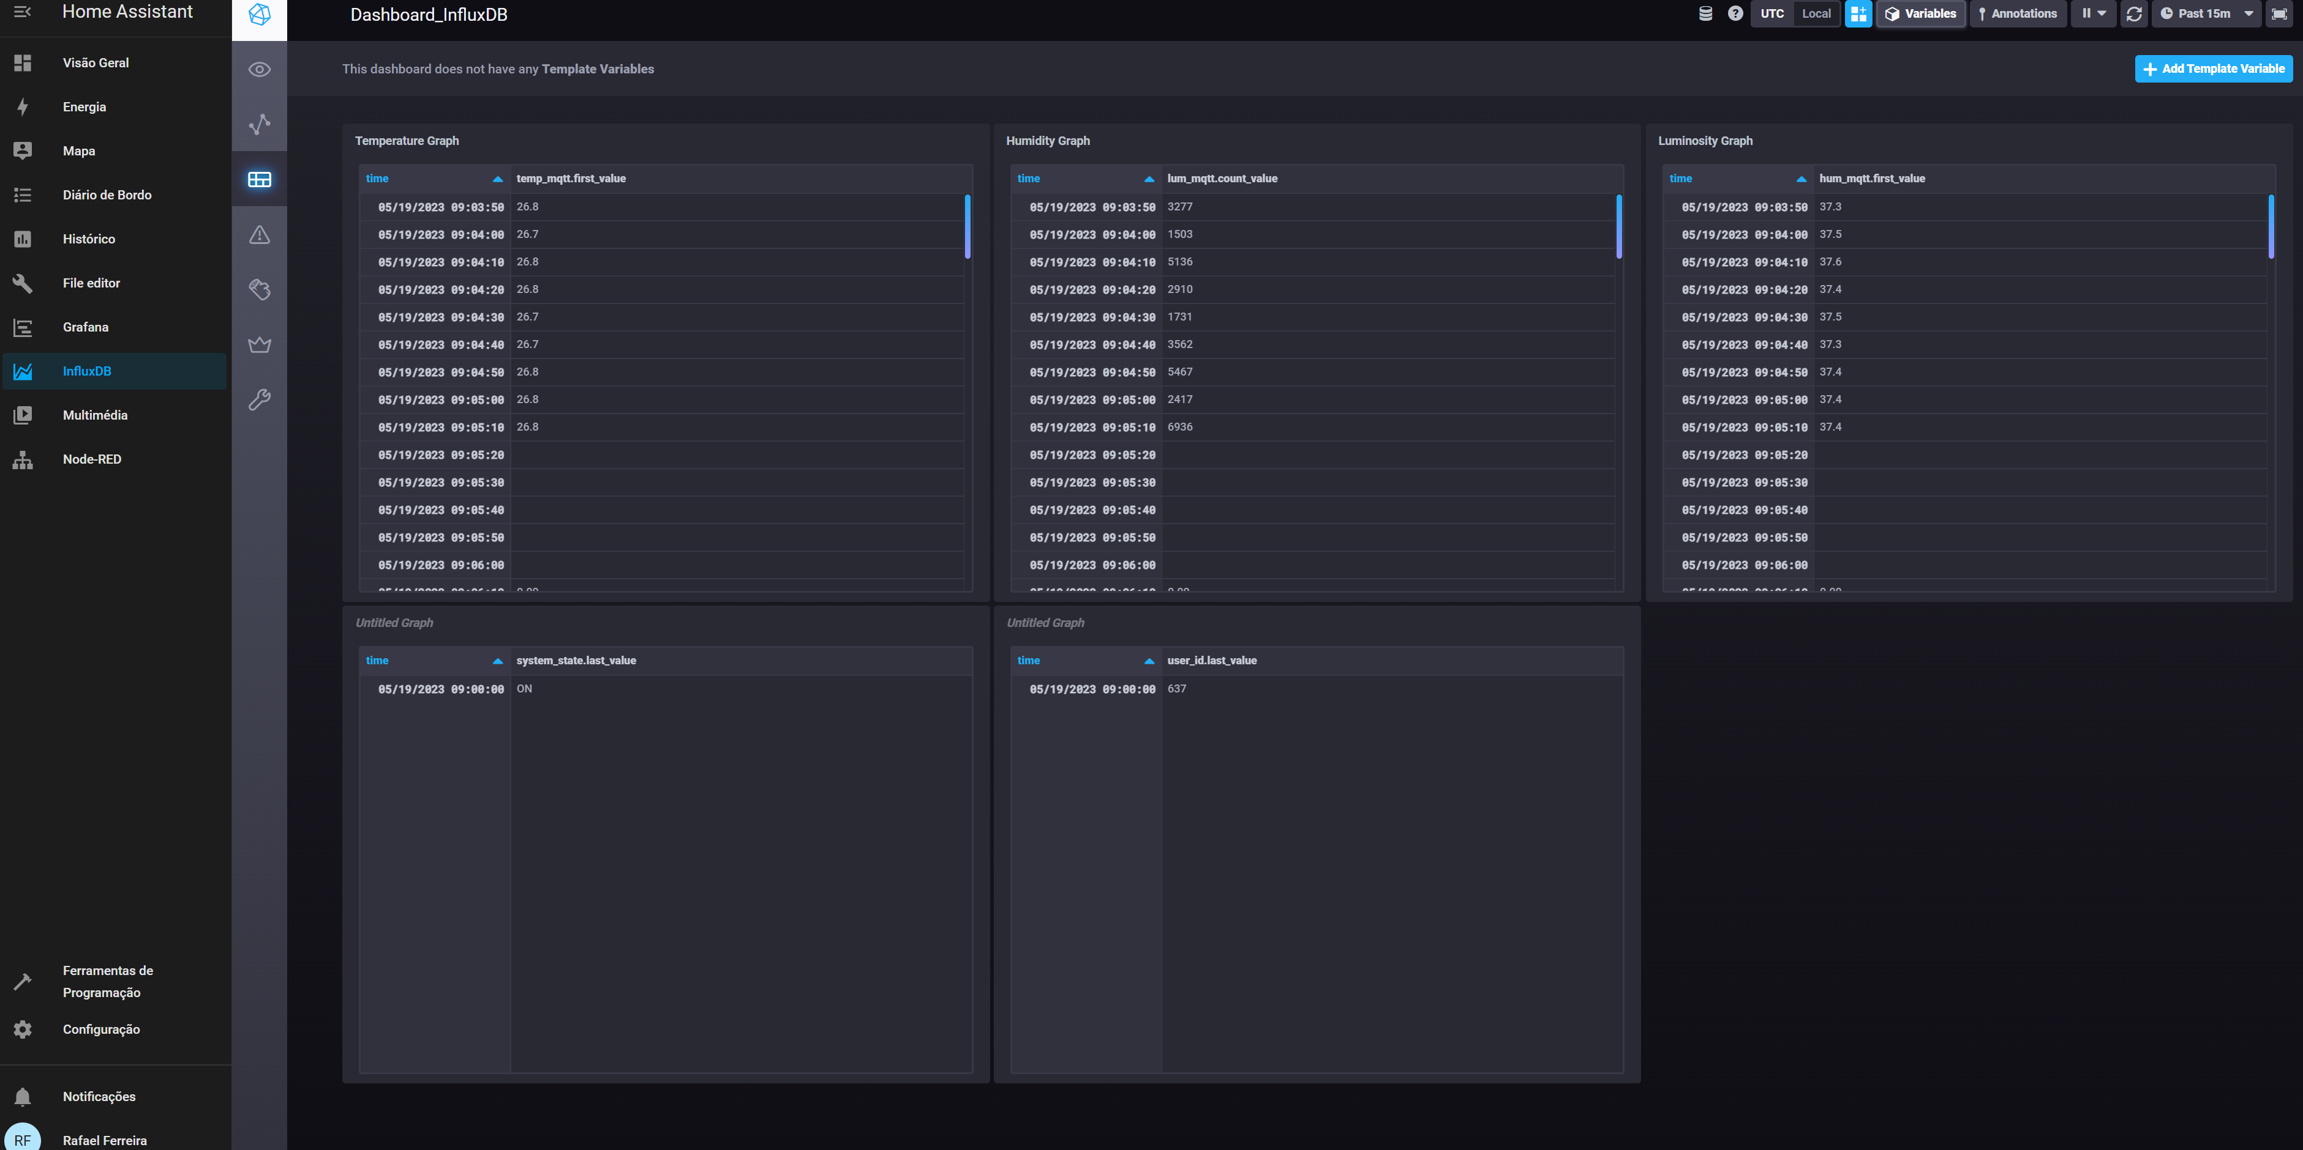
InfluxDB Database Visualization

Slide 8
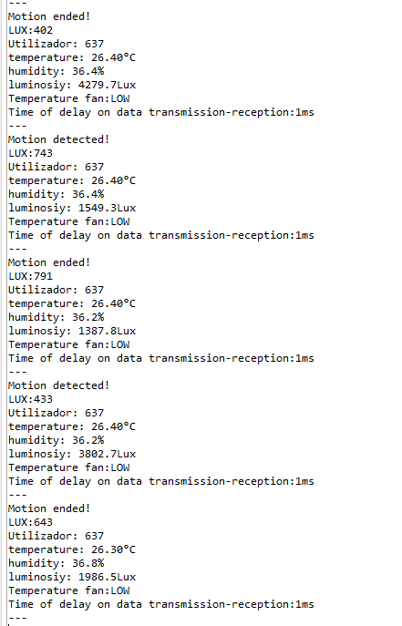
Physical Device Console Window

Slide 9
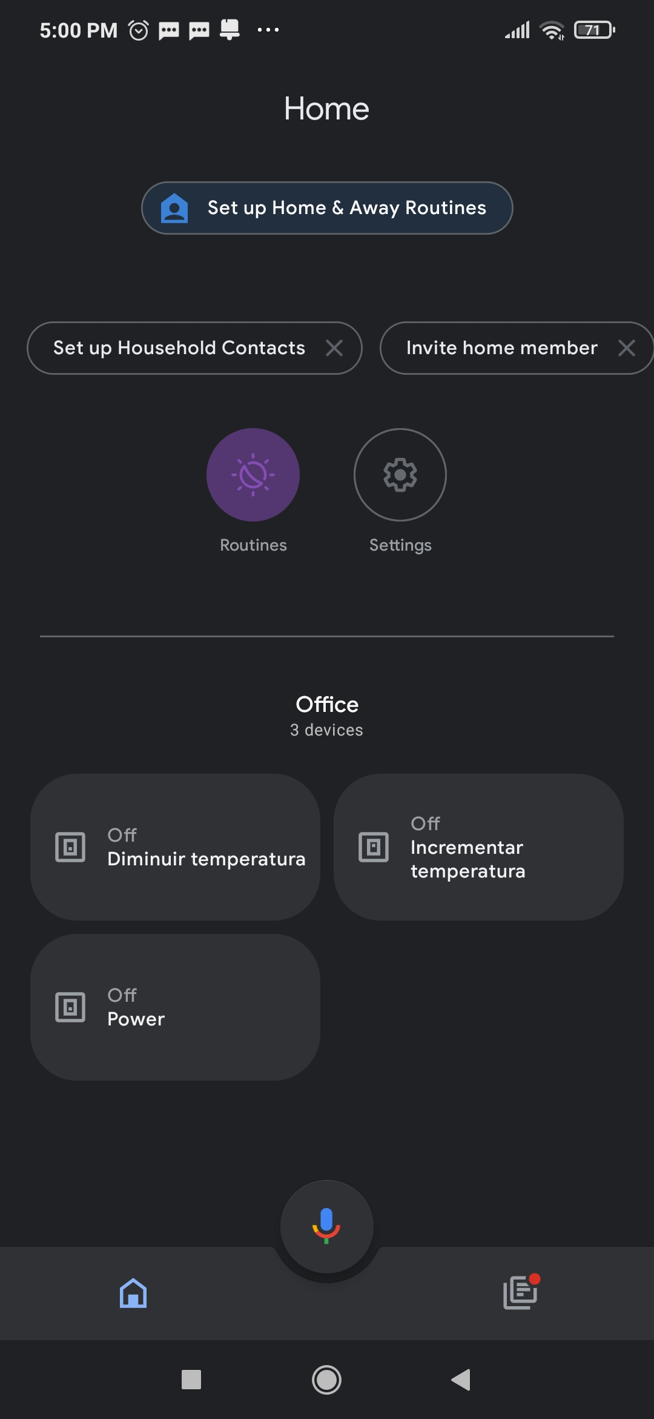
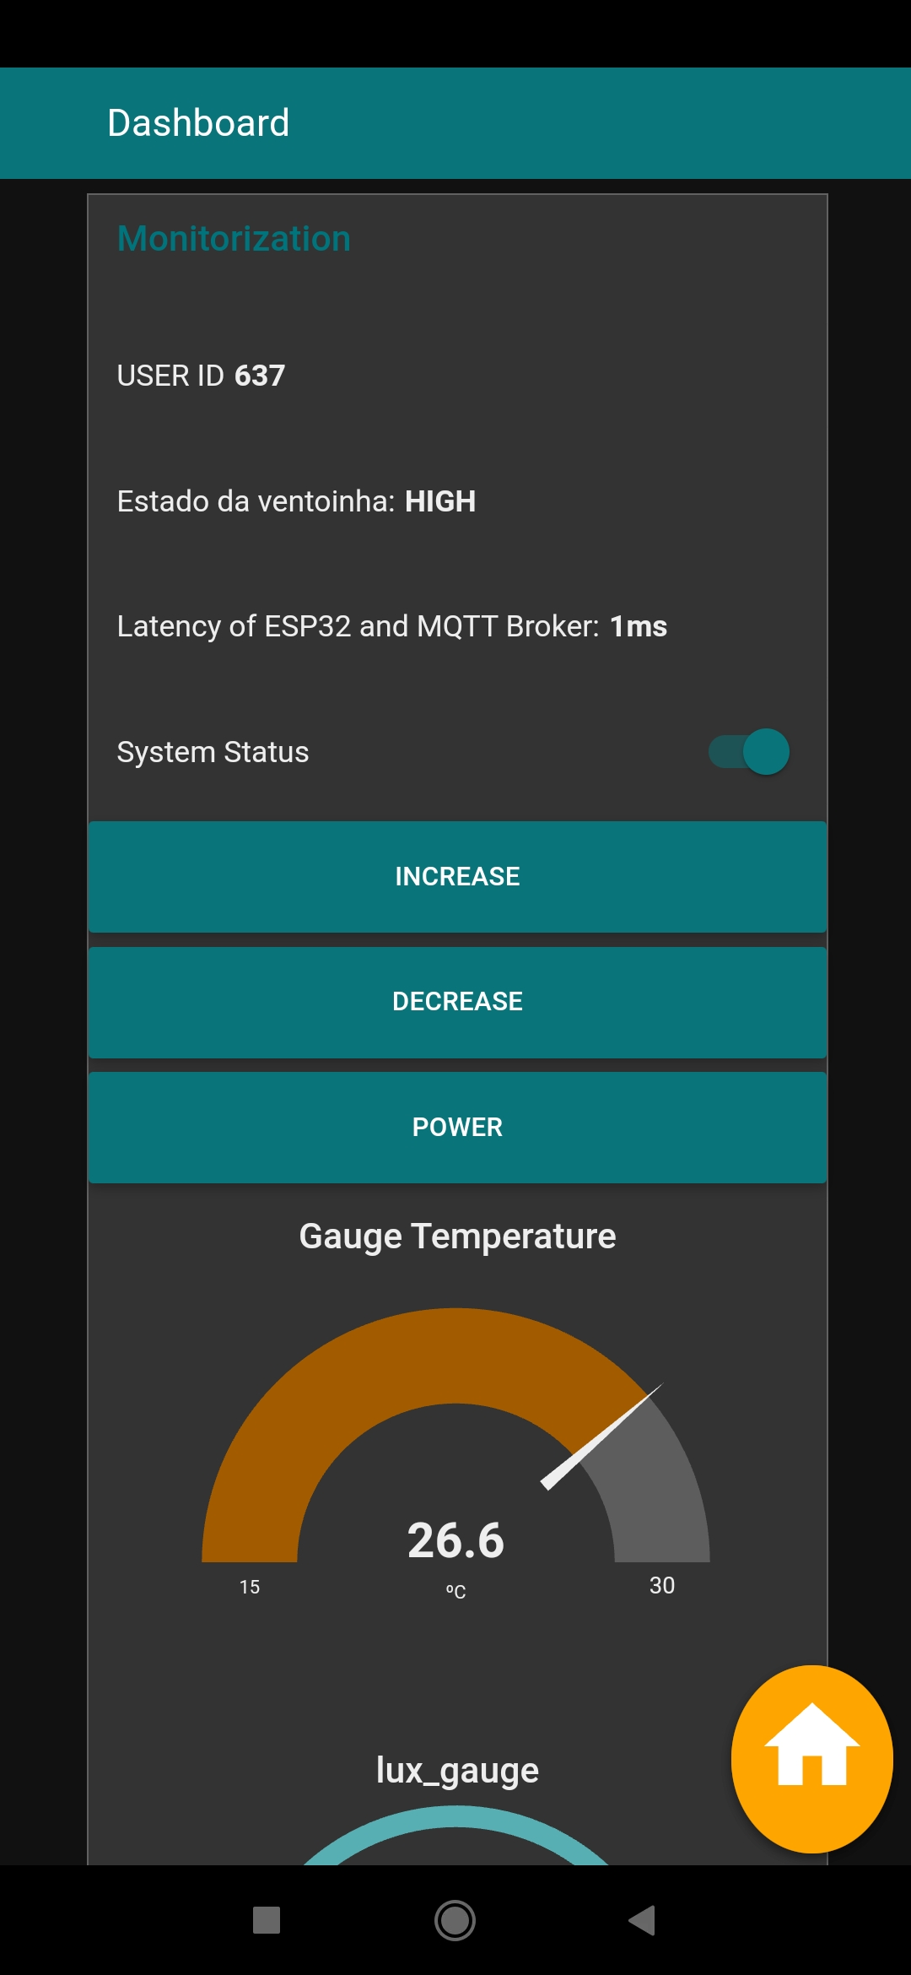
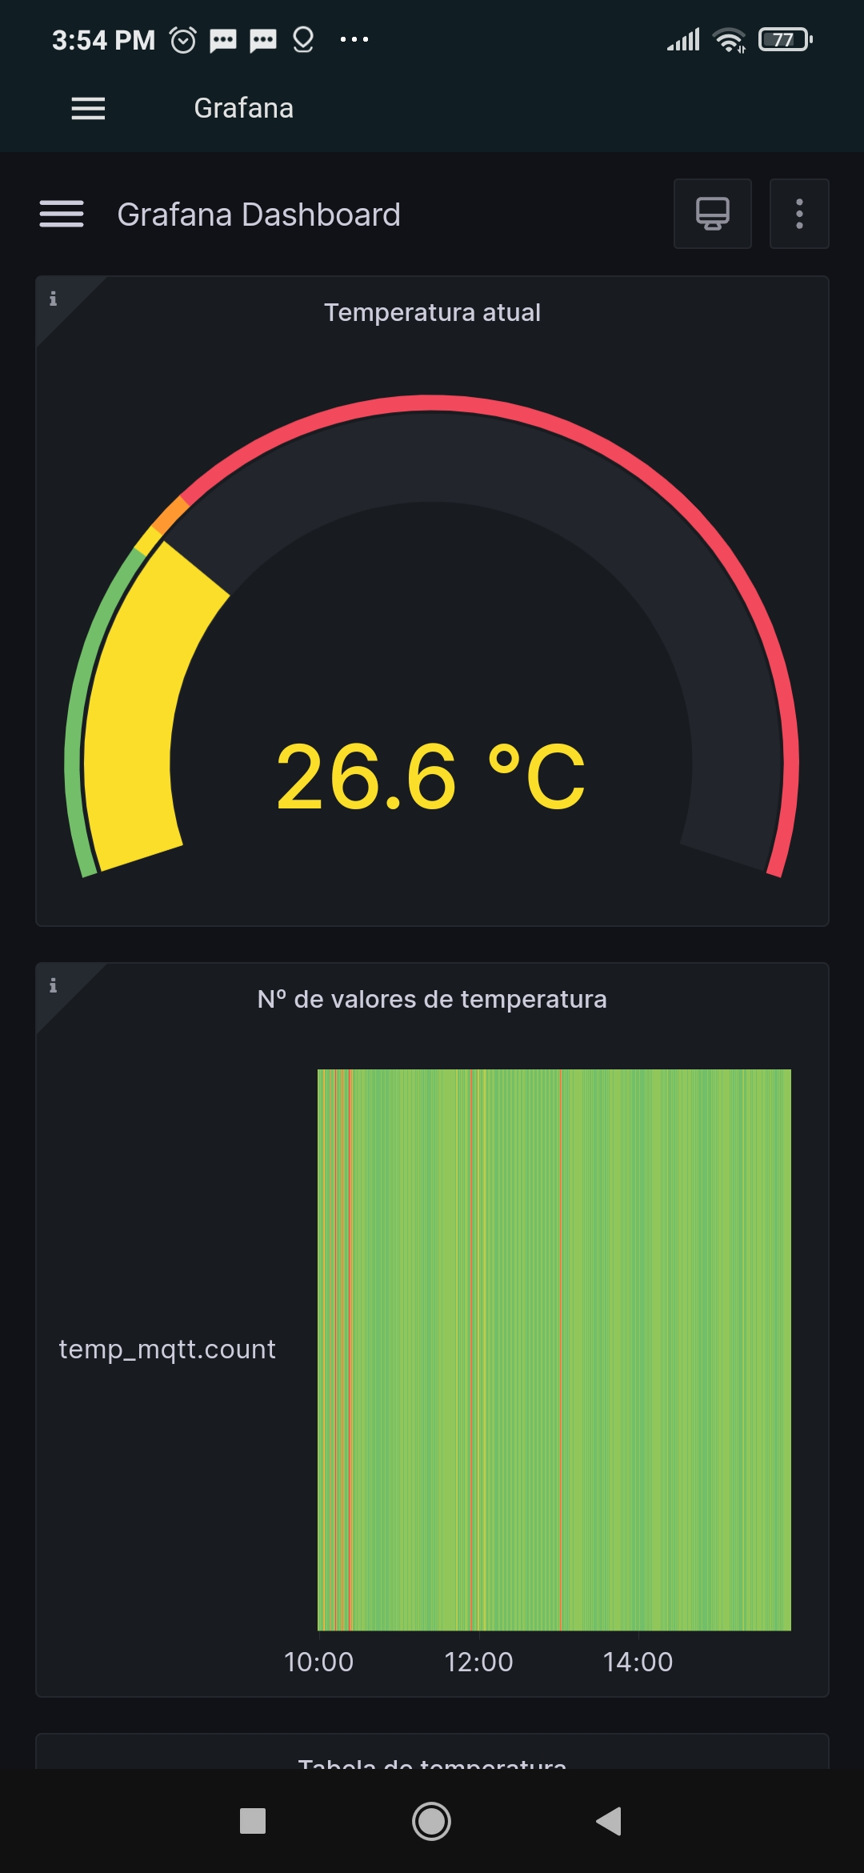
A partir da APP Home Assistant
Google Home com 3 botões de controlo
Dashboard Node-red em telemóvel
Dashboard Grafana em telemóvel

Slide 10
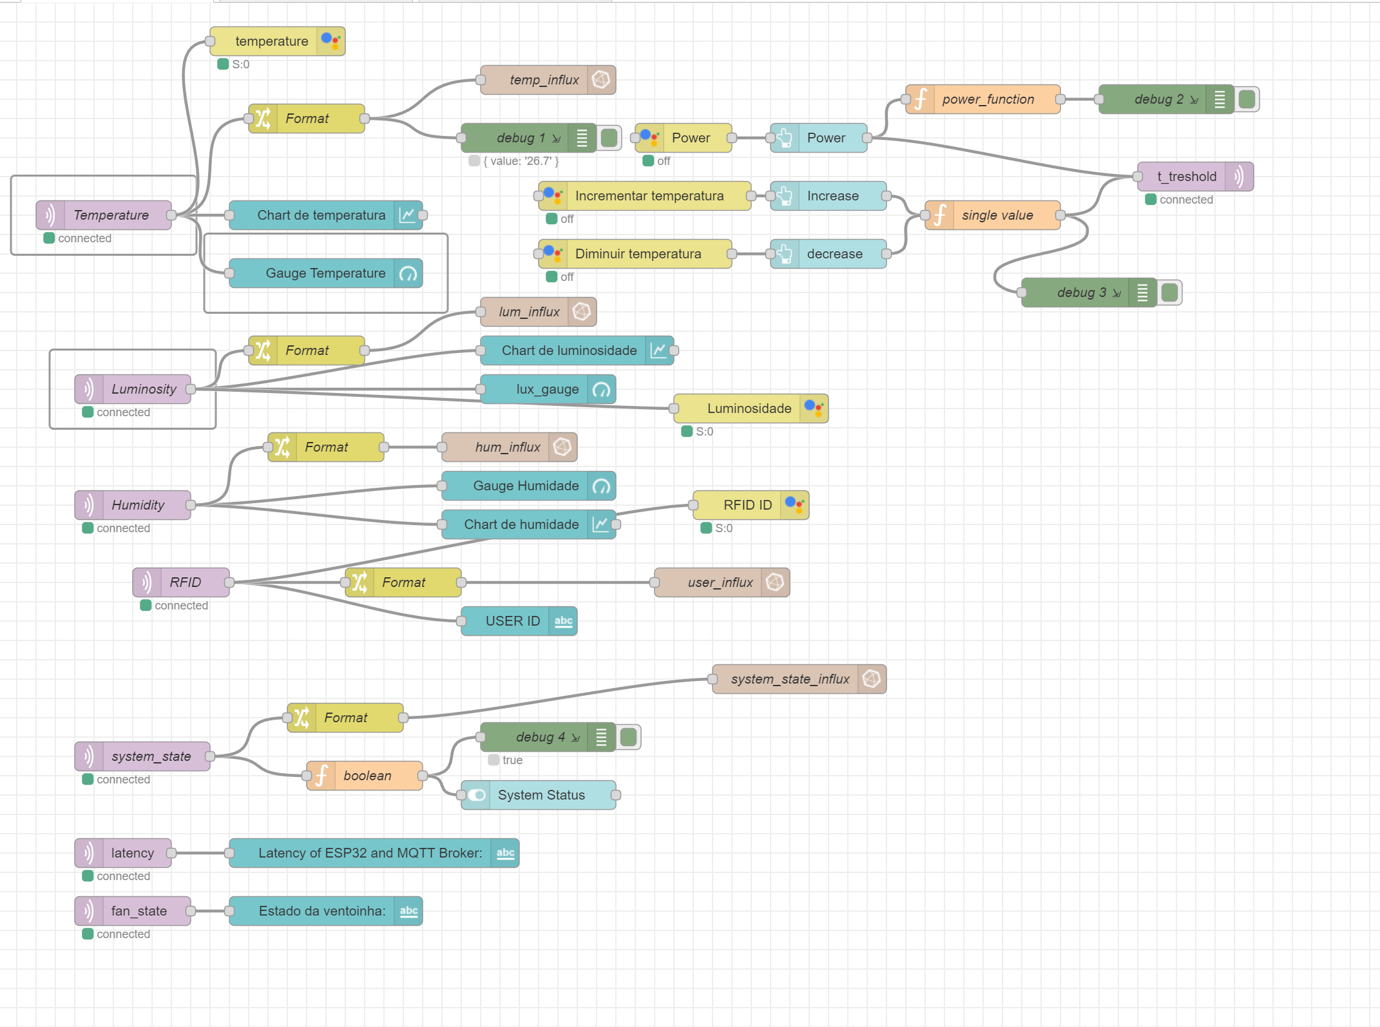
NODE-RED Programming flows

