Slide 2
Apartment Building Evaluation
in the City of Toronto
G. Rafael marinez Cedano - 301194568

Slide 3
agenda
Overview
Objective
Results
Recommendation

Slide 4

Are you agree with the idea that time is money?

Slide 5
Overview
Is a priority for the city Ensuring that tenants live in safe and well-maintained buildings.
More than 30 % of Toronto residents are renters.
In 2017 created the RentSafeTO program.
The Program works under the regulation of Property Standards Bylaw of the City of Toronto.
Promote the engagement and access to tenants information.

Slide 6
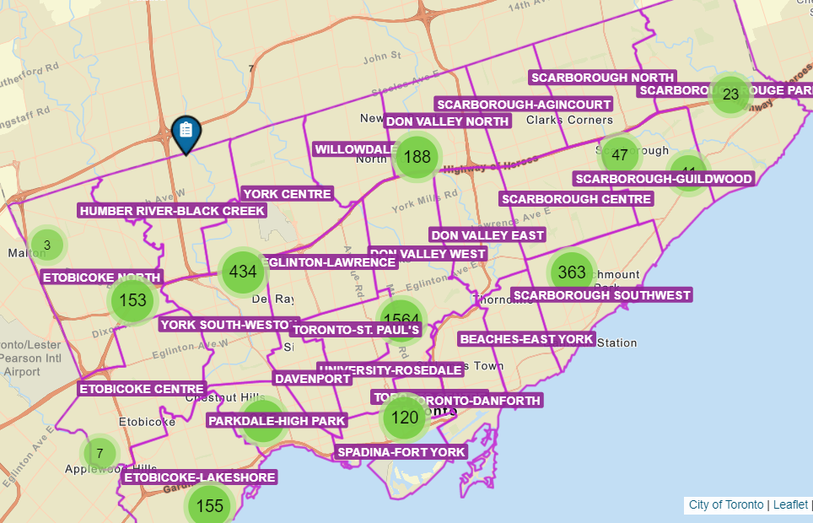
Objective
Analyze and identify how to improve the stakeholder building evaluation scores. Using the evaluations from 2017 to date.

Slide 7
Results

Slide 8
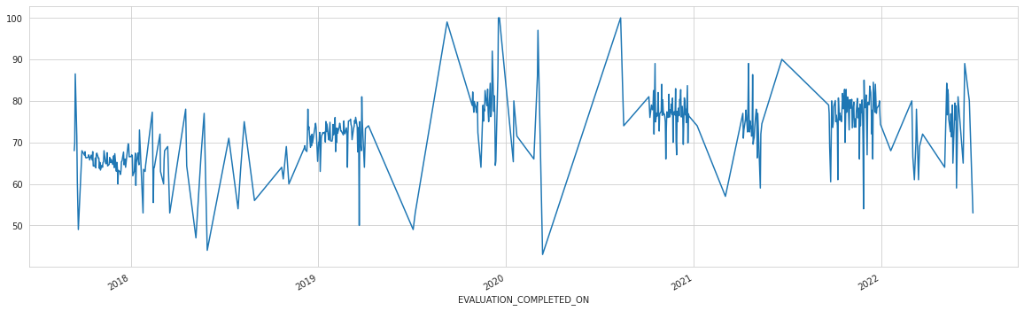
Taking into consideration the trends of past years and the current economic factors, the building evaluation score could decrease more than 2 points in relation to last year.
Score behavior from 2017 to 2022

Slide 9
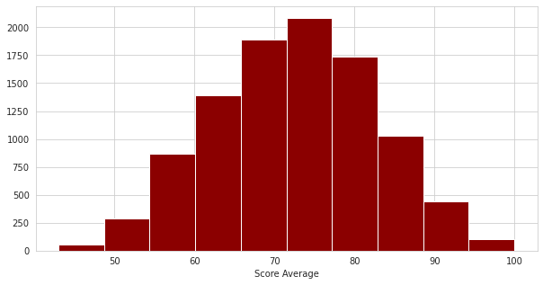
Table No.1
Average and Median building evaluation scores
 | 2021 | 2022
Average | 77.6 | 72.4
Median | 79 | 73

Slide 10
Recommendation
Table No.2
Considering that RentSafeTO evaluates approximately more than 20 areas in a building.
And after analyze the relationship of each of them with the final score. we recommend to Building owners, Real estate companies and Stakeholders should highlight at least 8(Table No.2) areas as a priority to achieve a final score above average.
Priority Building Areas
Security | Entrance lobby
Exterior grounds | Interior lighting level
Entrance lobby | Interior wall ceiling floor
Stairwells | Exterior cladding

Slide 11

Thank You !

