Slide 1








My Devices
Profile
Welcome to Smart Switch App
Device 1
Email:
Schedule
Off
Login
Device 2
Password:
On
Schedule
User Name
Create Account
Forgot password
Change Password
Login
Delete Account

Slide 2
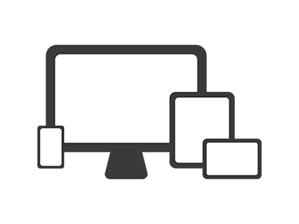


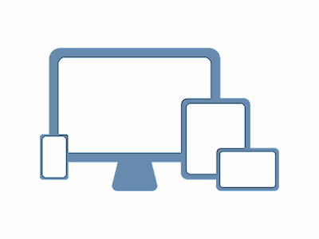
Device 2 – Schedule
Pair Device
Add Schedule
Schedule:
07:00 – 07:30
Please hold switch button for 3 seconds
19:30 – 23:30

Slide 3





