Slide 1
AZ-400.00 Module 10: Designing a Release Strategy

Slide 2
Lesson 01: Module overview

Slide 3
Module overview
Lesson 5: Choosing the right release management tool
Lesson 1: Module overview
Lesson 2: Introduction to continuous delivery
Lesson 6: Labs
Lesson 3: Release strategy recommendations
Lesson 7: Module review and takeaways
Lesson 4: Building a high-quality release pipeline

Slide 4
Learning objectives
After completing this module, students will be able to:
Differentiate between a release and a deployment
Describe the principle of release gates and how to deal with release notes and documentation
Define the components of a release pipeline
Choose a release management tool
Explain things to consider when designing your release strategy
Classify a release versus a release process, and outline how to control the quality of both

Slide 5
Lesson 02: Introduction to continuous delivery

Slide 6
Traditional IT development cycle
Uma boa quantidade de hotfixes e solicitações de mudança para produção
Muitas mudanças de escopo durante um projeto
Muito trabalho não planejado devido a dívida técnica (deriva ambiental, má qualidade, transferências)
Negócios envolvidos, mas não ligados a TI

Slide 7
Moving to continuous delivery

Slide 8
What is continuous delivery?
The eight principles of continuous delivery:
O processo de liberação / implantação de software DEVE ser repetível e confiável
Done significa “released”
Mantenha tudo sob controle de origem
Melhore continuamente
Todos são responsáveis pelo processo de liberação
Se algo for difícil ou doloroso, faça-o com mais frequência
Automatize tudo!
Construa com qualidade!

Slide 9
Releases and deployments
Liberação e implantação são frequentemente combinadas
Liberar não é o mesmo que implantação
Separe a versão funcional da versão técnica:
A versão funcional está expondo recursos aos clientes
A versão técnica está implantando funcionalidade

Slide 10
Discussion – the need for continuous delivery in your organization
Does your organization need continuous delivery?
Do you use agile/scrum?
Is everybody involved or only the Dev departments?
Can you deploy your application multiple times per day? Why or why not?
What is the main bottleneck for continuous delivery in your organization?
The Organization
Application Architecture
Skills
Tooling
Tests
Other things?

Slide 11
Lesson 03: Release strategy recommendations

Slide 12
Release pipelines

Slide 13
Artifact sources
Build artifacts
Package repositories
Container repositories
Files
Source control

Slide 14
Considerations for choosing the appropriate artifact source
Traceability and auditability
Immutability
Versioning

Slide 15
Demonstration: selecting an artifact source
DEMO

Slide 16
Considerations for deployment to stages
Queremos / precisamos implantar todos os dias?
Qual é o seu ambiente-alvo?
É usado por uma equipe ou por várias equipes?
Quem são os usuários? Eles querem uma nova versão várias vezes ao dia?
Quanto tempo leva para implantar?
Existe tempo de inatividade? O que acontece com o desempenho? Os usuários são afetados?

Slide 17
Setting up deployment stages
DEMO

Slide 18
Delivery cadence – three types of triggers
Continuous deployment trigger
Scheduled trigger
Manual trigger

Slide 19
Selecting your delivery and deployment cadence
DEMO
Notes:
You can choose to play the video or present a similar demo yourself.

Slide 20
Release approvals
As aprovações de liberação não são para controlar * como *, mas controlar * se * você deseja entregar várias vezes ao dia
Aprovações manuais ajudam a construir confiança sobre o processo de liberação automatizado
As portas de liberação fornecem controle adicional sobre o início e a conclusão do pipeline de implantação. Eles geralmente podem ser configurados como uma condição de pré-implantação e pós-implantação e podem executar a validação com outros sistemas automatizados até que requisitos específicos sejam verificados.

Slide 21
Demonstration: setting up manual approvals
DEMO
Notes:
You can choose to play the video or present a similar demo yourself.

Slide 22
Release gates
Release gates give you additional control over the start and completion of the deployment pipeline. They are often set up as a pre-deployment and post-deployment conditions.
Incident and issues management
User experience relative to baseline
Notification of users by integration with collaboration systems
Change management
Quality validation
Infrastructure health
Security scan on artifacts

Slide 23
Setting up a release gate
DEMO
Notes:
You can choose to play the video or present a similar demo yourself.

Slide 24
Lesson 04: Building a high-quality release pipeline

Slide 25
Release process versus release
The release process involves all the steps that you go through when you move your artifact that comes from one of the artifact sources.
A release is a package or container that holds a versioned set of artifacts specified in a release pipeline in your CI/CD process. It holds all the information required to carry out all the tasks and actions in the release pipeline, such as the stages (or environments), the tasks for each one, values of task parameters and variables, the release policies such as triggers, approvers, and release queuing options.
There can be multiple releases from one release pipeline (or release process)

Slide 26
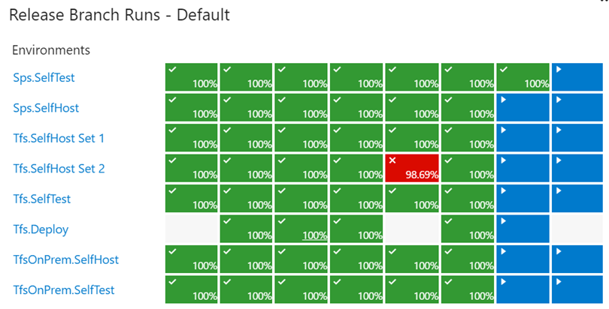
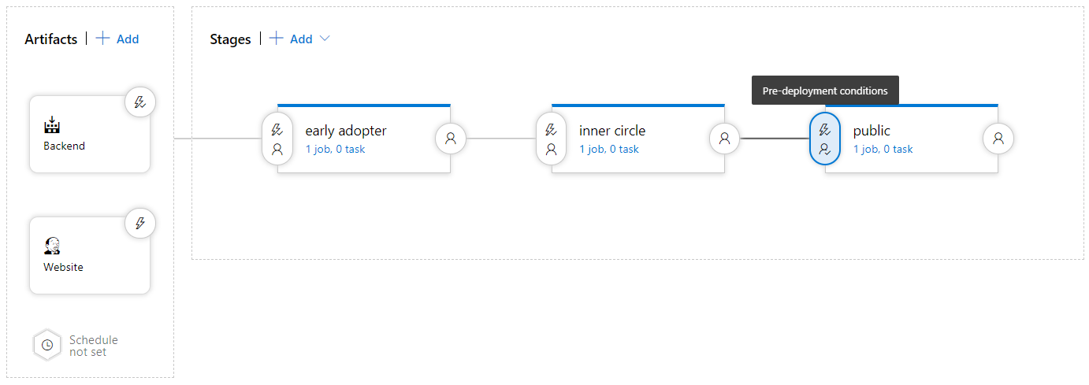
How to measure quality of your release process
Visualize your release process
Symptoms of broken process (every second day, only after rerun, never ending up in last stage)
Dashboard widgets

Slide 27
Using release gates to protect quality
No new blocker issues
Compliance checks
Code coverage on new code greater than 80%
Are there work items linked to the release?
Is the release started by someone else as the code committer?
No license violations
Is the performance not affected after a new release?
No vulnerabilities in dependencies
No new technical debt introduced

Slide 28
Release notes and documentation
Technical or Functional Documentation?
Where to store Documentation:
Document Store
Wiki
In the code base
In a Work Item

Slide 29
Lesson 04: Choosing the right release management tool

Slide 30
Considerations for choosing release management tools
Artifacts and artifact source
Stages
Triggers and schedules
Build and release tasks
Approvals and gates
Traceability, auditability and security

Slide 31
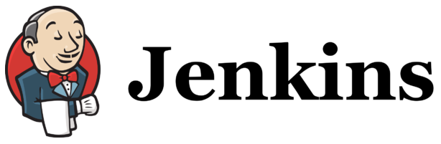

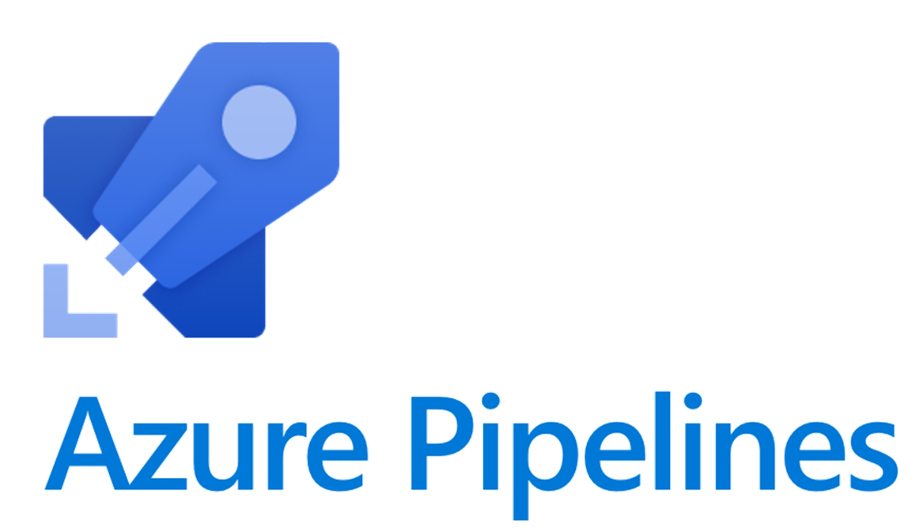


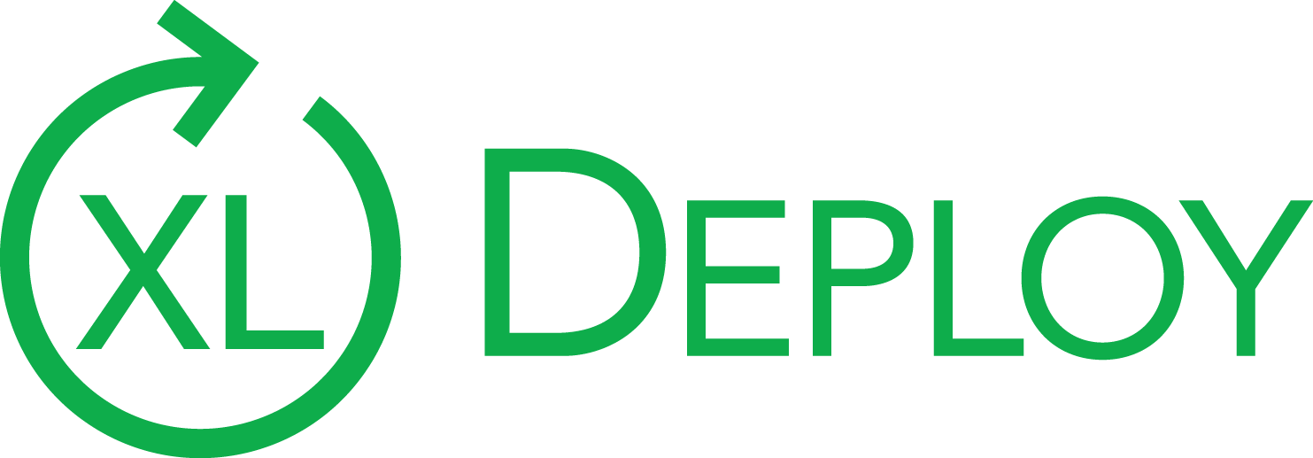
Common release management tools
Jenkins
Circle CI
Azure DevOps Pipelines
GitLab Pipelines
Atlassian Bamboo
XL Deploy/XL Release

Slide 32
Lesson 05: Labs

Slide 33
Controlling deployments using Release Gates
Lab overview:
This lab covers the configuration of the deployment gates and details how to use them to control execution of Azure pipelines.
Objectives:
Configure release pipelines
Configure release gates
Test release gates
Duration:
Notes:
The labs are updated on a regular basis. For the latest information please visit:
https://microsoftlearning.github.io/AZ400-DesigningandImplementingMicrosoftDevOpsSolutions/

Slide 34
Creating a release dashboard
Lab overview:
In this lab, you will step through creation of a release dashboard and the use of REST API to retrieve Azure DevOps release data, which you can make this way available to your custom applications or dashboards.
Objectives:
Create a release dashboard
Use REST API to query release information
Duration:
Notes:
The labs are updated on a regular basis. For the latest information please visit:
https://microsoftlearning.github.io/AZ400-DesigningandImplementingMicrosoftDevOpsSolutions/

Slide 35
Lesson 07: Module review and takeaways

Slide 36
What did you learn?
Differentiate between a release and a deployment
Define the components of a release pipeline
Explain things to consider when designing your release strategy
Classify a release versus a release process, and outline how to control the quality of both
Describe the principle of release gates and how to deal with release notes and documentation
Choose a release management tool

Slide 37
Module review questions
1
When you want to change an immutable object of any type, what do you do?
2
What can you use to prevent a deployment in Azure DevOps when a security testing tool finds a compliance problem?
Even if you create exactly what a user requested at the start of the project, the solution will often be unsuitable for the same user. Why?
3
Notes:
Q1 Answer: You make a new one and (possibly) remove the old one
Q2 Answer: Release gate
Q3 Answer: Their needs will have changed during the project

