Slide 1
AZ-400.00 Module 14: Managing Containers using Docker

Slide 2
Lesson 01: Module overview

Slide 3
Module overview
Lesson 1: Module overview
Lesson 2: Implementing a container build strategy
Lesson 3: Implementing Docker multi-stage builds
Lesson 4: Lab
Lesson 5: Module review and takeaways

Slide 4
Learning objectives
After completing this module, students will be able to:
Implement a container strategy including how containers are different from virtual machines and how microservices use containers
Implement containers using Docker
Implement Docker multi-stage builds

Slide 5
Lesson 02: Implementing a container build strategy

Slide 6
Why containers?
Portable – run containers wherever Docker is supported
Consistent – know that developers are working with identical code
Lightweight – far less disk, CPU, and memory than VMs
Efficient – fast deployment, booting, patching, updates

Slide 7
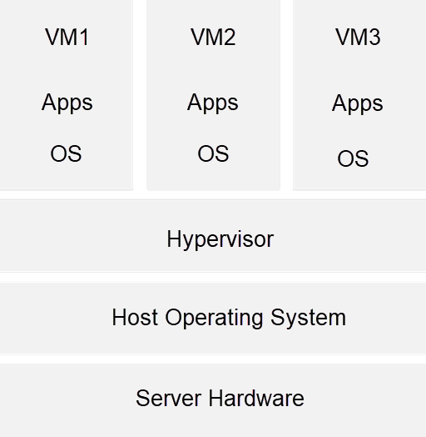
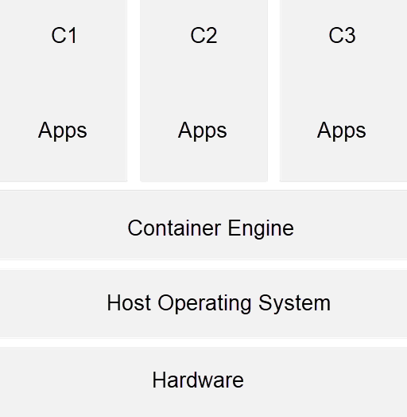
Structure of containers

Slide 8
Discussion: Containers versus Virtual Machines
In your development environment:
Atualmente, você usa virtualização de algum tipo?
Do you prefer to deploy containers or virtual machines?

Slide 9
Docker containers and development
Docker é uma plataforma de contentorização de software com um conjunto de ferramentas, modelo de empacotamento e mecanismo de implantação comuns
O Docker simplifica muito a conteinerização e distribuição de aplicativos que podem ser executados em qualquer lugar
Uma imagem Docker pode ser criada para implantar de forma idêntica em qualquer ambiente em segundos
O DockerHub tem mais de 180.000 aplicativos no repositório público da comunidade
Docker organizou a Open Container Initiative (OCI)
Notes:
For more information, you can see:
Docker Ebook, Docker for the Virtualization Admin - https://goto.docker.com/docker-for-the-virtualization-admin.html
Mark Russinovich blog post on Containers: Docker, Windows, and Trends- https://azure.microsoft.com/en-us/blog/containers-docker-windows-and-trends/

Slide 10
Working with Docker containers
docker build – create the image
docker pull – retrieve an image from a container registry
docker run – run the image to create a container instance (will auto pull if not already pulled)

Slide 11
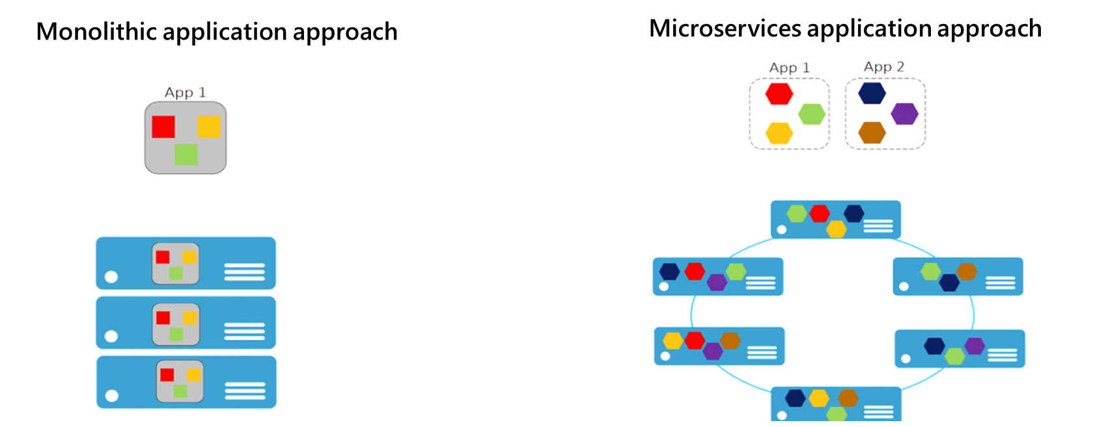

Microservices and containers
Com microsserviços, cada parte do aplicativo é implantada como um componente totalmente independente

Slide 12
Azure container-related services
Azure Container Instances permitem que você se concentre na criação de seus aplicativos, em vez de provisionar e gerenciar a infraestrutura
Azure Kubernetes Service é o padrão de fato para orquestração de contêineres
Azure Container Registry permite armazenar e gerenciar imagens de contêiner em um registro central
Azure Service Fabric para construir e operar aplicativos always-on, escalonáveis e distribuídos
Azure App Service fornece um serviço gerenciado para aplicativos da web baseados em Windows e Linux
Notes:
For more information, you can see:
Azure Container Instances - https://azure.microsoft.com/en-us/services/container-instances/
Azure Kubernetes Service - https://azure.microsoft.com/en-us/services/kubernetes-service/
Azure Container Registry - https://azure.microsoft.com/en-us/services/container-registry/
Azure Service Fabric - https://azure.microsoft.com/en-us/services/service-fabric/
Azure App Service - https://azure.microsoft.com/en-us/services/app-service/

Slide 13
Docker container registries
(Public) Docker Hub https://hub.docker.com
(Public) Red Hat Container Catalog https://access.redhat.com/containers
(Public) Microsoft Container Registry https://mcr.microsoft.com
(Private) Create your own registry (Azure Container Registry makes this easy)

Slide 14
Demonstration: Create an Azure Container Registry
Container Registry
Microsoft
Azure Container Registry is a private registry for hosting container images. Using the Azure Container Registry, you can store Docker-formatted images for all types of container deployments. Azure Container Registry integrates well with orchestrators hosted in Azure Container Service, including Docker Swarm, DC/OS, and Kubernetes. Users can benefit from using familiar tooling capable of working with the open-source Docker Registry v2.
Use Azure Container Registry to:
Store and manage container images across all types of Azure deployments
Use familiar, open-source Docker command line interface (CLI) tools
Keep container images near deployments to reduce latency and costs
Simplify registry access management with Azure Active Directory
Maintain Windows and Linux container images in a single Docker registry
Notes:
Create an Azure Container Registry - https://www.youtube.com/watch?v=IWbDG9cXa6s

Slide 15
Dockerfile core concepts
FROM ubuntu
LABEL maintainer="johndoe@contoso.com"
ADD appsetup /
RUN /bin/bash -c 'source $HOME/.bashrc; \
echo $HOME'
CMD ["echo", "Hello World from within the container"]
Dockerfiles are text files that contain the commands needed by docker build to assemble an image
Notes:
For more information, you can see: Dockerfile reference - https://docs.docker.com/engine/reference/builder/

Slide 16
Lesson 3: Implementing Docker multi-stage builds

Slide 17
Multiple stage builds
Mantenha o tamanho da imagem o menor possível
Cada instrução FROM inicia um novo estágio
Camadas são instruções adicionais adicionadas ao Dockerfile
Os estágios são numerados em ordem, começando com o estágio 0
Compilações em vários estágios ajudam a otimizar os arquivos, melhoram sua legibilidade e os tornam mais fáceis de manter
Os estágios são nomeados usando uma cláusula AS
Estágios de nomenclatura permitem que você os construa separadamente
Notes:
The Demonstration: Adding Docker Support to an Existing App explains the code sample in the student guide.

Slide 18
Multi-stage Dockerfiles
As compilações de vários estágios oferecem os benefícios do padrão do construtor sem o trabalho de manter arquivos separados
O código avança de uma fase para a próxima
FROM microsoft/aspnetcore:2.0 AS base
WORKDIR /app
EXPOSE 80
FROM microsoft/aspnetcore-build:2.0 AS builder
WORKDIR /src
COPY *.sln ./
COPY Web/Web.csproj Web/
RUN dotnet restore
COPY . .
WORKDIR /src/Web
RUN dotnet build -c Release -o /app
FROM builder AS publish
RUN dotnet publish -c Release -o /app
FROM base AS production
WORKDIR /app
COPY --from=publish /app .
ENTRYPOINT ["dotnet", "Web.dll"]
Notes:
aspnet:3.1-buster-slim
sdk:3.1-buster

Slide 19
Considerations for multiple stage builds
Adopt container modularity
Avoid unnecessary packages
Choose an appropriate base
Avoid including application data
Notes:
For more information, you can see: Use multiple stage builds - https://docs.docker.com/develop/develop-images/multistage-build/

Slide 20
Example builder pattern
Derive from a .NET base image with the whole runtime/SDK (Dockerfile.build)
Add source code
Produce a statically-linked binary
Copy the static binary from the image to the host (docker create, docker cp)
Derive de SCRATCH ou alguma outra imagem leve (Dockerfile)
Adicione o binário de volta
Envie uma pequena imagem para o Docker Hub

Slide 21
Multiple projects and solutions
Cada projeto tem seu próprio Dockerfile de vários estágios
Projetos de componentes compartilhados não têm Dockerfiles
Cada Dockerfile assume que seu contexto é o diretório da solução
Há um docker-compose.yml na raiz da solução
Multi.sln
docker-compose.yml
[Api]
Dockerfile
[Web]
Dockerfile

Slide 22
Demonstration: Add Docker support to an existing application
FROM microsoft/dotnet:2.1-aspnetcore-runtime AS base
WORKDIR /app
EXPOSE 6636
EXPOSE 44320
FROM microsoft/dotnet:2.1-sdk AS build
WORKDIR /src
COPY ["WebApplication1/WebApplication1.csproj", "WebApplication1/"]
…
RUN dotnet build "WebApplication1.csproj" -c Release -o /app
FROM build AS publish
RUN dotnet publish "WebApplication1.csproj" -c Release -o /app
FROM base AS final
WORKDIR /app
COPY --from=publish /app .
ENTRYPOINT ["dotnet", "WebApplication1.dll"]
Notes:
Add Docker Support to an Existing Application - https://www.youtube.com/watch?v=pYkQjmUsA-8

Slide 23
Lesson 04: Lab

Slide 24
Deploying Docker containers to Azure App Service web apps
Lab overview:
In this lab, you will learn how to use an Azure DevOps CI/CD pipeline to build a custom Docker image, push it to Azure Container Registry, and deploy it as a container to Azure App Service.
Objectives:
Build a custom Docker image by using a Microsoft hosted Linux agent
Push an image to Azure Container Registry
Deploy a Docker image as a container to Azure App Service by using Azure DevOps
Duration:
Notes:
The labs are updated on a regular basis. For the latest information please visit:
https://microsoftlearning.github.io/AZ400-DesigningandImplementingMicrosoftDevOpsSolutions/

Slide 25
Modernizing your existing ASP.NET apps with Azure
Lab overview:
In this lab, you will use the Nerd Dinner Application, an open source ASP.NET MVC project. View the live site at http://www.nerddinner.com. You will move the application DB to Azure SQL instance and add the Docker support to the application to run the application in Azure Container Instances.
Objectives:
Migrate LocalDB to SQL Server in Azure
Use Docker tools in Visual Studio and add Docker support for applications
Publish Docker images to Azure Container Registry (ACR)
Push Docker images from ACR to Azure Container Instances (ACI)
Duration:
Notes:
The labs are updated on a regular basis. For the latest information please visit:
https://microsoftlearning.github.io/AZ400-DesigningandImplementingMicrosoftDevOpsSolutions/

Slide 26
Lesson 05: Module review and takeaways

Slide 27
What did you learn ?
Implement a container strategy including how containers are different from virtual machines and how microservices use containers
Implement containers using Docker
Implement Docker Multi-Stage Builds

Slide 28
Module review questions
1
You are reviewing an existing Dockerfile. How would you know if it's a multi-stage Dockerfile?
2
You are designing a multi-stage Dockerfile. How can one stage refer to another stage within the Dockerfile?
3
What is the line continuation character in Dockerfiles?
4
When the Open Container Initiative defined a standard container image file format, which format did they choose as a starting point?
Notes:
Q1 Answer: Multi-stage Docker files are characterized by containing more than one starting point provided as FROM instructions.
Q2 Answer: The FROM clause in a multi-stage Dockerfile can contain an alias via an AS clause. The stages can refer to each other by number or by the alias names.
Q3 Answer: Lines can be broken and continued on the next line of a Dockerfile by using the backslash character.
Q4 Answer: The OCI used the Docker format as a starting point.

