Slide 1
AZ-400.00 Module 16: Implementing Feedback for Development Teams

Slide 2
Lesson 01: Module overview

Slide 3
Module overview
Lesson 5: Integrate and configure ticketing systems
Lesson 1: Module overview
Lesson 2: Implement tools to track system usage, feature usage, and flow
Lesson 6: Lab
Lesson 3: Implement routing for mobile application crash report data
Lesson 7: Module Review and Takeaways
Lesson 4: Develop monitoring and status dashboards

Slide 4
Learning objectives
After completing this module, students will be able to:
Configure crash report integration for client applications
Develop monitoring and status dashboards
Implement routing for client application crash report data
Implement tools to track system usage, feature usage, and flow
Integrate and configure ticketing systems with development team’s work management

Slide 5
Lesson 02: Implement tools to track system usage, feature usage, and flow

Slide 6
The inner loop
The inner loop
Code
Build
Test

Slide 7

Introduction to continuous monitoring
MIGRATE
GOVERN
Policy management
Cost management
SECURE
Security management
Threat protection
CONFIGURE
Configuration
Update management
Automation
Scripting
PROTECT
Backup
Disaster recovery
MONITOR
App, infra & network monitoring Log Analytics & Diagnostics

Slide 8
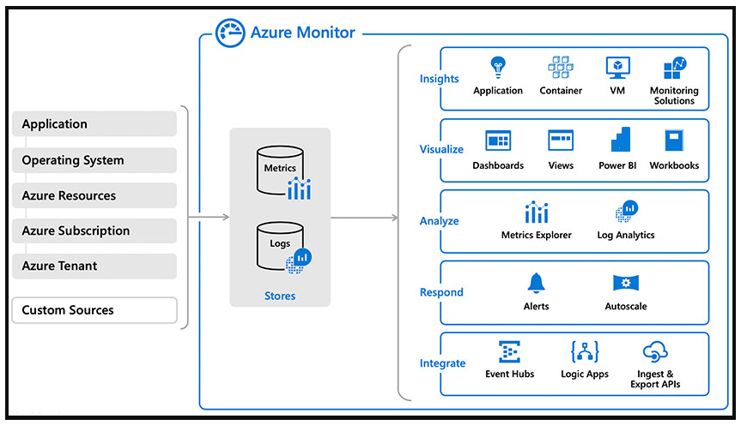
Azure Log Analytics

Slide 9
Kusto Query Language (KQL)
KQL is the language used to query Log Analytics
Supports queries and control commands
Supported within Azure Data Explorer and Azure Data Studio (with notebook support)

Slide 10

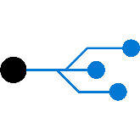
Azure application insights
Application Insights
Web pages
Client apps
Alerts
AI
Power BI
Https request
Application Insights
Your Web Services
Visual
Studio
AI
Dependency Calls
REST API
SQL
External Services
Background Services
Continuous
Export
AI
Azure

Slide 11
How do I use Application Insights?
Monitor
Detect, diagnose
Build, measure, learn

Slide 12
Demonstration: Adding Application Insights to an ASP.NET core application
DEMO
Notes:
Take a moment to complete the demonstration, as defined in the student manual.

Slide 13
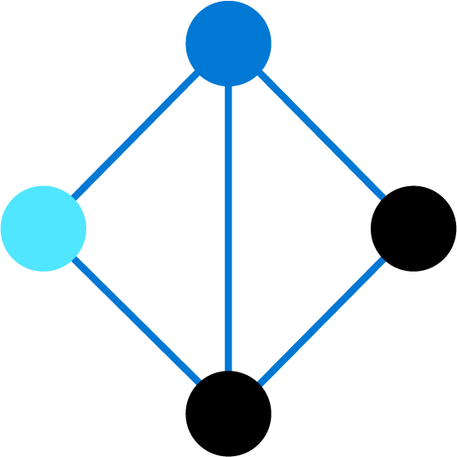
Lesson 03: Implement routing for mobile application crash report data

Slide 14
App Center Diagnostics
O App Center Diagnostics é um serviço de nuvem que ajuda os desenvolvedores a monitorar a integridade de um aplicativo, fornecendo os dados necessários para entender o que acontece quando um aplicativo falha durante o teste ou em estado selvagem
Na IU do App Center Diagnostics, você pode anexar, visualizar e baixar um binário e um anexo de teste para seus relatórios de falha
Rastreie os eventos que levam a uma falha para capturar informações úteis sobre o estado do seu aplicativo

Slide 15
Configure alerts
1
Faça login no App Center e selecione seu aplicativo
2
No menu esquerdo, navegue até Settings
3
Click on Email Notifications
4
Selecione quando um novo grupo de falha é criado

Slide 16
Create a bug tracker

Slide 17
Lesson 04: Develop monitoring and status dashboards

Slide 18
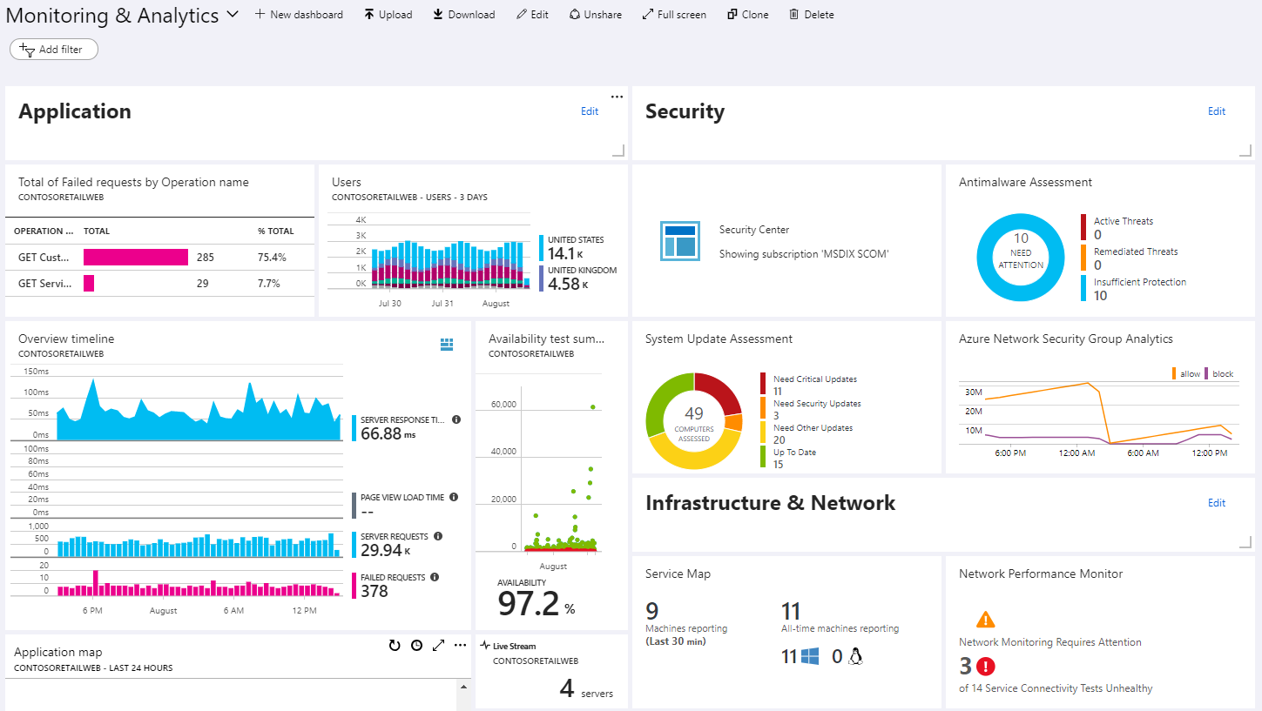
Azure Dashboards

Slide 19
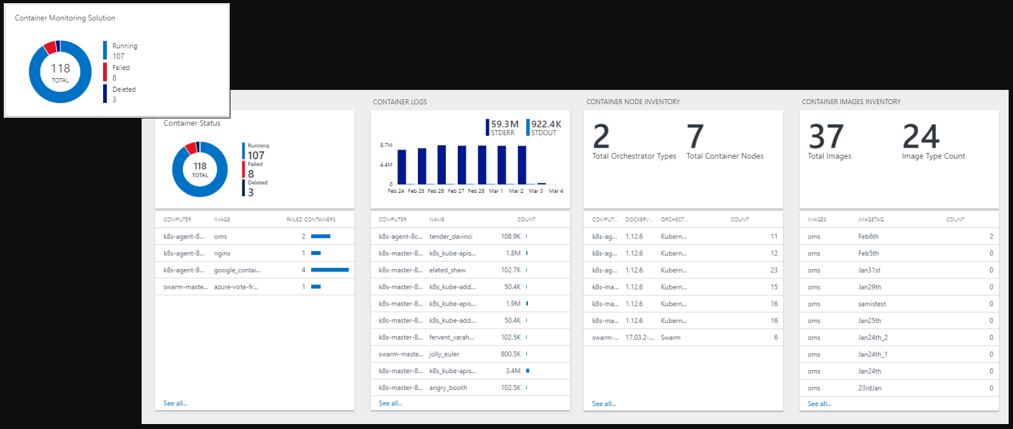
View Designer in Azure Monitor

Slide 20
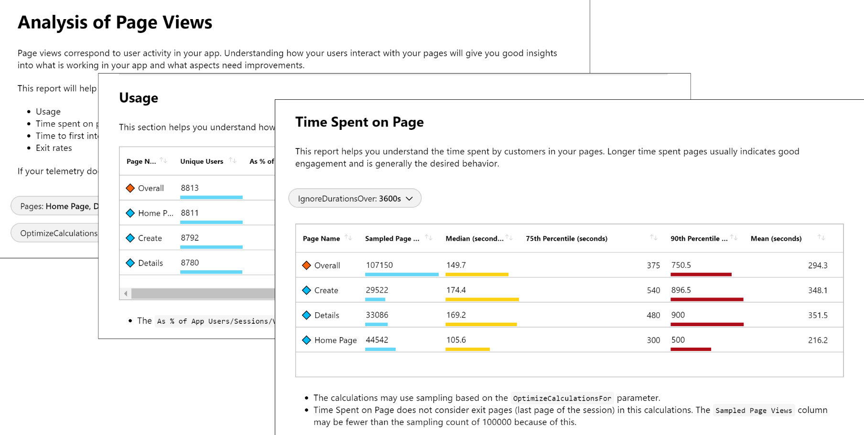
Azure Monitor workbooks

Slide 21
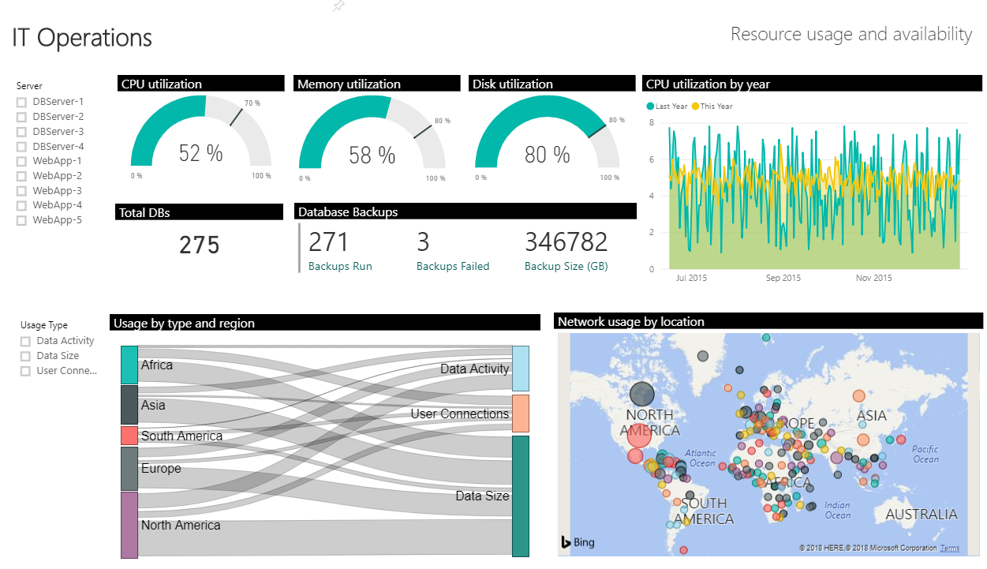
Power BI

Slide 22
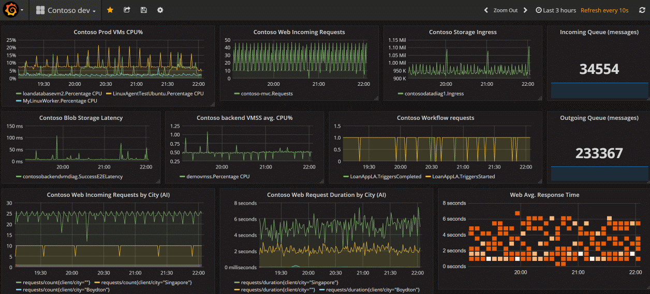
Grafana

Slide 23
Build your own custom application
Advantages:
Complete flexibility
Combine metrics and log data
Disadvantages:
Significant engineering required

Slide 24

Lesson 05: Integrate and configure ticketing systems

Slide 25
IT Service Management Connector
Advantages:
Create an incident or alert in your service desk solution based on alerts from Azure
Sync incident data from service desk solution to Azure Log Analytics
Correlate service desk data with Log Analytics data

Slide 26
Lesson 06: Lab

Slide 27
Monitoring application performance with Application Insights
Lab overview:
In this lab, you'll learn about how you can add Application Insights to an existing web application, as well as how to monitor the application via the Azure portal.
Objectives:
Deploy Azure App Service web apps
Generate and monitor Azure web app application traffic by using Application Insights
Investigate Azure web app performance by using Application Insights
Track Azure web app usage by using Application Insights
Create Azure web app alerts by using Application Insights
Duration:
Notes:
The labs are updated on a regular basis. For the latest information please visit:
https://microsoftlearning.github.io/AZ400-DesigningandImplementingMicrosoftDevOpsSolutions/

Slide 28
Lesson 07: Module review and takeaways

Slide 29
What did you learn?
Configure crash report integration for client applications
Develop monitoring and status dashboards
Implement routing for client application crash report data
Implement tools to track system usage, feature usage, and flow
Integrate and configure ticketing systems with development team's work management

Slide 30
Module review questions
Does Azure Monitor allow you to create alerts from log queries?
1
What features are provided by Azure Monitor?
2
3
What query language can you use to query Azure Log Analytics?
4
What platform integrations does Azure Monitor provide to visualize your logs in real time?
Notes:
Q1 Answer: yes
Q2 Answer: 1. Detect and diagnose issues across applications and dependencies with Application Insights.
2. Correlate infrastructure issues with Azure Monitor for VMs and Azure Monitor for Containers.
3. Create visualizations with Azure dashboards and workbooks.
4. Support operations at scale with smart alerts and automated actions.
Q3 Answer: Kusto Query Language (KQL)
Q4 Answer: Power BI and/or Grafana

