Slide 1
AZ-400.00 Module 18: Implementing Security in DevOps Projects

Slide 2
Lesson 01: Module overview

Slide 3
Module overview
Lesson1: Module overview
Lesson 2: Security in the pipeline
Lesson 3: Azure Security Center
Lesson 4: Lab
Lesson 5: Module review and takeaways

Slide 4
Learning objectives
After completing this module, students will be able to:
Define an infrastructure and configuration strategy and appropriate toolset for a release pipeline and application infrastructure
Implement compliance and security in your application infrastructure

Slide 5
Lesson 02: Security in the pipeline

Slide 6
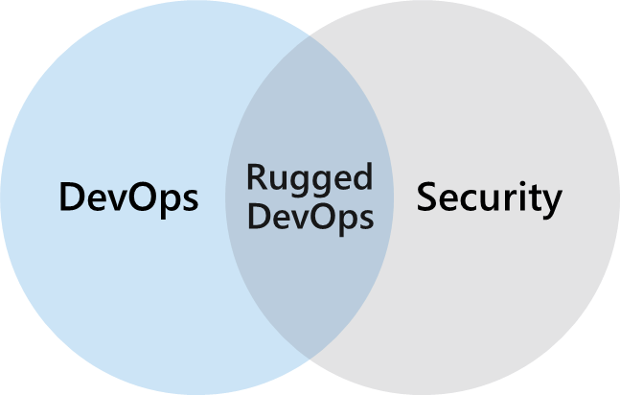
What is rugged DevOps ?
Rugged DevOps é um conjunto de práticas projetadas para integrar DevOps e segurança
Rugged DevOps is also sometimes referred to as DevSecOps
O objetivo é permitir que as equipes de desenvolvimento trabalhem rapidamente sem introduzir vulnerabilidades indesejadas
A estratégia de segurança inclui controle de acesso, proteção do ambiente, proteção do perímetro e muito mais
Notes:
O Rugged DevOps inclui questões maiores, como:
Meu pipeline está consumindo componentes de terceiros e, em caso afirmativo, eles são seguros?
Existem vulnerabilidades conhecidas em algum software de terceiros que usamos?
Com que rapidez posso detectar vulnerabilidades (hora de detectar)?
Com que rapidez posso corrigir as vulnerabilidades identificadas (hora de corrigir)?

Slide 7
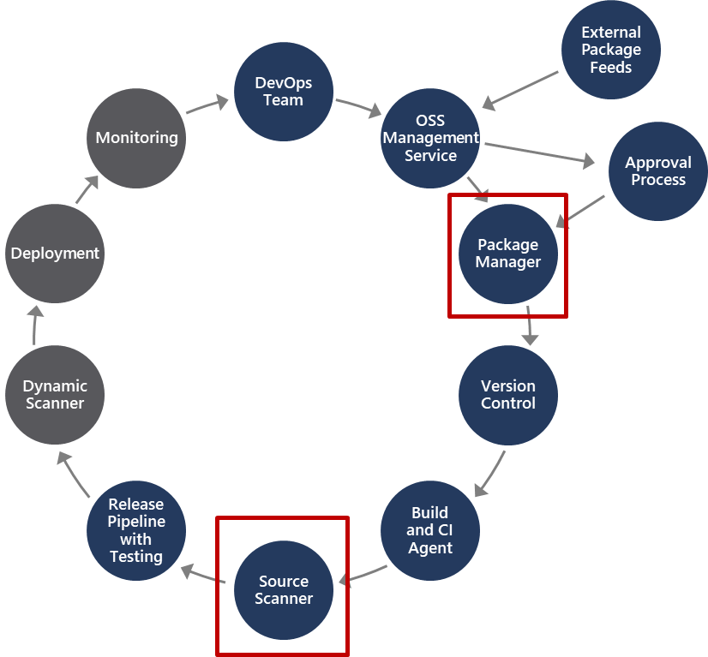
Rugged DevOps pipeline
Package management, e o processo de aprovação associado a ele, explica como os pacotes de software são adicionados ao pipeline e o processo de aprovação pelo qual eles precisam passar
Source scanner é para realizar uma varredura de segurança para verificar se certas vulnerabilidades de segurança não estão presentes em nosso código-fonte do aplicativo
Notes:
Existem duas áreas importantes no pipeline que fazem parte do Rugged DevOps e não de outros pipelines DevOps. Observe que essas duas áreas estão em partes diferentes do pipeline.

Slide 8
Software composition analysis (SCA)
Package Management:
Unique source of binary components
Create a local cache of approved components
Use Azure Artifacts to share and organize your packages
Package types: NuGet, npm, Maven, Gradle, Universal, and Python
Open-Source Software (OSS) Components:
Dependências reutilizadas podem ter vulnerabilidades de segurança
Certifique-se de ter a versão mais recente
Verifique os binários corretos
Resolva vulnerabilidades prontamente
Analisar o software para determinar sua composição pode ajudar a mitigar vulnerabilidades potenciais
Ferramentas de digitalização discutidas no próximo módulo

Slide 9
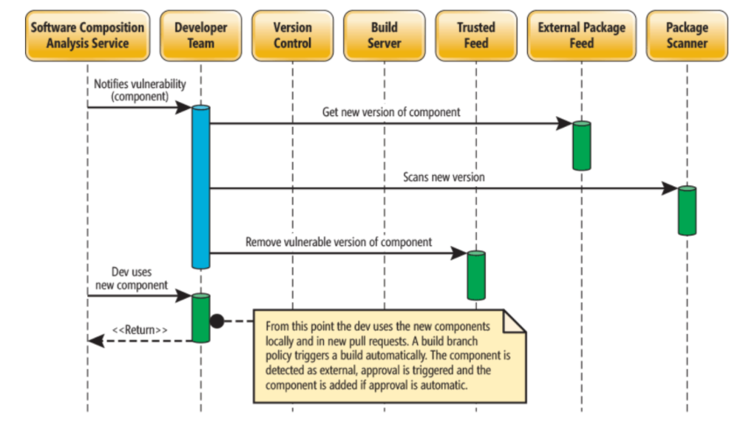

Slide 10
WhiteSource integration with Azure DevOps pipeline
WhiteSource é um exemplo de extensão disponível no Azure DevOps Marketplace
Se consumir pacotes externos, a extensão WhiteSource aborda especificamente as questões de segurança de código aberto, qualidade e conformidade de licença.
Detecte continuamente todos os componentes de código aberto em seu software
Receba alertas sobre vulnerabilidades de segurança de código aberto
Aplicar automaticamente a segurança de código aberto e conformidade de licença

Slide 11
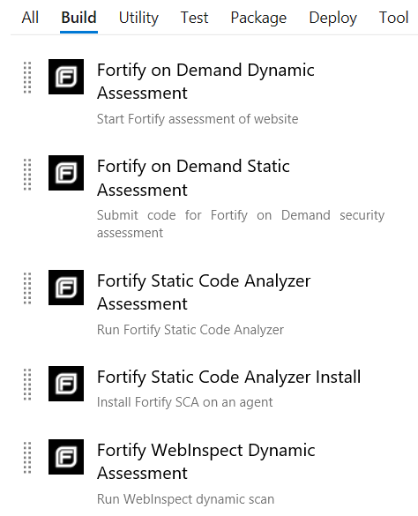
Micro Focus Fortify integration with Azure Pipelines
Pode adicionar tarefas de compilação ao pipeline de CI / CD para ajudar a identificar vulnerabilidades em seu código-fonte
Fornece um conjunto abrangente de analisadores de segurança de software
Fortify Static Code Analyzer: Identifica as causas raiz das vulnerabilidades de segurança do software
Fortify on Demand: Envia automaticamente solicitações de verificação estáticas e dinâmicas
Notes:
Micro Focus Fortify is another example of an extension you can leverage from the Microsoft DevOps Marketplace and can integrate with your CI/CD pipeline to address Rugged DevOps security-related issues.

Slide 12
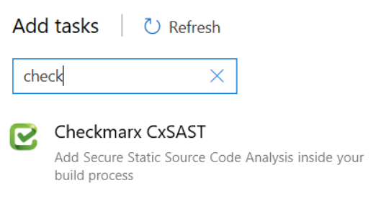
Checkmarx integration with Azure DevOps
Identifies, tracks, and fixes technical and logical security flaws:
Best fix location
Quick and accurate scanning
Incremental scanning
Seamless integration
Code portfolio protection
Easy to initiate Open-Source Analysis with Checkmarx Open-Source Analysis (CxOSA) and Checkmarx Static Application Security Testing (CxSAST)
Notes:
Static versus Dynamic Application Security Testing.
Static application security testing takes place while the application is not running and identifies flaws, vulnerabilities, back doors in the code while in that state. Static analysis can take place early in the dev cycle and help identify potential issues early on.
Dynamic application security testing takes place while the code is running, it will monitor memory usage, functional behaviours, performance, responses times and other items.

Slide 13
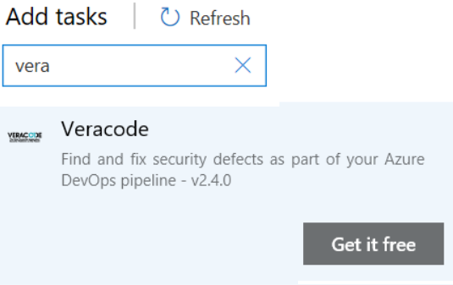
Veracode integration with Azure DevOps
Integre a segurança do aplicativo em suas ferramentas de desenvolvimento
Não pare por falsos alarmes
Alinhe suas práticas de segurança de aplicativos com suas práticas de desenvolvimento
Não se limite a encontrar vulnerabilidades, corrija-as
O processo de integração permite a digitalização no primeiro dia

Slide 14
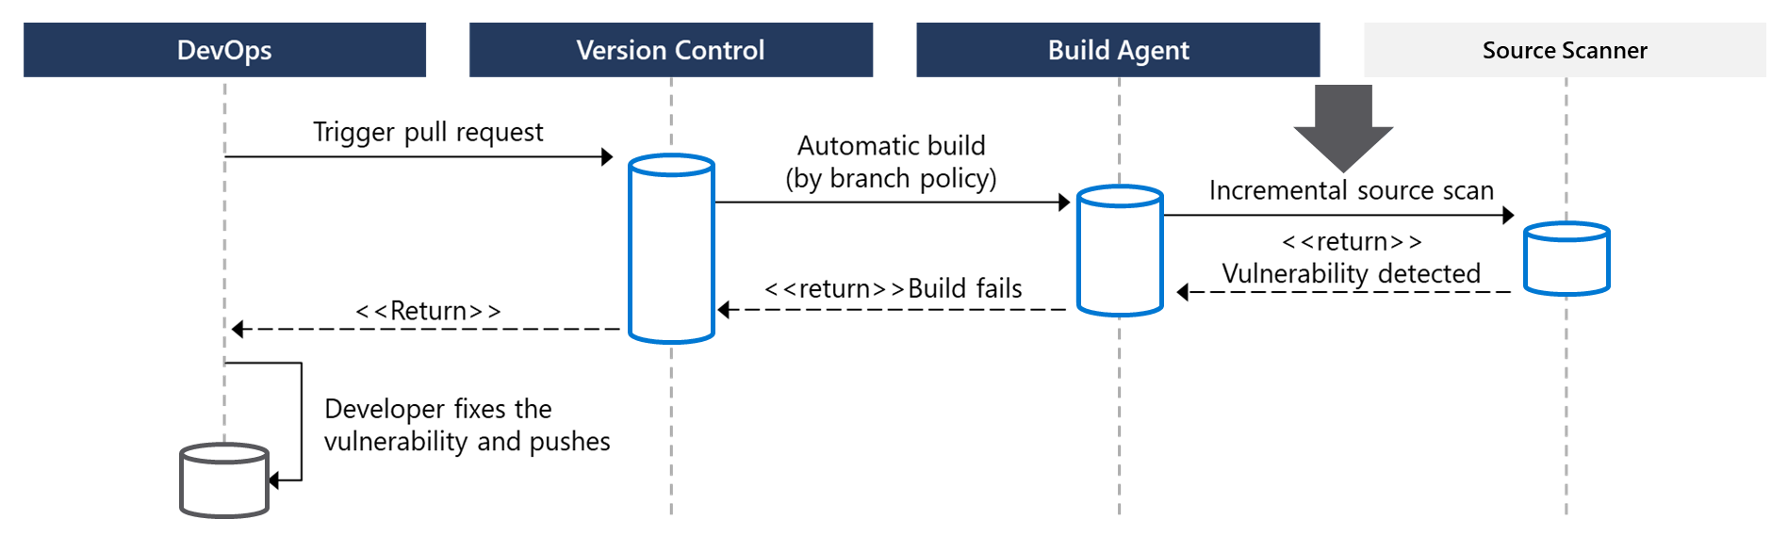
How to integrate software composition analysis checks into pipelines
Solicitações pull são a forma como as equipes DevOps enviam alterações
WhiteSource, Checkmarx, Veracode, and Black Duck by Synopsis pode facilitar varreduras incrementais
Integre a digitalização ao fluxo de trabalho de uma equipe em vários pontos ao longo do caminho

Slide 15
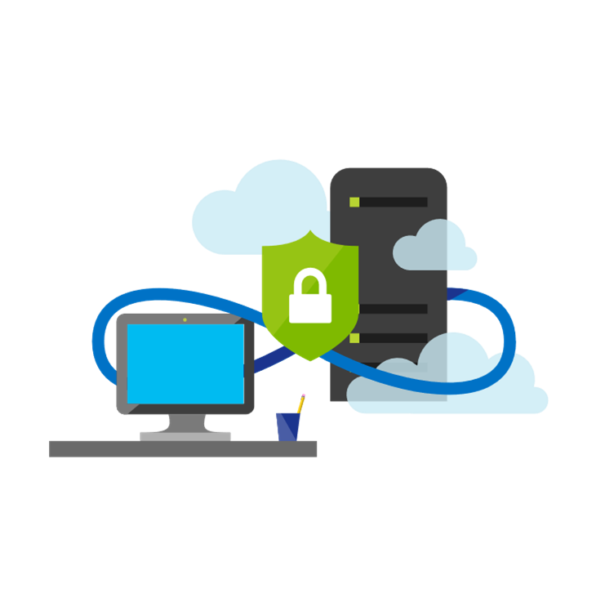
Implementing pipeline security
Use traditional operational methods for protecting identities and assets
Authentication and Authorization: Use Multi-Factor Authentication and Just enough Admin (JEA)
Use the CI/CD release pipeline: Use uma infraestrutura imutável e apenas usando seu pipeline
Manage Permissions: Proteja o pipeline usando RBAC
Dynamic Scanning: Testar aplicativos em execução, como teste de penetração
Monitoring Production: Procure por anomalias relacionadas à intrusão
Notes:
To improve security in general use Azure Resource Manager templates, or other code-based configurations, and Infrastructure as Code best practices, such as only making changes in templates, thereby making them traceable and repeatable. Also, use provisioning and configuration technologies such as Desired State Configuration, Azure Automation, and other third-party tools and products that integrate seamlessly with Azure.

Slide 16
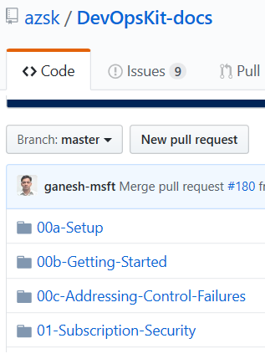
Secure DevOps kit for Azure (AzSK)
AzSK is a collection of scripts, tools, extensions, automations
Ajuda a proteger a assinatura
Permite o desenvolvimento seguro
Integra segurança em CI / CD
Fornece garantia contínua
Auxilia com alertas e monitoramento
Administrando os riscos da nuvem
Available at: https://github.com/azsk/DevOpsKit-docs
Notes:
Consider going to the GitHub site, https://github.com/azsk/DevOpsKit-docs, and showing the readme to call out some elements of the AzSK

Slide 17
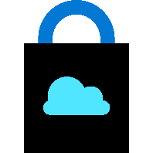
Lesson 03: Azure Security Center

Slide 18

Azure Security Center
Provide security recommendations
Monitor security settings
Monitor all your services
Use Azure Machine Learning
Analyze and identify potential attacks
Provide just-in-time (JIT) access control
Supports Windows and Linux operating systems
Available in two pricing tiers

Slide 19
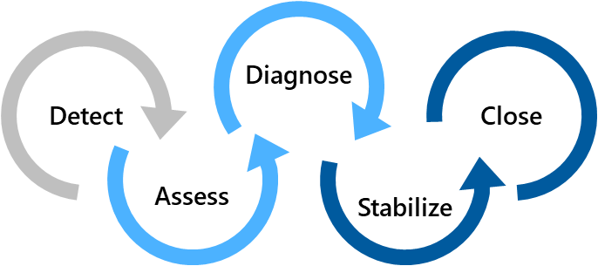
Azure Security Center usage scenarios
Scenario 1
Use Security Center for an incident response
Scenario 2
Use Security Center recommendations to enhance security
Security Policy
Recommendations
Detect – Verify a high security alert was raised
Configure a security policy
Access – Obtain information about the alert
Implement the recommendations for the security policy
Diagnose – Follow the remediation steps
Notes:
Scenario 1:
Many organizations learn how to respond to security incidents only after suffering an attack. To reduce costs and damage, it’s important to have an incident response plan in place before an attack occurs. You can use Azure Security Center in different stages of an incident response.
You can use Security Center during the detect, assess, and diagnose stages.
- Detect: Review the first indication of an event investigation. Example: Use the Security Center dashboard to review the initial verification that a high-priority security alert was raised.
- Assess: Perform the initial assessment to obtain more information about the suspicious activity. Example: Obtain more information about the security alert.
- Diagnose: Conduct a technical investigation and identify containment, mitigation, and workaround strategies. Example: Follow the remediation steps described by Security Center in that particular security alert.
Scenario 2:
You can reduce the chances of a significant security event by configuring a security policy, and then implementing the recommendations provided by Azure Security Center.
A security policy defines the set of controls that are recommended for resources within that specified subscription or resource group. In Security Center, you define policies according to your company's security requirements.
Security Center analyzes the security state of your Azure resources. When Security Center identifies potential security vulnerabilities, it creates recommendations based on the controls set in the security policy. The recommendations guide you through the process of configuring the needed security controls

Slide 20


Azure Policy
Is a service in Azure that you use to create, assign, and manage policies
Provides enforcement by using policies and initiatives
Runs evaluations on your resources and scans for those not compliant
Comes with several built-in policy and initiative definitions
Integrates with Azure DevOps by applying any continuous integration (CI) and continuous deployment (CD) pipeline policies
An example of an Azure policy that you can integrate with your DevOps pipeline is the Check Gate task
Notes:
Azure Policy Check Gate - https://docs.microsoft.com/en-us/azure/devops/pipelines/tasks/deploy/azure-policy-check-gate?view=vsts

Slide 21
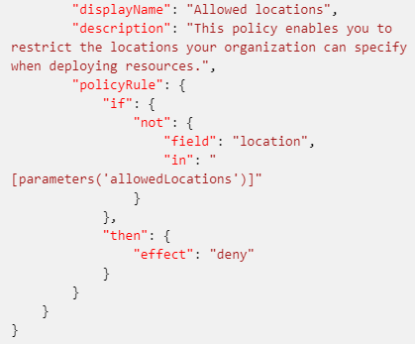
Policies
A policy definition expresses what to evaluate and what action to take
Policies are defined in JSON
Assign policies using Azure Portal, Azure CLI, or Azure PowerShell
Use remediation for non-compliant resources
The screenshot is a section of a policy file defining allowed locations
Notes:
A policy definition expresses what to evaluate and what action to take. For example, you could prevent VMs from deploying if they are exposed to a public IP address. You also could prevent a particular hard disk from being used when deploying VMs to control costs.
Every policy definition has conditions under which it is enforced, and an accompanying effect that takes place if the conditions are met.
The process of applying a policy to your resources consist of the following steps:
1. Create a policy definition.
2. Assign a definition to a scope of resources.
3. View policy evaluation results.

Slide 22
Initiatives
Uma definição de iniciativa é um conjunto de definições de política
Ajuda a rastrear seu estado de conformidade para uma meta maior
Atribuído a um escopo específico
Reduz a necessidade de atribuições de escopo individuais
Initiative Example:
Create an Initiative named “Enable Monitoring In Azure Security Center.” This would provide the following policies:
Monitor unencrypted SQL Database policy definition
Monitor OS vulnerabilities policy definition
Monitor missing Endpoint Protection policy definition
Even if you have a single policy, we recommend using initiatives if you anticipate increasing the number of policies over time

Slide 23
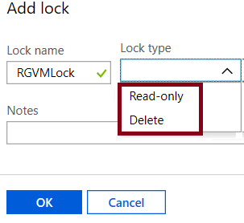
Resource locks
Prevent accidental deletion or modification of your Azure resources:
CanNotDelete – significa que usuários autorizados ainda podem ler e modificar um recurso, mas não podem excluí-lo
ReadOnly – significa que usuários autorizados podem ler um recurso, mas não podem excluí-lo ou atualizá-lo. Aplicar este bloqueio é como restringir todos os usuários autorizados às permissões concedidas pela função Leitor
In the Azure portal, the locks are called Delete and Read-only respectively

Slide 24
Azure Blueprints
Allows for the definition of a repeatable set of Azure resources that implement and adhere to an organization’s standards, patterns, and requirements
Pode garantir que uma implantação atenda aos padrões, padrões e requisitos de uma organização
É uma forma declarativa de orquestrar a implantação de vários modelos de recursos e outros artefatos
Fornece rastreabilidade e auditoria, bem como aderência
The blueprint definition (what should be deployed) and the blueprint assignment (what is deployed) supports improved deployment tracking and auditing
1
2
3
Create an Azure blueprint
Assign the blueprint
Track the blueprint assignments
Discussion: How do Azure Blueprint policies differ from templates?
Notes:
Azure Blueprints is also useful in Azure DevOps scenarios where blueprints are associated with specific build artifacts and release pipelines, and can be tracked more rigorously.
Note: At the time of writing, Azure Blueprints is in preview and has not yet been released publicly.
Discussion: How to Azure Blueprint policies differ from templates?
Answer:
The blueprints in Azure Blueprints are different from Azure Resource Manager templates. When Azure Resource Manager templates deploy resources, they have no active relationship with the deployed resources (they exist in a local environment or in source control). By contrast, with Azure Blueprints, each deployment is tied to an Azure Blueprints package. This means that the relationship with resources will be maintained, even after deployment. In this way, maintaining relationships improves auditing and tracking capabilities.

Slide 25
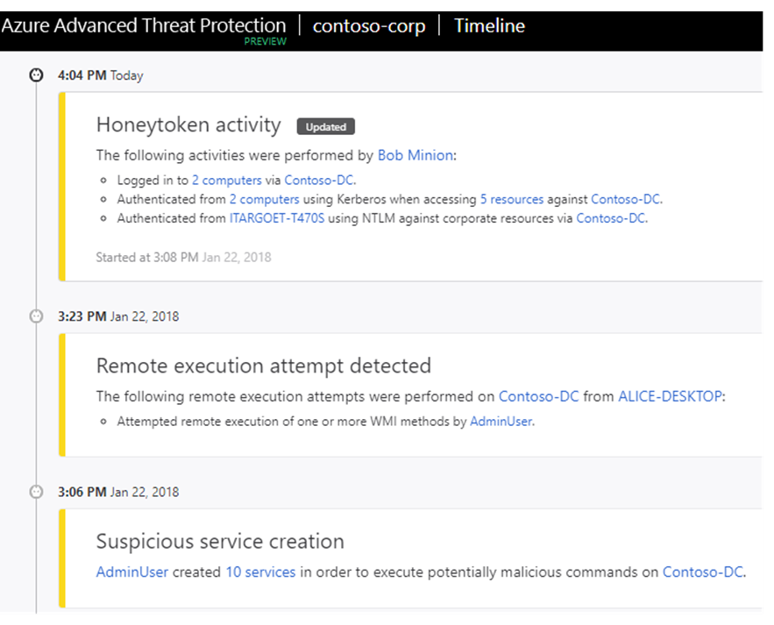
Azure Advanced Threat Protection (ATP)
Identifies, detects, and helps you investigate advanced threats, compromised identities, and malicious insider actions
Azure ATP portal monitors and responds to suspicious activity
Azure ATP sensor monitors domain controller traffic
Azure ATP cloud service connects to Microsoft Intelligent Security Graph
Notes:
Azure ATP portal. Azure ATP has its own portal, through which you can monitor and respond to suspicious activity. The portal allows you to create your Azure ATP instance, and view the data received from Azure ATP sensors.
You can also use the portal to monitor, manage, and investigate threats in your network environment. You sign in to the Azure ATP portal at https://portal.atp.azure.com. However, note that you must sign in with a user account that is assigned to an Azure AD security group that has access to the Azure ATP portal.
Azure ATP sensor. Azure ATP sensors are installed directly on your domain controllers. The sensor monitors domain controller traffic without requiring a dedicated server or configured port mirroring.
Azure ATP cloud service. Azure ATP cloud service runs on the Azure infrastructure, and is currently deployed in the United States, Europe, and Asia. The cloud service is connected to Microsoft Intelligent Security Graph

Slide 26
Lesson 04: Lab

Slide 27
Implement security and compliance in Azure DevOps Pipelines
Lab overview:
In this lab, we will create a new Azure DevOps project, populate the project repository with a sample application code, create a build pipeline. Next, we will install WhiteSource Bolt from the Azure DevOps Marketplace to make it available as a build task, activate it, add it to the build pipeline, use it to scan the project code for security vulnerabilities and licensing compliance issues, and finally view the resulting report.
Objectives:
Create a Build pipeline
Install WhiteSource Bolt from the Azure DevOps marketplace and activate it
Add WhiteSource Bolt as a build task in a build pipeline
Run build pipeline and view WhiteSource security and compliance report
Duration:
Notes:
The labs are updated on a regular basis. For the latest information please visit:
https://microsoftlearning.github.io/AZ400-DesigningandImplementingMicrosoftDevOpsSolutions/

Slide 28
Lesson 05: Module review and takeaways

Slide 29
What did you learn?
Define an infrastructure and configuration strategy and appropriate toolset for a release pipeline and application infrastructure
Implement compliance and security in your application infrastructure

Slide 30
Module review questions
1
Rugged DevOps combines which two elements?
2
Which term broadly defines what security means in rugged DevOps?
What component in Azure DevOps can you use to store, organize and share access to packages, and integrate those packages them with your continuous integration and continuous delivery pipeline?
3
4
What describes the term software composition analysis?
5
From where can extensions be sourced from, to be integrated into Azure DevOps CI/CD pipelines and help provide security composition analysis?
Notes:
Q1 Answer: DevOps and Security
Q2 Answer: Securing the pipeline
With rugged DevOps, security is more about securing the pipeline, determining where you can add security to the elements that plug into your build and release pipeline. For example, it's about how and where you can add security to you automation practices, production environments, and other pipeline elements while attempt to gain the speed of DevOps.
Rugged DevOps includes bigger questions such as: Is my pipeline consuming third-party components, and if so, are they secure? Are there known vulnerabilities within any of the third-party software we use? How quickly can I detect vulnerabilities (time to detect)? How quickly can I remediate identified vulnerabilities (time to remediate)?
Q3 Answer: Azure Artifacts
Q4 Answer: Analyzing open-source software (OSS) to identify potential security vulnerabilities and provide validation that the software meets a defined criteria to use in your pipeline
Q5 Answer: Azure DevOps Marketplace

Slide 31
Module review questions, continued
6
Which products are available as extensions in Azure DevOps Marketplace, and can provide either OSS or source code scanning as part of an Azure DevOps pipeline?
7
Which Azure service is a monitoring service that can provide threat protection and security recommendations across all your services both in Azure and on-premises?
8
Which Azure service should you use from the below list to monitor all unencrypted SQL databases in your organization?
9
Which facility allows you to prevent accidental deletion of resources in Azure?
Notes:
Q6 Answer: Whitesource, CheckMarx, Micro Focus Fortify, Veracode
Q7Answer: Azure Security Center
Q8 Answer: Azure Policy
Azure Policy is a service in Azure that you use to create, assign, and, manage policies. These policies enforce different rules and effects over your resources, which ensures they stay compliant with your corporate standards and service-level agreements (SLAs). A policy definition expresses what to evaluate and what action to take. For example, you could prevent VMs from deploying if they are exposed to a public IP address. You also could prevent a particular hard disk from being used when deploying VMs to control costs.
Q9 Answer: Locks
Locks help you prevent accidental deletion or modification of your Azure resources. You can manage these locks from within the Azure portal. To view, add, or delete locks, go to the SETTINGS section of any resource's settings blade. You may need to lock a subscription, resource group, or resource to prevent other users in your organization from accidentally deleting or modifying critical resources. You can set the lock level to CanNotDelete or ReadOnly.

