Slide 1
Category review: Chips
June 2020
Retail Analytics

Slide 2
Notes:
To view Privacy video explaining how important data privacy is to Quantium, please click here: https://www.youtube.com/watch?v=Zq1QDAkoRzU
or here Q:\Company Reference\Brand & Design\Brand videos\Q Privacy.mp4
At Quantium, we believe that data is the behavioural footprint of humanity and that it has to be treated with the utmost care and responsibility.
Histories, attitudes, indeed lives are stored within it in ways that aren’t always apparent – and that’s what makes its potential so powerful.
To work with it responsibly, sensitively, we set ourselves the highest data privacy protection and governance standards.
We have spent 17 years perfecting privacy-by-design and secure-by-design principles. Central to this is not holding any personally identifiable information about people –
we neither receive it, and put the necessary protections in place to be unable to decipher it.
Every aspect of handling data is safeguarded: from its de-identification, to its encryption – data security is paramount and of the highest grade.
We pride ourselves on gaining the trust of iconic organisations around the world through years of securely working with their data,
and in turn the trust that builds with their stakeholders.

Slide 3
Executive summary
This analysis highlights the financial distribution across various demographic groups.
Older Families (Budget Category): 163,363 $
Young Singles/Couples (Mainstream Category): 157,621$
Retirees (Mainstream Category): 155,677$
01
Most Profitable Customer Segments
The trial stores demonstrated superior performance compared to the control stores, indicating that the retail strategy was effective. This success supports the potential for expanding the strategy to additional locations.
02
Trial Store Strategy

Slide 4
01
Which customer segments generate the highest total sales for chips?

Slide 5
Overview: Supporting the findings for the most profitable customers
LIFESTAGE | CUSTOMER TYPE | FINANCIAL STATUS
Young Families | Budget | Budget conscious spending habits
Older Singles/Couples | Budget | Looking for affordable options
Retirees | Mainstream | Robust purchasing power
Mid-age Singles/Couples | Premium | Strong - Wealthy Financial Status
Young Singles/Couples | Mainstream | Healthy Financial Situation
Young Families (Budget): Offer value-focused product bundles and discounts to attract budget-conscious young families while maintaining product quality.
Older Singles/Couples (Budget): Focus on easy-to-use, affordable products with clear value propositions, including loyalty programs or promotions that reward repeat customers.
Retirees (Mainstream): Highlight convenience, comfort, and reliability in product offerings, along with promotions or loyalty programs to appeal to this financially stable group.
Mid-Age Singles/Couples (Premium): Provide premium options with personalized services, exclusive offers, or VIP memberships to capitalize on their willingness to invest in higher-end products.
Young Singles/Couples (Mainstream): Emphasize trendy and affordable items with convenient shopping experiences (e.g., fast delivery, easy returns), ensuring a balance between quality and price.

Slide 6
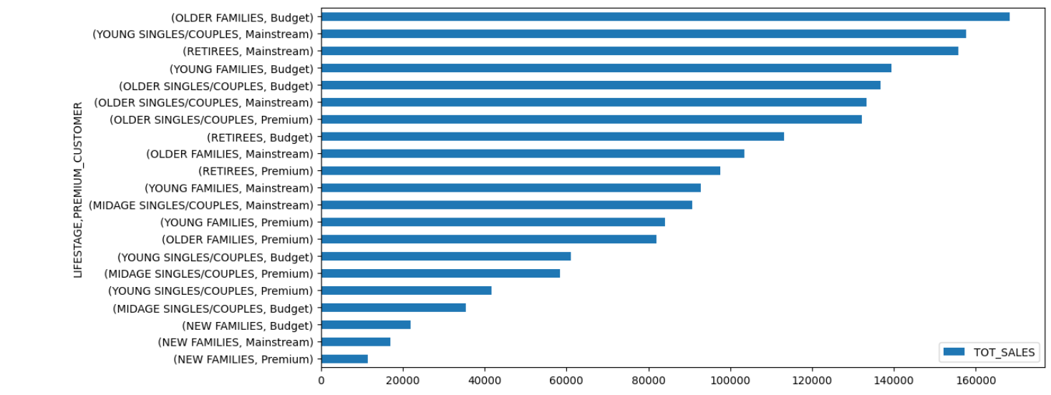
Affluence and its effect on consumer buying for the category of chips

Slide 7
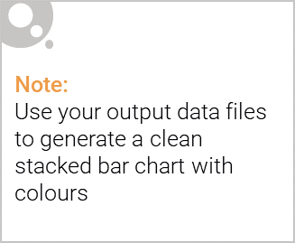
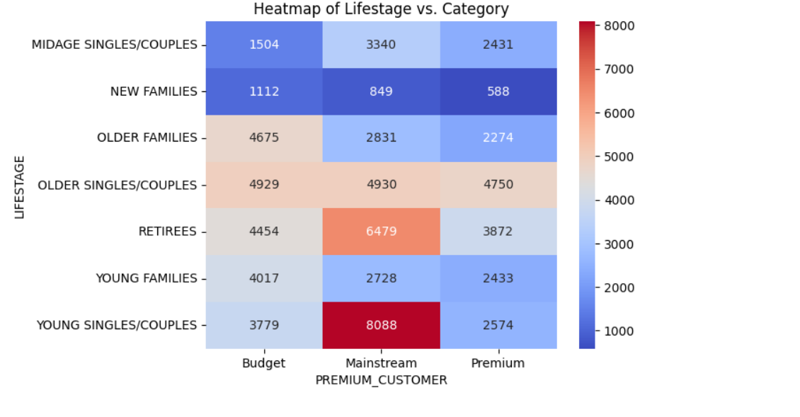
Editable (delete this)
Number of Customers by life stage and type

Slide 8
02
Trial store performance

Slide 9
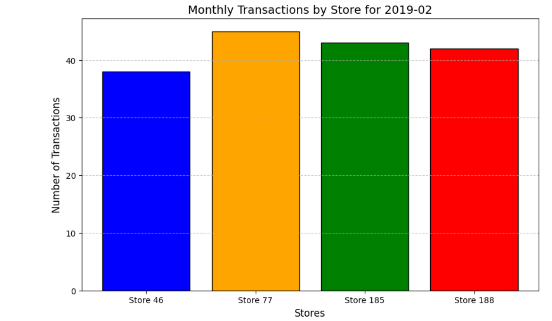
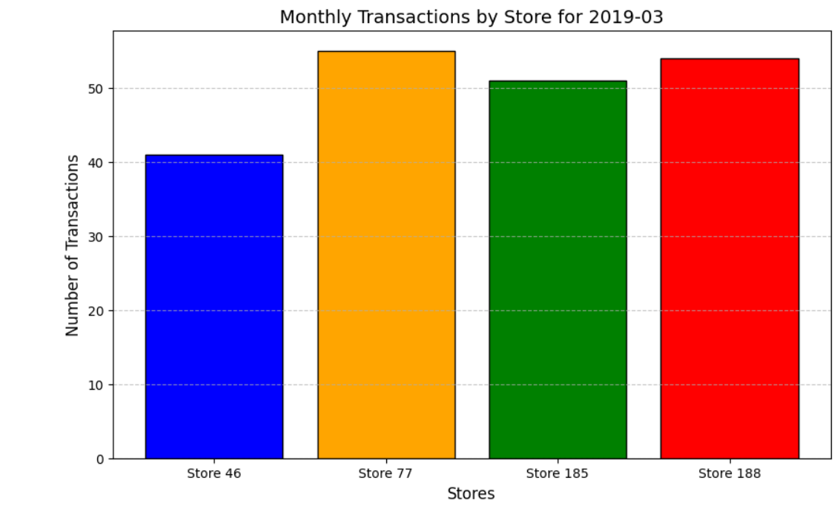
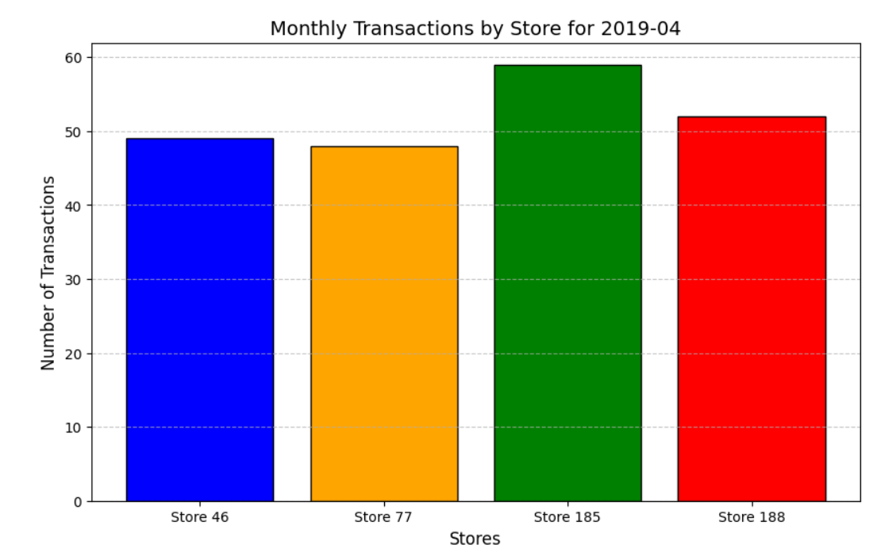
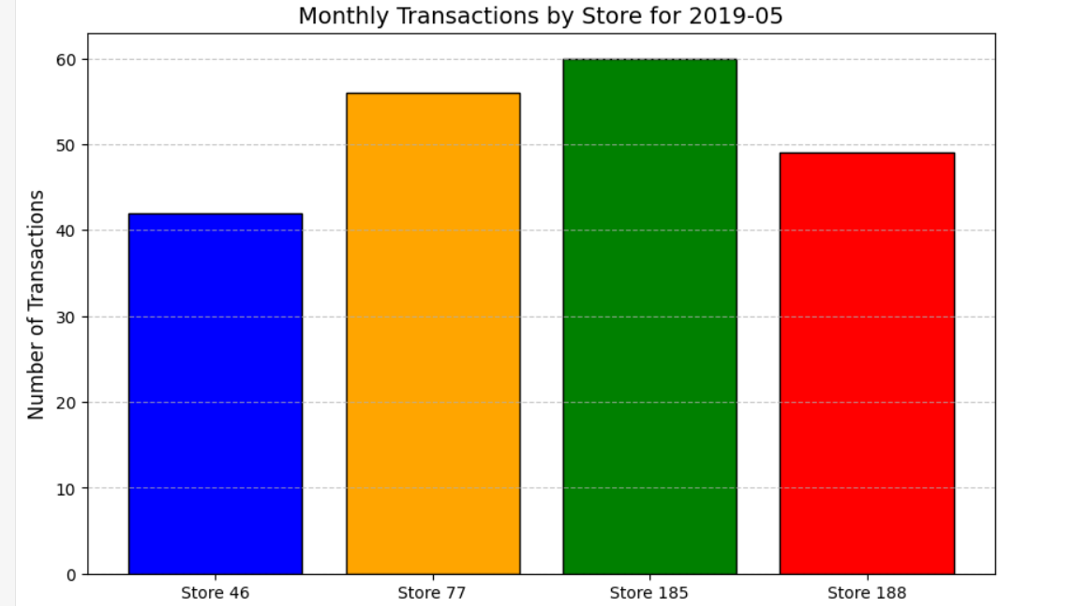
Explanation of the control store vs other stores

Slide 10
Performance Of Trial Store
Further Analysis
Investigate customer behavior: Analyze customer preferences, purchase patterns, and demographics in trial stores to understand performance drivers.
Examine regional and seasonal trends: Explore if regional or seasonal factors influenced the trial stores' success.
Strategy Exploration:
Assess scalability: Evaluate whether the trial strategy can be applied to other locations based on store size and demographics.
Refine key strategy elements: Identify successful components (e.g., pricing, assortment) and standardize them across all stores.

