Slide 2
IMAGE PROCESSING
Emotion Detection
System
Mariș Rafail - 30433
Emotion Detection System • Theoretical Background

Slide 3
OVERVIEW
Problem Description
What will the project do?
No research – initial ideea
A method for allowing the computer to detect the user’s emotional state will be implemented.
Known “why-did-I-choose-this”:
Lighting variances
Expressions not universally quantifiable
Need for real time processing ( Project is to be extended into my thesis – Affecting Minecraft’s graphic with respect to the emotions displayed by the user)
Cam
The laptop must have access to a camera => need a library
Alg
How will laptop know where face at?
Emo
How to get emotion? Deep Learn / Heavy math...
Need dataset
HCI
Empathetic AI interfaces
Emotion Detection System • Theoretical Background

Slide 4
Prob1
Solution (?)
import cv2 # See video 1 for installation
# Replace "0" with a file path to work with a saved video
stream = cv2.VideoCapture(0)
if not stream.isOpened():
print("No stream :(")
exit()
fps = stream.get(cv2.CAP_PROP_FPS)
width = int(stream.get(3))
height = int(stream.get(4))
# list of FourCC video codes: https://softron.zendesk.com/hc/en-us/articles/207695697-List-of-FourCC-codes-for-video-codecs
output = cv2.VideoWriter("assets/4_stream.mp4",
cv2.VideoWriter_fourcc('m', 'p', '4', 'v'),
fps=fps, frameSize=(width, height))
while True:
ret, frame = stream.read()
if not ret: # if no frames are returned
print("No more stream :(")
break
frame = cv2.resize(frame, (width, height))
output.write(frame)
cv2.imshow("Webcam!", frame)
if cv2.waitKey(1) == ord('q'): # press "q" to quit
break
stream.release()
cv2.destroyAllWindows() #!
Camera
Problem
Must access the laptop camera in real time and process the user’s face
Source:
Video
OpenCV documentation
Emotion Detection System • Theoretical Background

Slide 5
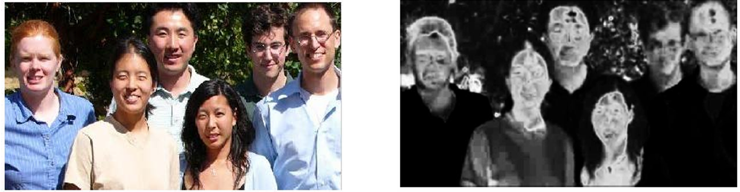
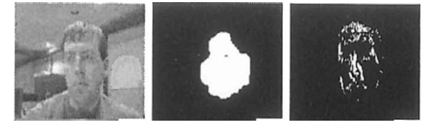
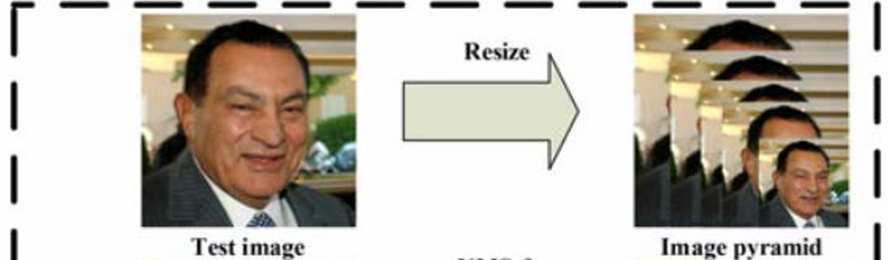
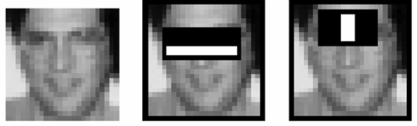
Solution (?)
Prob2
Color based
Algorithm – faces
Problem
How will we know where face at?
Found research paper (Robust Real-time Object Detection – Paul Viola, Michael Jones) + link
OMG official website
2. Gaze detection – Face mask needed
4. Deep learning
3. Viola and Jones – TODO: Read whatever face asta
Emotion Detection System • Theoretical Background

Slide 6
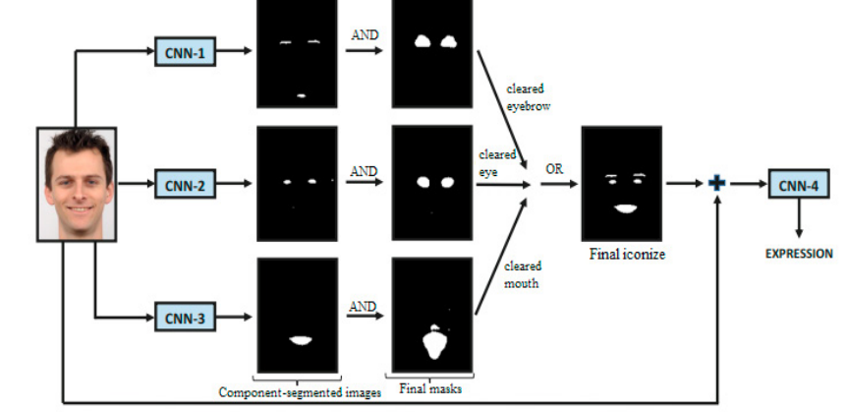
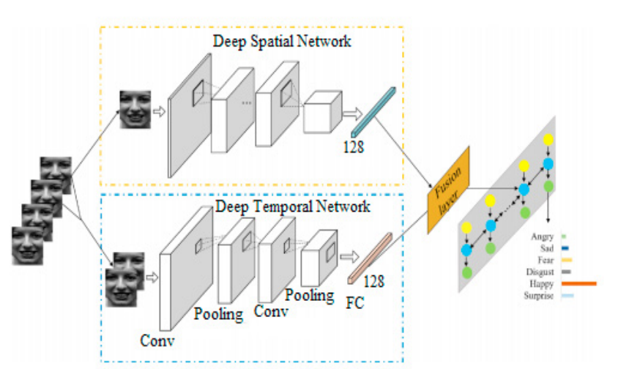
Solution (?)
Prob2
Proposal 1 – From paper (692)
Algorithm – emo’
Problem
How are emotions classified?
Research paper: Facial emotion recognition using deep learning: review and insights - Wafa Mellouk, Wahida Handouzi
2. Proposal 2 – From paper (692)
Emotion Detection System • Theoretical Background

Slide 7







DATASET
FER2013 Dataset
~35,000
48 × 48
7
Grayscale
Total Images
Pixel Resolution
Emotion Classes
Color Space
Emotion Classes
Dataset Split
Angry
Fear
Happy
Sad
Training
28,709 images
Validation
3,589 images
Surprise
Neutral
Disgust
Test
3,589 images
Source: Kaggle FER-2013 Competition (Goodfellow et al.)
Emotion Detection System • Theoretical Background

Slide 8
METHODS
How to do this?
1
2
CNN from Scratch
Transfer Learning (yoink)
Train my own CNN
Use a pre-trained model (MobileNetV2, ResNet50, VGG16) on the FER2013 dataset
Emotion Detection System • Theoretical Background

Slide 9
Tools
Libraries & Algorithms
Libraries I think might be useful
Algorithms recommended by “ vericu’ “
TensorFlow / Keras
▸
Haar Cascade / MTCNN
For the model
Face detection and localization from input frames
▸
Convolutional Layers
OpenCV
Automatic spatial feature extraction from images
To get and pre-process the image
▸
Batch Normalization
NumPy / Pandas
Stable and faster convergence during training
Numerical computations
▸
Softmax Activation
Matplotlib / Seaborn
Multi-class probability output (7 emotions)
Plots, maybe the confusion matrix
▸
Adam Optimizer
Adaptive learning rate for faster, stable training
Scikit-learn
▸
Data Augmentation
Slavescu said something about it :)
Flips, rotations & crops to reduce overfitting
Emotion Detection System • Theoretical Background

Slide 10
FLOW
Application Flow
01
02
03
04
05
Input
Face
Detection
Pre-
processing
CNN
Model
Output
▶
▶
▶
▶
Webcam /
Image / Video
Haar Cascade
or MTCNN
Resize 48×48
Normalize
Feature
Extraction
Probabilities
for 7 emotions
📷 Live / Static
😊 HAPPY 83%
😠 ANGRY 9%
Emotion Detection System • Theoretical Background

Slide 11
SOLUTION
Recommended solution by Claudiu
Chosen Approach:
Pre-trained on ImageNet → fine-tuned on FER2013 → real-time inference via OpenCV
Transfer Learning with MobileNetV2 + OpenCV Face Detection
01
Data Pipeline
02
Model Setup
Load FER2013, apply augmentation (flips, rotations, zoom). Normalize pixel values to [0,1]. Split into train/val/test.
Load MobileNetV2 (ImageNet weights). Freeze base layers. Add custom head: GlobalAvgPool → Dense(128) → Softmax(7).
03
Training
04
Inference App
Fine-tune with Adam optimizer (lr=0.0001). Train for 30–50 epochs with early stopping. Monitor val accuracy & loss.
OpenCV reads webcam frames. Haar Cascade detects faces. Crop + preprocess → model predicts → display label + confidence.
Emotion Detection System • Theoretical Background

