Slide 1
Mushrooms
By: Rafal Wawrzak

Slide 2
The Data
The Data is the how mushrooms look, by certain criteria
To find out how edible/poisonous mushroom by looks
It is categorized by colors, smells, and other visible properties
The original data was collected in the 1980

Slide 3
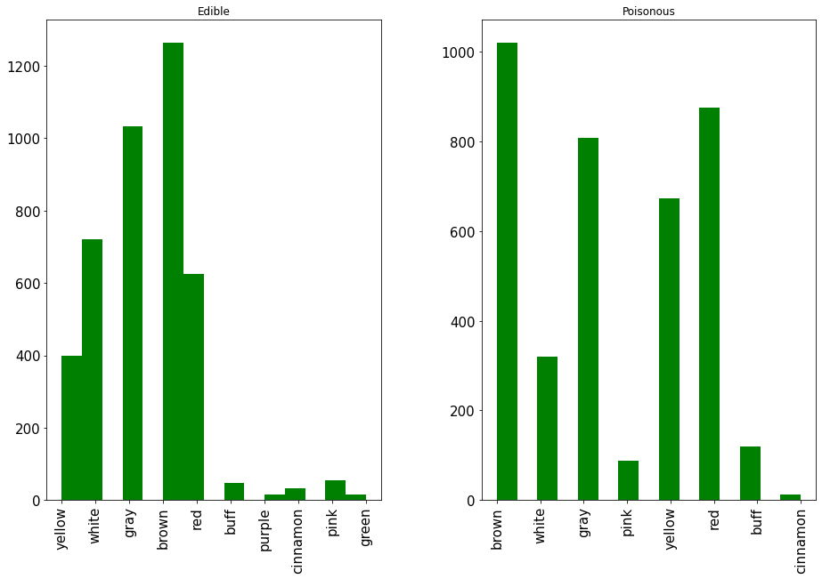
Interesting things about the data
The color of the cap if it’s edible or poisonous

Slide 4
Random Forest
Used a Random forest algorithm to predict what is edible and what is poisonous, it has a 100% accuracy prediction, and it’s fairly speedy (under 1 sec)
–Evaluations —
Training accuracy was 100%
Testing accuracy was 100%

Slide 5
Don’t judge a mushroom by it’s looks
Mushrooms come in many shapes and sizes, some are edible while others are not. They may have similar looks, but the doesn’t mean they are edible, most common poisonous ones have similar color as those that are not.
There are some mushrooms that may look like the are edible, but they are not.

