Slide 1
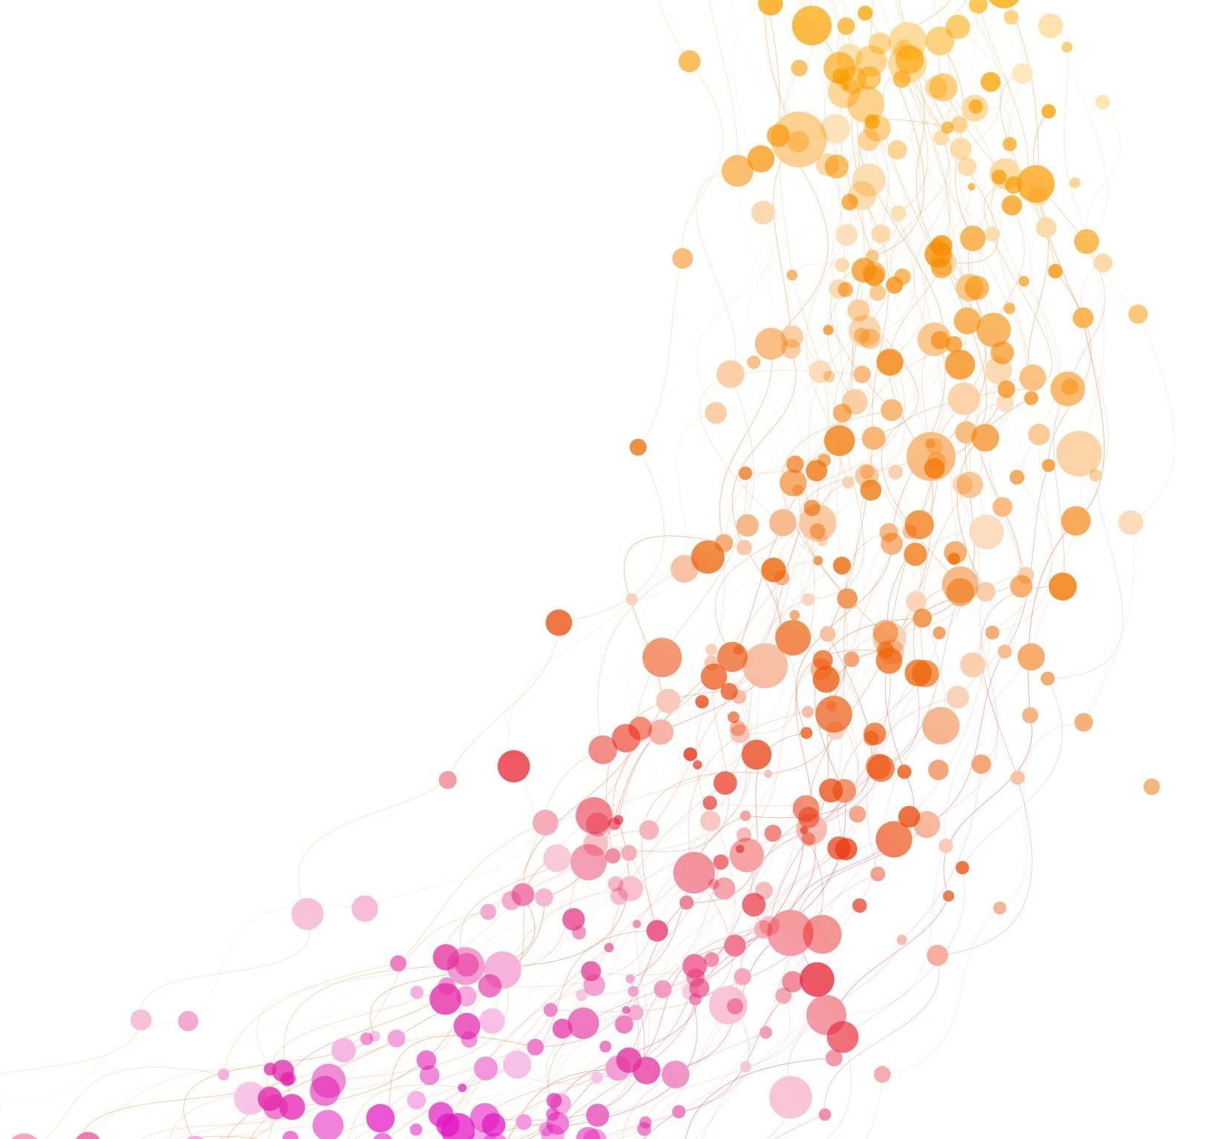
Estimating discrete choice models with Biogeme
Onur Akman
Complex Social Systems (2025)
19/03/2025
onur.akman@uj.edu.pl

Slide 2
Introduction
We will explore discrete choice modeling: Modeling how people make decisions among discrete alternatives.
How do people choose where to eat?
How do people choose what to watch?
How do people choose where to sit in this lab?
We will use Biogeme, a Python package for estimating choice models.

Slide 3
Why Model Discrete Choices?
Many real-world problems involve choices:
Product selection (brand A vs. B)
Online decisions (click vs. no click)
We are interested in
understanding how people make choices,
what are the factors in their thought processes and
replicating them in the future with maximum accuracy.
Understanding choices helps with policy-making, marketing, and system design.
Unlike simple statistics, DCM helps analyze the causal effects of factors on choices.

Slide 4
Natural question: Why Not Just Use Machine Learning?
ML excels at prediction but often lacks interpretability.
With DCM, we can:
Interpret coefficients meaningfully.
Make counterfactual analyses (e.g., “What if we reduce bus fares by 10%?”).
Ensure choices follow rational behavior (e.g., consistency with economic theory).

Slide 5
DCM: Toy example
Step 1: Define the problem
How do people choose which one to buy among the three shampoo products?
Step 2: Obtain data
We need a dataset containing:
decisions of consumers
useful information about the consumers and the products (eg., age of the consumer, income of the consumer, price of the shampoo)

Slide 6
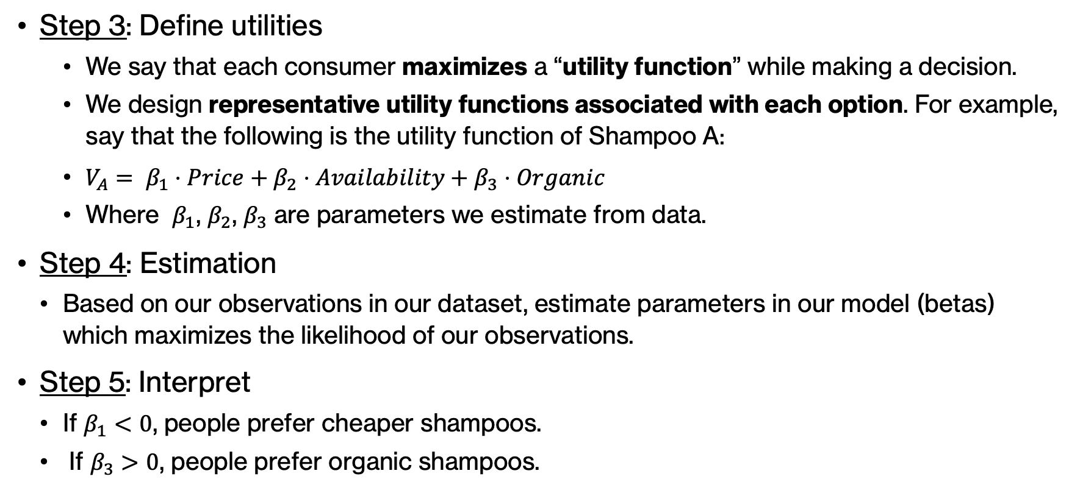
DCM: Toy example (2)
Step 3: Define utilities
We say that each consumer maximizes a “utility function” while making a decision.
We design representative utility functions associated with each option. For example, say that the following is the utility function of Shampoo A:
$V_{A}= β_{1}⋅Price+β_{2}⋅Availability+β_{3}⋅Organic$
Where $β_{1}$, $β_{2}$, $β_{3}$ are parameters we estimate from data.
Step 4: Estimation
Based on our observations in our dataset, estimate parameters in our model (betas) which maximizes the likelihood of our observations.
Step 5: Interpret
If $β_{1}<0$, people prefer cheaper shampoos.
If $β_{3}>0$, people prefer organic shampoos.

Slide 7

Biogeme
Biogeme provides a unified framework for:
Defining parameters and utility functions
Abstraction in estimation
A catalog of discrete choice models
It is developed and maintained by Prof. Michel Bierlaire, Ecole Polytechnique Fédérale de Lausanne, Switzerland.
Website: https://biogeme.epfl.ch/

Slide 8
Tutorial
Colab link:
https://colab.research.google.com/drive/1a5wheL60vVlXnq_PxmmTL5Ky8ShyH3Ks?usp=sharing
Colab link (shortened):
https://tinyurl.com/486akz5a
Download the notebook from:
ComplexSocialSystemsCourse > labs > lab2

