Slide 1
Binary Classification for Credit Card Fraud Detection
-
Milestone presentation
Rafał Leja, Hanna Makowska

Slide 2
Models trained
Data preprocessing
Logistic Regression
KNN
Random Forest
XGBoost
stratified split

Slide 3
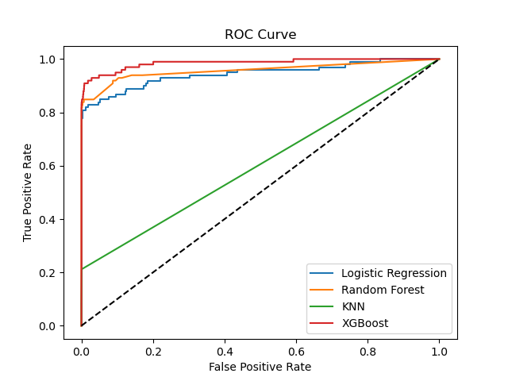
Comparison: ROC

Slide 4
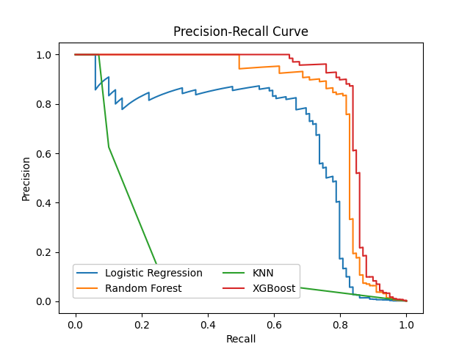
Comparison: Precision Recall Curve

Slide 5
Confusion matrix comparison:
 | TN | FP | FN | TP
LR | 56850 | 13 | 38 | 61
RF | 56855 | 8 | 29 | 70
KNN | 56863 | 0 | 92 | 7
XGBoost | 56857 | 6 | 21 | 78

Slide 6
Comparison: Precision, Recall, F-1, Accuracy
 | Precision | Recall | F-1 | Accuracy
LR | 0.824324 | 0.616162 | 0.705202 | 0.999105
RF | 0.897436 | 0.707071 | 0.790960 | 0.999350
KNN | 1.000000 | 0.070707 | 0.132075 | 0.998385
XGBoost | 0.928571 | 0.787879 | 0.852459 | 0.999526

Slide 7
Comparison: Fit Time
 | Time [s]
LR | 17.7
RF | 54.7
KNN | 11.8
XGBoost | 13.4

Slide 8
What are we planning to do:
SMOTE
Bootstraping
Time corelation

