Slide 1
Binary Classification for Credit Card Fraud Detection
-
Final presentation
Rafał Leja, Hanna Makowska

Slide 2
About the data
The dataset contains transactions made by credit cards in September 2013 by European cardholders
The dataset is highly unbalanced, the positive class (frauds) account for 0.172% of all transactions.
The dataset contains 30 features - Time, Amount V1, V2, ..., V28 - PCA transformed features
Class | Count
0 | 284315
1 | 492

Slide 3
Models trained
Data preprocessing
Logistic Regression
KNN
Random Forest
XGBoost
stratified split

Slide 4
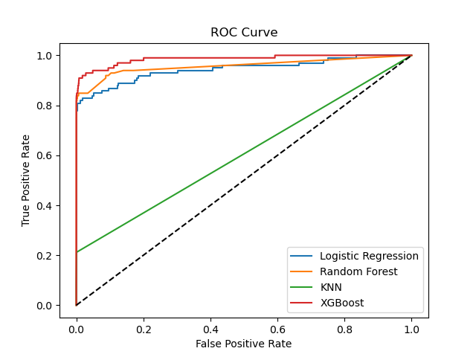
Comparison: ROC

Slide 5
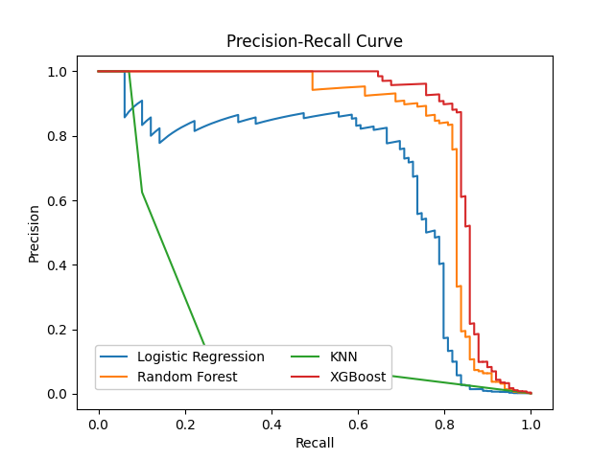
Comparison: Precision Recall Curve

Slide 6
Confusion matrix comparison: (Milestone)
 | TN | FP | FN | TP
LR | 56850 | 13 | 38 | 61
RF | 56855 | 8 | 29 | 70
KNN | 56863 | 0 | 92 | 7
XGBoost | 56857 | 6 | 21 | 78

Slide 7
Comparison: Precision, Recall, F-1, Accuracy (Milestone)
 | Precision | Recall | F-1 | Accuracy
LR | 0.824324 | 0.616162 | 0.705202 | 0.999105
RF | 0.897436 | 0.707071 | 0.790960 | 0.999350
KNN | 1.000000 | 0.070707 | 0.132075 | 0.998385
XGBoost | 0.928571 | 0.787879 | 0.852459 | 0.999526
LR (bootstrap) | 0.850746 | 0.575758 | 0.686747 | 0.999087
RF (bootstrap) | 0.900000 | 0.727273 | 0.804469 | 0.999386
KNN (bootstrap) | 0.400000 | 0.040404 | 0.073394 | 0.998227
XGBoost (bootstrap) | 0.927711 | 0.777778 | 0.846154 | 0.999508

Slide 8
Improvements:
Polynomial Features -> Logistic regression
SMOTE -> Random Forest, XGBoost
Threshold = 0 -> KNN

Slide 9
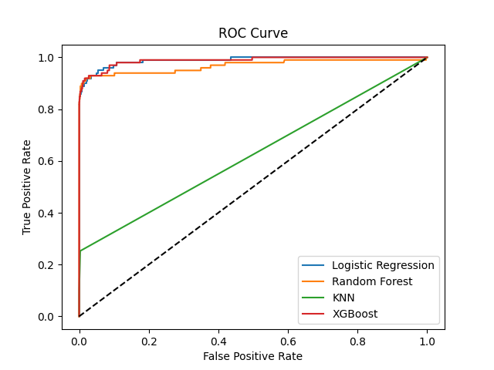
Comparison: ROC (improved)

Slide 10
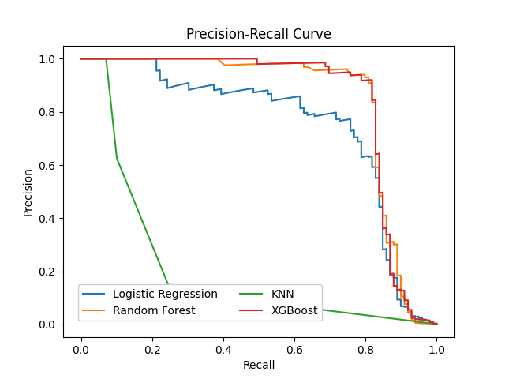
Comparison: Precision Recall Curve (improved)

Slide 11
Confusion matrix comparison: (Improved)
 | TN | FP | FN | TP
LR | 56850 | 13 | 36 | 63
RF | 56855 | 8 | 18 | 81
KNN | 56690 | 173 | 74 | 25
XGBoost | 56856 | 7 | 19 | 80

Slide 12
Comparison: Precision, Recall, F-1, Accuracy (improved)
 | Precision | Recall | F-1 | Accuracy
LR | 0.828947 | 0.636364 | 0.720000 | 0.999140
RF | 0.910112 | 0.818182 | 0.861702 | 0.999544
KNN | 0.126263 | 0.252525 | 0.168350 | 0.995664
XGBoost | 0.919540 | 0.808081 | 0.860215 | 0.999544
LR (bootstrap) | 0.817073 | 0.676768 | 0.740331 | 0.999175
RF (bootstrap) | 0.927711 | 0.777778 | 0.846154 | 0.999508
KNN (bootstrap) | 0.128571 | 0.181818 | 0.150628 | 0.996436
XGBoost (bootstrap) | 0.927711 | 0.777778 | 0.846154 | 0.999508

Slide 13
Comparison: Fit Time
 | Time [s]
LR | 17.7
RF | 54.7
KNN | 11.8
XGBoost | 13.4

Slide 14
Comparison: Prediction Time
 | Time to predict test set (56962 elements) [s]
LR | 0.00615
RF | 0.08008
KNN | 12.20929
XGBoost | 0.02043

Slide 15
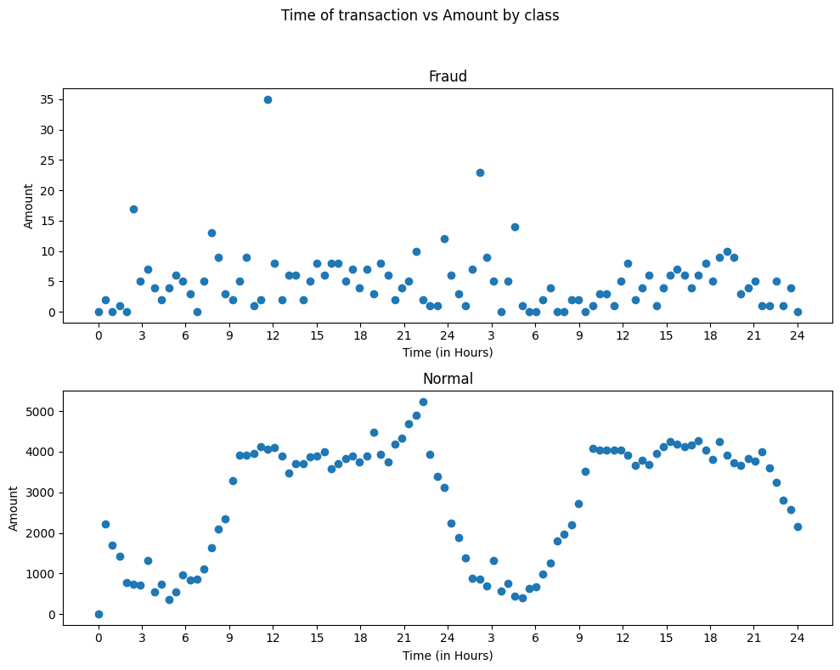
Time Correlation

Slide 16
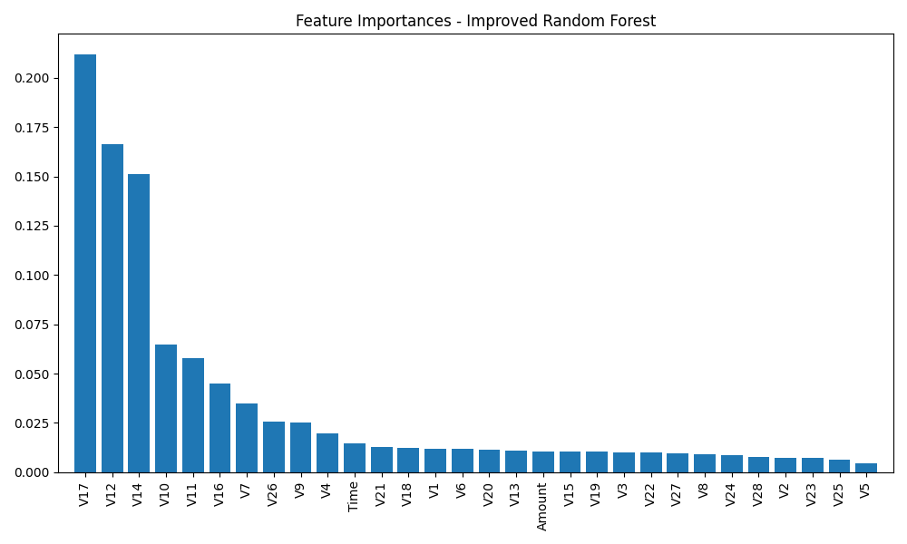
Feature importance for the best model (Random Forest)

Slide 17
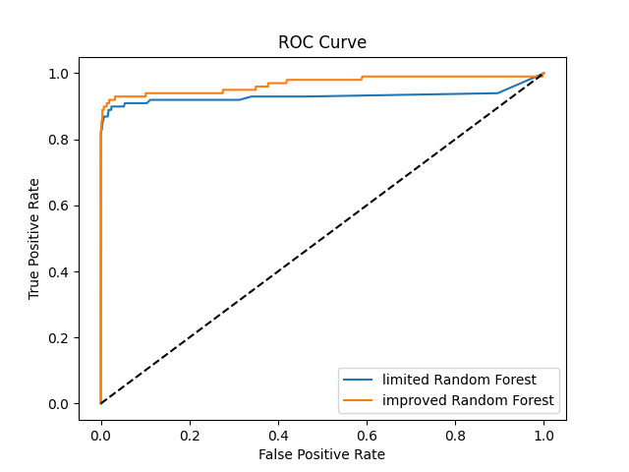
Random forest limited to 10 best features:
Precision | 0.9268 (+ 0.0168)
Recall | 0.7677 (- 0.0504)
F1 Score | 0.8398 (- 0.0219)
Accuracy | 0.9995 (± 0)

