Slide 1
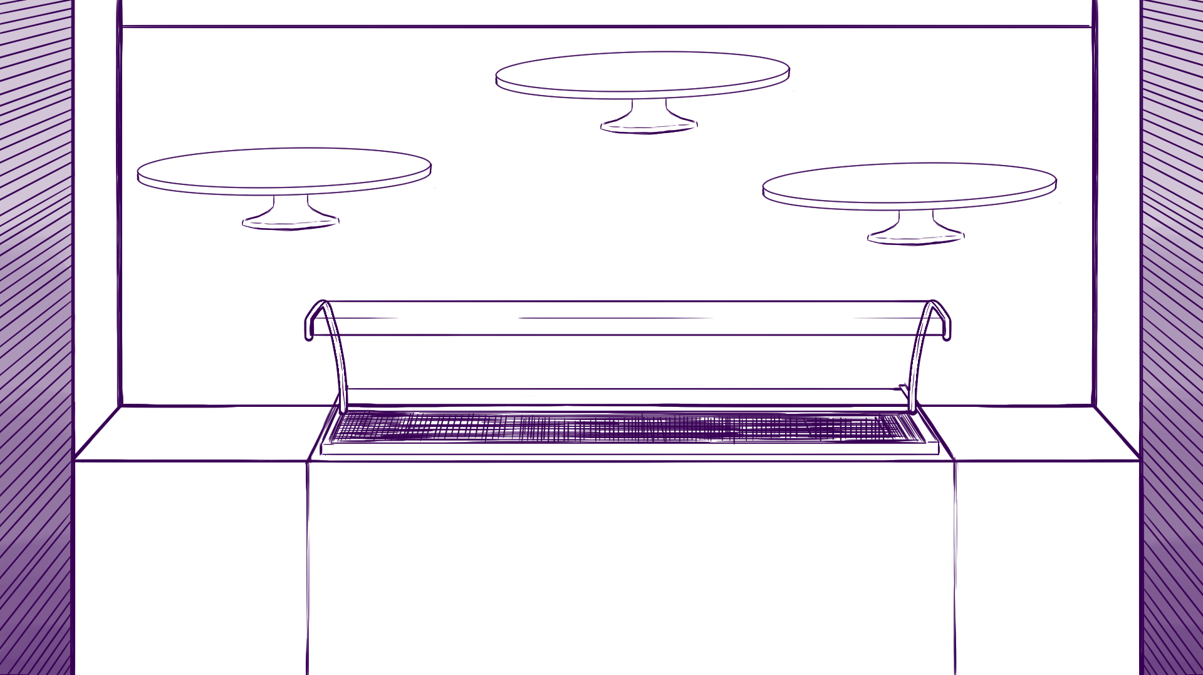

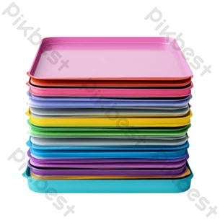


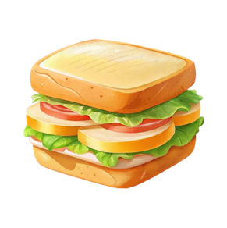
Heating Top
Trays
Register
Fridge
Freezer
Go to Storage
Go to Kitchen

