Slide 1
Network Security Design Architecture
Cloud Security?
ECPI University
By:
Rafat Khandaker
CIS 225
Instructor: Bryan Bechard

Slide 2
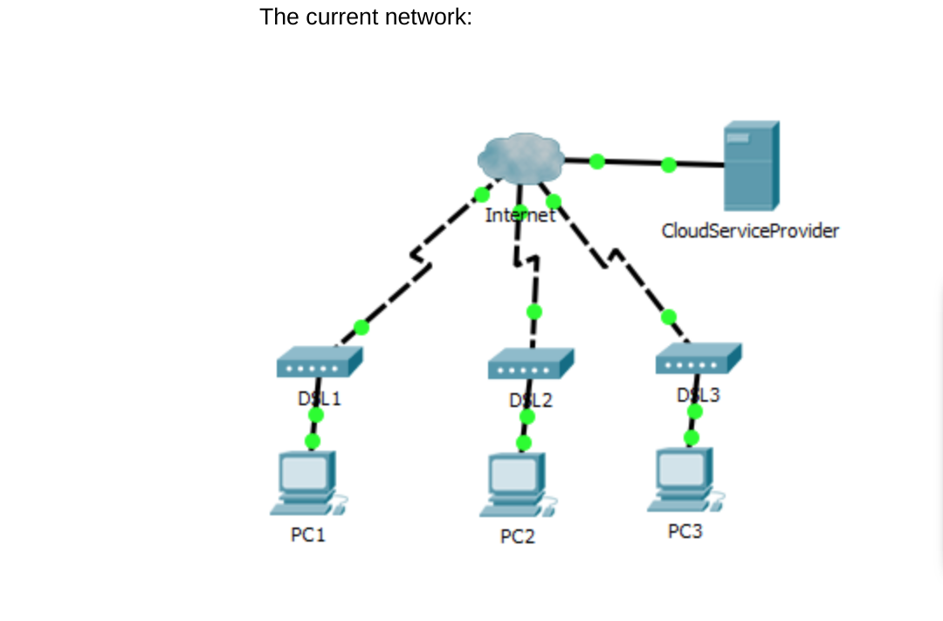
Current Model
How to Improve this system?

Slide 3
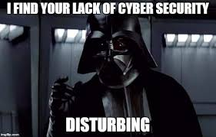
Problems:
Lacks Dimension
Not Scalable
Single point of failure
No Security
All Services in single resource
No Disaster Recovery
Not a Cloud Solution

Slide 4
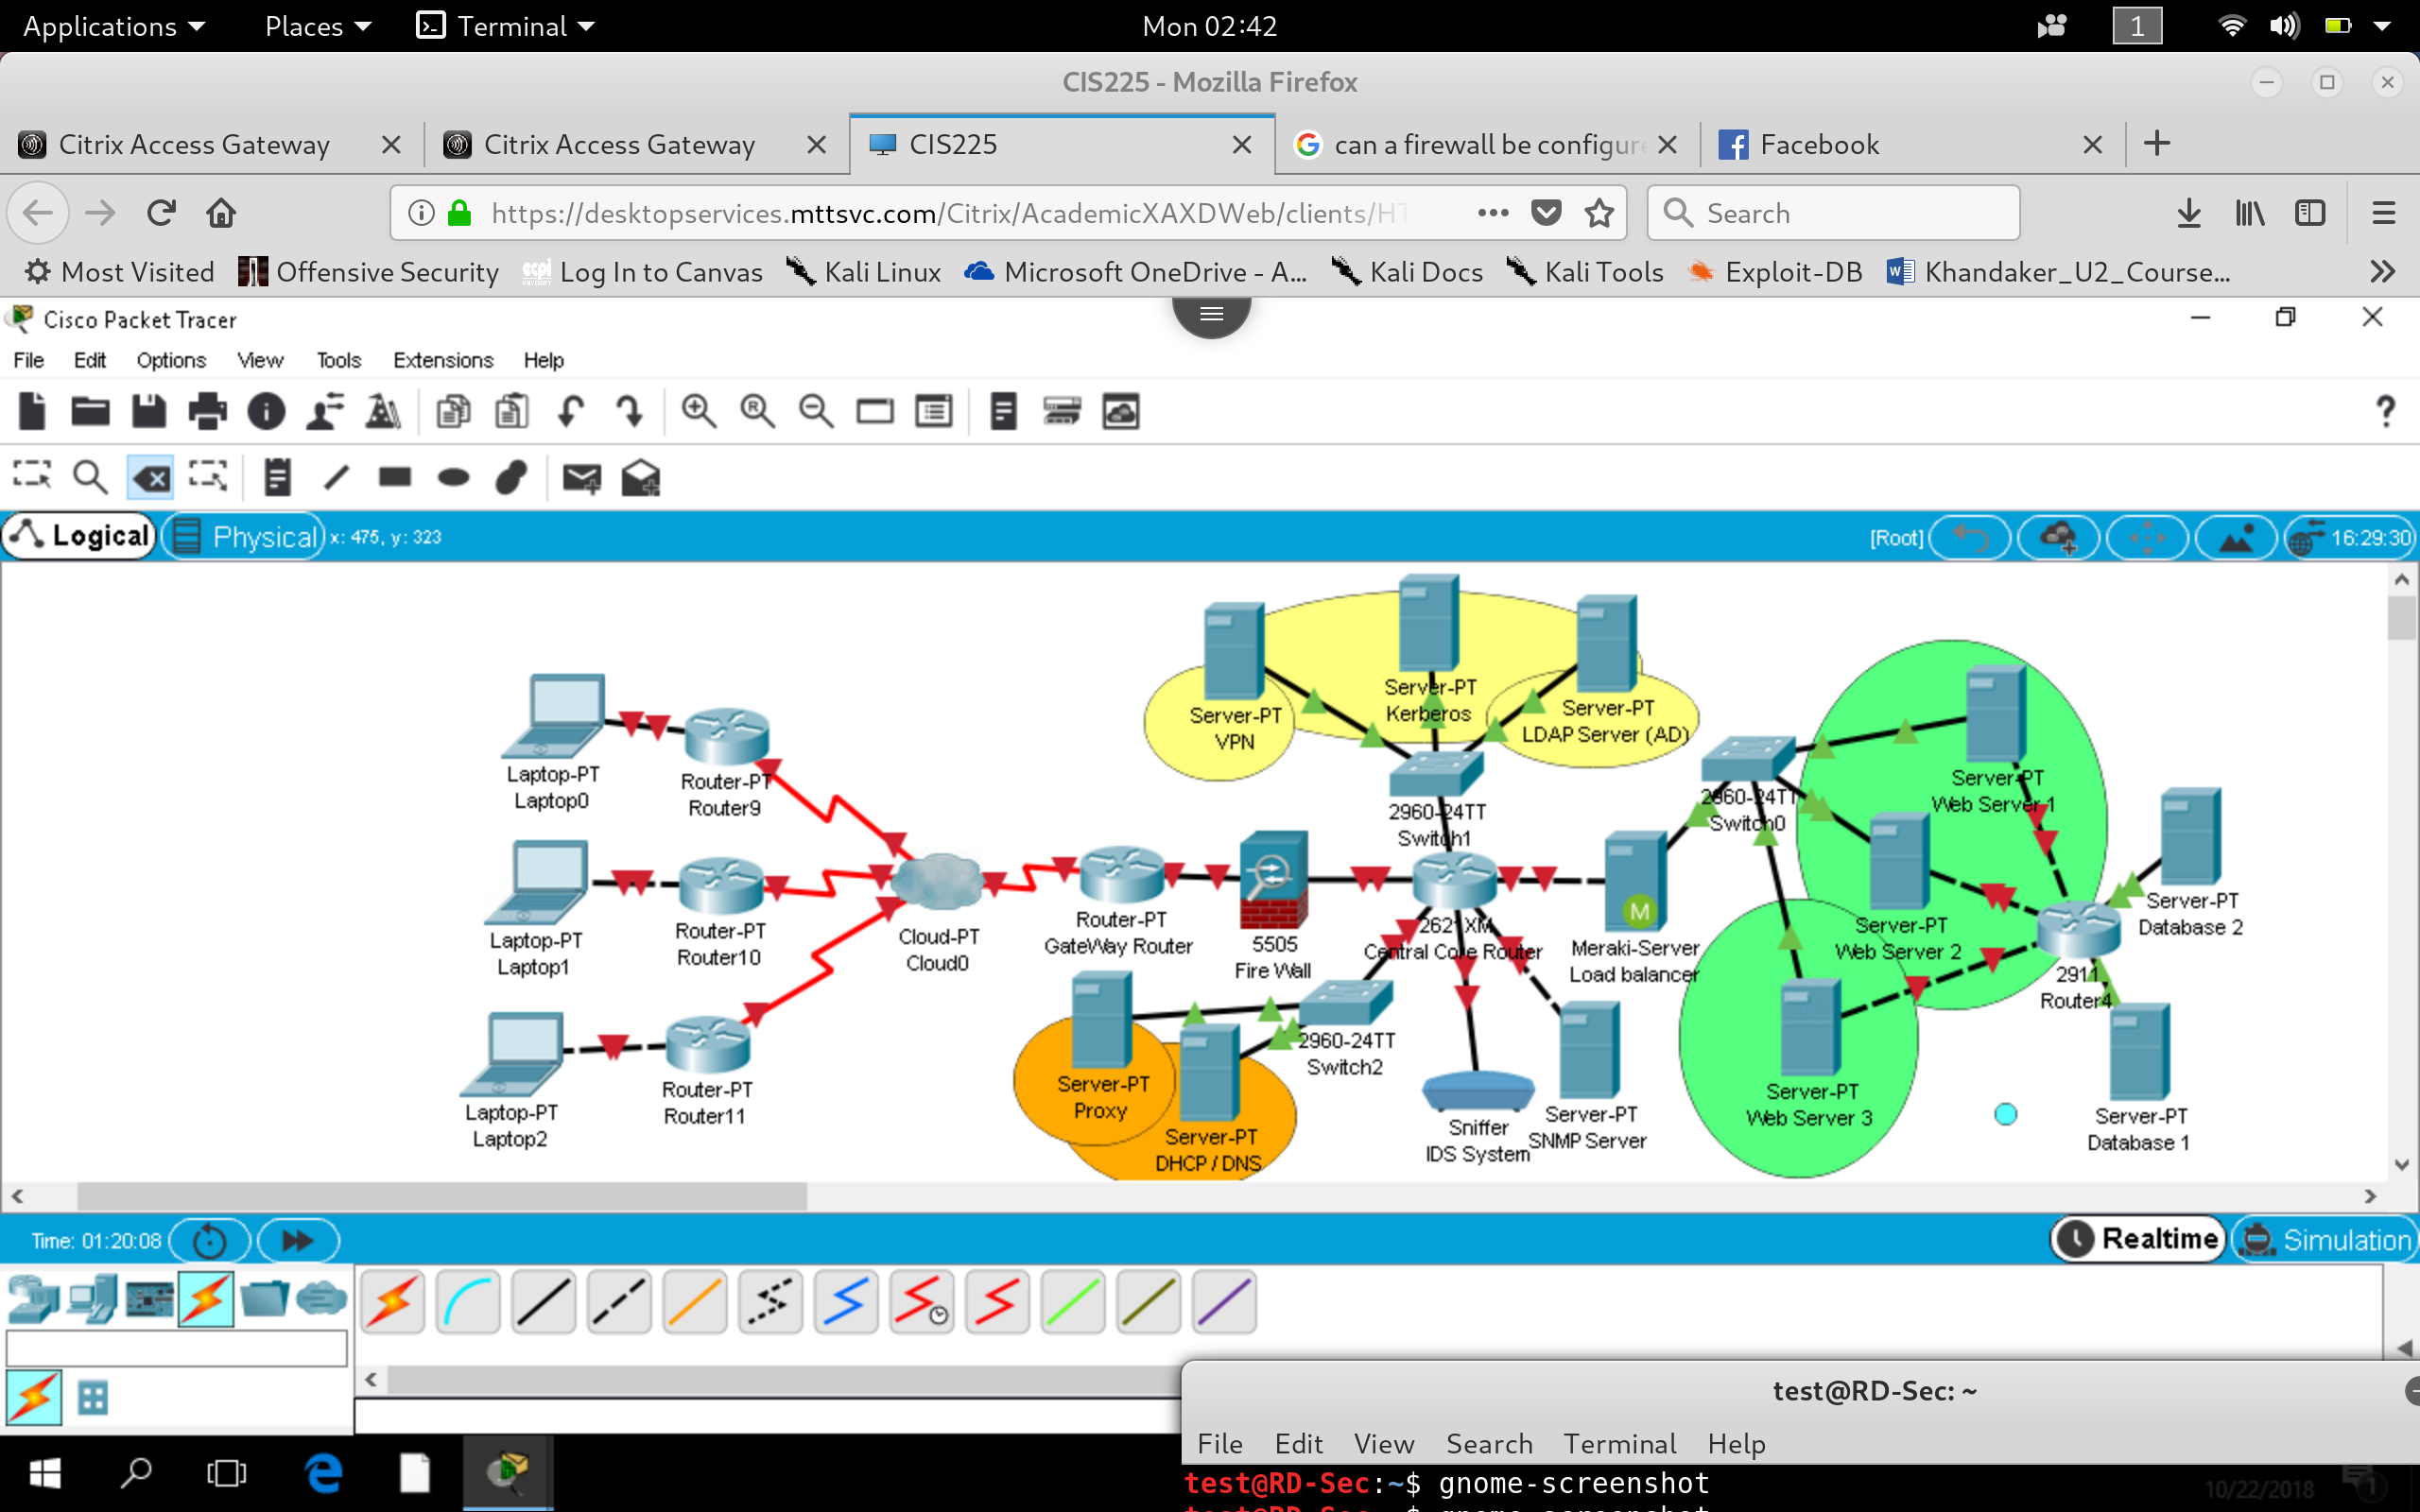
Proposal
Scalable
Multi-Points Failure
Segmented
Robust
Secure
Manageable
Intelligent Design
Recoverable Solution

Slide 5
Security Advantages?
Auditing user accounts, segment resources by user privilege
Handling authentication of user accounts into network
Secure access into Intranet resources
Monitoring network traffic and system Logs for administration
Security Reasoning
Services:
LDAP AD Accounts
Kerberos
VPN
IDS / SNMP

Slide 6
Continued ...
Proxy
DHCP
DNS
Load Balancing
To cache and limit http access going outbound network, increasing performance and securing network utilization
Assignment and management of Host device IP leases
Applying meaningful names to internal domain services
Increase performance and optimization of web resources

Slide 7
Continued...
Firewall
Routers
Switches
To prevent and limit port usage going outbound and inbound traffic, to be used as necessary. Limiting redundant traffic.
Offers ACL security and broadcast filtering
Fast packet switching inside collision domain and virtual segmenting via VLAN configuration

Slide 8
Details Of Technology
1) Gateway Router: is connected to a serial link to the Internet to intercept Incoming traffic into intranet work, will contain highest bandwidth rating to allow maximum optimization of network utilization. Without a ACL list, reducing processing on this router to only handle initial traffic routing.
2) Fire Wall: Intercepts the Gateway connection and limits traffic based on port incoming and outgoing traffic requirements
3) Core Router: Distributes Network traffic into different Server farms for different tasks. Configured with ACL and communication restrictions. Also Configured with SNMP port & Port mirroring to allow traffic to be processed by IDS System.
1) Gateway Router: is connected to a serial link to the Internet to intercept Incoming traffic into intranet work, will contain highest bandwidth rating to allow maximum optimization of network utilization. Without a ACL list, reducing processing on this router to only handle initial traffic routing.
2) Fire Wall: Intercepts the Gateway connection and limits traffic based on port incoming and outgoing traffic requirements
3) Core Router: Distributes Network traffic into different Server farms for different tasks. Configured with ACL and communication restrictions. Also Configured with SNMP port & Port mirroring to allow traffic to be processed by IDS System.

Slide 9
Details Of Technology Continued...
6) Orange Server Farm: Includes proxy and DHCP service to new devices through VPN and internal static servers with leased IP address. Separated DHCP assignment into separate broadcast domain usually because BootP protocol will request new lease time for new authenticated devices through VPN, traffic can be segmented and monitored separately for new devices this way. Proxy is used to cache default web pages and prevent users from accessing unauthorized sites from internal network, improving network bandwidth utilization and security.
7) Load Balancer: traffic requesting access to web resources will be directed through load balancer to improve performance of web service utilization. This segments HTTP request traffic into this node and ACL of core router can be configured with appropriate security through this node.
8) Green Server Farm: Included within the same collision domain for faster packet switching capabilities through load balanced HTTP requests into web services.
9) Terminating Database Router: Router segmenting Database servers to separate broadcasting into unnecessary request to database server, router can be configured with ACL to restrict unnecessary port based access into links. Also, segmenting links so only web services can communicate with Database servers, not intended for direct access, unless by administrator. System can be accessed in a different way for production environment.

Slide 10
Overall Advantages
Weight distributed bandwidth between Router to Router configuration, Access resources through switch via VLAN configuration. Improving network bandwidth and implementing "principle of least privilege" philosophy of design
Auditing and authentication via user active directory accounts, allowing users within network to retain identity and only users with identity can access services.
Management of authenticated sessions via Kerberos, IP address scaling VIA DHCP configuration & Secure access into resources via VPN. Limiting access into unnecessary traffic via Firewalls and Proxy.
Improved performance through load balancing
Use of Virtualization on each server to scale the service resource by running multiple instances of each service

Slide 11
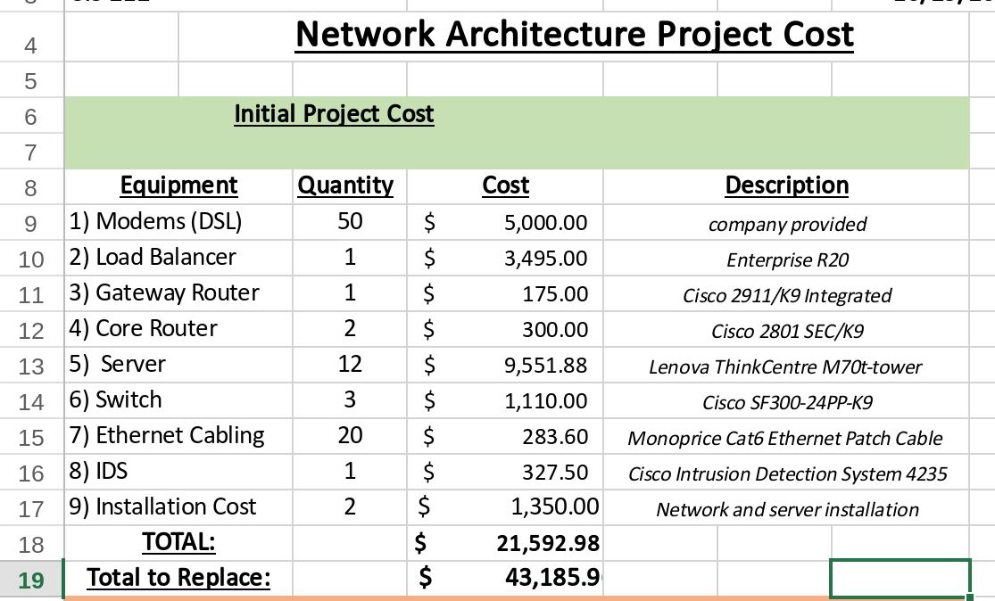
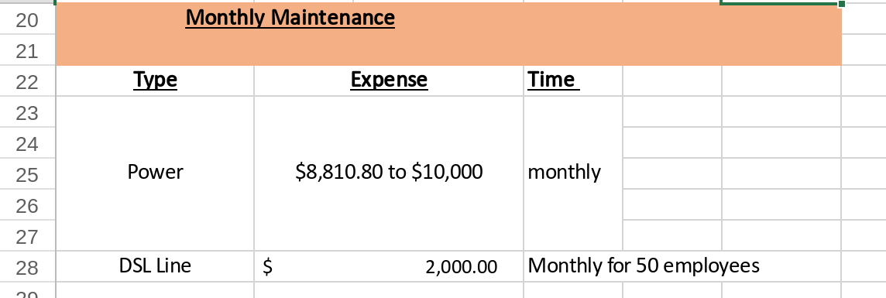
Cost Benefit Analysis
INITIAL COST
MAINTENANCE COST

Slide 12
COST BENEFIT ANALYSIS
Total System cost is $20,000. Recommendation to create failsafe environment and double the number of devices in expenditure.
Total System x2 will be $40,000.
Installation cost brings price to : $43,185
Double the system requirement will ensure fail-safe solution that can migrate service in case of failure and adopt for scalability. Cost savings include the ability to be robust and minimize damage to business operations. Current model cannot recover from disaster failure. The amount of damage to business will equate to the loss of money due to business operations plus replacement damages to recover operations. This may require a new robust system anyway. Potential loss from current model can be expected to be 3 times the investment to migrate to a robust and fail-safe system. Savings include %70 loss of business operations due to failure.

Slide 13
Future Growth
Cloud Bursting option to accommodate for potential growth of the company. Scaling Microsoft services with Azure in the Infrastructure layer. Offers scalability for reduced cost of implementing infrastructure solution.

Slide 14
References
Ciampa, M.(2016). CompTIA Security+ Guide to Network Security Fundamentals. Cengage

