Slide 1
Bangladesh Army University of Science and Technology
Project Name: E-Matrimony
Group Members: 1. Rafath Bin Zafar Auvee
ID: 180201044
2. Fakhrul Islam Fuad
ID: 180201067
3. Tazrian Billah
ID: 180201069
4. Sumaiya Nishi
ID: 180201070
Supervisor: 1. Fatema Tuz Zohra
- Lecturer, Dept of CSE
2. Naima Islam Nodi
- Assistant Lecturer, Dept of CSE

Slide 2
PROJECT INFORMATION
To find someone perfect easily.
To make connection digitally.
To find someone based on your personality.
To be happy.
IN THIS PROJECT ONE CAN ADD INFORMATION OF A USER LIKE HIS/HER NAME, AGE, GENDER, FATHERS NAME, MOTHER’S NAME, ADDRESS, CONTACT, EDUCATIONAL QUALIFICATION, INTEREST!

Slide 3
Algorithm
Step 1: Login credentials for bride, bridegroom and admin.
Step 2: If bride or bridegroom (USER):
Step 1: User can Create Profile
Step 2: User can update their profile
Step 3: Can find someone and contact
Step 3: If Admin:
Step 1: Can add, edit profile.
Step 2: Can delete profile
Step 3: Update System

Slide 4
HEADER FILE USED IN THIS PROJECT
#include<stdio.h> - stdio.h is a header file which includes all standard I/O operations.Basically it contains the prototypes of all the input output functions used in C
#include<stdlib.h> - stdlib.h is the header of the general purpose standard library of C programming language which includes functions involving memory allocation, process control, conversions and others.
#include<conio.h> - conio.h is a C header file used mostly by MS-DOS compilers to provide console input/output. It is not part of the C standard library or ISO C, nor it is defined by POSIX.
#include<string.h> - Strings are defined as an array of characters.
#include<windows.h> - Windows.h, is base header file for Win32 programming, its contain declaration of almost all basic windows macros and different typesdef

Slide 5
BUILT IN FUNCTION USED IN THIS PROJECT
1. Struct - A structure is a user defined data type in C/C++. A structure creates a data type that can be used to group items of possibly different types into a single type.
2. FILE *fopen - This functions is used to open a file to perform operations such as reading or writing
3. fp - file pointer to the data type “FILE”
4. fread - To read the count number of object size and length from the input file name to the array
5. fwrite - To write the selected file from the pointer data type
6. Filename - The actual file name with the path of the file
7. fopen - This function creates a new file if the mentioned file name does not exist
8. fflush - This is used for output stream only and is to clear the output buffer move the buffered data to console
9. fclose - To closed the file pointed by the file pointer

Slide 6
BUILT IN FUNCTION USED IN THIS PROJECT
18 . sleep – Sleep function delays program execution for a given number of seconds.
19 . printf – printf() function is used to print the “character, string, float, integer, octal and hexadecimal values
20 . scanf – scanf is a function that reads formatted data from stdin (i.e, the standard input stream, which is usually the keyboard, unless redirected) and then writes the results into the arguments given.
21 . system – the system function allows a C program to run another program by passing a command line (pointed to by string) to the operating system's command processor that will then be executed.
22 . strupr – The strupr( ) function is used to converts a given string to uppercase.
23 . gets – The gets method is used to read complete set of characters from the console
24 . sizeof – It is a compile-time unary operator and used to compute the size of its operand. It returns the size of a variable
25 . strcmp – The strcmp() function takes two strings and returns an integer. The strcmp() compares two strings character by character.
26 . goto – goto can transfer the program’s within the same block and there must a label, where you want to transfer program’s control.

Slide 7
BUILT IN FUNCTION USED IN THIS PROJECT
27 . exit – In C, exit() terminates the calling process without executing the rest code which is after the exit() function.
28 . return – A function in C can be called either with arguments or without arguments. These function may or may not return values to the calling functions. All C functions can be called either with arguments or without arguments in a C program.
29 . remove – The remove function in C/C++ can be used to delete a file. The function returns 0 if files is deleted successfully, other returns a non-zero value. Using remove() function in C, we can write a program which can destroy itself after it is compiled and executed.
30 . rename – In the C Programming Language, the rename function changes the name of a file. You must close the file before renaming, as a file can not be renamed if it is open.
31 . getch – getch() reads a single byte character from input. getch() is a way to get a user inputted character. It can be used to hold program execution
32 . feof – feof() function is a file handling function in C programming language which is used to find the end of a file.
33 . break – The break statement ends the loop immediately when it is encountered.
34 . continue – The continue statement skips the current iteration of the loop and continues with the next iteration.

Slide 8
USER DEFINED FUNCTION USED IN THIS PROJECT
void menu()
void male_add_profile()
void female_add_profile()
void add_profile()
void male_search_profile()
void my_profile()
void female_search_profile()
void search_profile()
void male_modify_profile()
void edit_my_profile()
void female_modify_profile()
void modify_profile()
void female_delete_profile()
void male_delete_profile()
void delete_profile()
void help()

Slide 9
USER DEFINED FUNCTION USED IN THIS PROJECT
17 . void credits()
18 . void terms_of_use()
19 . void male_displayAll()
20 . void female_displayAll()
21 . void male_search_by_district()
22 . void female_search_by_district()
23 . void male_sign_in()
24 . void female_sign_in()
25 . void sign_in()
26 . void admin()
27 . void welcome_message()
28 . void search_by_location()
29 . void main_program()

Slide 10
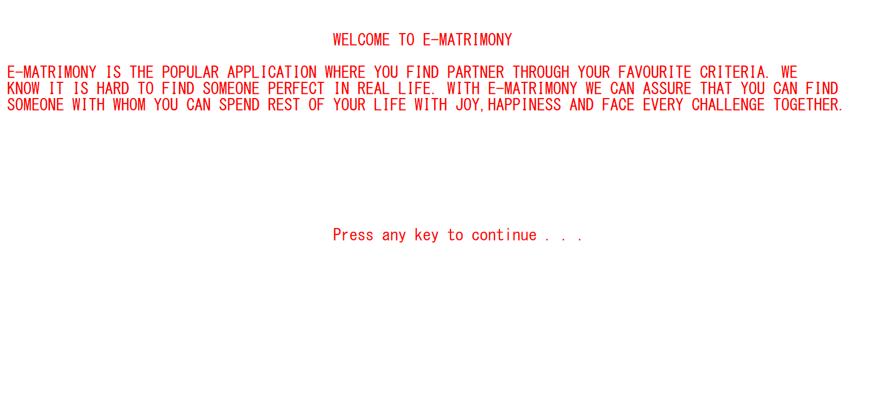
void_welcome_message() – First Screen

Slide 11
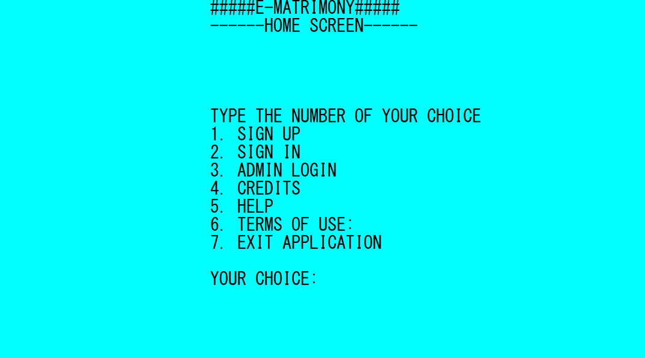
void main_program() – Second Screen

Slide 12
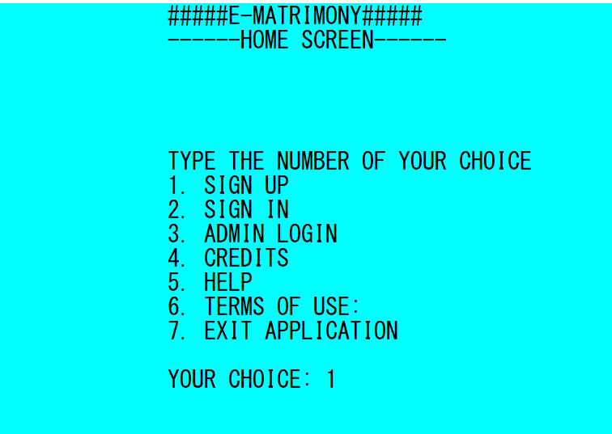
void add_profile() – Sign Up

Slide 13
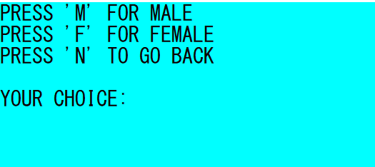
void male_add_profile() / void female_add_profile() /

Slide 14
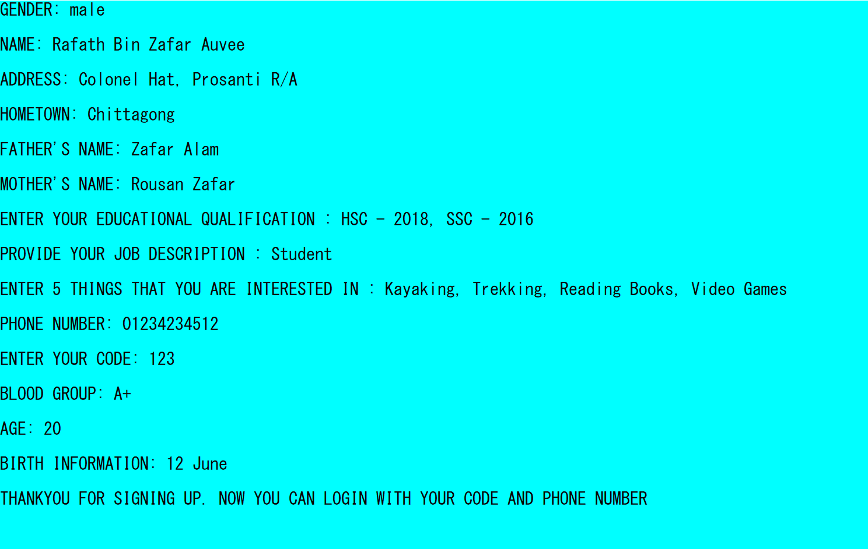
void male_add_profile() – Signing up – male.txt

Slide 15
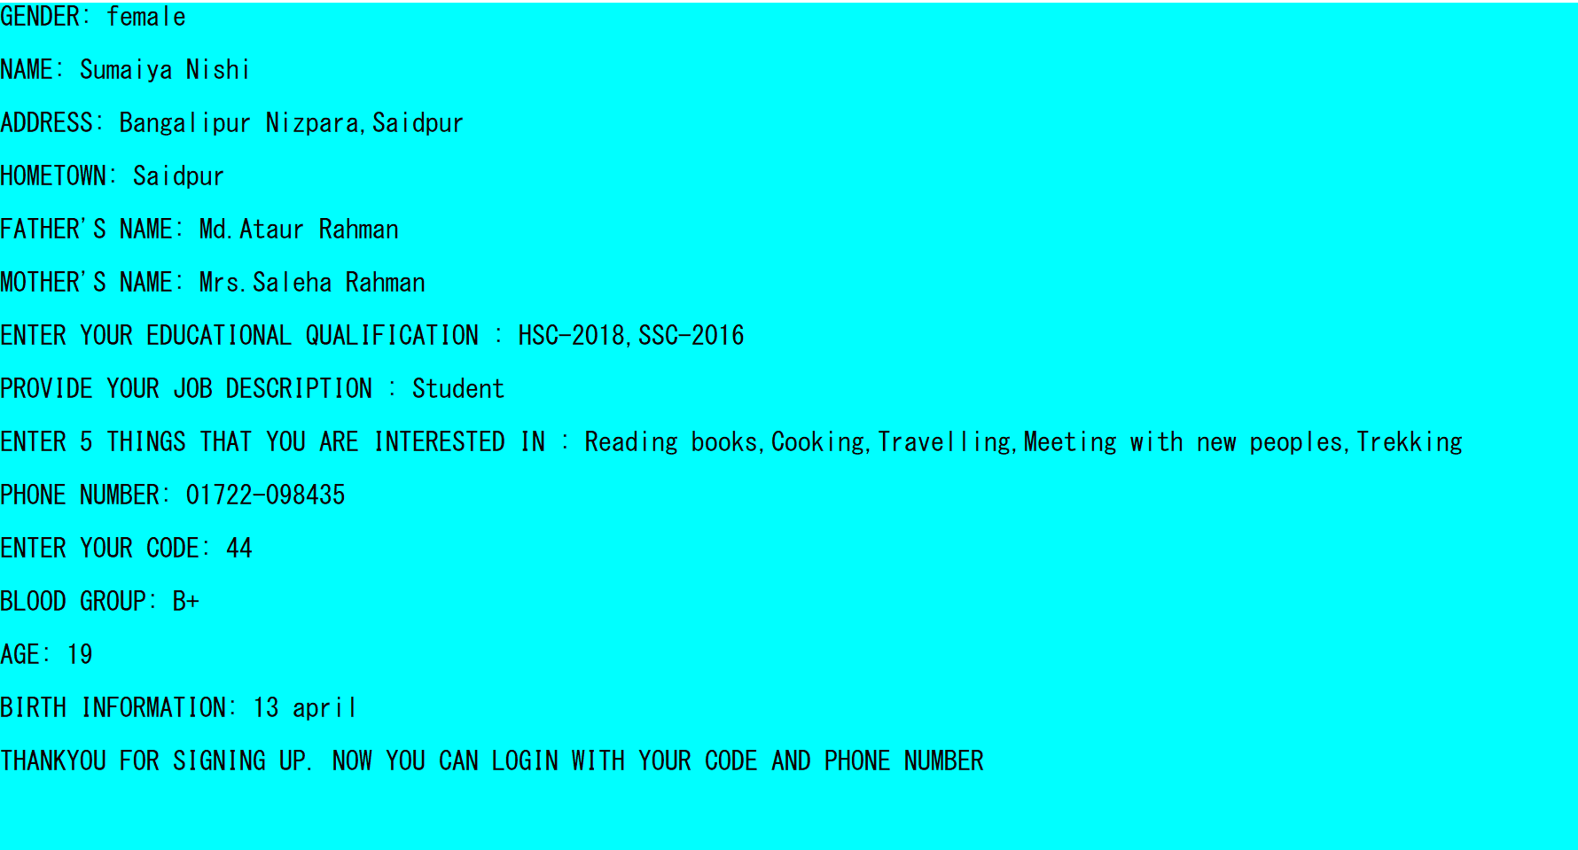
void female_add_profile() – Signing up – female.txt

Slide 16
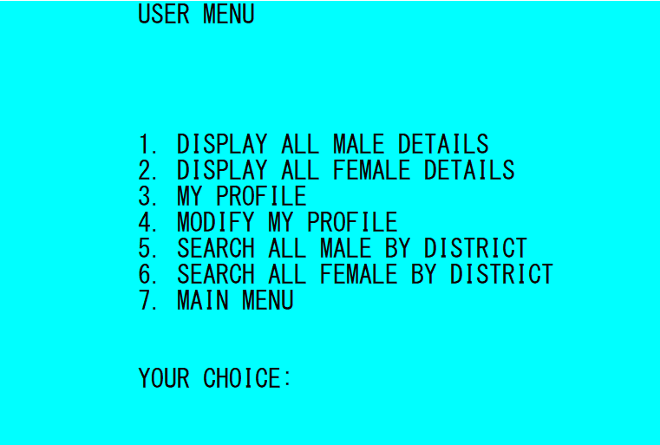
void female_sign_in() / void male_sign_in()
USER SIGN IN – USER DASHBOARD

Slide 17
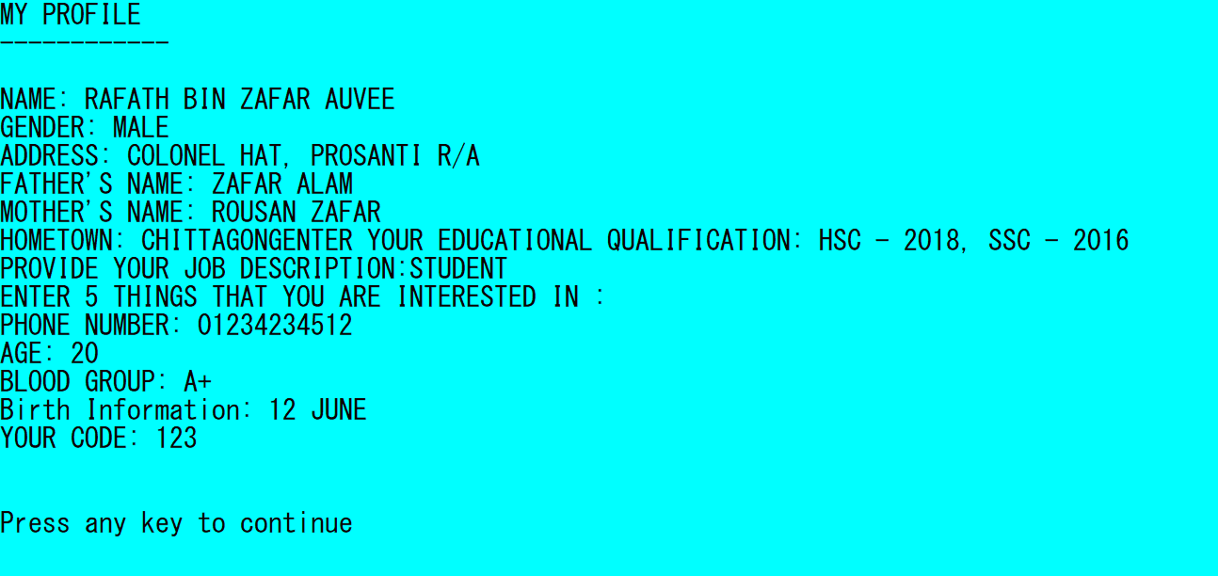
void my_profile() - MY PROFILE – USER DASHBOARD

Slide 18
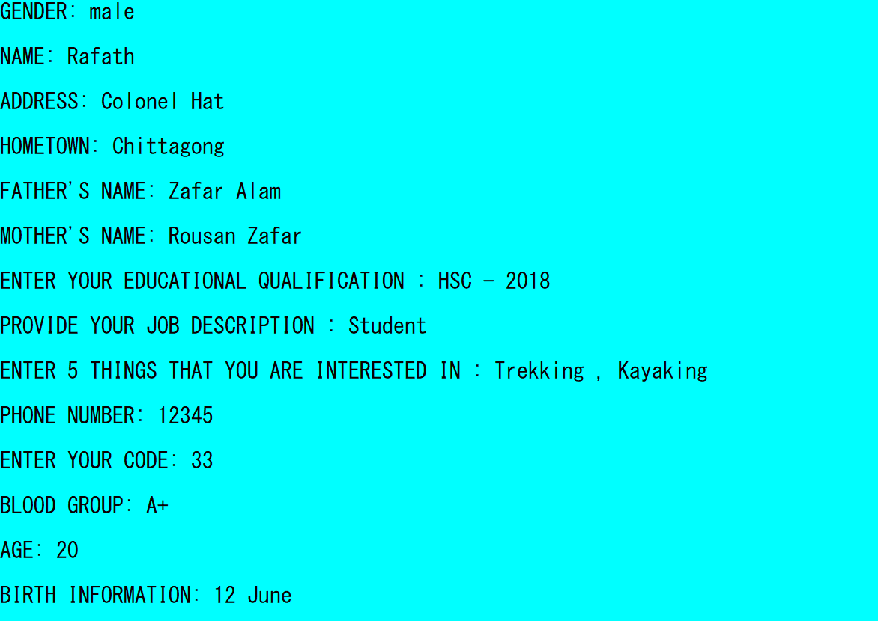
MODIFY MY PROFILE – USER DASHBOARD

Slide 19
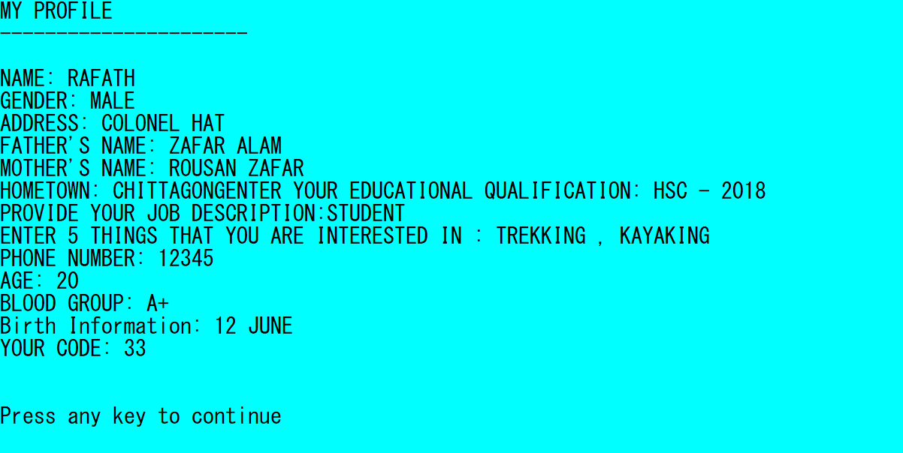
AFTER MODIFY MY PROFILE – USER DASHBOARD

Slide 20
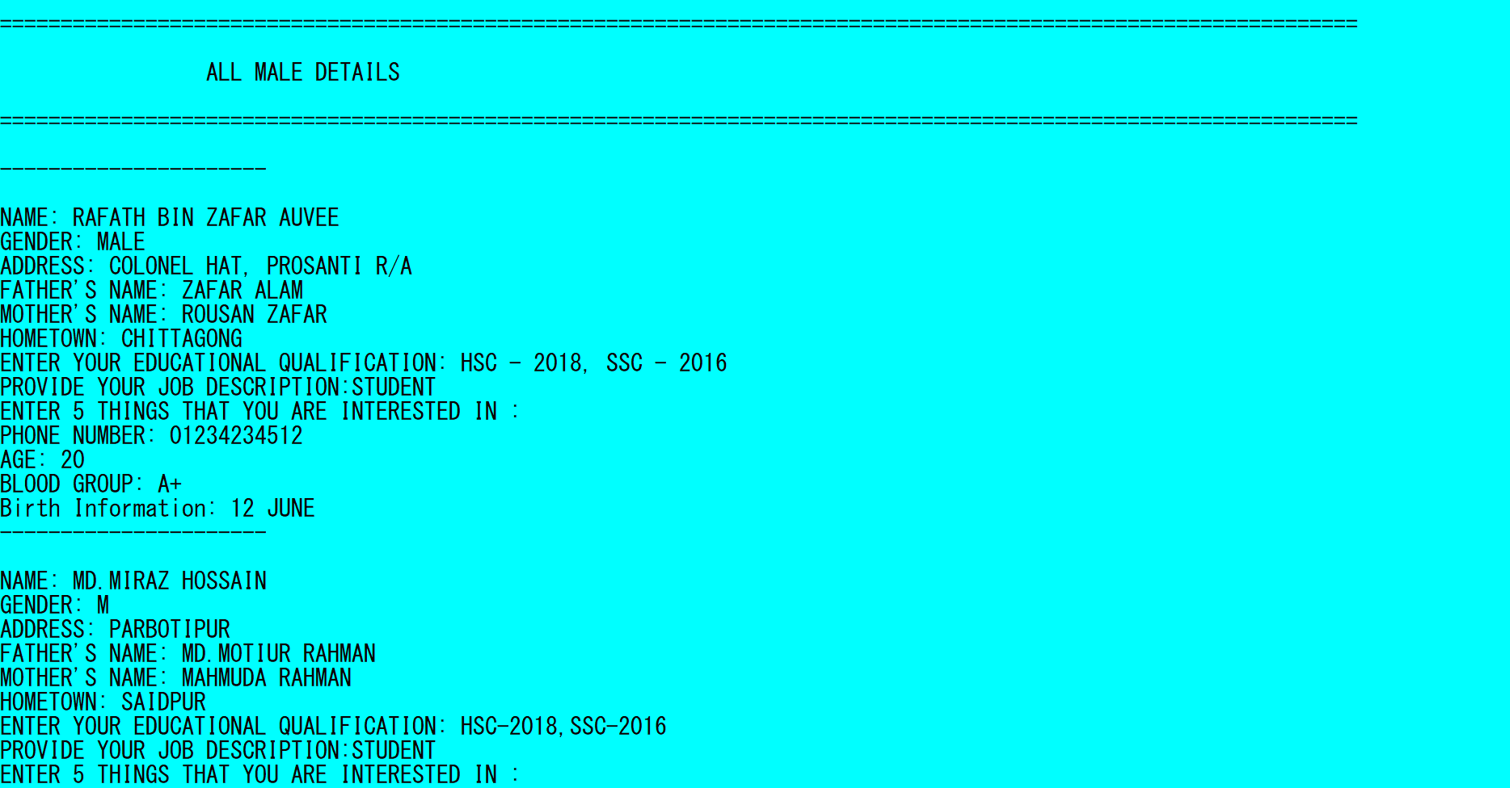
void male_displayAll() - ALL MALE DETAILS
– USER DASHBOARD

Slide 21
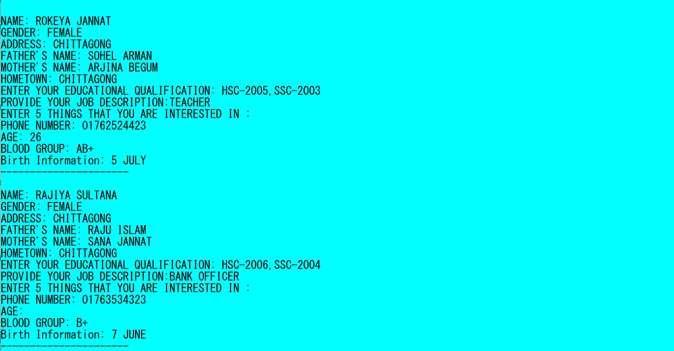
void female_displayAll() - ALL FEMALE DETAILS
– USER DASHBOARD

Slide 22
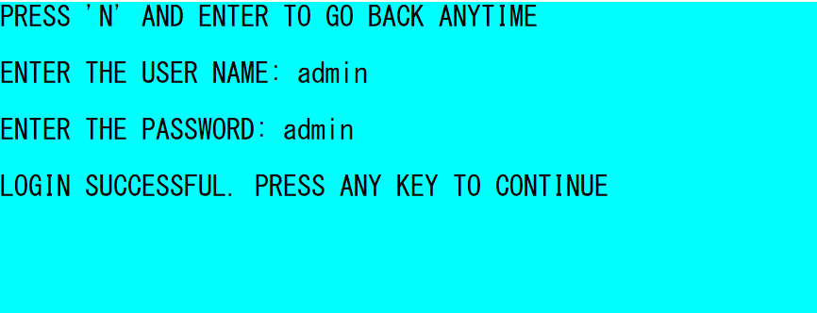
ADMIN LOGIN CREDENTIALS…..

Slide 23
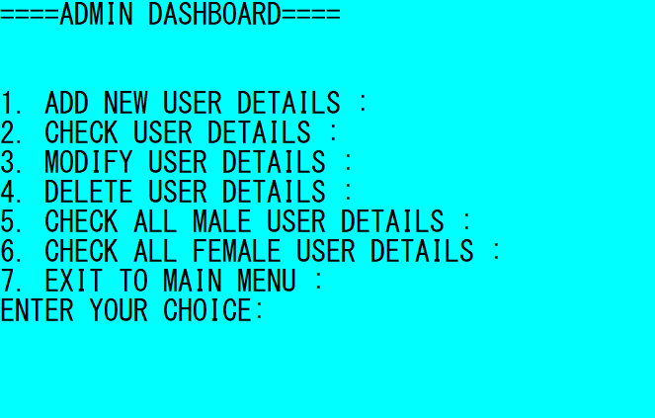
ADMIN DASHBOARD

Slide 24
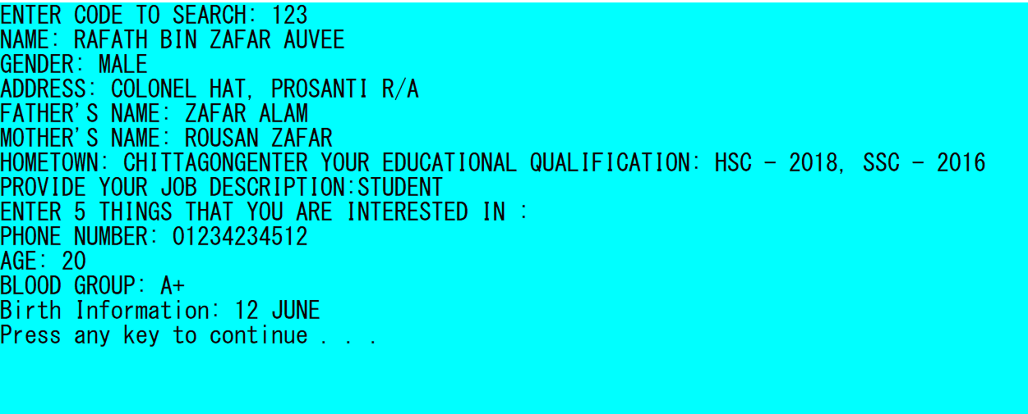
SEARCHING USER DETAIL- ADMIN DASHBOARD

Slide 25
ADD USER DETAILS - ADMIN DASHBOARD

Slide 26
void male_displayAll() - ALL MALE DETAILS
– ADMIN DASHBOARD

Slide 27
void female_displayAll() - ALL FEMALE DETAILS
– ADMIN DASHBOARD

Slide 28
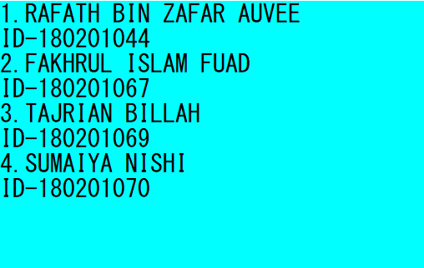
void credits() - CREDITS

Slide 29
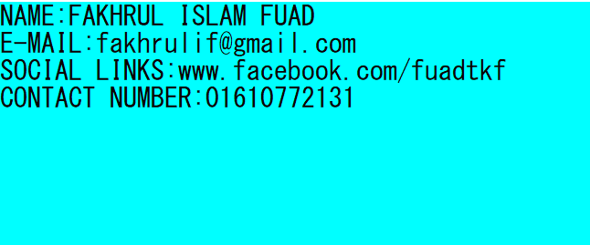
void help() – HELP

Slide 30
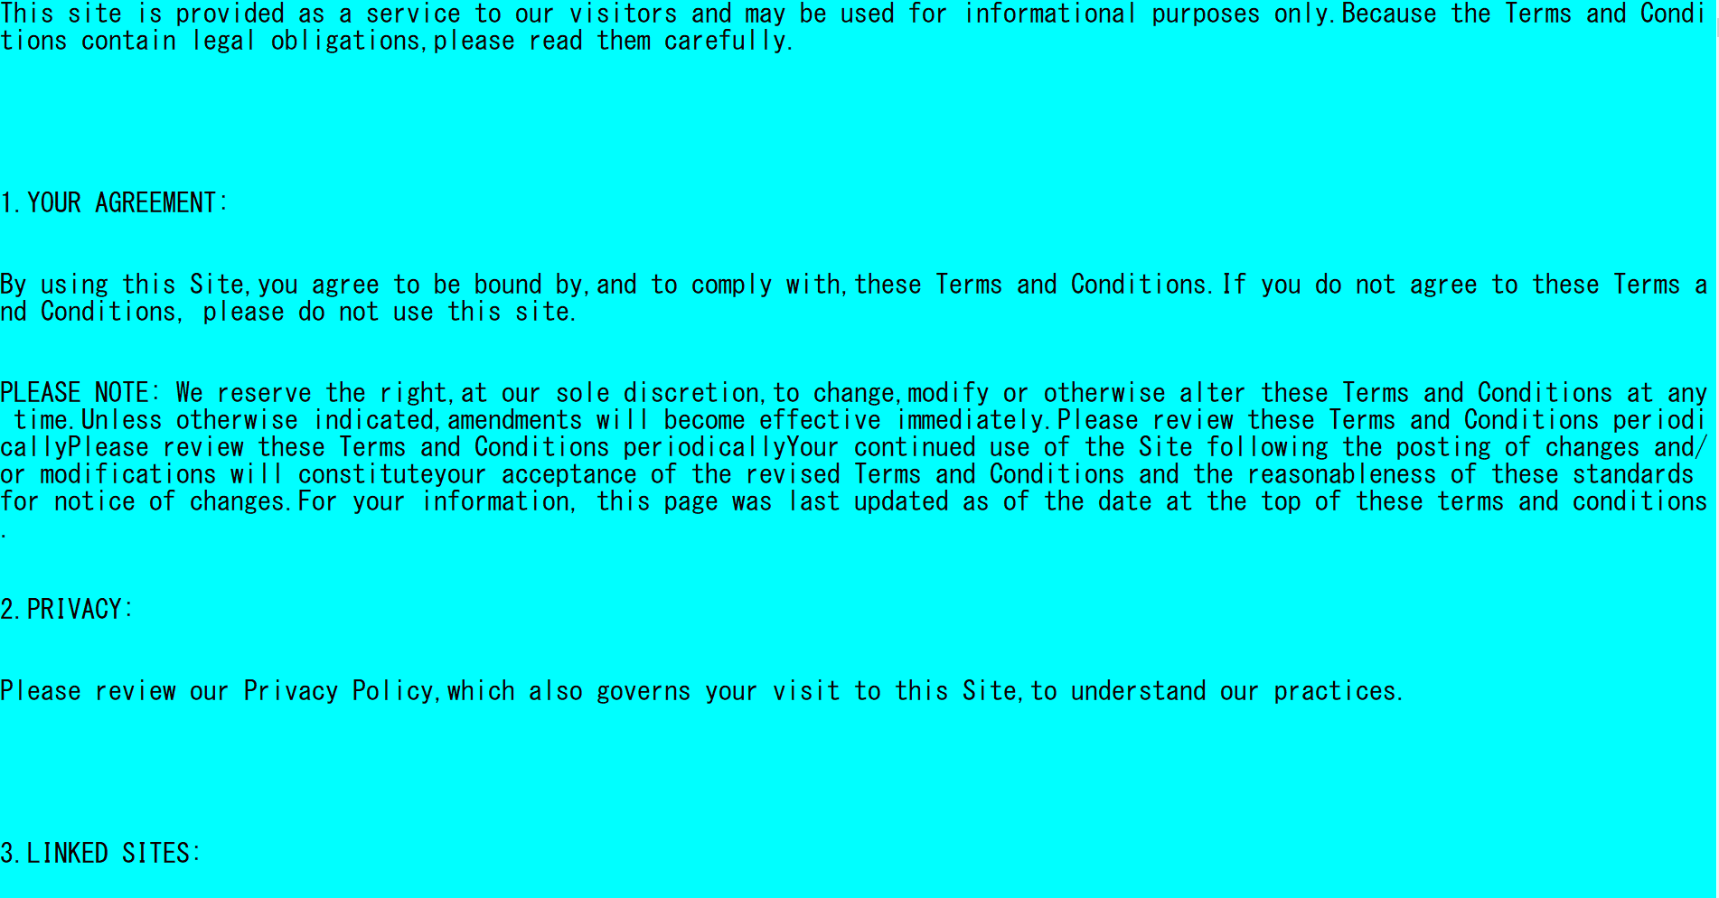
void terms_of_use() – TERMS OF USE

Slide 31
Why we used Binary Mode
They can hold a higher amount of data,
Are not readable easily
Provides better security than text files.

Slide 32
Conclusion
We know it is hard to find someone perfect in real life. With E-Matrimony we can assure that you can find someone with whom you can spend rest of your life with joy, happiness and face every challenge together.

Slide 33
FUTURE IMPROVEMENTS
We can add more criteria like jobs, interest, age, religion, nationality, race etc to improve for better search result.
We can image to enhance the user profile.
We can add “forget password” system like if user forget his or her password then he or she can manage to retrieve the password with mail.
You can happiness percentage.
Improve UI design.

Slide 34
Referrence
https://www.geeksforgeeks.org/
https://www.programiz.com/c-programming/c-file-input-output
http://www.tutorialdost.com/C-Programming-Tutorial/27-C-File-IO-Handling.aspx
https://stackoverflow.com/
https://www.programmingsimplified.com
https://www.includehelp.com/c/goto-statement-in-c-language.aspx
https://www.codesdope.com/blog/article/predefined-string-functions-of-c-in-stringh-librar/

Slide 35
THANK YOU

