Slide 1

Footpon!
Team J³
Jacky Li
Te-Chun Chao
Tang Jiang

Slide 2
What is Footpon?

Slide 3
Combine real-world walking and coupons

Slide 4

Shopping

Slide 5
Spend by shopper every day
11.7 Billions $
In August 2010
By the report of U.S Census Bureau

Slide 6
Shopping
Spend lots of time walking
Not rewarding
Shopping on Internet?

Slide 7
What if we can save money by walking?

Slide 8
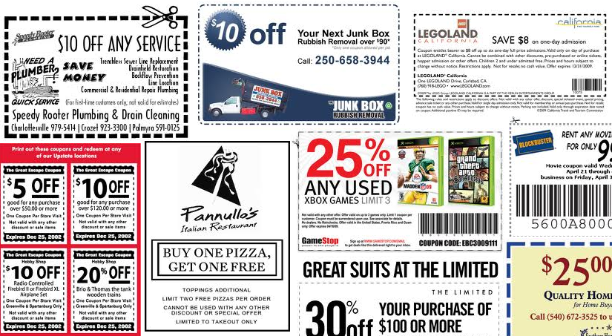
Coupons

Slide 9
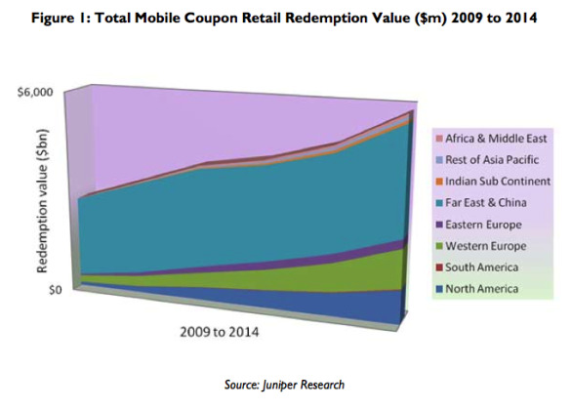
Mobile Coupon Will Reach 6 Billions by 2014

Slide 10
Coupons
Not different from paper coupons
Can’t get the deal you want
Managing coupons is a waste of time

Slide 11
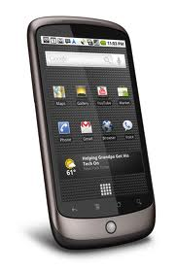
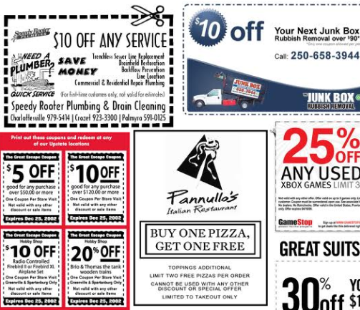
Combination

Slide 12
Footpon!

Slide 13
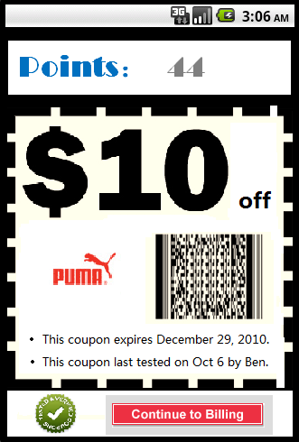

FootPoint The more you walk, the more you get

Slide 14
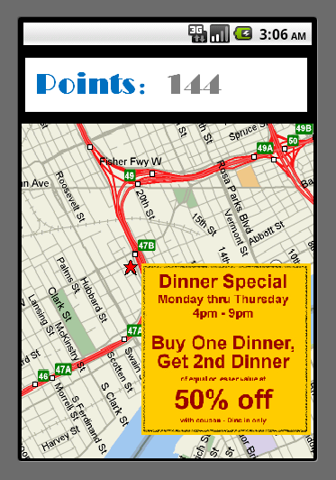
Preference Knowing where you live and give the coupons that you want

Slide 15
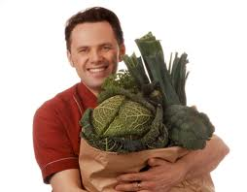
Health Reward for being healthy

Slide 16
5 Abstraction What is this project?

Slide 17
Location based coupon

Slide 18
Record your steps

Slide 19
Give you reward

Slide 20
Analysis of your area

Slide 21
Provide the coupon you want

Slide 22
Footpon on business side
Spend more time in your shop
More customers
Level of coupons
Find the shopper hot spot

Slide 23


Social Service Provider You can’t live without them
Facebook
Foursquare

Slide 24



Competitions
Yowza!!
My Coupon
Groupon

Slide 25
What we want to achieve? In next 8 week

Slide 26
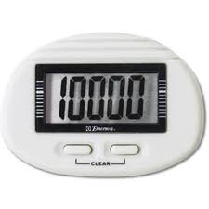
A Pedometer

Slide 27
Coupon API /get/coupons

Slide 28
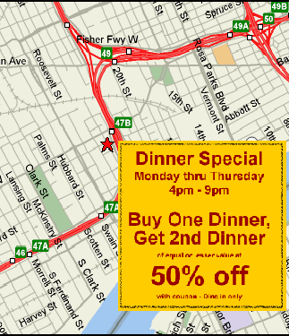
Map view with coupon information

Slide 29
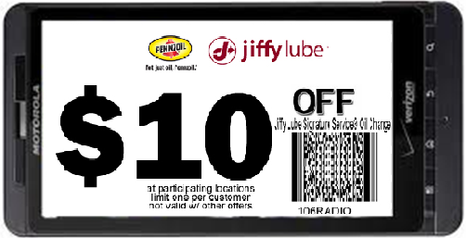
Show Coupon On Phone

Slide 30
Technical Solution
Android side:
Accelerometer
Touch screen
Camera
GPS/Google Map API
Foursquare/Facebook API
Server side:
PHP/Ruby/HTML
MySQL

Slide 31

Question ?
?

