Slide 1
Physics-Informed Neural Networks: A Deep Learning Framework for Solving Forward and Inverse Problems Involving Nonlinear Partial Differential Equations
Journal of Computational physics, 2019

Slide 2

Contributions
Data-driven solution of PDEs using –
Continuous time models
Discrete time models
Data-driven discovery of PDEs (Inverse problem) using –
Continuous time models
Discrete time models
All the above approaches based on neural network with innovative loss schemes
Large step size made possible for discrete time models
Works very well even in highly non-linear solution space

Slide 3
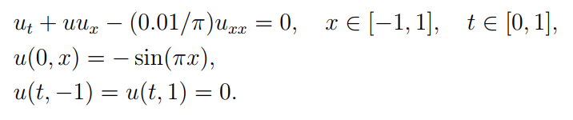
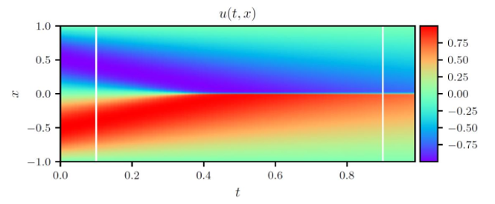
Data Driven Solution: Continuous Time Models

Slide 4
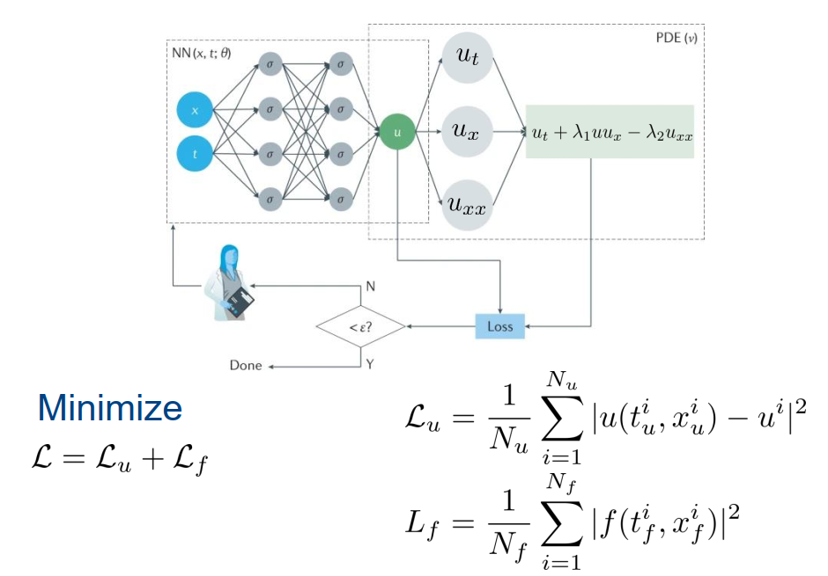
Data Driven Solution: Continuous Time Models (contd.)

Slide 5
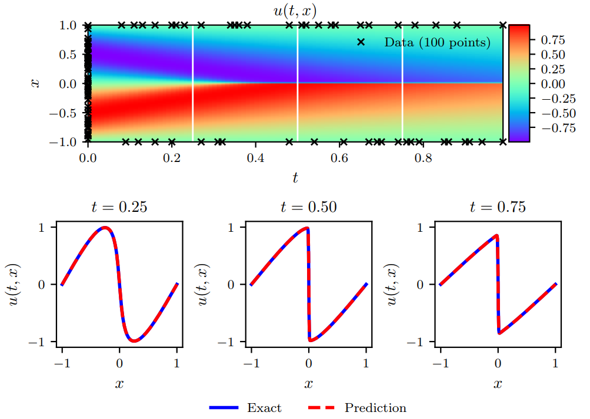
Data Driven Solution: Continuous Time Models (contd.)

Slide 6
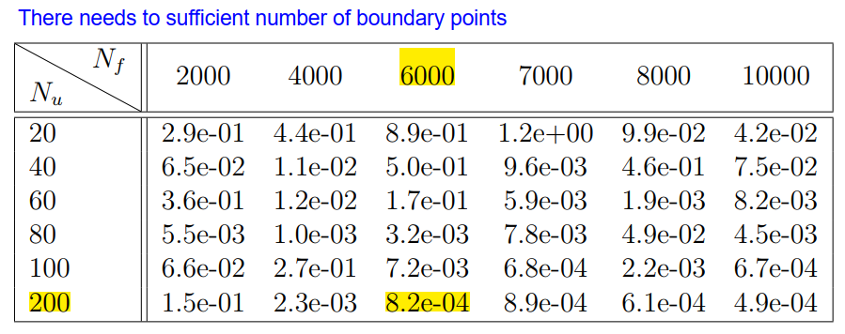
Data Driven Solution: Continuous Time Models (contd.)

Slide 7
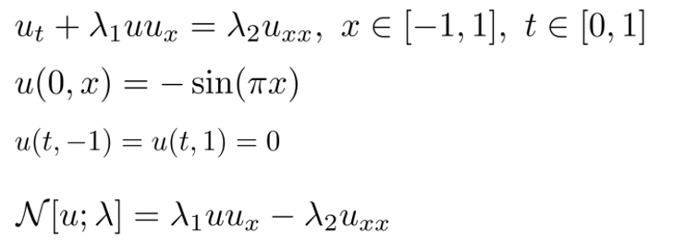
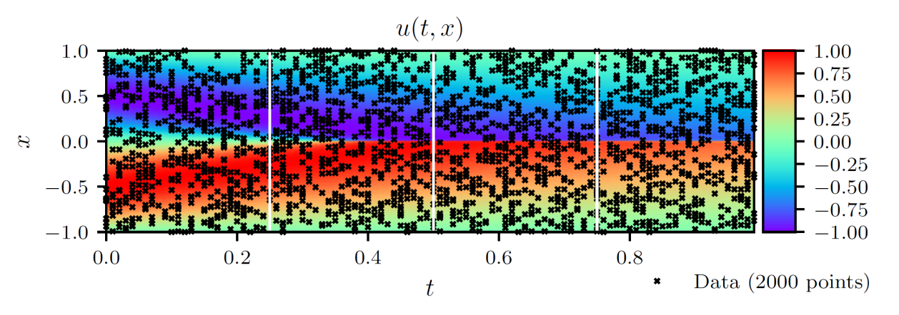
Data Driven Discovery: Continuous Time Models
Interesting Points:
The 2000 points require ground truth for the latent variable u
The other points are unsupervised collocation points
What would happen if we did not use any ground truth points? What if we simply used the forward problem setting consisting of initial, boundary and collocation points??

Slide 8
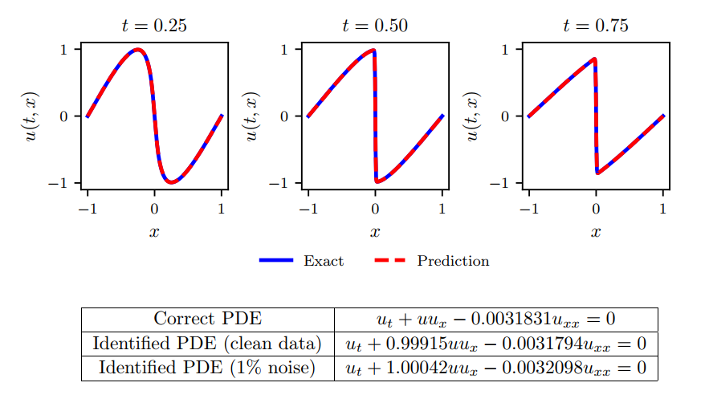
Data Driven Discovery: Continuous Time Models (contd.)

Slide 9
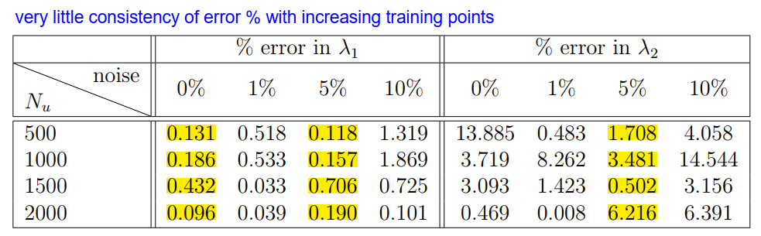
Data Driven Discovery: Continuous Time Models (contd.)

Slide 10
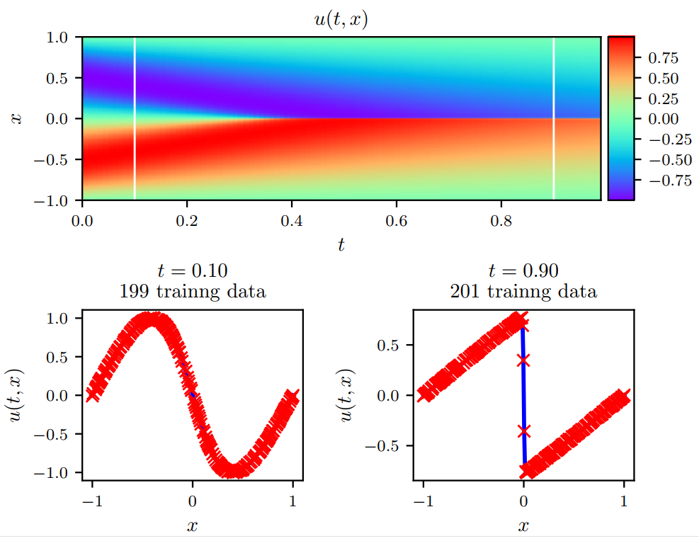
Data Driven Discovery: Discrete Time Models
In continuous time models, need training data from all over the space
In practical scenarios, can only observe ground truth points at distinct time points in space
Discrete time models require only two such time point data for inverse problem solving
The temporal gap between these two time points are allowed to be large

Slide 11
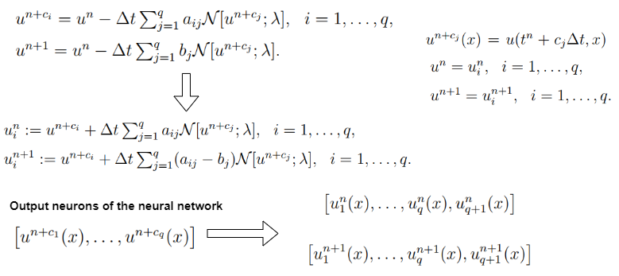
Data Driven Discovery: Discrete Time Models (contd.)

Slide 12
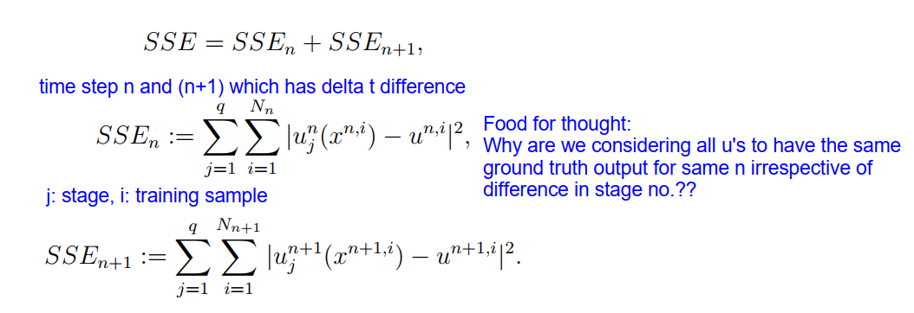
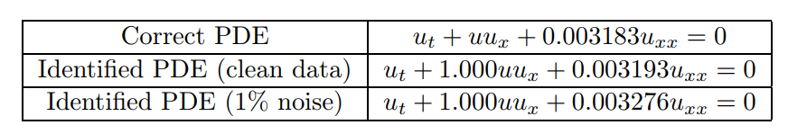
Data Driven Discovery: Discrete Time Models (contd.)

Slide 13
What About Data Driven Solution Using Discrete Time Models??
In discrete time model, you will have collocation points taken from one time stamp and you predict solution for another time stamp
Essentially, you are not discovering the hidden variable u after training
You are only managing to know about the u values for a particular time step after one round of training
Potentially low possibility of wide adoption for PDE solving

Slide 14
Limitations of Continuous Time Models and High Level Idea of Solutions

Slide 15


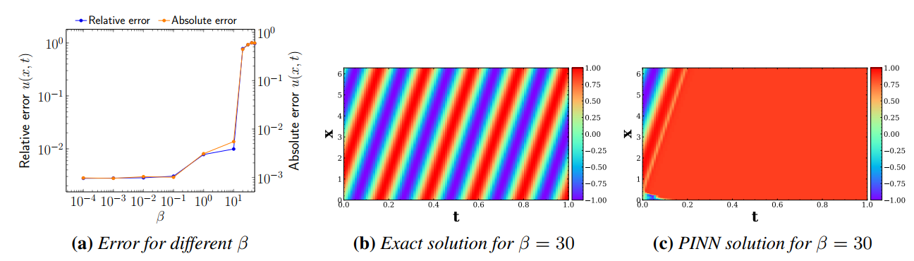
Problem with Soft Constraint Regularization
1D convection equation with analytical solution
Characterizing possible failure modes in physics-informed neural networks, NIPS, 2021

Slide 16
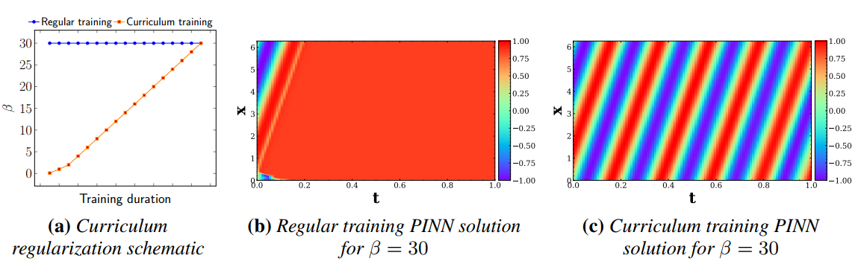
Possible Solution (Curriculum Learning)

Slide 17
Problem with Collocation Point Sampling
1D convection equation with analytical solution
Adaptive Self-supervision Algorithms for Physics-informed Neural Networks, arXiv, 2022

